Slide 1
Database Management System
Lecture No : 11

Slide 2
Join
Used to merge two or more tables
Types
Inner Join
Left Join
Right Join
Cross Join

Slide 3
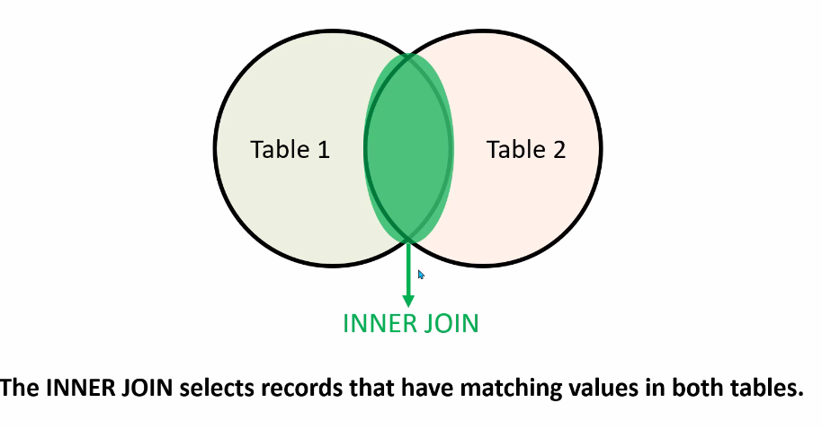
Inner Join

Slide 4
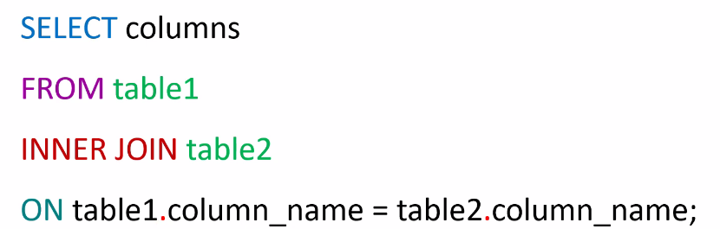
Syntax for inner join

Slide 5
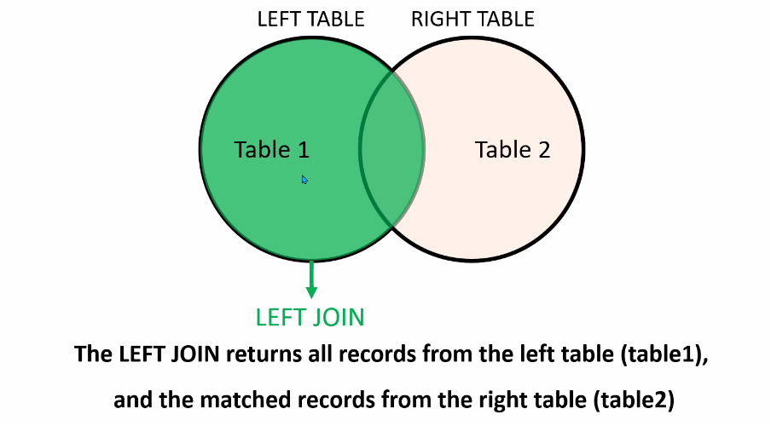
Left Join

Slide 6
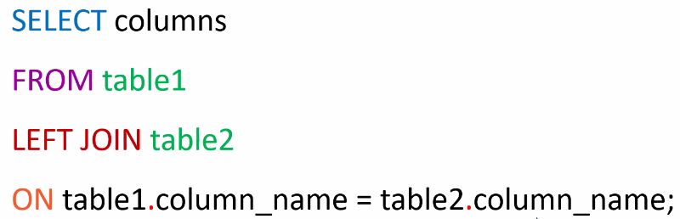
Syntax for Left Join

Slide 7
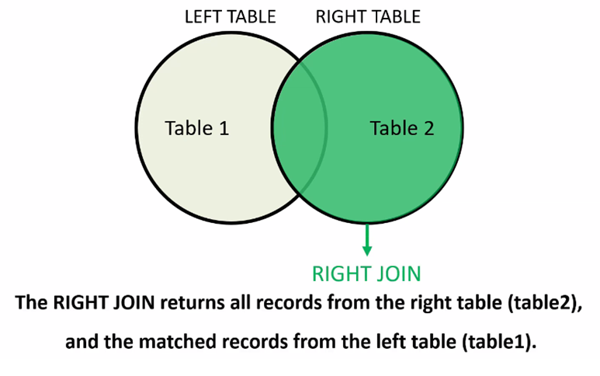
Right Join

Slide 8
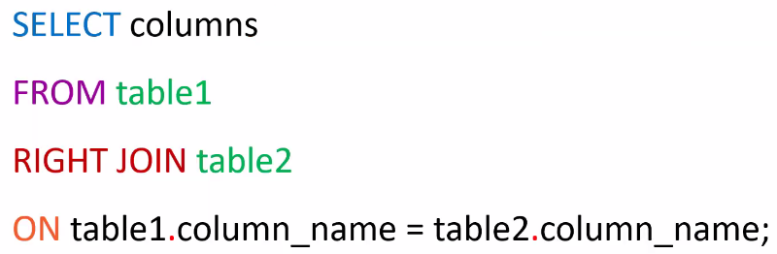
Syntax for Right Join

Slide 9
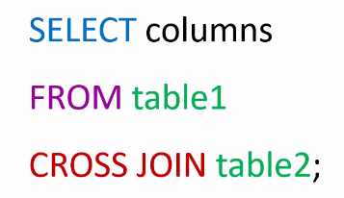
Cross Join

Slide 10
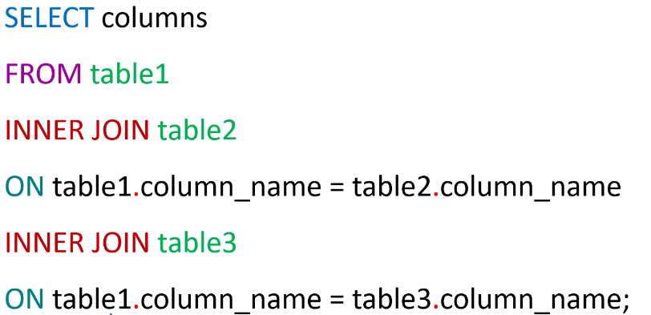
Inner Join for Multiple Tables

