Slide 1
Database management system
Lecture No : 12

Slide 2
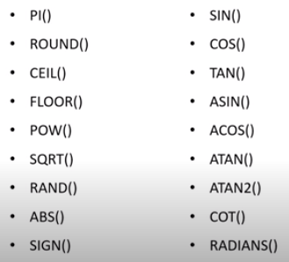
List of Arithmetic Functions in MySQL

Slide 3
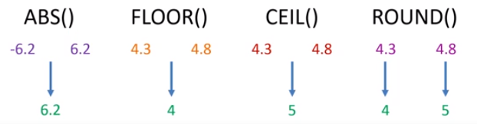
MySQL Arithmetic Functions

Slide 4
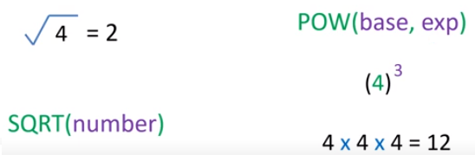
MySQL Arithmetic Functions(cont…)

Slide 5
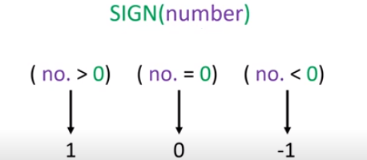
MySQL Arithmetic Functions(cont…)

Slide 6
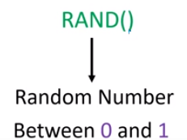
MySQL Arithmetic Functions(cont…)

Slide 7

MySQL Arithmetic Functions(cont…)
Syntax:
Result:

Slide 8

MySQL Arithmetic Functions(cont…)
Syntax:
Result:

Slide 9

MySQL Arithmetic Functions(cont…)
Syntax:
Result:

Slide 10
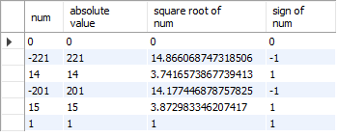
MySQL Arithmetic Functions(cont…)
Syntax:
Result:

