Slide 1
DBMS
Lecture No : 13

Slide 2
Topics
Types of relationship in ERD/ Cardinality
One to One
One to Many
Many to Many

Slide 3
Participation Constraints
Total Participation
Partial Participation

Slide 4
Types of entity
Strong entity
having a key attribute in order to identify each record uniquely
Weak entity (don’t have a key attribute)

Slide 5
Identifying Relationship
A relationship between a strong and weak entity
Weak entity uses the key of strong entity
Partial key of a weak entity combines with the key of strong entity to uniquely identify instances of weak entity

Slide 6
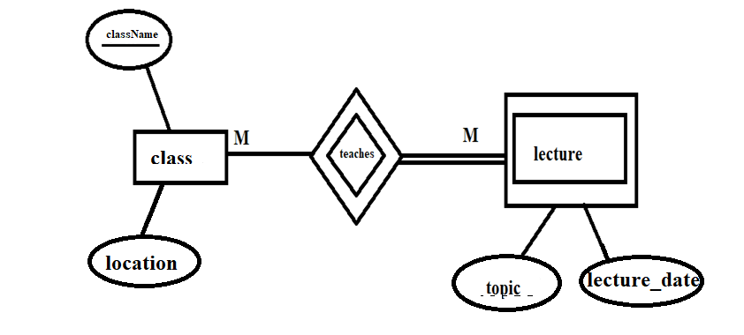
ER diagram

Slide 7
Class Assignment
Create an ERD having the following entities
Guardian considered as a weak entity
Student
Teacher

