Slide 1
DBMS
Lecture No : 14

Slide 2
ACID Properties
Stands for ( Atomicity, Consistency, Isolation, Durability)
It is a set of properties of database transaction.
Provides data validity

Slide 3
Atomicity
Example:
R(A)
A=A-50
W(A)
Commit;
A failed transaction can be restarted from the beginning but can never be resumed

Slide 4
Consistency
Total amount before and after transaction must be same.
Example:
A=5000
B=1000
A=A-1000
A=4000
B=B+1000
B=2000
Before Transaction A+B=6000
After Transaction A+B=6000

Slide 5
Isolation
Multiple transactions occur independently without interference
Changes occurring in a particular transaction will not be visible to any other transaction until that particular change in that transaction is written to memory or has been committed.

Slide 6
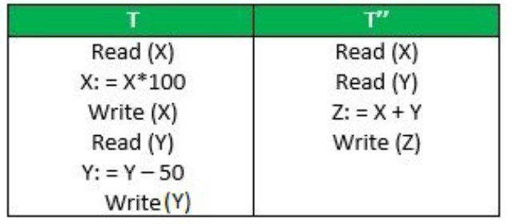
Isolation
X=500,Y=500
Suppose has been executed till Read(Y) and then T” starts.
T” reads correct value of X but incorrect value of Y
T’ (X+Y=50000+500
=50500) not consistent
T’=X+Y=50000+450
=50450

Slide 7
Durability
Once the transaction has completed executed the updates to the database are stored to the non volatile memory.
Theses effects of the transactions never lost.

