Slide 1
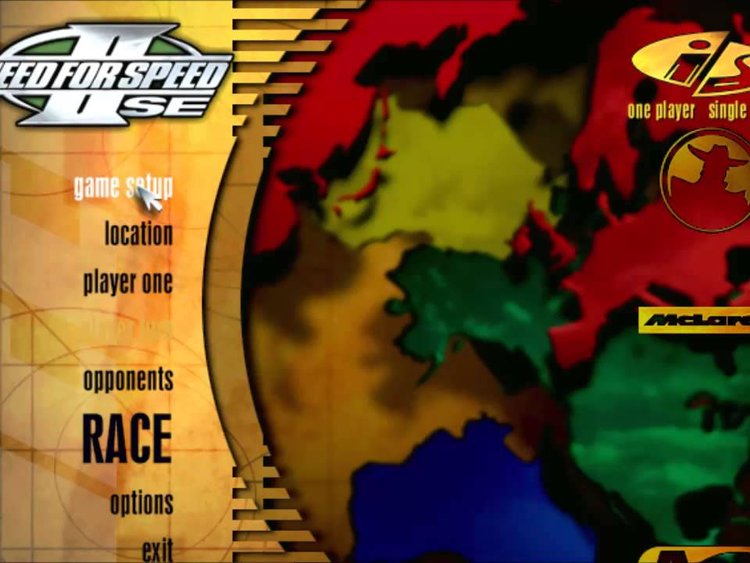
HCI Focus — Need for Speed II SE Main Menu
1) Hover / Selection Feedback
The cursor lights up game setup before you click it instant confirmation of what you're about to pick, so you don't misclick.
1
2
2) Vertical Menu List
Location, player one, opponents a short plain-language stack so the player always knows where a given option lives.
3
3) Emphasized RACE Button
Bigger, bolder text sets the primary action apart from the rest of the list a clear pointer to the next step.
Reflection:
Add a stronger hover state (a glow or slight scale-up, not just a color shift) to every menu item, so the feedback is obvious even on low- contrast displays or for players with color-vision differences.

Slide 2
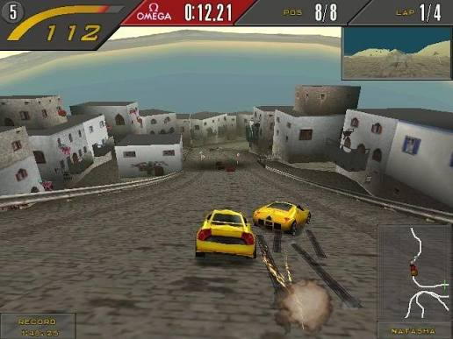
CG Focus — Need for Speed II SE In-Race View
1) Perspective Camera & Converging Road
The road narrows to a vanishing point and the horizon fades into haze classic depth cues that make the screen feel 3D.
1
2
2) Polygonal Building Meshes
Low-poly, flat-shaded facades form the town's walls and rooftops — simple geometry that still reads as solid structure at speed.
3
3) Directional Lighting & Shadows
Sunlight from the upper-left casts visible shadows under the cars and buildings, anchoring everything to the ground.
Reflection :
Mostly helps — shadows and perspective let players judge turns and distance at speed. But the blocky, low-poly geometry sometimes blurs t he line between a solid wall and a passable alley until it's almost too late.

