Slide 1

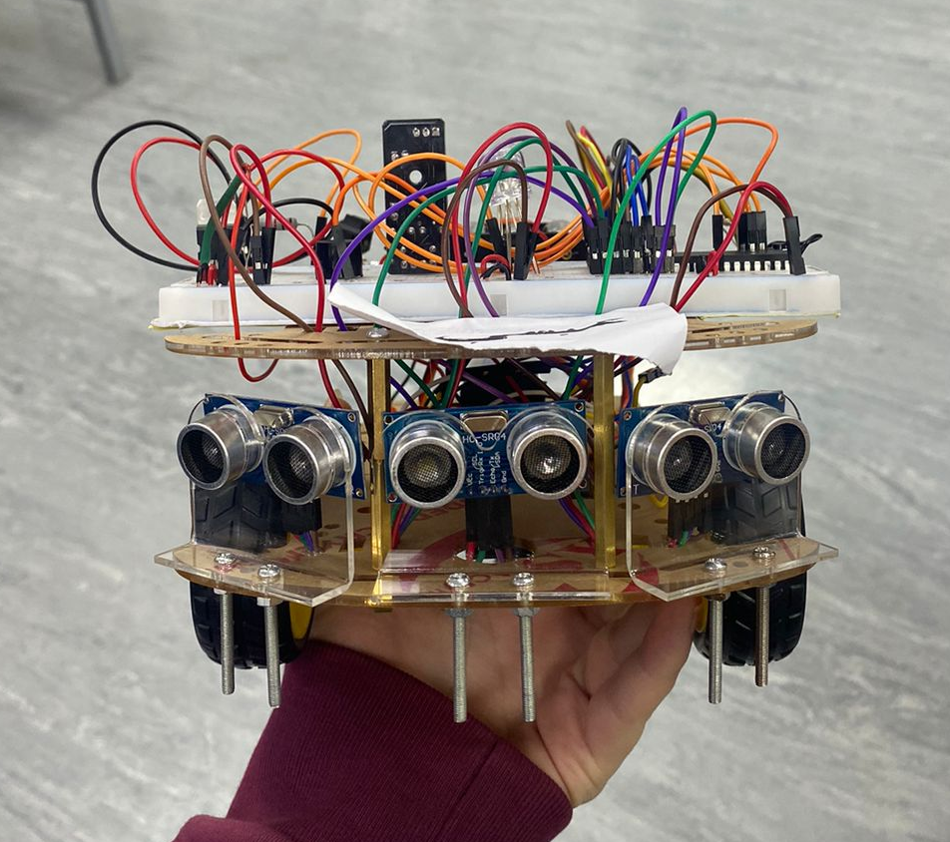
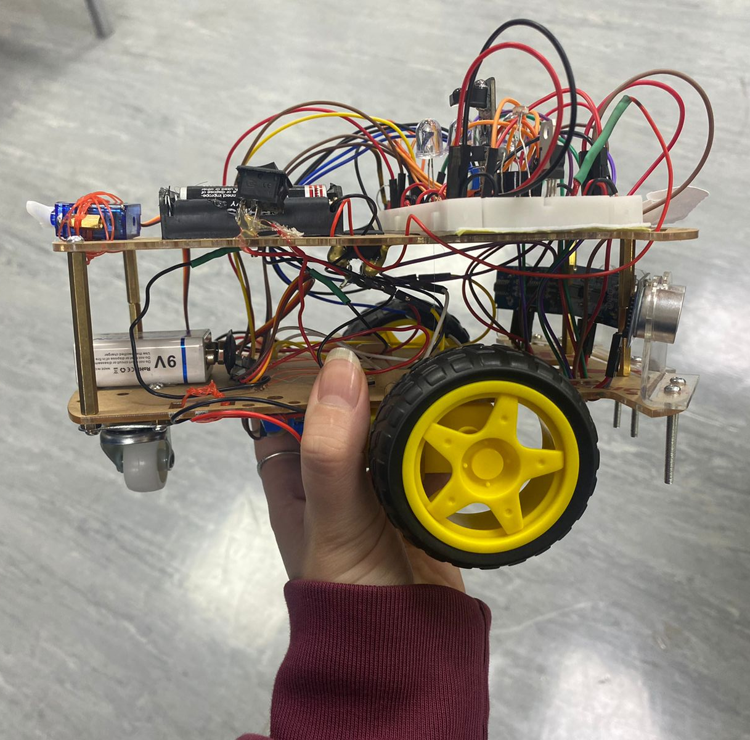
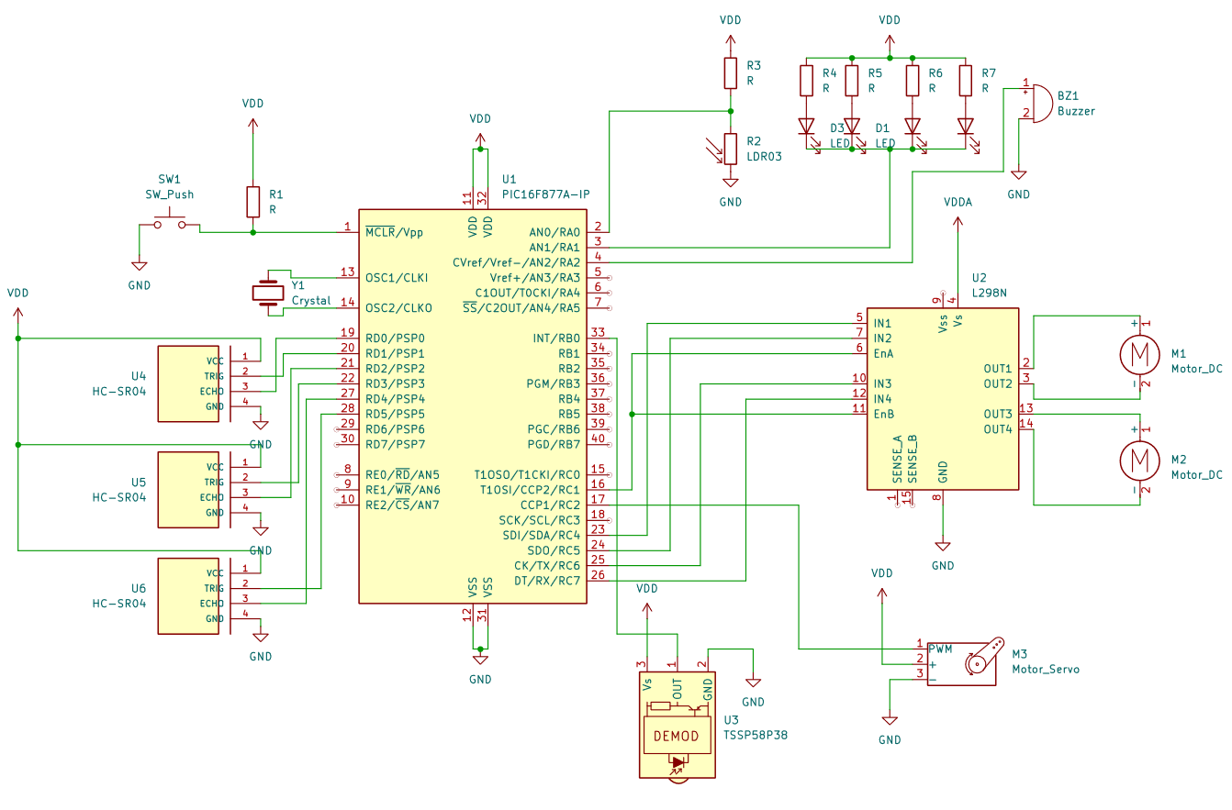
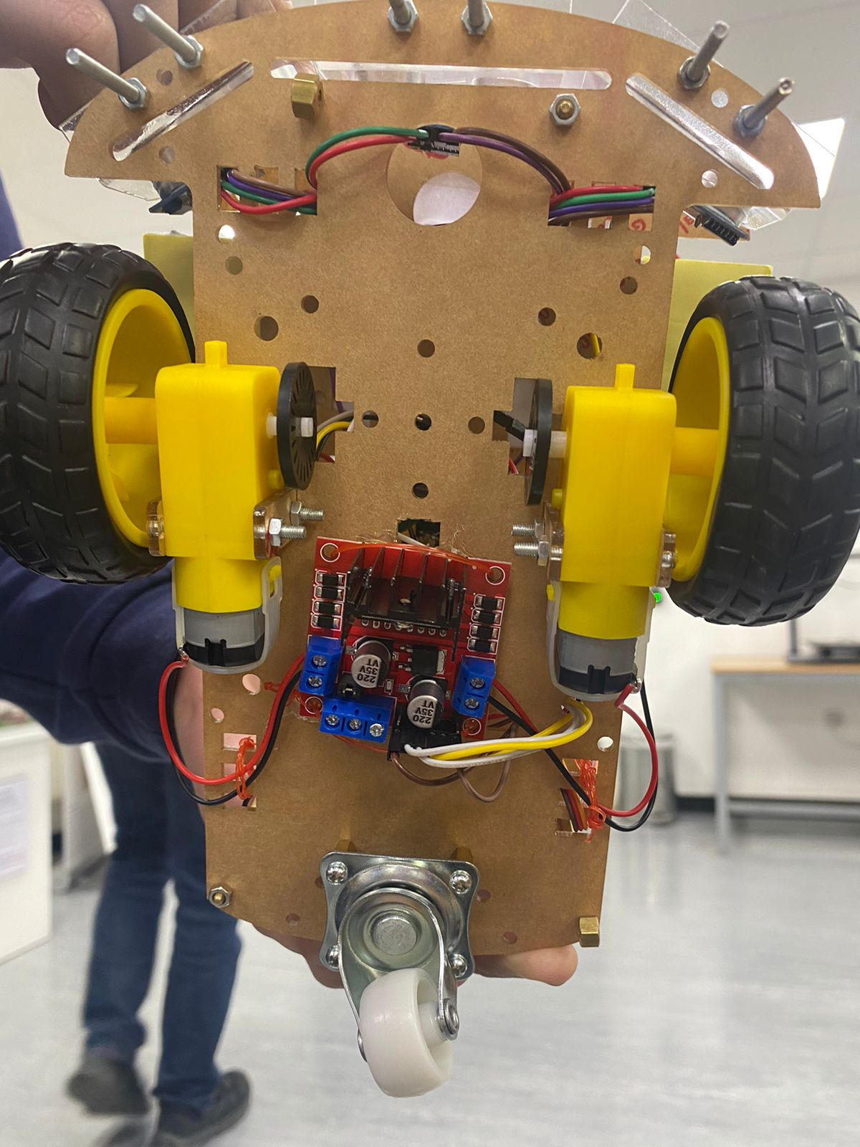
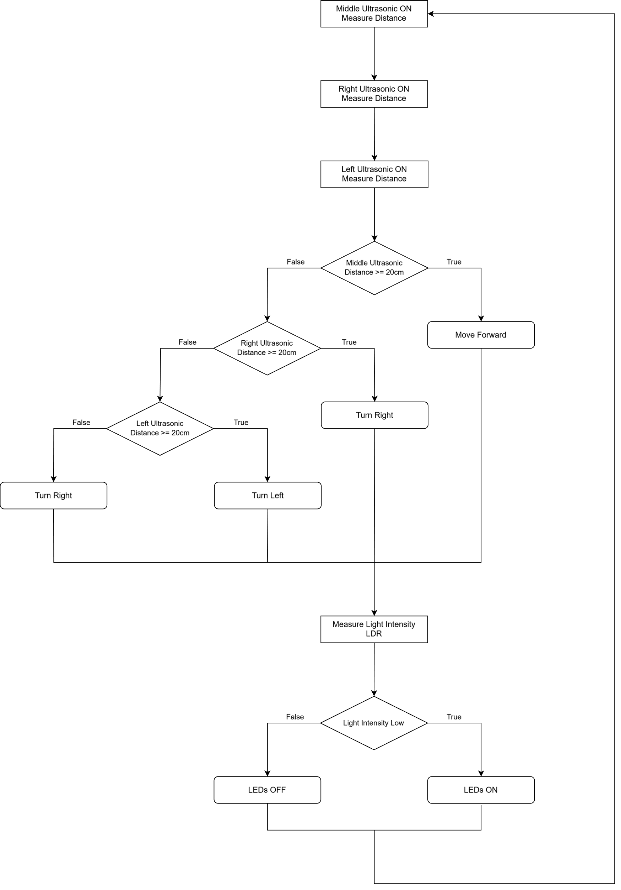
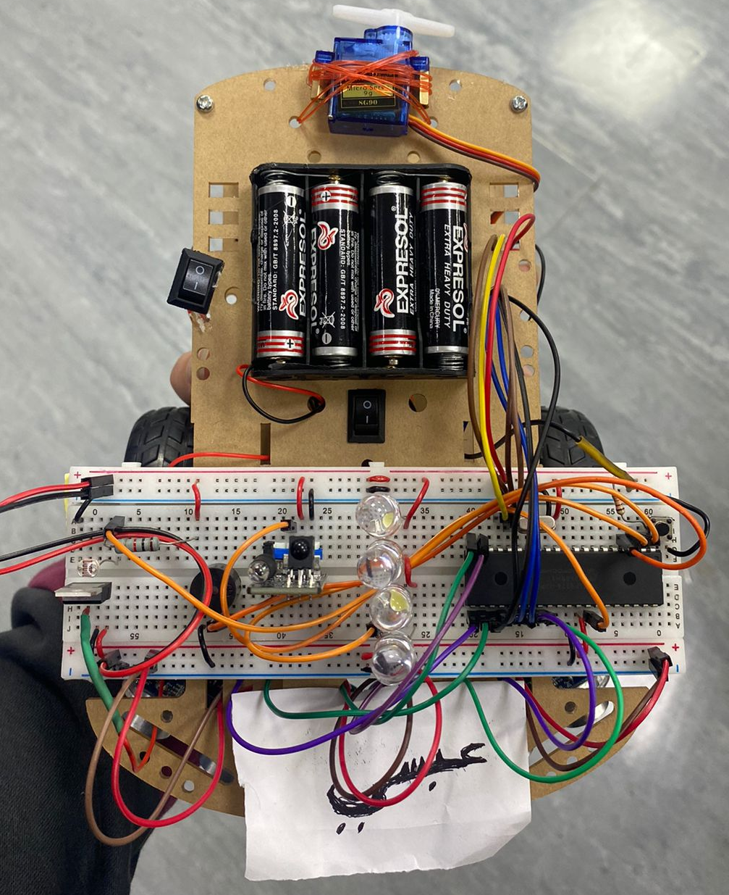
Avoido Obstacle Avoidance Robot
Qais Jildeh, Abdallah Al-Omari, Malak Alshawish
Supervisor: Prof. Belal Sababha Embedded Systems Final Design Project, Fall 2024 King Abdullah II School of Engineering
Princess Sumaya University for Technology
Introduction
The Avoido project involves developing an autonomous obstacle-avoiding robot using ultrasonic sensors for obstacle detection and an IR sensor for interrupt-based tasks. The robot will move around using DC motors, and the state is indicated by LEDs and buzzers. This system integrates interrupt-based and timer-based tasks to ensure real-time obstacle detection and response. This simplified solution provides an effective method for autonomous navigation that can be applied to warehouse automation and search and rescue scenarios.
Results
Figure 3: Front View
Figure 4: Side View
Figure 5: Bottom View
Figure 6: Top View
Design
Avoido is powered by a PIC16F877A microcontroller, seamlessly integrating hardware and software to create an efficient obstacle-avoiding system. With ultrasonic sensors for obstacle detection and an IR sensor for rapid responses, Avoido navigates its surroundings with ease. A servo motor raises a flag to signal when the environment is well-lit, while LEDs and a buzzer provide real-time feedback. An LDR sensor enhances adaptability in varying lighting conditions. Custom software ties it all together, processing sensor data and executing intelligent, responsive movements, making Avoido a smart and autonomous robotic marvel!
Figure 1: Circuit Schematic
Figure 3: Software Design
Conclusion
The Avoido project successfully demonstrates an autonomous robot capable of real-time obstacle detection and avoidance using ultrasonic sensors. By integrating DC motors, LEDs, and buzzers, it achieves smooth navigation while meeting key technical requirements such as PWM control, interrupt-based tasks, and standalone operation. This project highlights teamwork and innovation, translating embedded systems principles into practical application.

