Slide 1
Predicting Student Evaluation in Higher Education Using Educational Data Mining Techniques
Presented By :
Momil Seedat (L1S22MSDS0002)
Qaisar Abbas (L1s22MSDS0001)

Slide 2
Introduction
This research paper examines the impact on education and student performance. By analyzing various factors like socio-economic background, learning environments, study habits, and technology access, the study aims to propose solutions to address the challenges faced by students. Ultimately, the goal is to enhance educational outcomes during these unprecedented times.

Slide 3
Literature Review
Several research papers have examined the application of data mining techniques in predicting student performance in education.
Romero et al. (2019): Explored data mining techniques like decision trees and neural networks to predict academic performance by considering factors like prior academic records, demographics, and course-related data.
Ahmed et al. (2019): Used machine learning algorithms such as decision trees and support vector machines to predict student performance based on features like prior academic records and demographics.
Rasheed et al. (2021): Conducted a comprehensive review of educational data mining techniques, highlighting the importance of considering factors beyond academics, such as learning behaviors and psychomotor skills, to enhance prediction accuracy.

Slide 4
Research Gap
Despite the advancements in educational data mining techniques for predicting student performance, there exists a research gap in considering additional factors beyond academic performance.
While academic performance is undoubtedly important, other factors such as learning behaviors, attitudes, psychomotor skills, student demographics, and self-regulation have been found to significantly influence student success.
The research gap emphasizes the importance of considering a broader range of variables in data analysis to understand student outcomes comprehensively. By addressing this gap and incorporating additional factors, predictive models can offer a holistic view for educators to develop targeted interventions

Slide 5
Research Purpose:
Identifying at-risk students and implementing targeted interventions is essential for educational institutions. Our research aims to understand the factors influencing student performance by analyzing past academic records and exploring variables such as socio-economic background, learning behaviors, and demographics.
By examining these factors, we aim to provide valuable insights that will enable educational institutions to proactively support students and improve their academic journey, ultimately enhancing overall educational outcomes.

Slide 6
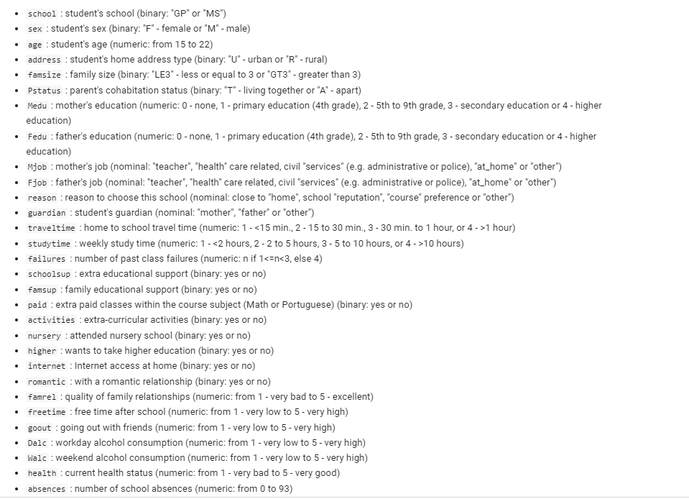
Dataset Description

Slide 7
Methodology
Data Preprocessing:
Perform data cleaning and handle missing values, outliers, and inconsistencies.
Conduct feature scaling to normalize the range of independent variables or features.
Data Inspection:
Analyze the dataset to gain an understanding of its structure, distribution, and relevant statistical properties.
Identify any patterns, trends, or correlations among the variables.
Training and Testing Data:
Split the dataset into training and testing subsets.
Ensure that both subsets are representative of the overall dataset and maintain the distribution of variables.
Feature Selection:
Identify relevant features that significantly influence student performance.
Utilize techniques such as statistical analysis, correlation analysis, or feature importance ranking.

Slide 8
Proposed Methodology Cont…
Model Development and Evaluation:
Select appropriate machine learning algorithms (e.g., knn, logistics regression, random forests, or support vector machines) for prediction.
Train the models using the training dataset and evaluate their performance using appropriate evaluation metrics (e.g., accuracy, precision, recall).
Model Optimization:
Fine-tune the model parameters to optimize performance.
Apply techniques such as cross-validation or grid search to find the optimal combination of parameters.
Predictive Analysis and Interpretation:
Apply the optimized model to predict student performance on the testing dataset.
Analyze and interpret the results, considering the influence of various factors on student performance.

Slide 9
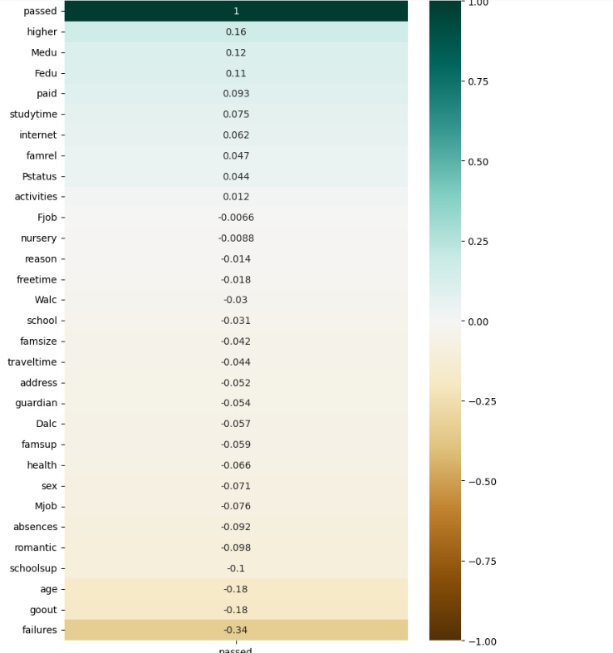
Results : (Feature Correlation)
Based on this heatmap we can do a quick conclusion about most impacted features on student status:
tree most impacted (positively) features:
-mother and father with height education had a positive impact on student performance
-the students who wants to take higher education are having also good grades sow it could be better to tell student how great and fun to take higher education
tree most impacted (negatively) features:
-going out with friends to much hours can impact badly
-age and failures are other features that also impact negatively the student performances.

Slide 10
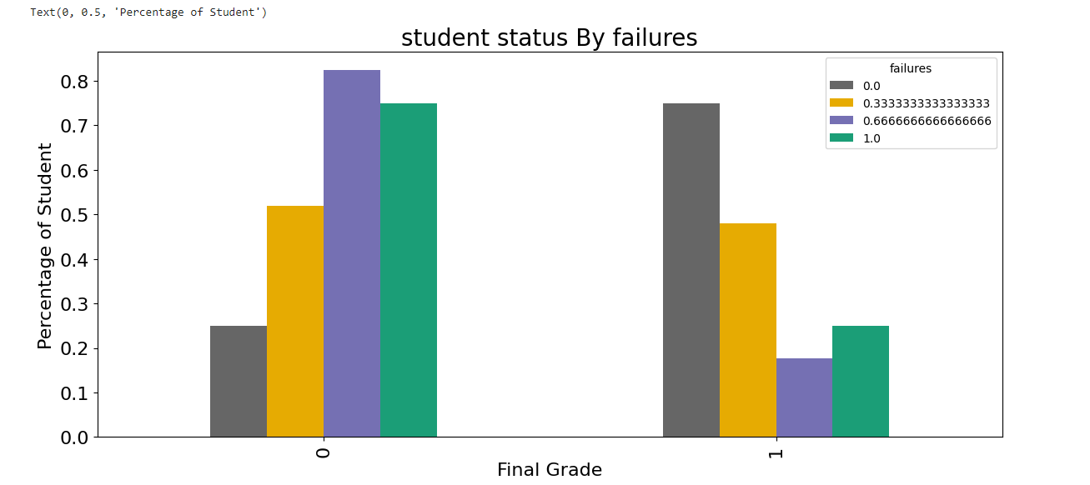
Results : Student status By failures
most of people who passed the exam had failures show it could be a good choice to study hard and pass all the grades

Slide 11
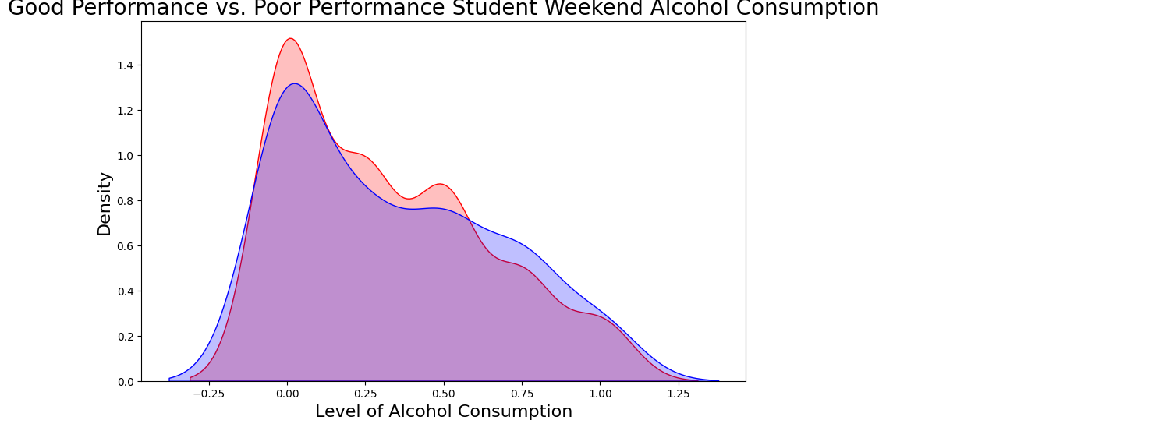
Results: Performance Comparison on the basis of alcohol consumption
For weekly alcohol consumption it doesn't have an strong impact on student performance .Even people with low consumption had low grad.

Slide 12
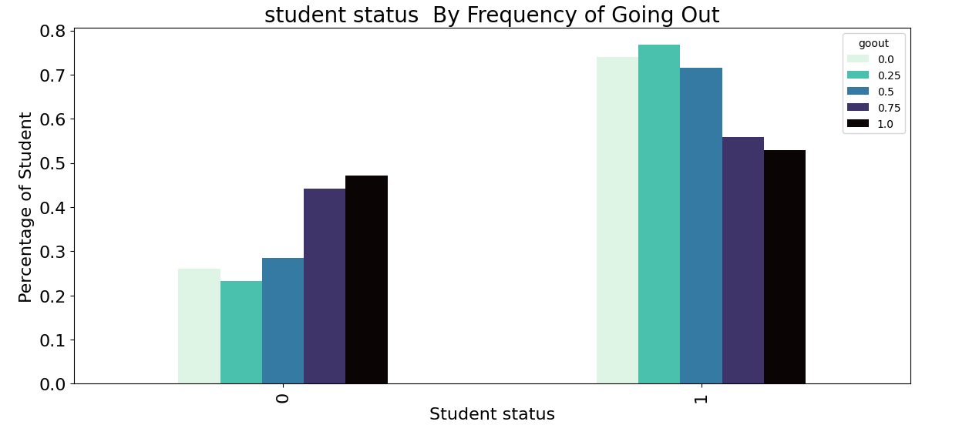
Result: Frequency of going out
it seems that most of people who passed the exam had less hour of going out ,as a conclusion we should limit the hour of going out with friend

Slide 13
Results
To train our model we applied three types of algorithm
Logistic regression
KNN
Support vector machine

Slide 14
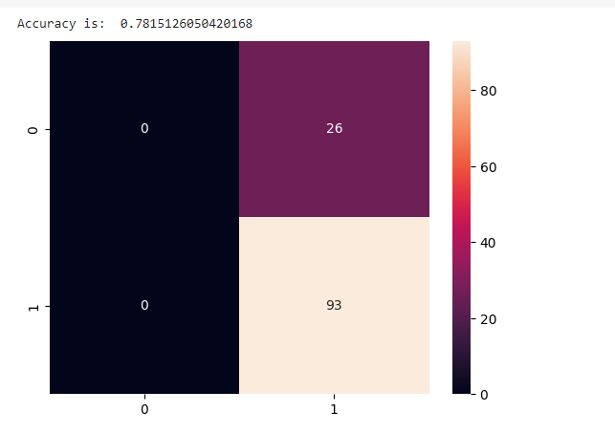
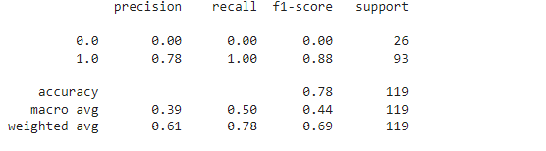
KNN results
we got the best model with k=17 and metrics=chebychev and we got a better accuracy of 79% as we can see the impact of hyper_parameters wasn't so strong the importent parameter is the randome_state.

Slide 15
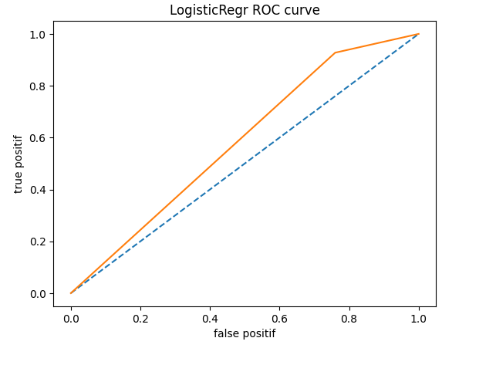
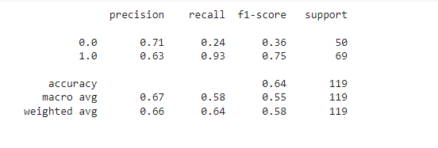
Logistic Regression

Slide 16
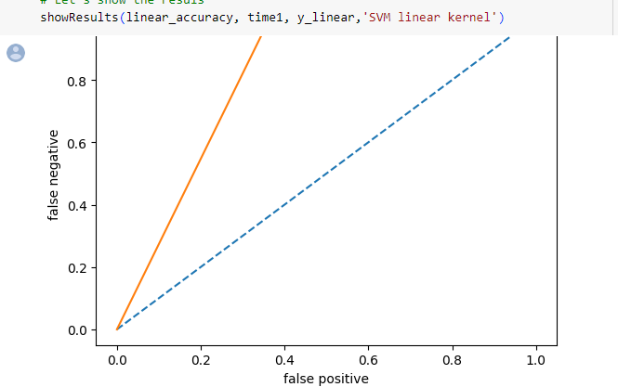
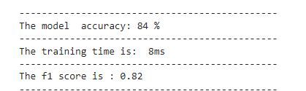
Support Vector Machine
The support vector machine classifier with high accuracy of 84%, the confusion matrix is roughly diagonal which indicate that this classifier is able to label data correctly.

Slide 17
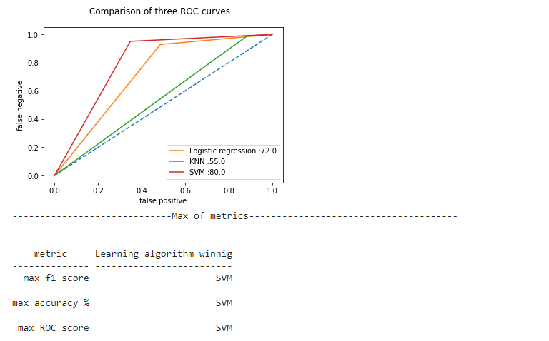
Comparison three curves

Slide 18
Conclusion
In this study, we analyzed the factors that have a positive or negative impact on student performance based on the classification results from our dataset. We found that factors such as father's education, guardian, aspirations for higher education, study time, and father's job have a positive impact on student performance. On the other hand, factors like age, health, going out with friends, absences, and failures have a negative impact.
It is important to note that these findings are based on the specific dataset and context of the two chosen Portuguese schools. The results may vary in different educational settings and cultures. Additionally, some factors may have complex relationships and may not have a direct causal effect on student performance.

Slide 19
Future work
In future research, it would be valuable to consider a larger and more diverse dataset from multiple educational institutions to validate and generalize the findings. Additionally, conducting qualitative studies or surveys could provide deeper insights into the impact of these factors on student performance and identify potential underlying mechanisms.

