Slide 1
Knowledge representation and graph reasoning

Slide 2
agenda
Introduction
Implementation
Experiments
Code Demonstration
Conclusion
Q&A (Questions and Answers)

Slide 3
Introduction
I reimplemented this paper called “Knowledge representation and graph reasoning” to showcase the core concept of Knowledge Representation and reasoning,
This paper highlights how knowledge can be effectively represented and queried within AI systems
We have different types of schemas to represent various types of knowledge; this implementation uses triplets (Subject → Predicate → Object) to create a structured graph.
The knowledge is represented in the form of a CSV file, which serves as the knowledge base for this system
Rules and relationships between entities are defined in a grammar.py file, which works as the reference engine for processing queries.
The system allows us to query different graphs using node names and symbols defined in the grammar.py file.
This implementation processes queries, evaluates relationships, and generates results in both graphical (DOT format) and textual forms, demonstrating how knowledge can be organized, queried, and visualized effectively.

Slide 4
Implementation(1)
Data Representation: The data is stored in a CSV file (Book1.csv) in the form of triplets: Subject, Predicate, Object.
Knowledge Graph Creation: The kgl library is used to load the triplet data and build a Knowledge Graph.
Reverse Indexing: Connections between nodes in the graph are indexed to allow efficient query operations.
Trie-Based AutoComplete: The pygtrie library is used to create a trie structure for storing node connections, enabling query autocompletion.
Web Framework Integration: The Flask framework is used to set up two routes: one for query input and another for query autocompletion.
Query Evaluation: The Knowledge Graph processes queries, evaluates relationships, and generates results in JSON format.
Graph Visualization: The query results are converted into DOT format using graph_to_dot() for visualization with tools like Graphviz.
Error Handling: Errors in user queries are managed gracefully, providing informative JSON error responses.

Slide 5
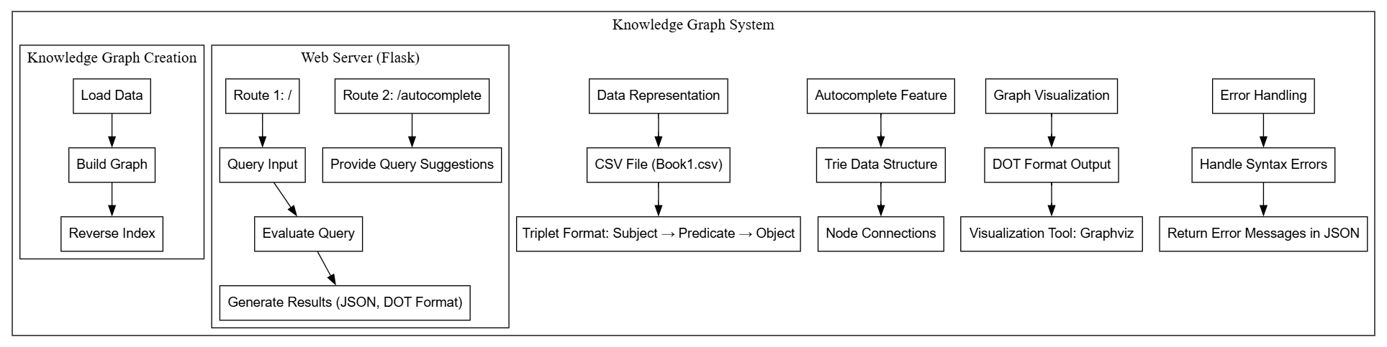
Implementation(2)
This graph represents the implementation flow of a Knowledge Graph System. The process starts with data representation, where a CSV file stores triplet data (Subject → Predicate → Object). The knowledge graph is created by loading data, building the graph, and generating a reverse index. A Flask web server handles user queries and provides autocomplete suggestions using a trie data structure. Query results are generated in JSON or DOT format and visualized using tools like Graphviz. Lastly, error handling ensures any syntax issues return meaningful messages.

Slide 6
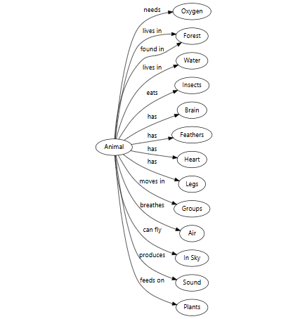
Experiment(1)
After implementing the paper, I ran the code as provided, and it successfully demonstrated the relationship of the "Animal" entity within a knowledge graph. The system visualizes the data in a structured format where each connection represents a specific relationship between the entity (subject) and its attributes (object) using predicates. For example, the "Animal" entity has relationships like "needs" Oxygen, "lives in" Forest and Water, "eats" Insects, and "has" Brain, Feathers, Heart, and Legs. Additionally, it shows dynamic capabilities, such as representing movements ("moves in Groups"), behaviors ("breathes Air," "can fly"), and dependencies ("produces Sound," "feeds on Plants"). This graphical representation clearly demonstrates how the subject-predicate-object schema can be used to organize and visualize relationships in a knowledge graph. The experiment validates the model's ability to systematically represent and query real-world knowledge in an AI-driven system.

Slide 7
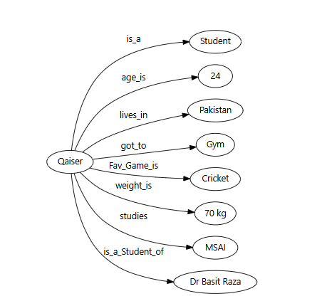
Experiment(2)
After rerunning the code, I modified the dataset to include my personal information, and the resulting knowledge graph accurately represented it. The entity "Qaiser" serves as the central node, and various attributes (relationships) are connected to it through predicates. For instance, "Qaiser" is_a_Student, age_is 24, and lives_in Pakistan, effectively showing biographical information. Additional relationships include activities and interests, such as got_to Gym and Fav_Game_is Cricket. Further details like weight_is 70 kg and studies MSAI provide more context about the individual. The graph also highlights connections to "Dr Basit Raza," under the predicate is_a_Student_of. This demonstrates the flexibility of the knowledge graph to adapt to personalized data while maintaining a structured and visual representation of subject-predicate-object relationships. The experiment proves how effectively a knowledge graph system can organize, query, and display relational information for a given entity.

Slide 8
Code Demonstration
Let's Run the code

Slide 9
Conclusion
This paper presents an experimental research study aimed at demonstrating the fundamental concepts of knowledge representation in AI systems. A small-scale system was developed to provide insights into how knowledge is structured, represented, and extracted using well-defined rules. The study further explores how knowledge is translated from one form to another, specifically from raw data into meaningful relationships and visualizations. By implementing this system, it becomes clear how entities, their attributes, and connections can be represented, queried, and analyzed to build a functional knowledge graph. This experiment not only highlights the importance of structured data representation but also showcases the role of rule-based systems and visualization tools in extracting and interpreting knowledge effectively. Overall, it serves as a foundation for understanding how intelligent systems process and utilize knowledge, paving the way for more complex AI applications in the future.

Slide 10
Any Questions?

Slide 11
Thank you
Qaiser Farooq

