Slide 1
Description :
The "CV maker" project is a software application that allows users to create professional-looking resumes and cv easily. The application has been developed using the java programming language and features a graphical user interface (GUI) implemented with swing. The project makes use of a database to store user information, such as personal details, work experience, education, and skills. , The CV maker application also features a document generation module.

Slide 2
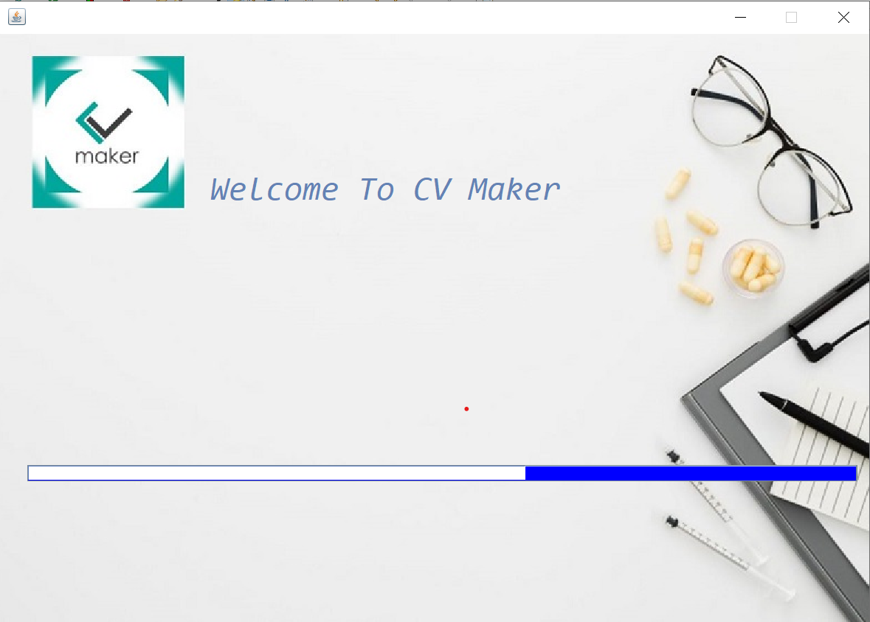
This is first page of project and loading page .

Slide 3
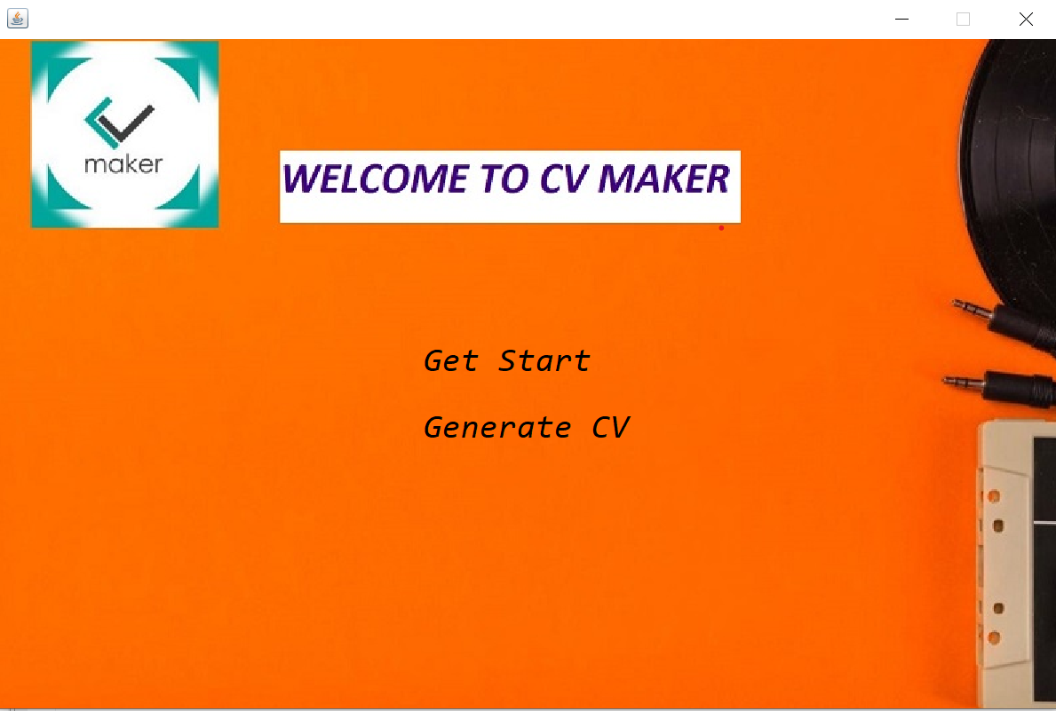
Second page of project and in this two Get Start and Generate CV label used when user inter get Start other page open for taking data and when user click generate CV Documents will created pdf .

Slide 4
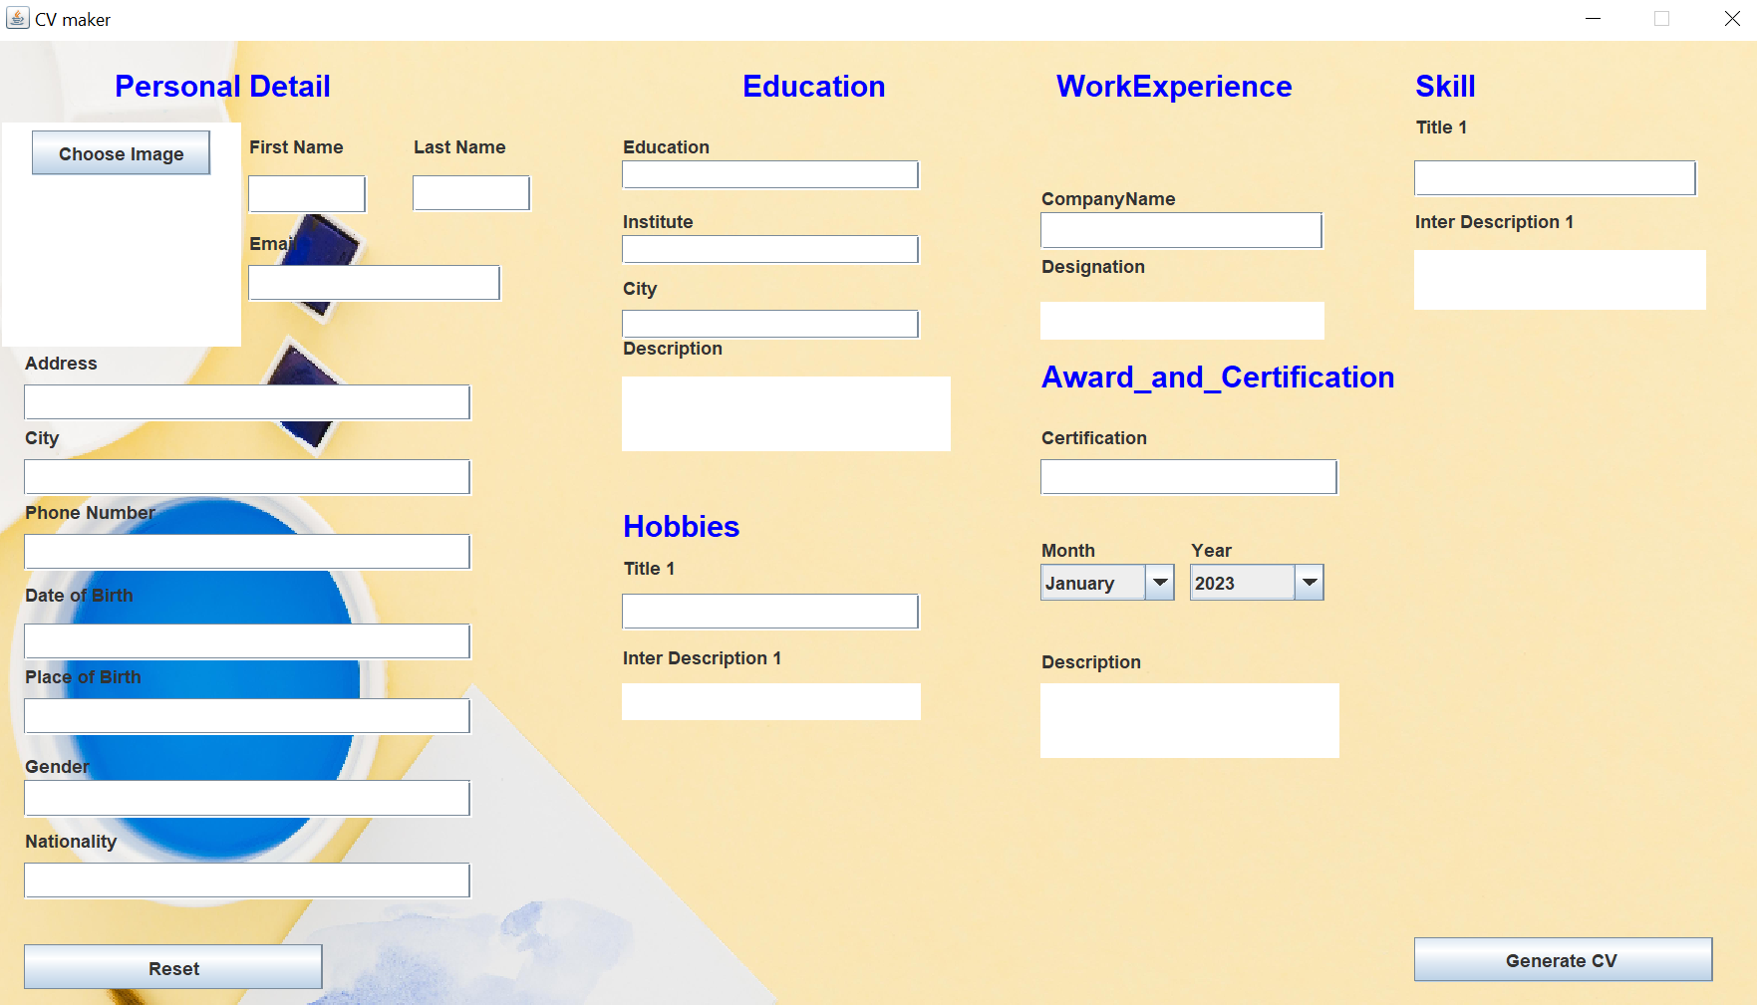
In this page All data taken from user for creating cv

Slide 5
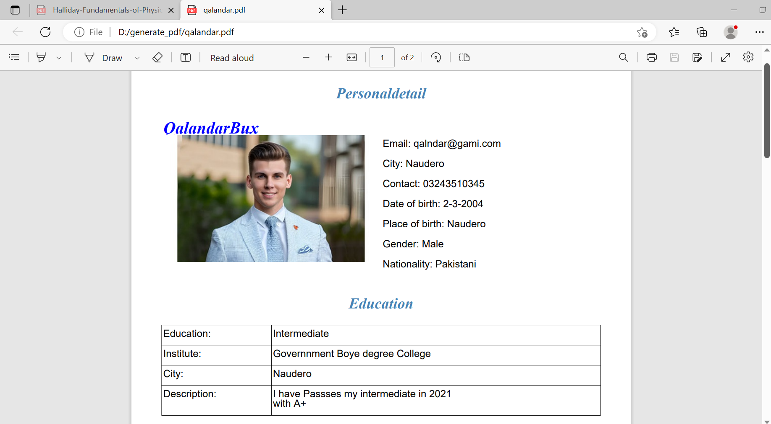
This is generated pdf Document Half page other next PPt page

Slide 6
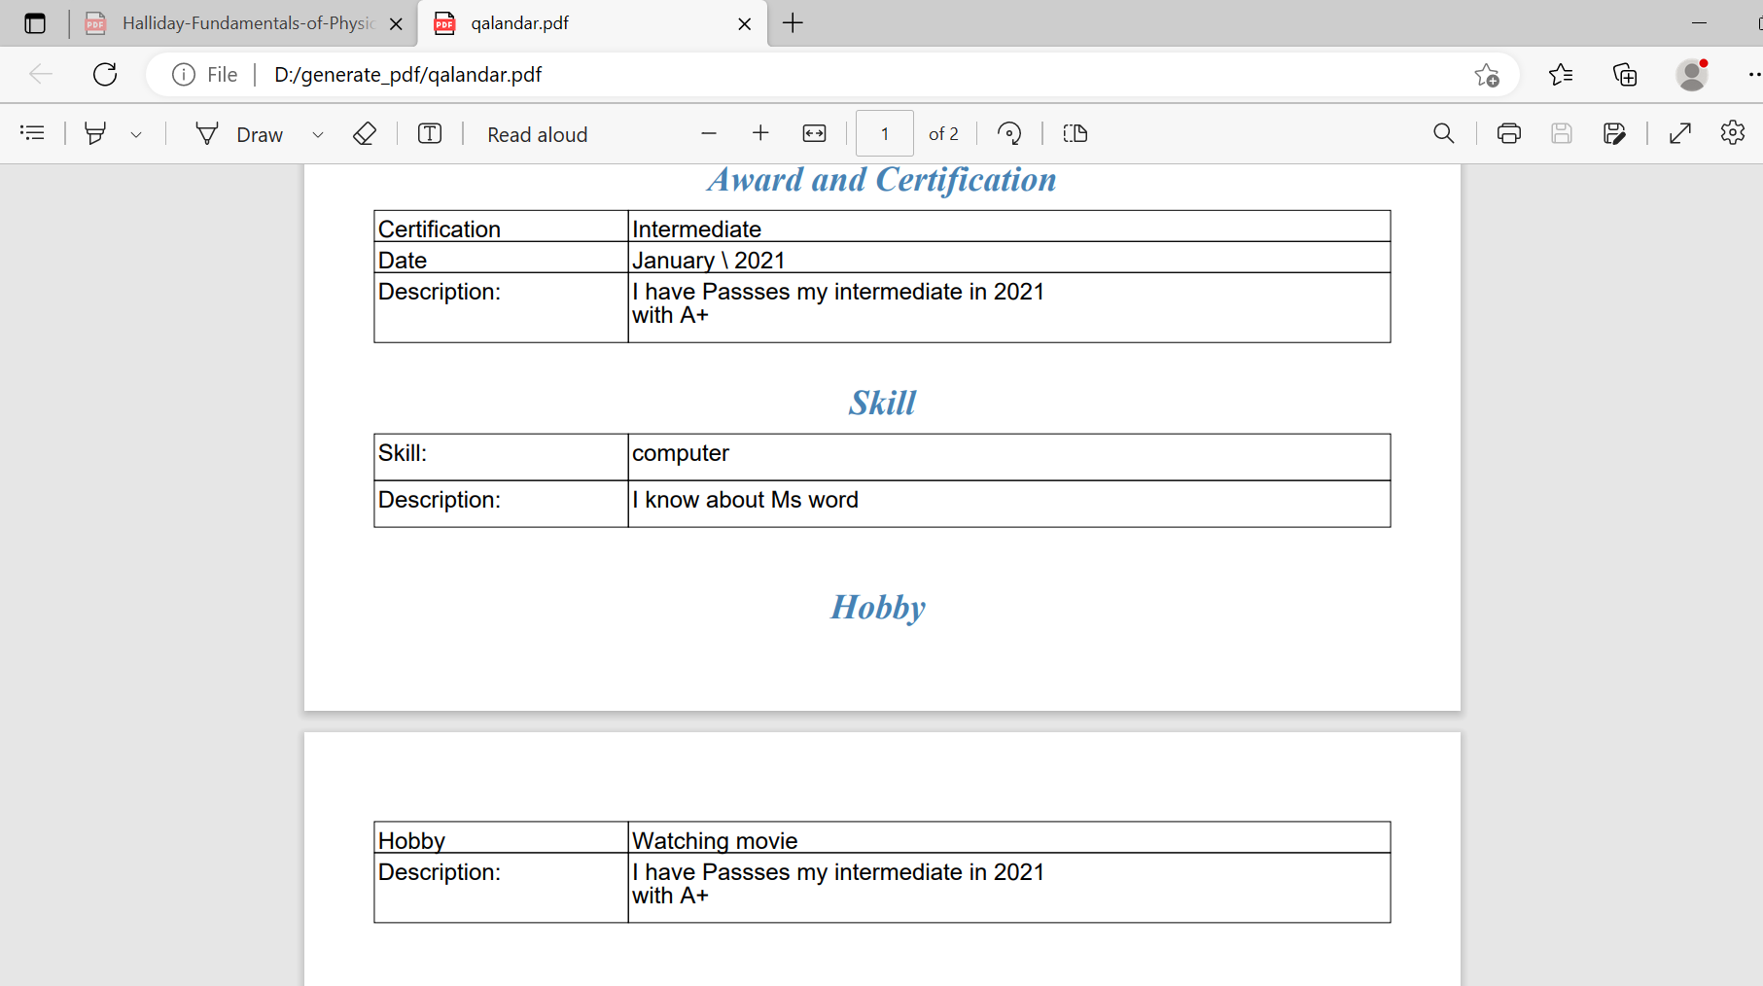
This cv generated pdf pic

