Slide 1
Seminar On
PHISHING ATTACK
By :
QAMASH BASHIR

Slide 2
Contents
02
Introduction
﻿What is phishing attack
Typical Scenario of phishing
﻿History of phishing attack
Types of phishing attack & it's example
Phishing statistics
Prevention from phishing attack
﻿Anti-phishing software
Punishment & Cyber law
Conclusion
Reference

Slide 3
03
Introduction
Phishing is a type of social engineering attack often used to steal user data, including login credentials and credit card numbers.

Slide 4
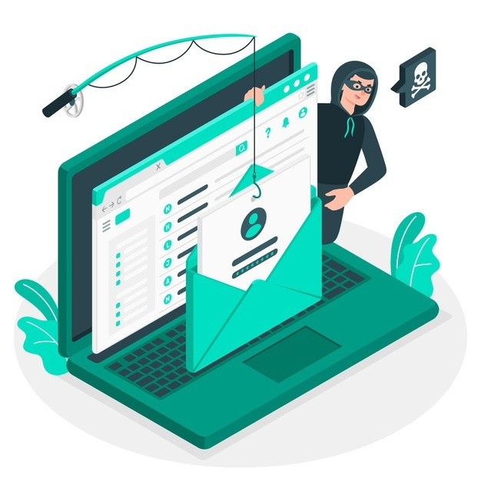
04
What is Phishing?
The term Phishing can be defined as an act of attempting to acquire sensitive information by pretending to be a trustworthy entity.

Slide 5
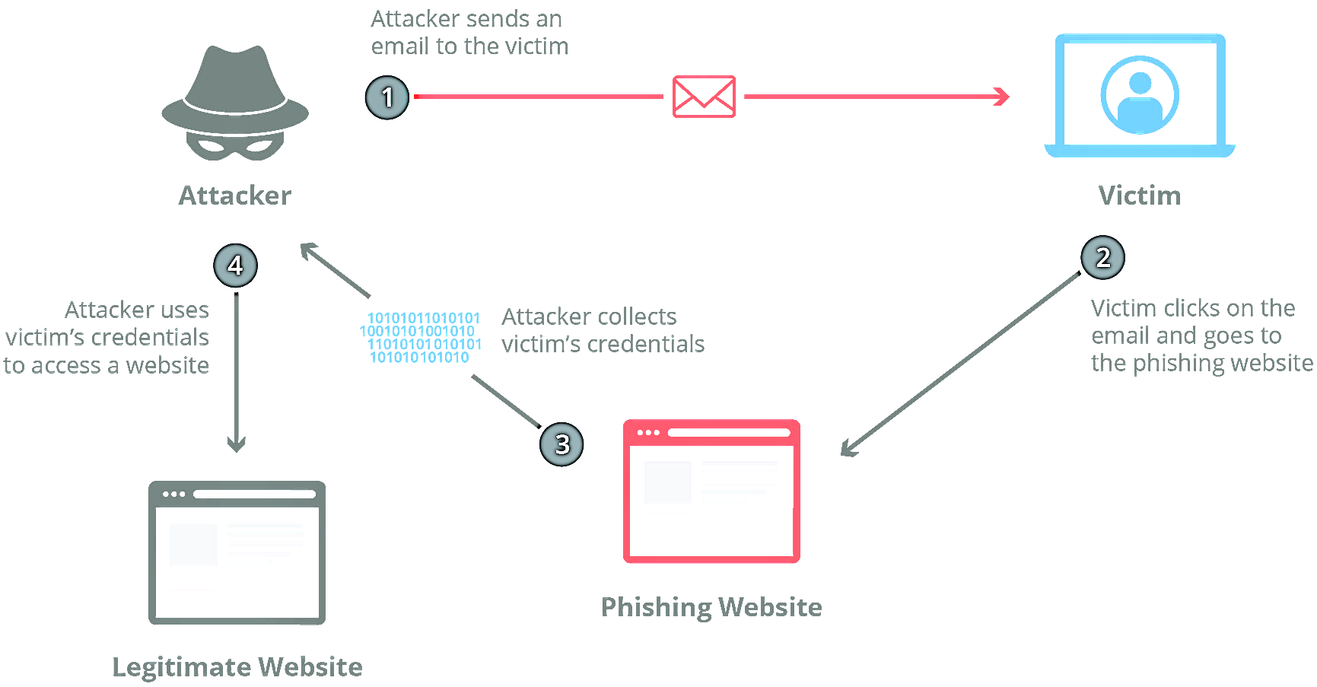


Typical Scenario of Phishing Attacks
05

Slide 6
History of Phishing Attack
06
1990
2008
2019
The first phishing attempt is recorded on America online (AOL). Hacker attempt to steal login credentials & personal information from AOL to resell online.
Bitcoin & crypto currency are launched this increases the creation of malware as it is easier for cyber criminals to securely receive payment from their victims
Cyber criminals begin hiding malicious code inside image files to slip through user's anti-virus software
Th riseof E-commerce encourages cyber criminals to create spoofed websites, impersonating popular domain like ebay & PayPal.
Phishing becomes the primary technique to deliver ransomware
2000
2013

Slide 7




07
Types of Phishing Attacks
EMAIL PHISHING
CLONE PHISHING
SPEAR PHISHING
VOICE PHISHING

Slide 8
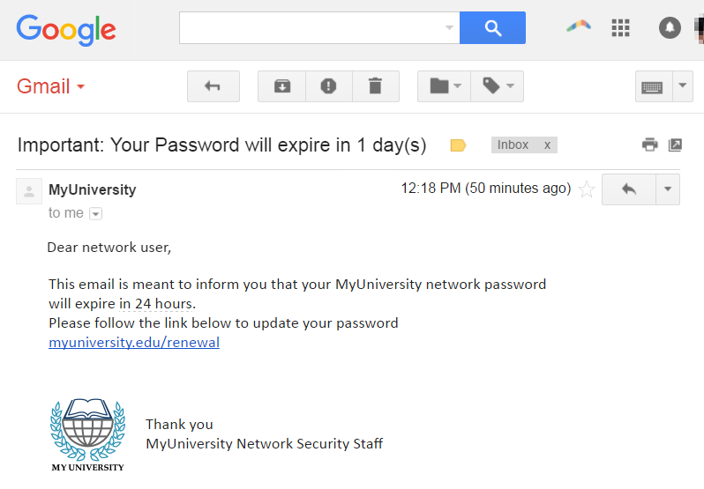
01
08
Email Phishing & it's Example
The most widely known form of phishing, this attack is an attempt to steal sensitive information via an email that appears to be from a legitimate organization.

Slide 9
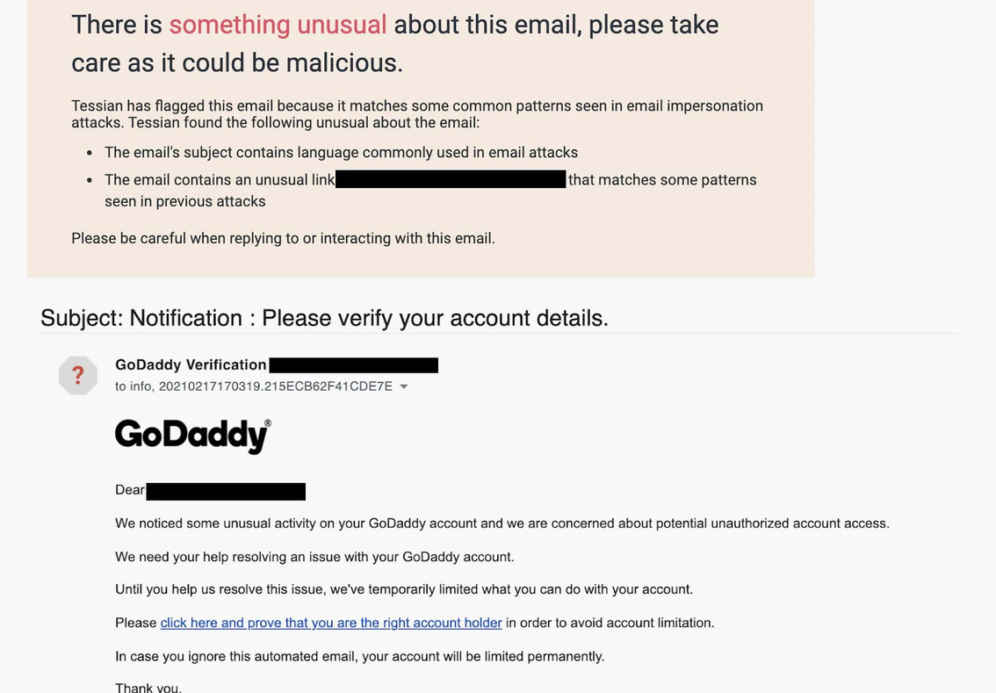
02
09
Spear Phishing & it's Example
These email messages are sent to specific people within an organization, usually high-privilege

Slide 10
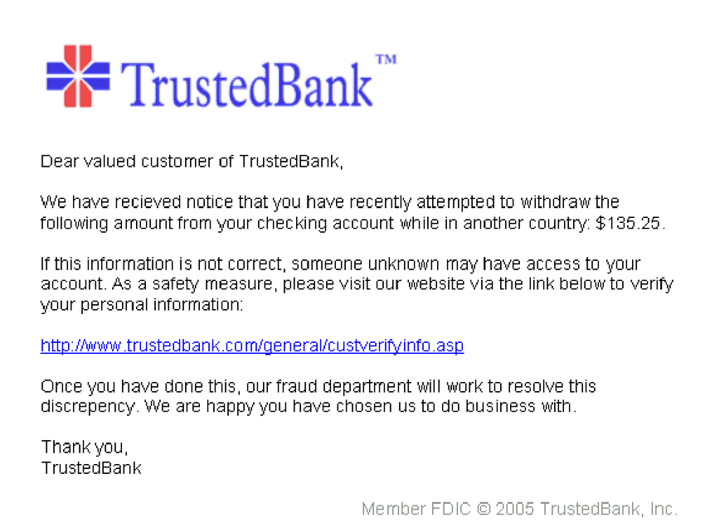
03
10
Clone Phishing & it's Example
In this type of phishing, the attacker clones a genuine or legitimate email that you might have received from an authentic sender but sent from a spoofed email id

Slide 11
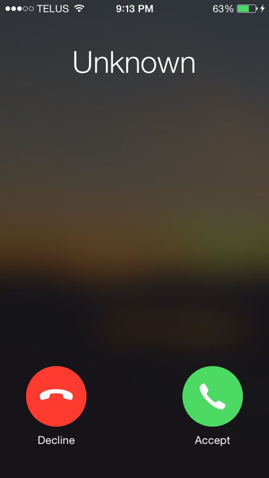
04
11
Voice Phishing & it's Example
Vishing—or voice phishing—is the use of fraudulent phone calls to trick people into giving money or revealing personal information.

Slide 12
PHISHING ATTACK STATISTICS IN PAKISTAN
2012
2013
2014
Phishing is the most common form of cyber crime, with an estimated 3.4 billion spam emails sent every day. Over 48% of emails sent in 2022 were spam.
2015
2016
2017
2018
2019
2020
0
20,000
40,000
60,000
Number of cyber crimes reported across Pakistan
12

Slide 13
PHISHING ATTACK STATISTICS
Other
8%
During the first quarter of 2021, 24.9% of phishing attacks worldwide were directed towards financial institution
On top of that, social media accounted for 23.6 percent of attacks making these two the highest targeted industries when it came to phishing during this period.
Logistics and shipping
5.8%
Financial Institution
24.7%
E-commerce
7.6%
Payment
8.5%
Socila Media
23.7%
SaaS
19.7%
Most targeted industry
, first quarter of 2021
13

Slide 14
PREVENTIONS FROM PHISHING ATTACK
Know what a phishing scam look like
Don't click on that link
Don't give your information to unsecured site
﻿Rotate your password regularly
﻿Install Firewalls
﻿Install Anti-phishing software
14

Slide 15
ANTI-PHISHING SOFTWARE
01
Area 1 Horizon
Cloud based service that offer protection from phishing on Email & network based vectors
02
GreatHorn
This cloud- native email security service protect from phishing attack on office 365, email carrying ransomware
03
IronScale
This is a self learning email security platform powered by AI. It can help you to detect & predict phishing attacks.
15

Slide 16

PUNISHMENT AND CYBER LAW
Cybercrime is a criminal activity that uses a computer, the internet, or other digital technology as its primary means of perpetration. In Pakistan, the Prevention of Electronic Crimes Act, 2016 (PECA) is the primary legislation dealing with cybercrime. Since the enactment of PECA in 2016, various offences have been defined and punishable under the law. The maximum punishment for these offences is imprisonment for up to three years, or a fine of up to PKR one million.
16

Slide 17

CONCLUSION
No single technology will completely stop Phishing Attacks.
However a combination of good organization and practice, proper application of current technologies and improvement in security technology has the potential to drastically reduce the prevalence of phishing and the losses suffered from it.
17

Slide 18
Thank You
18

