Slide 1
Book1
File created on: 05/08/21 09:35:29 م

Slide 2
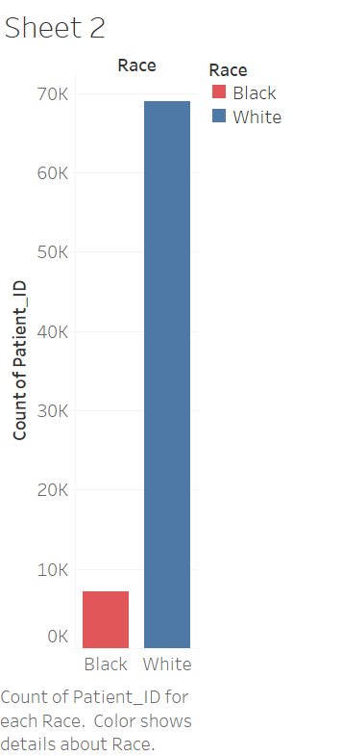

Slide 3
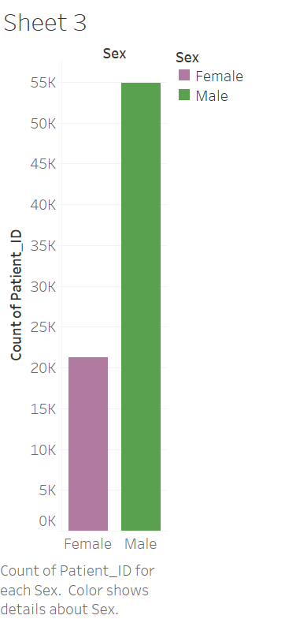

Slide 4
