Slide 1

Acute and chronic laryngitis
By Dr:. Mariwan Latif Fatah
M.B.ch.B _F.I.C.M.S

Slide 2

Key Features
Infections of the larynx may be acute or chronic in nature.
Symptoms and signs include hoarseness, pain, dysphagia, cough, dyspnea, stridor, and signs of systemic illness.
Therapy is directed at the causative organism and is supportive of any airway issues present.
Laryngoscopy with biopsy and/or culture may be necessary as some infections may mimic neoplasms, or require this information for a definitive diagnosis.

Slide 3
ACUTE LARYNGITIS
Acute infective laryngitis is the most common form of infection in the larynx.
The majority of the infection is caused by viruses, including rhinovirus, adenovirus, Para influenza virus and respiratory syncytial virus.

Slide 4
LARYNGO-TRACHEOBRONCHITIS (CROUP)
Laryngo-tracheobronchitis is a subacute upper respiratory tract infection most commonly caused by Para influenza viruses types I, II and III, accounting for 75–80 per cent of cases.
Adenovirus, respiratory syncytial virus and influenza viruses types A and B compose the remaining cases.

Slide 5
Children between the ages of 6 months and 3 years are more commonly affected, and such cases of croup usually last for 3 to 7 days.

Slide 6
Many cases are self-limiting, and most patients do not need admission to hospital for treatment.
Croup is the most common cause of stridor in children, and approximately 5 per cent of these patients require tracheal intubation.
The infection is more prevalent in autumn and winter months.
The disease is uncommon in adults

Slide 7
The viral infection causes inflammation and edema in the larynx, the trachea and the bronchus.
The subglottis is the most affected area. The cricoid cartilage is the only complete cartilaginous ring in the upper respiratory tract that prevents any expansion in acute inflammation

Slide 8
The clinical features of croup
are ‘barking’ cough, hoarse voice and low-grade fever. Barking cough is a highly predictive symptom for croup.
When the patient is drooling saliva, acute epiglottis must be considered.
Stridor and respiratory distress happen when the subglottic airway becomes narrowed

Slide 9
Patients with bacterial tracheitis caused by staphylococcus and streptococcus are more systemically unwell, with high fever and leukocytosis.
Non-infective causes of stridor, including subglottic stenosis due to previous prolonged intubation, foreign body, laryngomalacia, tracheomalacia, subglottic haemangioma, laryngeal web, vocal cord palsy or neoplasm, need to be excluded.

Slide 10
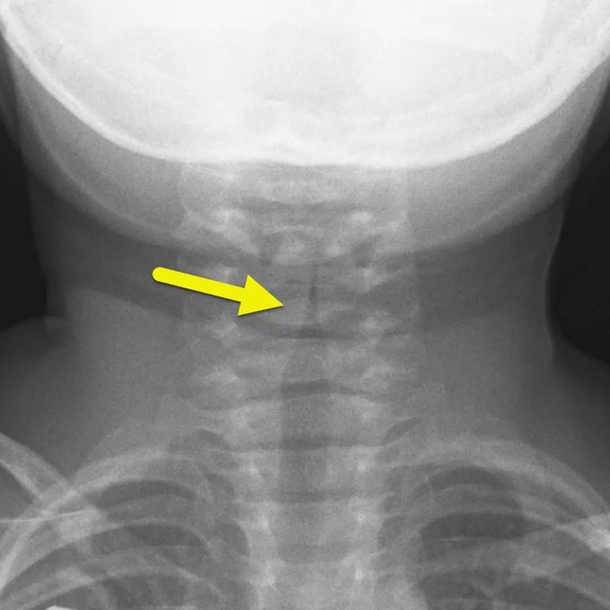
Flexible fibre-optic laryngoscopy can reveal subglottic inflammation and oedema as well as excluding any other pathologic changes in the larynx.
An anteroposterior soft tissue x-ray of the neck, performed only if the child’s airway is safe and in a stable condition, may show a symmetrical narrowing of the subglottic known as a ‘steeple sign’.

Slide 11
The treatment for croup is air humidification, nebulized adrenaline 1:1000 5 mL and systemic corticosteroids. Oral, intramuscular and inhaled steroids are shown to be effective.
The rapid onset of action of nebulized adrenaline causes mucosal vasoconstriction and reduced vascular permeability, resulting in reduction of mucosal oedema and Acute epiglottitis (supraglottitis)
Patients treated with nebulized adrenaline need to be reassessed 3 to 4 hours after administration in the event of regression of stridor. The anti-inflammatory action of a systemic corticosteroid may take several hours

Slide 12
Tracheal intubation may be necessary in severe cases.
A whole size smaller than the anticipated endotracheal tube for age and size of the child (half a size smaller for infants up to 6 months old) should be used to avoid causing intubation injury to the subglottic mucosa.

Slide 13
ACUTE EPIGLOTTITIS (SUPRAGLOTTITIS)
Acute epiglottitis is a potentially life-threatening infection due to acute inflammation and edema of the supraglottis, in particular the epiglottis, causing laryngeal airway obstruction. Therefore, epiglottitis is also known as supraglottitis.
The classic causative infectious agent is Haemophilus influenzae type b.

Slide 14
The infection predominantly affected children between 2 and 4 years old, but the incidence of acute epiglottitis in children has dramatically decreased following the introduction of the Hib vaccine.
The infection is now more commonly found in adults.

Slide 15
Group A Streptococcus pneumoniae, Staphylococcus aureus, Klebsiella pneumoniae, Haemophilus parainfluenzae and beta-haemolytic streptococci (groups A, B, C and F) are associated with epiglottitis in the post-vaccination era.
simplex type 1, varicella-zoster and parainfluenza, can cause the infection in immunocompromised patients.

Slide 16
Patients often present with a short history of sore throat and fever and then rapidly deteriorate to odynophagia, dysphagia, drooling of saliva, airway obstruction and stridor within a few hours. Cervical lymphadenitis is not uncommon.
In children, acute epiglottitis can be difficult to differentiate from acute laryngo-tracheobronchitis (croup).

Slide 17
Drooling of saliva is commonly seen in children with acute epiglottis, while coughing is often a sign in croup.
In adults, an acutely severe sore throat and odynophagia with no obvious sign of inflammation in the oropharynx should raise the suspicion of acute epiglottitis

Slide 18
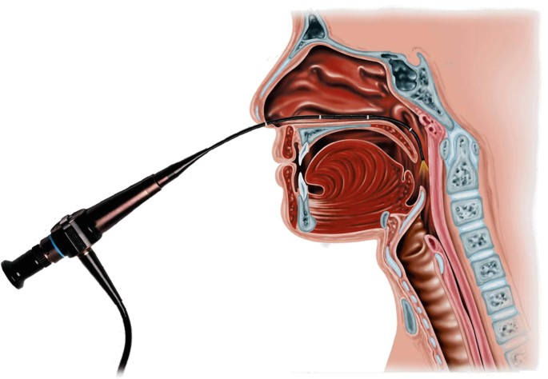
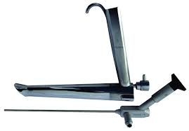
The diagnosis is made on visualization of the larynx either by using a rigid laryngoscope under general anaesthesia after securing of the airway in children or
by using a fibre-optic nasendoscope in awake adults

Slide 19
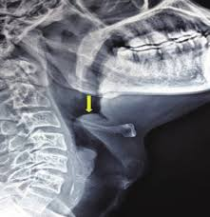
The lateral view on radiography of the soft tissue of the neck can show a swollen epiglottis, often known as a ‘thumbprint sign’.

Slide 20
Radiography is also useful to exclude retropharyngeal abscess, which is more common in children than in adults.

Slide 21
The differential diagnoses of acute epiglottitis include retropharyngeal abscess, laryngotracheobronchitis, foreign body, inhalation burns, corrosive ingestion, angioedema, parapharyngeal abscess, tonsillitis, pharyngitis and laryngeal carcinoma in adults.

Slide 22
Treatment
Hospitalization. Essential because of the danger of respiratory obstruction.
Antibiotics. Ampicillin or third generation cephalosporin are effective against H. influenzae and are given by parenteral route (i.m. or i.v.) without waiting for results of throat swab and blood culture.
Steroids. Hydrocortisone or dexamethasone is given in appropriate doses i.m. or i.v. They relieve oedema and may obviate need for tracheostomy.

Slide 23
Adequate hydration. Patient may require parenteral fluids.
Humidification and oxygen. Patient may require mist tent.
Intubation or tracheostomy. It may be required for respiratory obstruction.

Slide 24
LARYNGEAL DIPHTHERIA
AETIOLOGY
Mostly, it is secondary to faucial diphtheria affecting children below 10 years of age. Incidence of diphtheria in general is declining due to widespread use of immunization.

Slide 25
PATHOLOGY
Effects of laryngeal diphtheria are due to:
1. Formation of a tough pseudo membrane over the larynx and trachea which may completely obstruct the airway.
2. Exotoxin liberated by bacteria leading to myocarditis and various neurological complications

Slide 26
CLINICAL FEATURES
• General symptoms. Onset is insidious with low-grade fever (100–101°F), sore throat and malaise but patient is very toxaemic with tachycardia and thready plus .
• Laryngeal symptoms. Hoarse voice, croupy cough, inspiratory stridor, increasing dyspnoea with marked upper airway obstruction.
.

Slide 27
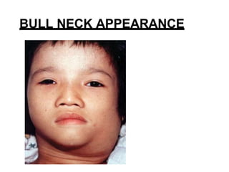
• Membrane. Greyish white membrane is seen on the tonsil, pharynx and soft palate. It is adherent and its removal leaves a bleeding surface. Similar membrane is seen over the larynx and trachea.
• Cervical lymphadenopathy. Characteristic “bull-neck” may be seen

Slide 28
DIAGNOSIS
Laryngeal diphtheria is mostly secondary to faucial diphtheria. Diagnosis is always clinical but confirmed by smear and culture of Corynebacterium diphtheriae.

Slide 29
TREATMENT
1. Diphtheria antitoxin. Dose depends on clinical severity and duration of illness, and varies from 20,000 to 100,000 units i.v. route as saline infusion after a test dose. It neutralizes free toxin circulating in the blood.
2. Antibacterials. Benzylpenicillin, 500,000 units i.m. every 6 h for 6 days, is effective against diphtheria bacilli. Erythromycin can be given to those who are allergic to penicillin.

Slide 30
Maintenance of airway. Tracheostomy may become essential. Direct laryngoscopy, removal of diphtheritic membrane and intubation can be done. Intubation relieves respiratory obstruction and can make subsequent tracheostomy easy.
4. Complete bed rest for 2–4 weeks is essential to guard against effects of myocarditis

Slide 31
COMPLICATIONS
1. Asphyxia and death due to airway obstruction.
2. Toxic myocarditis and circulatory failure.
3. Palatal paralysis with nasal regurgitation.
4. Laryngeal and pharyngeal paralysis.

Slide 32
chronic laryngitis
TUBERCULOSIS OF LARYNX
AETIOLOGY
It is almost always secondary to pulmonary tuberculosis, mostly affecting males in middle age group. Tubercle bacilli reach the larynx by bronchogenic or haematogenous routes.

Slide 33
PATHOLOGY
Disease affects posterior part of larynx more than anterior.
Parts affected are: (i) interarytenoid fold, (ii) ventricular bands, (iii) vocal cords and (iv) epiglottis, in that order. Tubercle bacilli, carried by sputum from the bronchi, settle and penetrate the intact laryngeal mucosa particularly in the interarytenoid region (bronchogenic spread).
This leads to formation of submucosal tubercles which may later caseate and ulcerate..

Slide 34
SYMPTOMS AND SIGNS
They would greatly depend on the stage of tuberculosis. Weakness of voice is the earliest symptom followed by hoarseness. Ulceration in the larynx gives rise to severe pain which may radiate to the ears. Swallowing is painful with marked dysphagia in later stages.

Slide 35
LARYNGEAL EXAMINATION
1. Hyperaemia of the vocal cord in its whole extent or confined to posterior part with impairment of adduction is the first sign.
2. Swelling in the interarytenoid region.
3. Ulceration of vocal cord giving mouse-nibbled appearance.
4. Superficial ragged ulceration on the arytenoids and interarytenoid region.

Slide 36
6. Granulation tissue in interarytenoid region or vocal process of arytenoid.
6. Pseudoedema of the epiglottis “turban epiglottis.”
7. Swelling of ventricular bands and aryepiglottic folds
8. Marked pallor of surrounding mucosa

Slide 37
DIAGNOSIS
In addition to X-ray chest and sputum examination, biopsy of laryngeal lesion is essential to exclude carcinoma and differentiate it from other condition

Slide 38
TREATMENT
Treatment is the same as for pulmonary tuberculosis. Voice rest is important

Slide 39
LUPUS OF THE LARYNX
Unlike tuberculosis of larynx which mostly affects posterior parts, lupus involves the anterior part of larynx.
Epiglottis is involved first and may be completely destroyed by the disease.
The lesion spreads to aryepiglottic folds and sometimes to ventricular bands.

Slide 40
Lupus of larynx is a painless and often an asymptomatic condition and may be discovered on routine laryngeal examination in cases of lupus of nose.
There is no pulmonary tuberculosis.
Treatment is ant tubercular drugs.
Prognosis is good

Slide 41
SYPHILIS OF THE LARYNX
It is a rare condition now.
Only gumma of tertiary stage is sometimes seen.
It may occur in any part of the larynx and present as a smooth swelling which may later ulcerate. Diagnosis is only on biopsy and serological tests. Laryngeal stenosis is a frequent complication

Slide 42
LEPROSY OF THE LARYNX
It is a rare condition and is often associated with leprosy of the skin and nose.
It presents as diffuse nodular infiltration of epiglottis, aryepiglottic folds and arytenoids.

Slide 43
Lesions may ulcerate.
It is associated with nasal leprosy.
Diagnosis is made on biopsy from the lesion.
Deformity of the laryngeal inlet and stenosis are the end results of this disease after healing.

Slide 44
SCLEROMA OF THE LARYNX
It is a chronic inflammatory condition caused by Klebsiella rhinoscleromatis.
Nasal involvement is very common in India.
Laryngeal involvement may be seen occasionally with or without a nasal lesion.
Typically, it presents as a smooth red swelling in the subglottic region.
Hoarseness of voice, wheezing and dyspnoea may be the presenting symptoms in addition to the nasal lesion.

Slide 45
Diagnosis is made on biopsy.
Treatment is by streptomycin or tetracycline, often combined with steroids to prevent fibrosis.
Subglottic stenosis is a frequent complication requiring subsequent reconstructive surgery

Slide 46
LARYNGEAL MYCOSIS
Fungal infections such as candidiasis, histoplasmosis and blastomycosis may rarely affect the larynx.
Diagnosis is usually made on biopsy and on finding a similar lesion in other parts of the body.

Slide 47
Reference
1.synopsis of otolaryngology
2. diseases of the ear , nose and throat.
3. handbook of otolaryngology

Slide 48
Thanks

