Slide 1
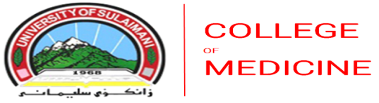
Nasal Polyps
Dr.Haval Ahmed Hama
MBChB, F.K.B.M.S
(Otolaryngology, Head and Neck Surgeon)
University of Sulaimani, College of Medicine.
Branch of clinical science.

Slide 2
Learning Outcomes
• Define nasal polyps and explain their pathogenesis.
• Classify nasal polyps according to site and etiology.
• Describe the pathology, clinical features, and management of Ethmoidal Polyps.
• Describe the pathology, clinical features, and management of Antrochoanal Polyps.
• Discuss complications, recurrence, and preventive strategies.

Slide 3
Definition
Nasal polyps:- are benign, edematous inflammatory swellings of the nasal or paranasal sinus mucosa.
They arise due to chronic inflammation, allergy, or mucociliary dysfunction.
They are non-neoplastic and often associated with chronic rhinosinusitis or asthma.

Slide 4
Etiology and Pathogenesis
Chronic mucosal inflammation leads to stromal edema and infiltration by eosinophils.
Prolapse of edematous mucosa into nasal cavity forms a polyp.
Contributing factors include:
– Allergy and asthma
– Aspirin intolerance (Samter’s triad)
– Chronic sinus infection
– Cystic fibrosis and ciliary dyskinesia
– Fungal sinusitis

Slide 5
Classification of Nasal Polyps
1.Ethmoidal polyps – Bilateral, multiple, allergic, arise from ethmoidal labyrinth.
2.Antrochoanal polyp – Solitary, unilateral, non-allergic, arises from maxillary sinus.
3.Fungal/inflammatory polyps – Associated with fungal or chronic infective sinusitis.
4.Secondary polyps – Arise secondary to neoplastic or anatomical obstruction.

Slide 6
Ethmoidal Polyps – Overview
• Arise from mucosa of ethmoidal labyrinth and middle meatus region.
• Usually bilateral and multiple.
• Associated with allergy, asthma, and chronic ethmoidal sinusitis.
• Common in adults.

Slide 7
Ethmoidal Polyps – Pathology
• Composed of edematous stroma with plasma cells, lymphocytes, and eosinophils.
• Covered by respiratory epithelium with thickened basement membrane.
• Lacks glands and nerves → insensitive to touch.
• Often multiple, may fill nasal cavity and reach nasopharynx.

Slide 8
Ethmoidal Polyps – Clinical Features
• Gradual, bilateral nasal obstruction.
• Watery nasal discharge and postnasal drip.
• Hyposmia or anosmia.
• Dull frontal headache and mouth breathing.
• Nasal speech, especially in children.

Slide 9
Ethmoidal Polyps – Examination & Investigations
• On endoscopy: smooth, glistening, pale masses in middle meatus.
• Move with respiration, insensitive, do not bleed.
• CT scan: opacified ethmoidal cells, possible extension into nasal cavity.
• Allergy testing if clinically indicated.

Slide 10
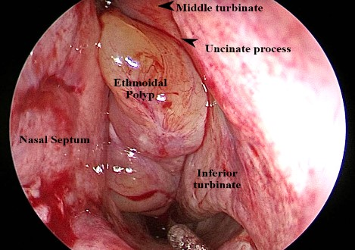

Slide 11
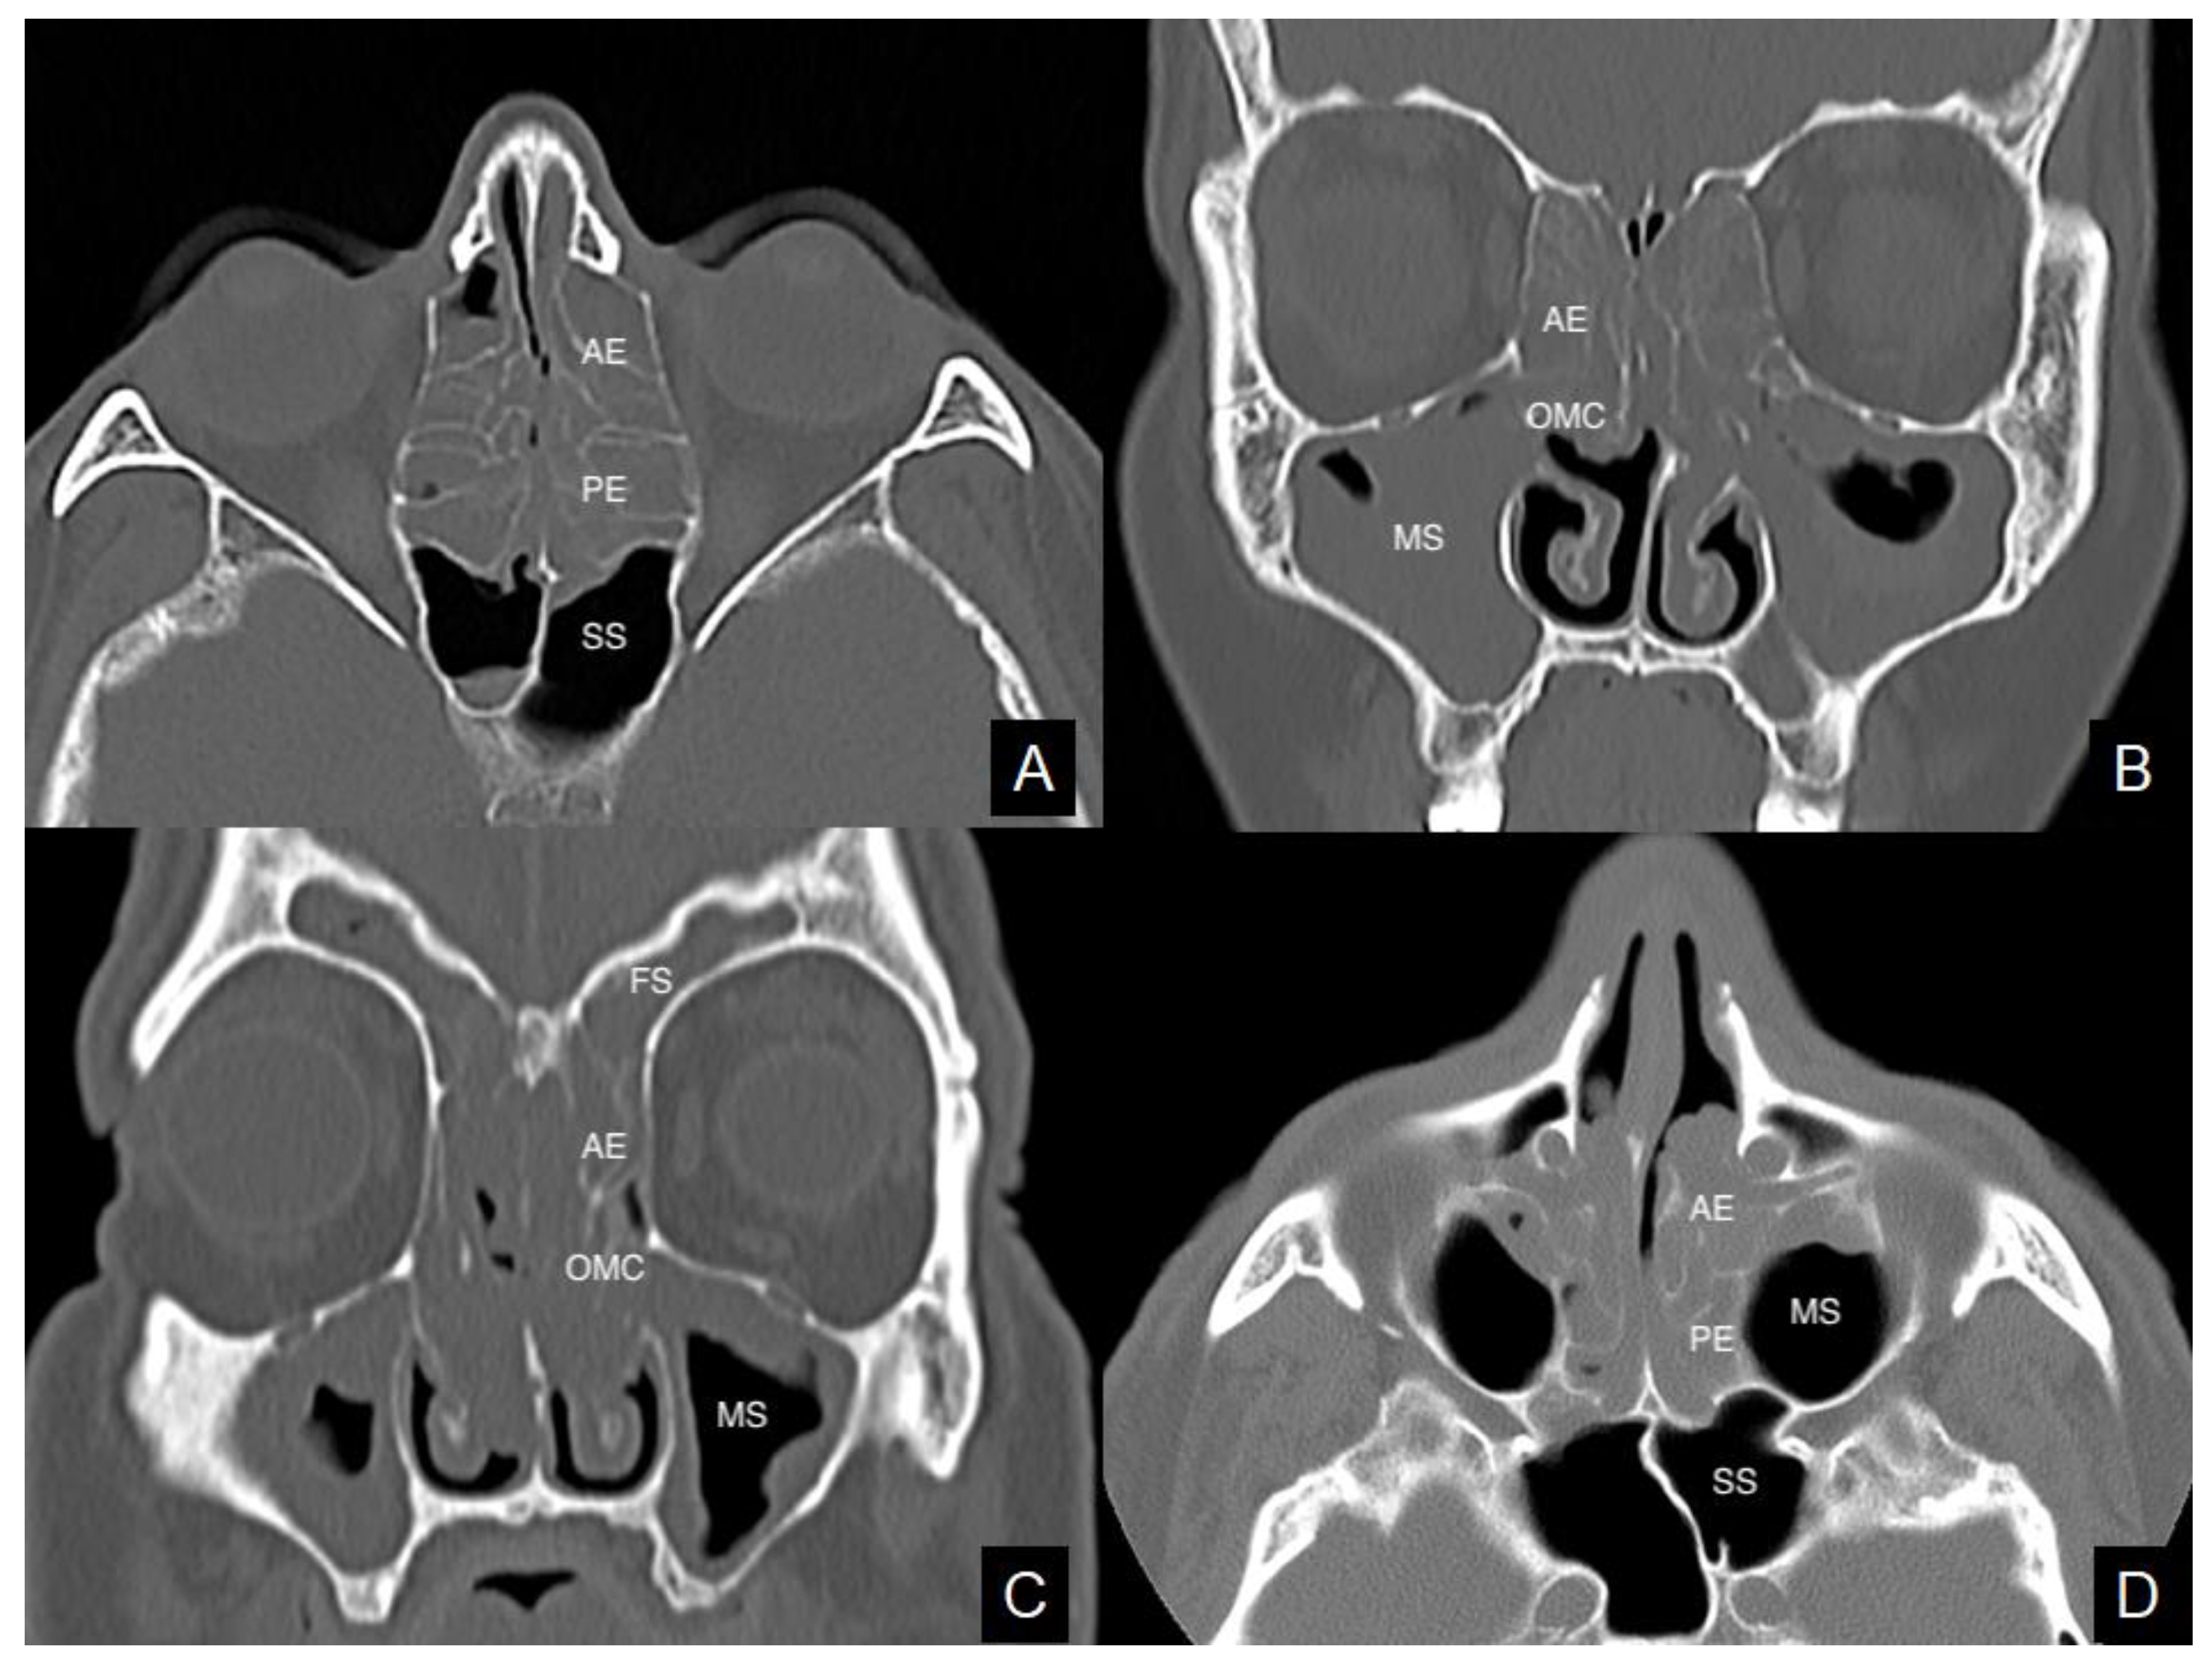

Slide 12
Ethmoidal Polyps – Management
Medical Treatment:
• Intranasal corticosteroids (mainstay)
• Short course of oral corticosteroids (for severe obstruction)
• Antihistamines and saline nasal irrigation
• Treat underlying allergy or infection
Surgical Treatment:
• Functional Endoscopic Sinus Surgery (FESS) to remove polyps and clear ethmoidal air cells.
• Aim: restore ventilation and drainage.

Slide 13
Antrochoanal Polyp – Definition and Epidemiology
• A solitary polyp originating from the maxillary sinus mucosa.
• Passes through the accessory or natural ostium into the nasal cavity and extends to the choana or nasopharynx.
• Common in children and young adults.
• Usually unilateral and non-allergic in origin.

Slide 14
Antrochoanal Polyp – Pathogenesis and Stages
Pathogenesis:
• Chronic infection in maxillary sinus → localized mucosal edema → pedunculated swelling → prolapse into nasal cavity.
Stages:
1. Antral stage – confined to maxillary sinus.
2. Nasal stage – extends into nasal cavity.
3. Choanal stage – extends into choana/nasopharynx.

Slide 15
Antrochoanal Polyp – Clinical Features
• Unilateral nasal obstruction.
• Mucous nasal discharge and snoring.
• Hyponasal speech.
• Mass visible in nasopharynx on endoscopy.
• May cause sleep disturbance or Eustachian tube dysfunction.

Slide 16
Investigations and Management
Investigations:
• Nasal endoscopy – confirms origin and extent.
• CT scan – shows single mass filling maxillary sinus and extending posteriorly.
Management:
• Surgical removal of antral and nasal portions.
• Functional Endoscopic Sinus Surgery (FESS) – preferred.
• Caldwell-Luc operation in adults for recurrence or inaccessible antral part (avoid in children).

Slide 17
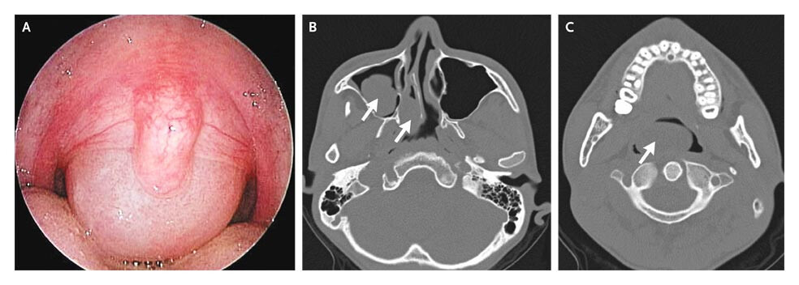

Slide 18
Ethmoidal polyp
Antrochoanal polyp
Mostly seen in adults
Nasal stuffiness leading to total nasal obstruction
Partial/total loss of smell
Headache (associated sinusitis)
On anterior rhinoscopy, polyps appear as – Smooth, glistening – Grape-like masses – Often pale in color – May be sessile or pedunculated – Insensitive to probing – Do not bleed on touch – Often multiple and bilateral
Purulent discharge (associated with sinusitis)
Unilateral nasal obstruction
Bilateral nasal obstruction – when polyp grows into the nasopharynx – starts obstructing the opposite choana
Thick and dull voice – hyponasality • Nasal discharge – mostly mucoid
On Anterior rhinoscopy - may be missed as it grows posteriorly ,Large, smooth, greyish mass covered with nasal discharge , Soft, can be moved up and down with the probe
Posterior rhinoscopy – Globular mass filling the choana or the nasopharynx – A large polyp may hang down behind the soft palate and present in the oropharynx

Slide 19
Complications and Prognosis
Complications:
• Chronic sinusitis
• Nasal deformity (rare)
• Secondary infection
• Recurrence (especially in ethmoidal type)
Prognosis:
• Excellent with complete surgical clearance and control of underlying allergy.
• Long-term intranasal steroid spray helps prevent recurrence.

Slide 20
Conclusion
• Nasal polyps are benign mucosal swellings due to chronic inflammation.
• Ethmoidal polyps – bilateral, allergic, multiple.
• Antrochoanal polyp – unilateral, solitary, from maxillary sinus.
• Management combines medical therapy with surgical removal (FESS).
• Recurrence prevention requires long-term topical steroid therapy.

Slide 21
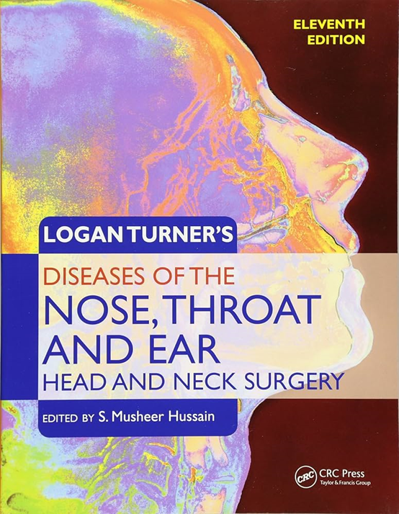
Source

