Slide 1
Inflammatory diseases of the pharynx
Muaid Ismaiel Aziz
Professor in Otorhinolaryngology–Head & Neck Surgery
Fellowship in Rhinology- Skull Base Surgery
MBChB , FICMS, FACS, DOHNS-Ed.

Slide 2
Symptomatology of Pharyngeal diseases
Sore throat
Dysphagia
Odynophagia
Cough
Halitosis
Aspiration
Referred otalgia
Voice change (Hyponasal, muffled voice, hoarseness)
Nasal obstruction
Epistaxis

Slide 3
Red flags
Unilaterality
Peroid exceed 4 wks
Progressive in nature
Weight loss
A sensation of a lump in the throat is a very frequent complaint. This may be an early symptom of cancer but is more commonly due to other things like globus pharyngeus

Slide 4
Examination
Post nasal mirror of NP
Endoscopy of NP (Rigid endoscopy, FNE)
Tongue depressor
Laryngeal mirror
Paplation of lateral pharngeal wall, base of tounge
Examination of neck (position, size, number, distribution and fixation)
For example, posterior triangle lymph nodes are often enlarged in viral illness, including mononucleosis and toxoplasmosis. Supraclavicular lymphadenopathy can be present in gastro-intestinal, lung and breast disease.

Slide 5
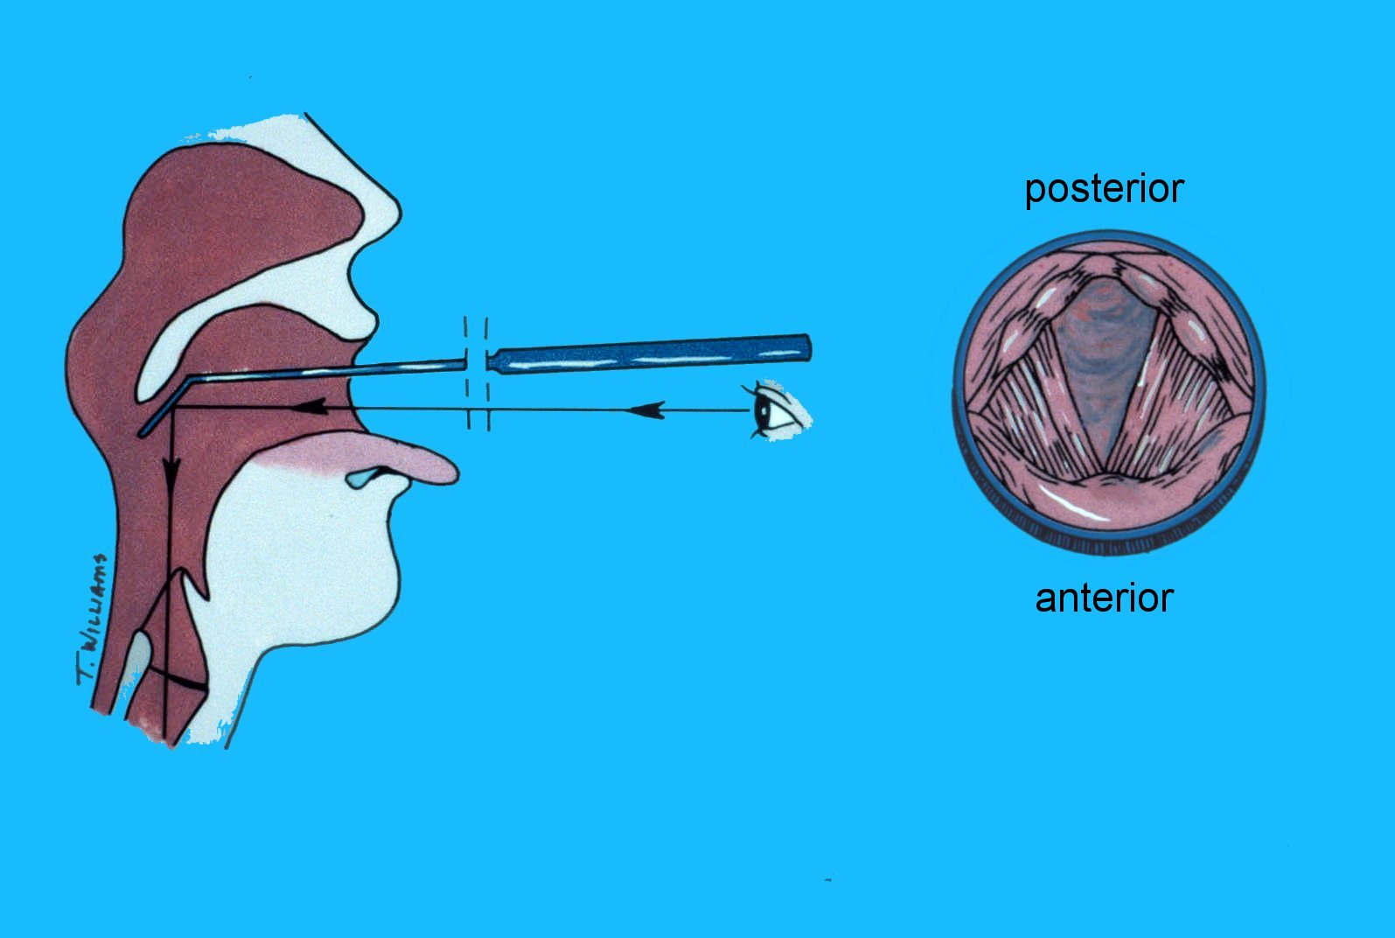
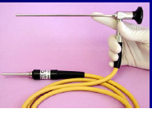
Indirect mirror
Telescopic

Slide 6
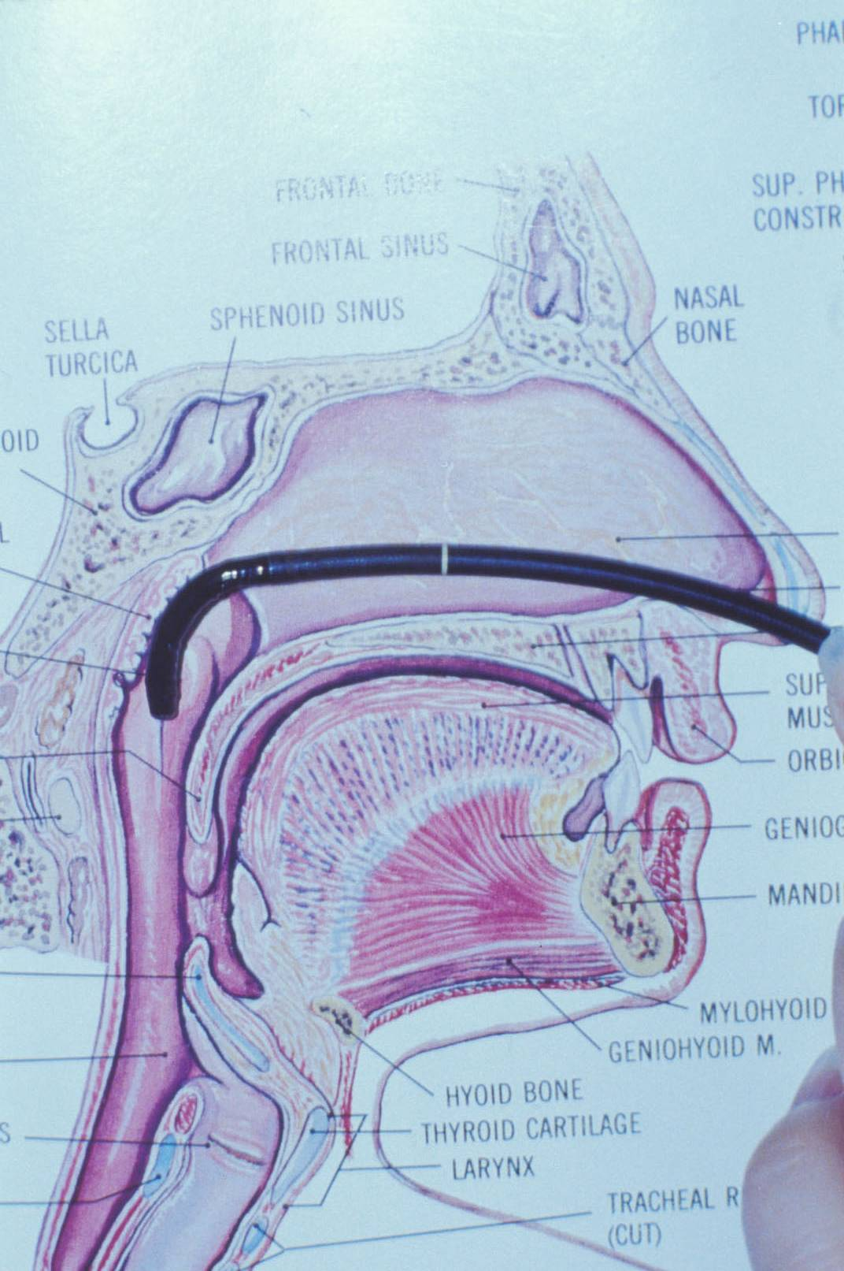
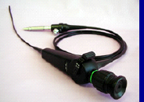
Fiberoptic laryngoscopy

Slide 7
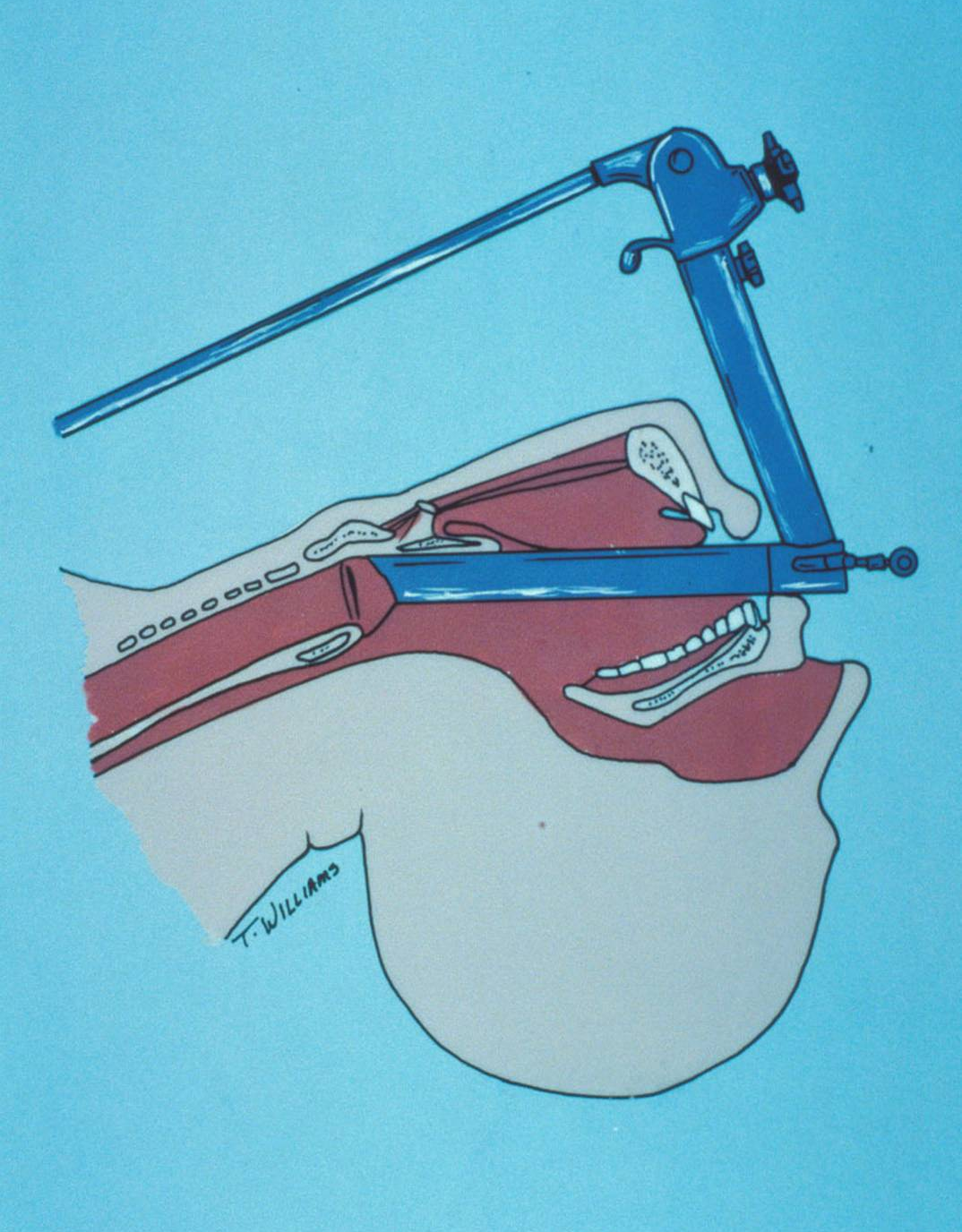
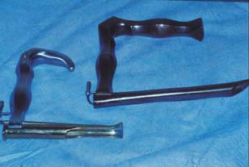
Direct Examination

Slide 8
The larynx must be examined during FNE with clear documentation of airway patency and vocal cord paralysis. The latter can occur with hypopharyngeal tumours (due to direct laryngeal invasion or nerve involvement in the neck) or nasopharyngeal tumours (nerve involvement at the skull base).
The ear drums should be examined for evidence of otitis media and other causes of referred pain. Tuning fork tests and audiometry may be helpful.
Horner’s syndrome and trismus suggest extrapharyngeal tumour spread.

Slide 9
Sore throat
Sore throat is not necessarily infectious in etiology. Non-infectious causes include:
Inhalation of dry air (mouth breathing)
Exposure to irritants, e.g. occupational exposure, cigarette smoking
Laryngopharyngeal reflux disease
Globus pharyngeus
In association with functional dysphonia
Pharyngeal and laryngeal cancer
Red flags’ should be sought (persistence, unilateral symptoms especially associated with otalgia, association with other symptoms, e.g. hoarseness and dysphagia.

Slide 10
Treatment
is
conservative

Slide 11
Pharyngitis & Adeno-tonsillar disease
Acute pharyngo-tonsillitis ((sore throat))
(a spectrum of conditions, from acute inflammation localized 1ry to the tonsils to acute pharyngitis involving whole pharynx)
Affect both sex, all ages, but more in children, more in 5-7 y, but can occur in ages below 3 years & above 50 y, Possibly due to people being exposed to new pathogens when starting school or when moving away from home.

Slide 12
Etiology
Viral 40-60% (rhinovirus, adenovirus, coxsackievirus, parainfluenza virus and coronavirus.) (Epstein-Barr virus (EBV), causing infectious mononucleosis, human immune deficiency virus (HIV), and cytomegalovirus (CMV).
Bacterial 5-30%
GABHS is the most common bacterial pathogen
No pathogen isolated 30%

Slide 13
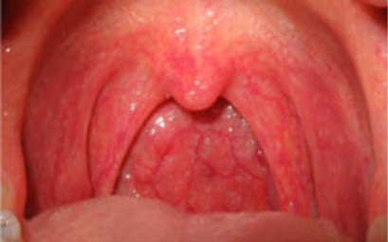
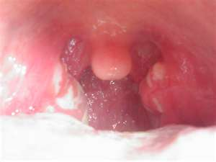
Clinical finding
Clinical differentiation of viral from GABHS infection is rarely possible.
Sore throat is present in all with the classical history of sore throat, fever, chills, malaise, headache, anorexia, abdominal pain.
Cough, sneezing, rhinorrhea
Signs: enlarged congested tonsil +/- membranous exudate which will not differentiate viral from bacterial infection.
Pharyngeal erythema, soft palate petechiae, cervical LAP.
Pharyngitis w lower respiratory tract infection specially when present w persistent non productive cough.

Slide 14
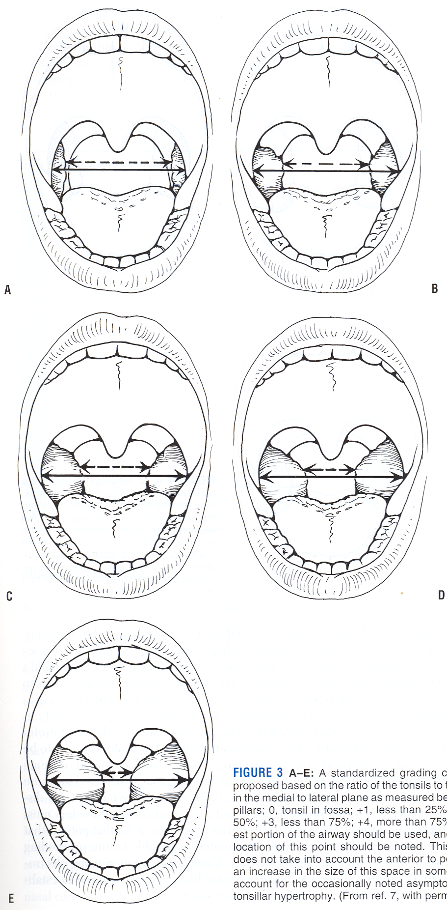
Grading the Size of Tonsils
Grading system:
0 – tonsils in fossa
+1 – tonsils less than 25%
+2 – tonsils less than 50%
+3 – tonsils less than 75%
+4 – tonsils greater than 75%

Slide 15
D.DX of Pharyngeotonsilitis
IMN:
Kissing membranous tonsillitis
Stertor, and airway obstruction
A short-lived maculopapular rash, splenomegaly and rarely hepatomegaly and cranial neuropathies, Upper eyelid oedema.
Investigations: Abnormal lymphocytes, Serological evidence of IgM-specific antibodies to viral capsid antigen is the gold standard for diagnosis.
Treatment is supportive;
No ampicillin, no sports for 6 weeks
Steroid may be useful in kissing tonsils
Tonsillectomy in case of AWO, and bleeding
Infections
Non infectious
Tumors

Slide 16
Treatment
Reassurance, rest and plenty of fluids
Analgesia
Steroids
Antibiotics
The role of antibiotics is controversial, with no good evidence that routine treatment with antibiotics leads to more rapid resolution of symptoms. In a patient who is clinically deteriorating, antibiotics may be prescribed.
Penicillin V is the first-line treatment in such cases.
Ampicillin-based antibiotics should be avoided because a rash may develop if the tonsillitis is caused by EBV.
The indications for hospital referral include dysphagia and the development of symptoms of respiratory obstruction.

Slide 17
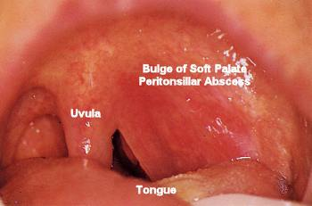
Complications
Non suppurative
Acute rheumatic fever
Glomerulonephritis
Suppurative
Peritonsillar infection
Parapharyngeal space abscess
Retropharyngeal space abscess

Slide 18
Chronic Adeno-tonsillar hypertrophy
Manifesting as various degree of airway obstruction in children
Small at birth, enlarged over 4 y
AWO
ENURESIS
GROWTH PROBLEM
CARDIOPULMONARY COMPLICATIONS
CRANIOFACIAL GROWTH ABNORMALTIES

Slide 19
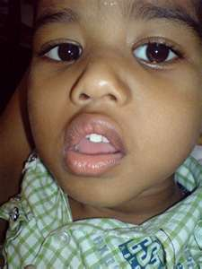
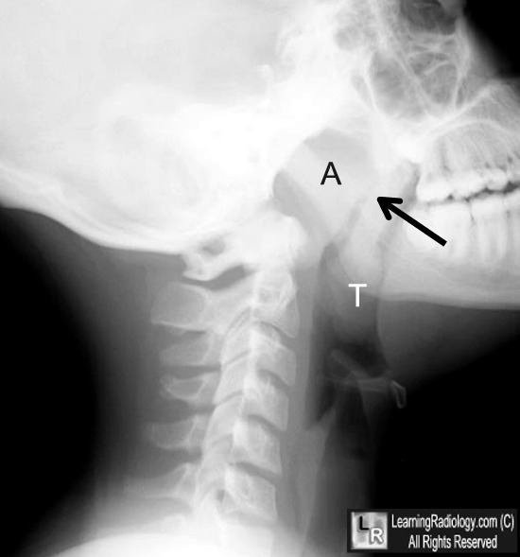
DIAGNOSTIC ASSEESMENT OF ADENOTONSILITIS
Physical exam.
Craniofacial stigmata (Open mouth breathing, elongated face, dark circles under the eyes & dental malocclusion)
Hypo-nasal speech
Tonsil size
lymphadenopathy
Investigation
Evaluation of adenoid tissue?

Slide 20
Indications for TS
infection
Recurrent acute tonsillitis
Recurrent acute tonsillitis associated w other conditions (CVD, recurrent febrile convulsion)
Chronic tonsillitis that unresponsive to the medical treatment or associated w halitosis, persistent sore throat, tender cervical adenitis
Peritonsillar abscess
Streptococcal carrier unresponsive to medical treatment
Tonsillitis associated w abscessed cervical nodes
IMN w severely obstructing tonsil unresponsive to medication

Slide 21
Obstruction
Excessive snoring & chronic mouth breather
OSA or sleep disturbances
Adeno-tonsillar hypertrophy w core pulmonale, failure to thrive, dysphagia, speech abnormalities, Craniofacial growth anomalies & occlusion anomalies
Others (tumors)

Slide 22
Surgical indications for adenoidectomy
Infection
Purulent adenoiditis
Adenoid hypertrophy associated w COM w effusion, chronic recurrent AOM, COM w perforation, with or without otorrhea
Obstruction
same of indication of the tonsillectomy
Others; chronic sinusitis

Slide 23
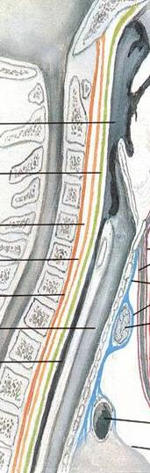
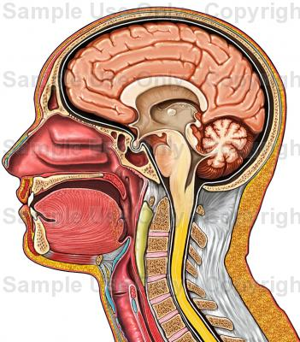
Retropharyngeal abscess
Predominantly in childhood after URTI
90% in < 6 y
In adults (trauma, extension from other spaces, TB)

Slide 24
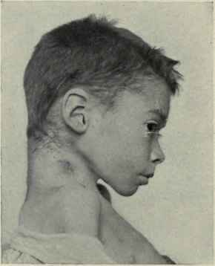
Clinical manifestations
Retropharyngeal space abscess
Sore throat / dysphagia / stiff neck
torticollis
Excessive drooling
Fever, tachypnoea
LAP
Bulging posterior pharyngeal wall
Upper airways obstruction

Slide 25
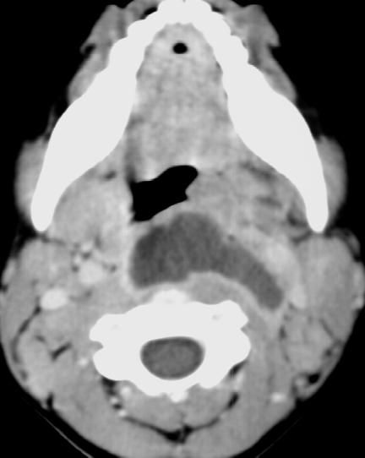
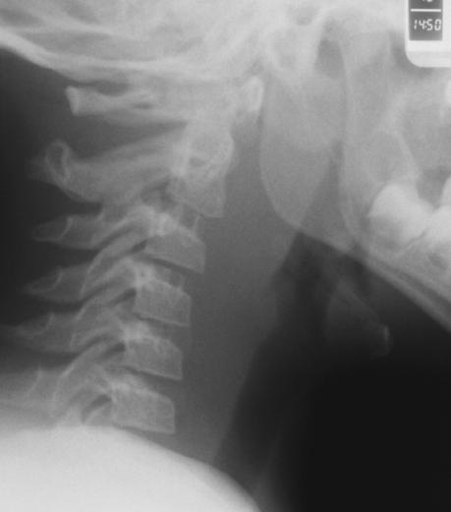
Investigations

Slide 26
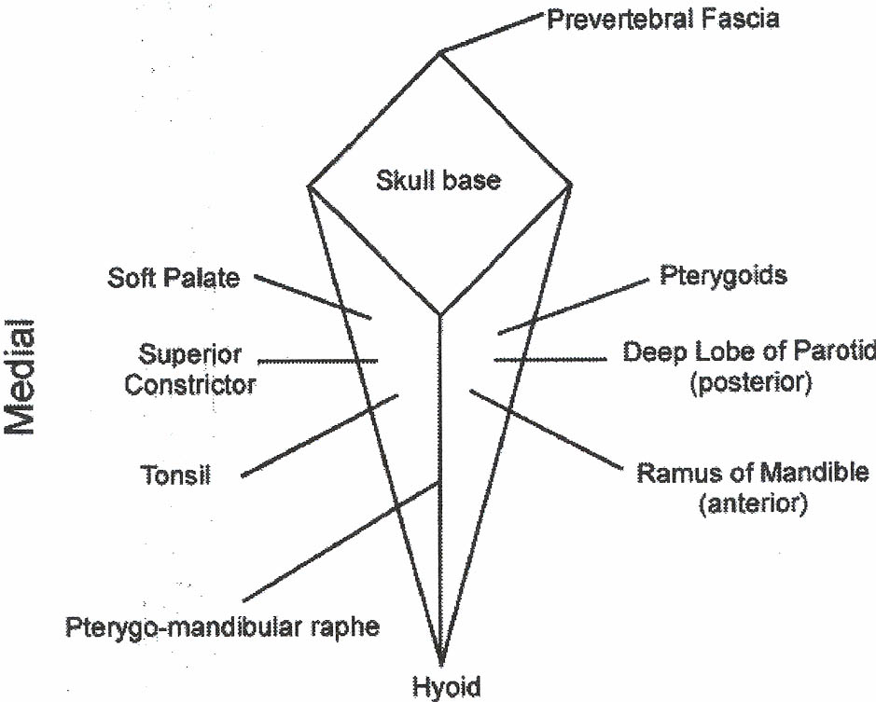
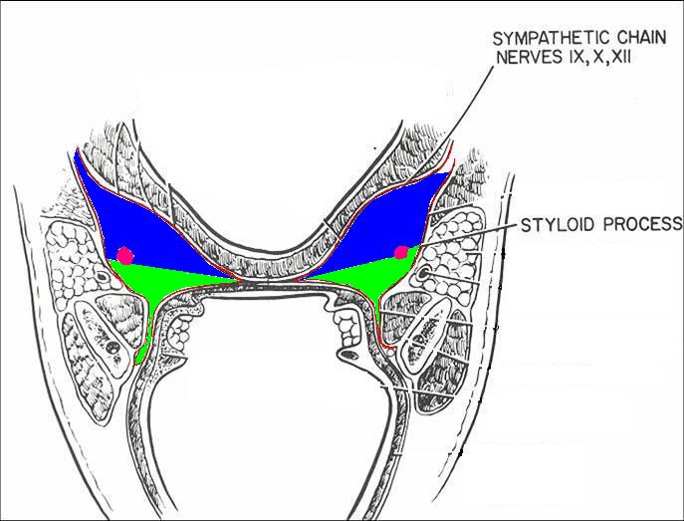
Parapharyngeal space
Pre-styloid
  Muscular compartment
  Medial—tonsillar fossa
  Lateral—medial pterygoid
  Contains fat, connective tissue, nodes
Post-styloid
  Neurovascular compartment
  Carotid sheath
  Cranial nerves IX, X, XI, XII
  Sympathetic chain

Slide 27
Presentation
Pre-styloid
Post-styloid
Fever, chills
Neck pain
Odynophagia
Trismus
Swelling below angle of the mandible
Medial displacement of lateral pharyngeal wall
Sepsis syndrome w little pain & swelling
IX-XII
Ipsilateral Horner's syndrome

Slide 28
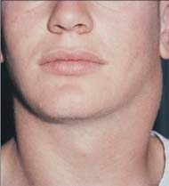
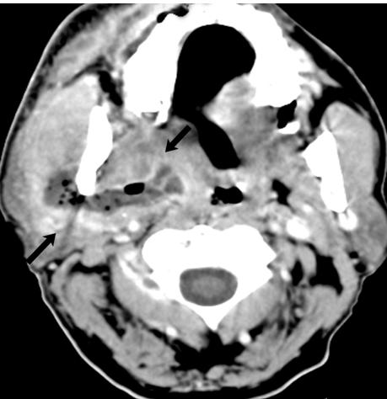
Parapharyngeal space abscess

Slide 29
Treatment
Secure airway
Fluid replacement
IV AB for up to 48 hrs
Surgery for
Most deep abscess(airway obstruction)
Sepsis syndrome
No response to AB

Slide 30
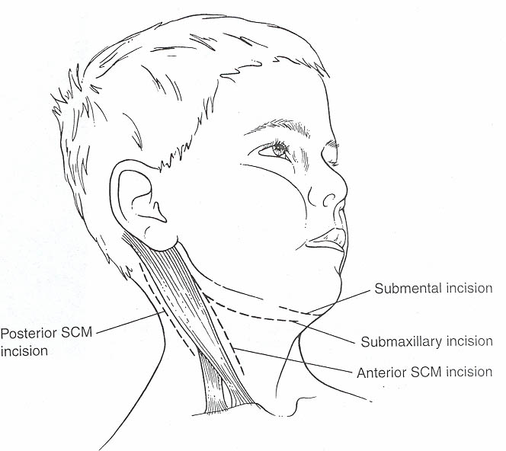
Surgery
External drainage
  Landmarks
    Tip of greater horn of hyoid
    Cricoid cartilage
    Styloid process
    SCM
Transoral drainage
  Parapharyngeal, retropharyngeal abscesses
  Great vessels lateral to abscess
  Tonsillectomy for exposure

Slide 31
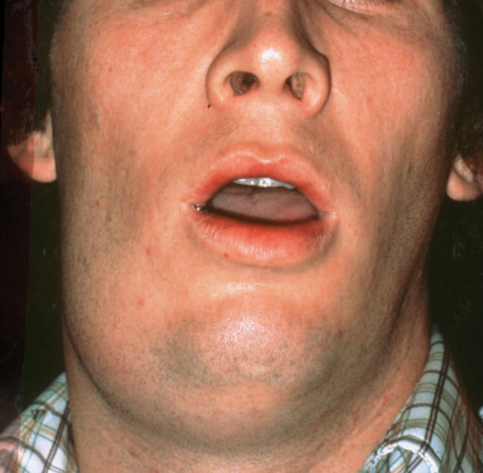
Angina???? Ludwig's
Involvement submental, submandibular & sublingual spaces bilaterally
Rapid spreading, firmly indurated cellulitis originated intraorally
Erythema, tenderness, firm edema without fluctuance
Tissue fluid non purulent
Rapid spread to lateral pharyngeal / retropharyngeal space
Rapidly obstruct upper airway
Treatment is
IV AB
Close airway monitoring
Surgery for debridement & decompression

Slide 32
thanks

