Slide 1

VITAL VIEW
AI-Powered Nail-Based Health Screening
Final Year Project
Presented by:
L1F22BSCS0667 Qasim Naseer
L1F22BSCS0641 Badar Shahbaz
L1F22BSCS1182 Fahad Tanveer
Introduction
AI-based mobile/web app to detect nail and related internal diseases from images.

Slide 2
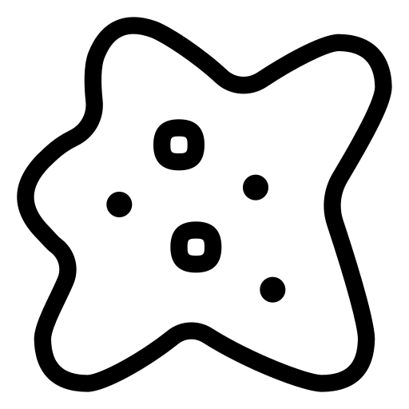
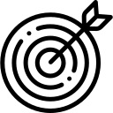
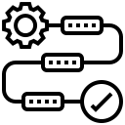






VITAL VIEW
Introduction:
Medical Relevance:
An AI-powered mobile and web application that analyzes nail images to detect early signs of various nail and internal diseases using machine learning.
Nail changes often signal systemic conditions. Early detection is critical, yet such signs are frequently overlooked due to lack of awareness and diagnostic tools.

Slide 3
VITAL VIEW
Introduction:
Medical Relevance:
Identified Problem:
An AI-powered mobile and web application that analyzes nail images to detect early signs of various nail and internal diseases using machine learning.
Nail changes often signal systemic conditions. Early detection is critical, yet such signs are frequently overlooked due to lack of awareness and diagnostic tools.
No accessible tool exists for automated nail disease detection. Patients often miss early warning signs, delaying treatment and diagnosis of serious conditions.

Slide 4
VITAL VIEW
Existing Solutions VS Vital View
Medical Relevance:
Identified Problem:
Tool / Study | Focus | Limitation | Vital View
NailNet | Onychomycosis only | Single disease focus | Covers multiple conditions
SkinVision | Skin lesion detection | Not nail-specific | Nails are core input
DermAssist | General dermatology | Nails excluded | Nail-specific AI
Academic Models | Nail image classification | No real-world deployment | Usable app with real data
Nail changes often signal systemic conditions. Early detection is critical, yet such signs are frequently overlooked due to lack of awareness and diagnostic tools.
No accessible tool exists for automated nail disease detection. Patients often miss early warning signs, delaying treatment and diagnosis of serious conditions.

Slide 5
VITAL VIEW
Existing Solutions VS Vital View:
Aims & Objectives
Identified Problem:
Tool and Research | Focus | Limitation | Vital View
NailNet | Onychomycosis only | Single disease focus | Covers multiple conditions
SkinVision | Skin lesion detection | Not nail-specific | Nails are core input
DermAssist | General dermatology | Nails excluded | Nail-specific AI
Academic Models | Nail image classification | No real-world deployment | Usable app with real data
Build an AI model to classify nail diseases.
Deploy via mobile/web for real-time screening.
Achieve 80–90% diagnostic accuracy.
No accessible tool exists for automated nail disease detection. Patients often miss early warning signs, delaying treatment and diagnosis of serious conditions.

Slide 6
VITAL VIEW
Existing Solutions VS Vital View:
Internal Illnesses Reflected in Nail Changes:
Tools and Research | Focus | Limitation | Vital View
NailNet | Onychomycosis only | Single disease focus | Covers multiple conditions
SkinVision | Skin lesion detection | Not nail-specific | Nails are core input
DermAssist | General dermatology | Nails excluded | Nail-specific AI
Academic Models | Nail image classification | No real-world deployment | Usable app with real data
Aims & Objectives:
Melanoma Skin cancer (melanoma spread to organs)
Onychomycosis Diabetes, peripheral vascular disease
Psoriatic. Psoriatic arthritis, autoimmune disorders
Onychogryphosis. Diabetes, poor circulation, neurological impairment
Clubbing. Lung diseases (COPD, cancer), heart failure, liver, IBD
Pitting Psoriasis, alopecia areata, immune system dysfunction
Blue Finger Hypoxia ,Heart/Lung Failure , Circulatory disorders
Build an AI model to classify nail diseases.
Deploy via mobile/web for real-time screening.
Achieve 80–90% diagnostic accuracy.

Slide 7
VITAL VIEW
Aims & Objectives:
Internal Illnesses Reflected in Nail Changes:
Development Stack:
5,000 labeled nail images (8 categories)
Build an AI model to classify nail diseases.
Deploy via mobile/web for real-time screening.
Achieve 80–90% diagnostic accuracy.
Melanoma Skin cancer (melanoma spread to organs)
Onychomycosis Diabetes, peripheral vascular disease
Psoriatic. Psoriatic arthritis, autoimmune disorders
Onychogryphosis. Diabetes, poor circulation, neurological impairment
Clubbing. Lung diseases (COPD, cancer), heart failure, liver, IBD
Pitting Psoriasis, alopecia areata, immune system dysfunction
Blue Finger Hypoxia ,Heart/Lung Failure , Circulatory disorders
Dataset
📱 Frontend
Mobile: React Native
Web: React.js
🧠 AI Model
Model: CNN
Framework: TensorFlow / PyTorch
☁️ Backend & Cloud (Firebase)
Database: Firestore
Storage: Firebase Storage (images)
Auth: Firebase Authentication
API: Firebase Cloud Functions

Slide 8
VITAL VIEW
Internal Illnesses Reflected in Nail Changes:
Development Stack:
Anticipated Results:
5,000 labeled nail images (8 categories)
Melanoma Skin cancer (melanoma spread to organs)
Onychomycosis Diabetes, peripheral vascular disease
Psoriatic. Psoriatic arthritis, autoimmune disorders
Onychogryphosis. Diabetes, poor circulation, neurological impairment
Clubbing. Lung diseases (COPD, cancer), heart failure, liver, IBD
Pitting Psoriasis, alopecia areata, immune system dysfunction
Blue Finger Hypoxia ,Heart/Lung Failure , Circulatory disorders
Dataset
Accurate AI model (80-90% target accuracy).
User-friendly mobile app for real-time screening.
Early-warning tool to prompt medical consultation.
📱 Frontend
Mobile: React Native
Web: React.js
🧠 AI Model
Model: CNN
Framework: TensorFlow / PyTorch
☁️ Backend & Cloud (Firebase)
Database: Firestore
Storage: Firebase Storage (images)
Auth: Firebase Authentication
API: Firebase Cloud Functions

Slide 9
VITAL VIEW
Development Stack:
Expected Results:
Conclusion:
5,000 labeled nail images (8 categories)
Dataset
Accurate AI model (80-90% target accuracy).
User-friendly mobile app for real-time screening.
Early-warning tool to prompt medical consultation.
This AI-powered app enables early detection of nail and internal health issues, supporting both users and healthcare professionals with fast, scalable screening via mobile and web
📱 Frontend
Mobile: React Native
Web: React.js
🧠 AI Model
Model: CNN
Framework: TensorFlow / PyTorch
☁️ Backend & Cloud (Firebase)
Database: Firestore
Storage: Firebase Storage (images)
Auth: Firebase Authentication
API: Firebase Cloud Functions

Slide 10
VITAL VIEW
Anticipated Results:
Conclusion:
Accurate AI model (80-90% target accuracy).
User-friendly mobile app for real-time screening.
Early-warning tool to prompt medical consultation.
This AI-powered app enables early detection of nail and internal health issues, supporting both users and healthcare professionals with fast, scalable screening via mobile and web

Slide 11
VITAL VIEW
Thank you
Conclusion:
This AI-powered app enables early detection of nail and internal health issues, supporting both users and healthcare professionals with fast, scalable screening via mobile and web

