Slide 2
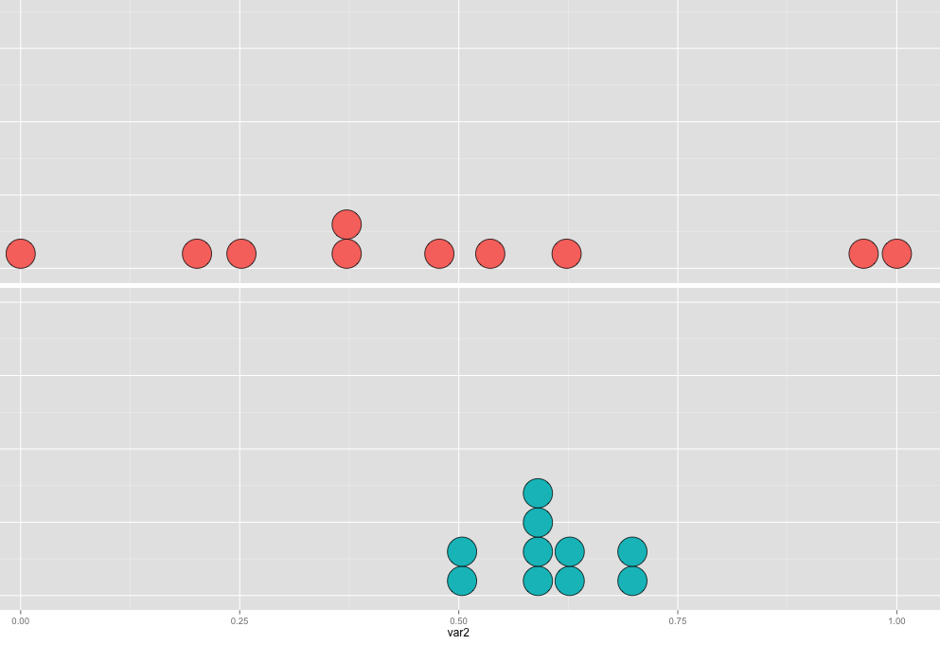
Measuring consistency
Low consistency
High consistency

