Slide 1
Dice Game

Slide 2
Outline
Introduction
Benefits
Problem statement
Flowchart
System calls
Conclusion

Slide 3
Introduction
A simple dice game involving file handling and synchronization through signals.
Three players play the game involving a referee. It continues until one of them scores 50 points.

Slide 4
Problem statement
Synchronization, each player should wait for his/her turn to roll the dice.
This is not possible when different parts of code are operating independently.
Different process require access to the same data.

Slide 5
Proposed methodology
One process is created for each player.
Each player’s process is dependent on the main parent process.
Only one process is under execution at a time due to signals sent by parent process.
All other processes are waiting.
A file is created which is accessible to all the processes, the file keeps track of each player’s points.
The program ends when the referee function send the termination signals to all the processes (occurs when one of the players scores 50 points) .

Slide 6
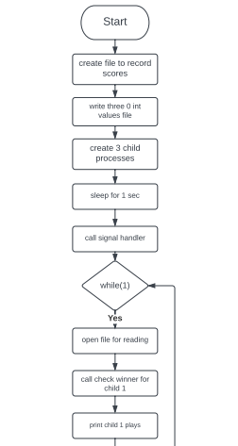
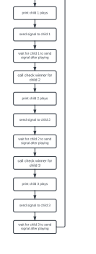
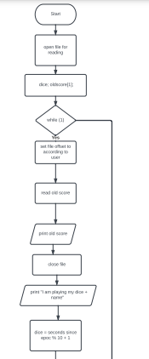
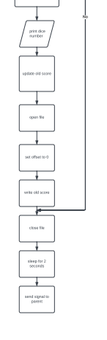
Flowcharts

Slide 7
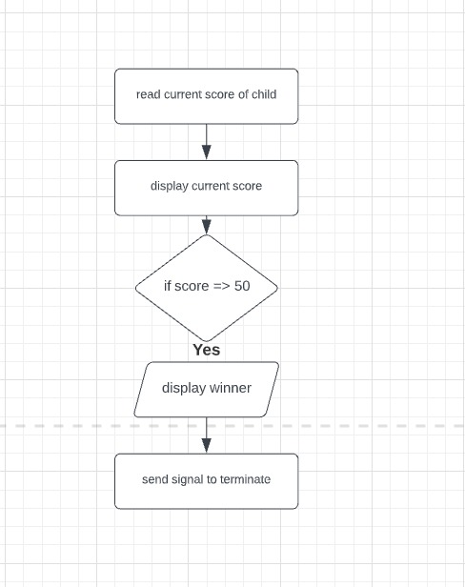
Flowcharts CoNT

Slide 8
System calls
system calls used in this project are given below:
Open
Close
Read
write
fork
Time
Sigaction
Lseek
Kill
sleep
getppid

Slide 9
conclusion
After implementing this project we learn the basic concepts of how can we use system calls to obtain specific kernel functionalities.
This is achieved by creating and reading/writing from/to files and communicating between processes through signals.

Slide 10
Thank you

