Slide 1
Rational Numbers Arithmetic in MIPS Assembly
Qaasid Bajwa CSC 21000
10/15/24

Slide 2
Introduction
Overview of the program
User inputs two rational numbers (numerator/denominator)
Supports four operations: addition, subtraction, multiplication, and division
Handles division by zero errors

Slide 3
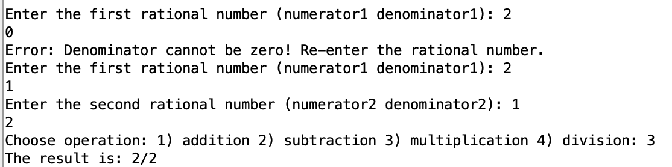
Program Structure
Input Handling: Reads two rational numbers
Operation Selection: Prompts user to choose an arithmetic operation
Arithmetic Operations: Performs the selected operation
Error Handling: Prevents division by zero
Output: Prints the result as a rational number

Slide 4
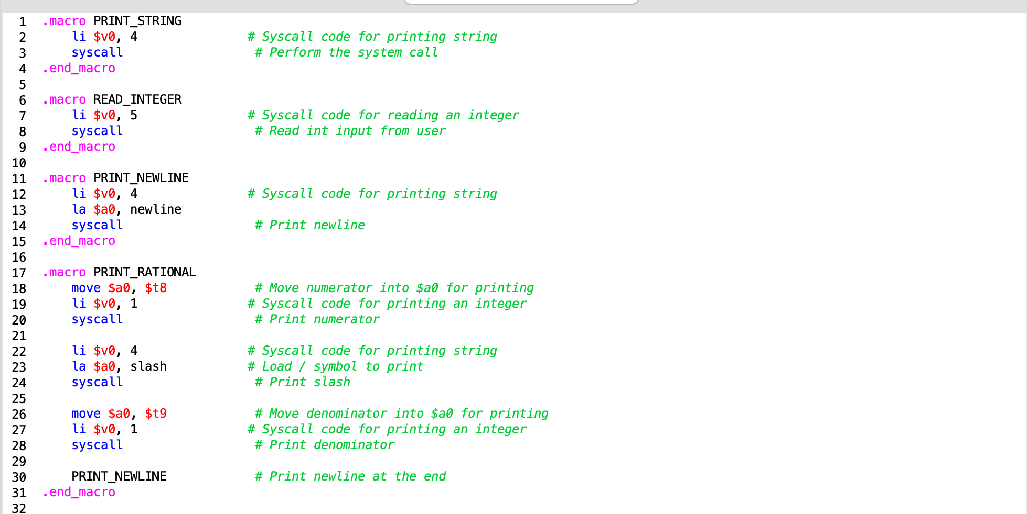
Macro Definitions
PRINT_STRING: Prints a string
READ_INTEGER: Reads integer input
PRINT_NEWLINE: Prints a newline character
PRINT_RATIONAL: Prints rational number as numerator/denominator

Slide 5
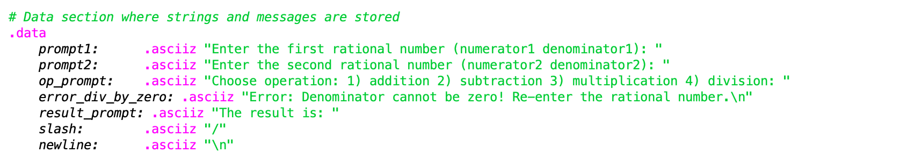
Data Section
Stores strings for prompts and error messages
Example: Prompt for input, operation choices, error messages for division by zero

Slide 6
Main Logic
Start: The program begins execution and prepares to prompt the user for input.
Get First Rational Number: The program displays a message asking the user to input the first rational number, consisting of a numerator and denominator. After receiving the inputs, the program checks if the denominator is zero. If it is zero, the program displays an error message and asks the user to re-enter the first rational number.
Get Second Rational Number: The program then prompts the user to input the second rational number. Again, it checks if the denominator is zero. If the denominator is zero, it displays an error message and asks the user to re-enter the second rational number.
Operation Selection:The program asks the user to select an arithmetic operation: addition, subtraction, multiplication, or division. The user inputs their choice, and the program reads and stores the selection.

Slide 7
Main Logic (cont.)
Perform Arithmetic Operation:
Based on the user's choice, the program performs the corresponding arithmetic operation:
Addition: It cross-multiplies the numerators with the opposite denominators and adds the results. The denominators are also multiplied to get the common denominator.
Subtraction: Similar to addition, but it subtracts the cross-multiplied numerators.
Multiplication: The numerators are multiplied together, and the denominators are multiplied together.
Division: The program multiplies the numerator of the first fraction by the denominator of the second fraction, and the denominator of the first fraction by the numerator of the second.
Print Result: The program prints the resulting rational number in the form numerator/denominator.
Error Handling: If, at any point, a denominator of zero is entered (in either rational number input or during division), the program displays an error message and asks the user to re-enter valid inputs.
End: The program terminates with a system exit once the result is displayed or if an invalid operation is selected.

Slide 8
Error Handling
Prevents division by zero
Prints error message and prompts user to re-enter rational numbers
Includes jumps to error handlers

Slide 9
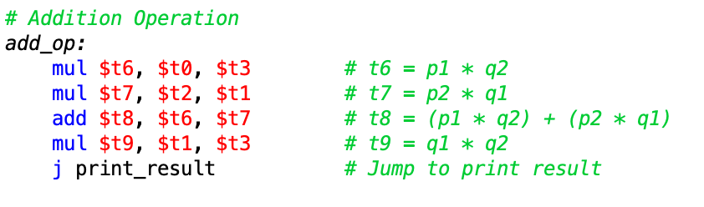
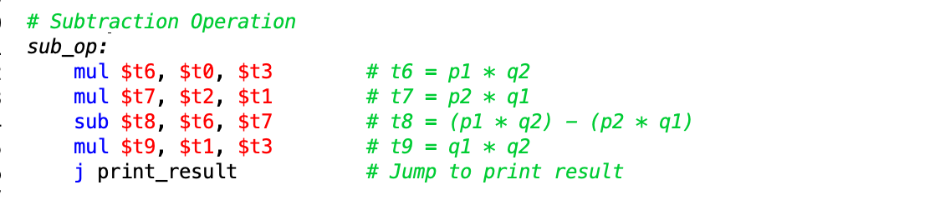
Rational Arithmetic Operations
Operations on Rational Numbers
The program supports four arithmetic operations on rational numbers:
Addition: Code: The addition operation is computed by multiplying across denominators and adding the cross-products of numerators.
Subtraction: Code: Subtraction follows the same logic as addition, except it subtracts the cross-products.

Slide 10
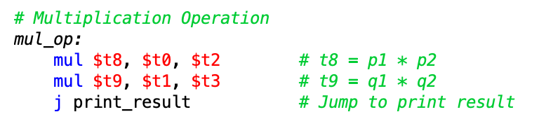
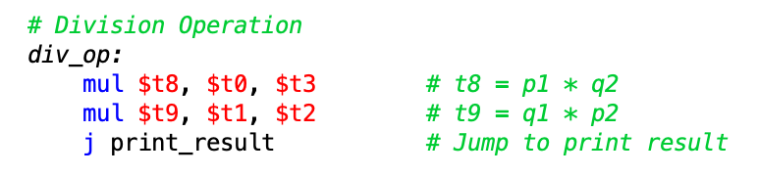
Rational Arithmetic Operations (cont.)
Multiplication: Code: Simple multiplication of numerators and denominators.
Division: Code: Flip the second fraction and multiply.

Slide 11
Conclusion
Comprehensive Rational Arithmetic: The program successfully performs rational number arithmetic (addition, subtraction, multiplication, and division) by managing inputs, computing results, and outputting the correct results in the form of fractions.
Efficient Use of Macros: The use of macros like PRINT_STRING, READ_INTEGER, and PRINT_RATIONAL simplifies repetitive tasks, making the program more efficient and reducing code redundancy.
Effective Error Handling: Error handling ensures robustness. Specifically, division by zero, which is a common issue in rational arithmetic, is addressed by validating inputs and preventing invalid operations.
Streamlined User Interaction: The program's interaction with the user is streamlined with clear prompts and immediate error feedback, enhancing the user experience by guiding them through valid input and operations.
Future Improvements:
Possible improvements include extending the program to handle larger inputs (overflows) or further optimizing the division process to handle mixed fractions or improper fractions.

