Slide 1
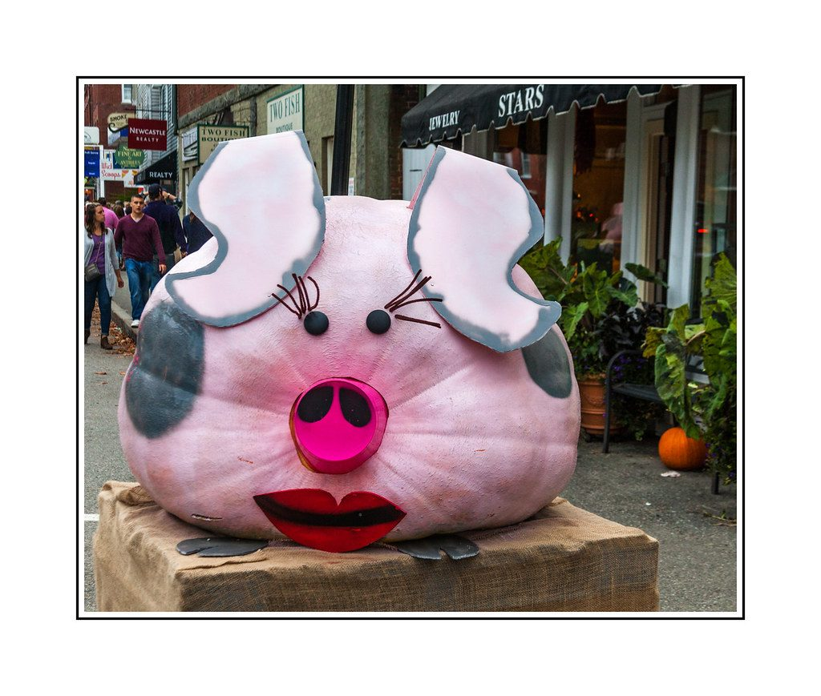
Environmental variation
YEAR 9 SCIENCE · 9A GENETICS AND EVOLUTION · LESSON 1 OF 7
Why do the same kind of organism come in so many sizes, shapes and colours?
Exploring Science International 9 · Student Book pages 5 to 7 · Workbook pages 3 to 4
Notes:
Welcome to 9A, Genetics and evolution. This unit asks where variation comes from, how it is passed on, and how it drives evolution. Today: variation caused by the environment.

Slide 2
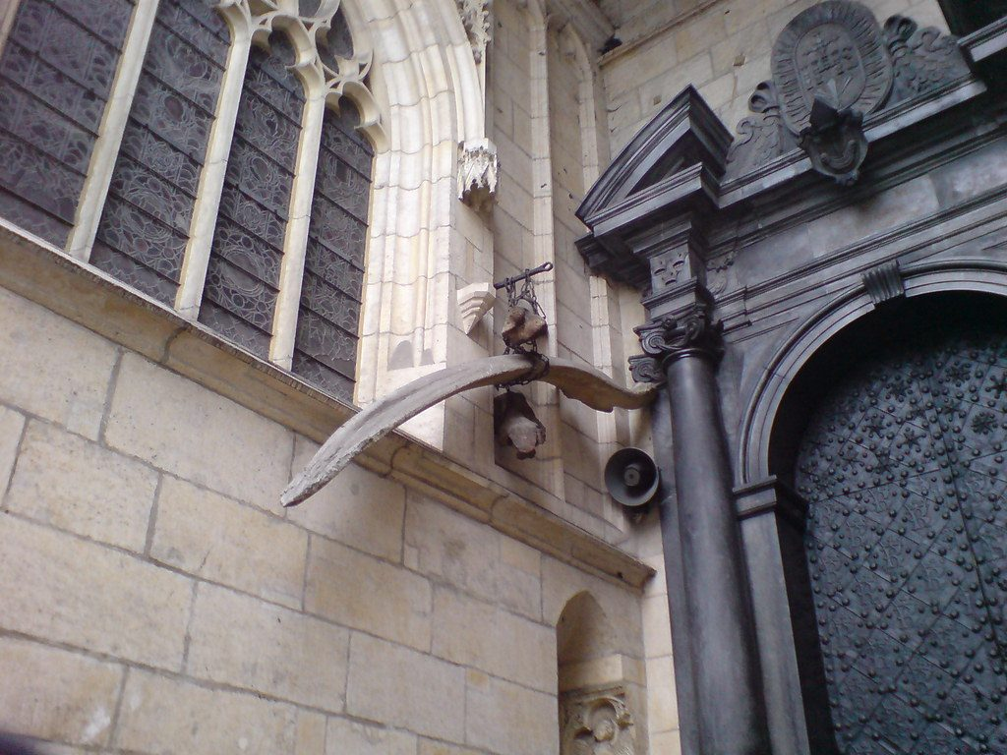
Do Now: the dragon of Krakow
DO NOW
4
min
A story says these bones are from a fire-breathing dragon killed by Krak, a shoemaker's apprentice.
1. What animals could the bones really be from?
2. What does 'extinct' mean?
3. Name one species that is extinct.
The 'dragon bones' outside Wawel Cathedral, Krakow
Image: nedrichards, CC BY-SA 2.0, via Wikimedia Commons
Notes:
Four minutes, in books. The bones are probably from a whale and a mammoth. Myths often started when people found bones of extinct animals they could not explain. Extinct: no living members of the species are left. Take examples: dinosaurs, dodo, mammoth, thylacine.

Slide 3
Today
TODAY
Today I can ...
I can describe abiotic and biotic environmental factors and give examples of environmental variation.
I can tell continuous variation from discontinuous variation, and explain why environmental variation can make classification difficult.
Key words today
species
extinct
environment
abiotic factor
biotic factor
characteristic
variation
environmental variation
continuous variation
discontinuous variation
classification
Meanings are in the key words box on your worksheet.
Notes:
Read each goal aloud. Point out the key words box on the worksheet. Students with the Chinese key words sheet have the same words with Chinese beside them.

Slide 4
Monster pumpkins
HOOK
These pumpkins can have a mass of over 1000 kg. They did not get this big by chance. What did the growers give the plants?
Talk to a partner for one minute. Make a list.
A giant pumpkin, painted for a show
Image: Me in ME, CC BY 2.0, via Wikimedia Commons
Notes:
Expected: extra light, water, warmth, mineral salts (fertiliser), space, no weeds or pests. Everything on the list is part of the plant's environment. Keep the list on the board for the next slide.

Slide 5
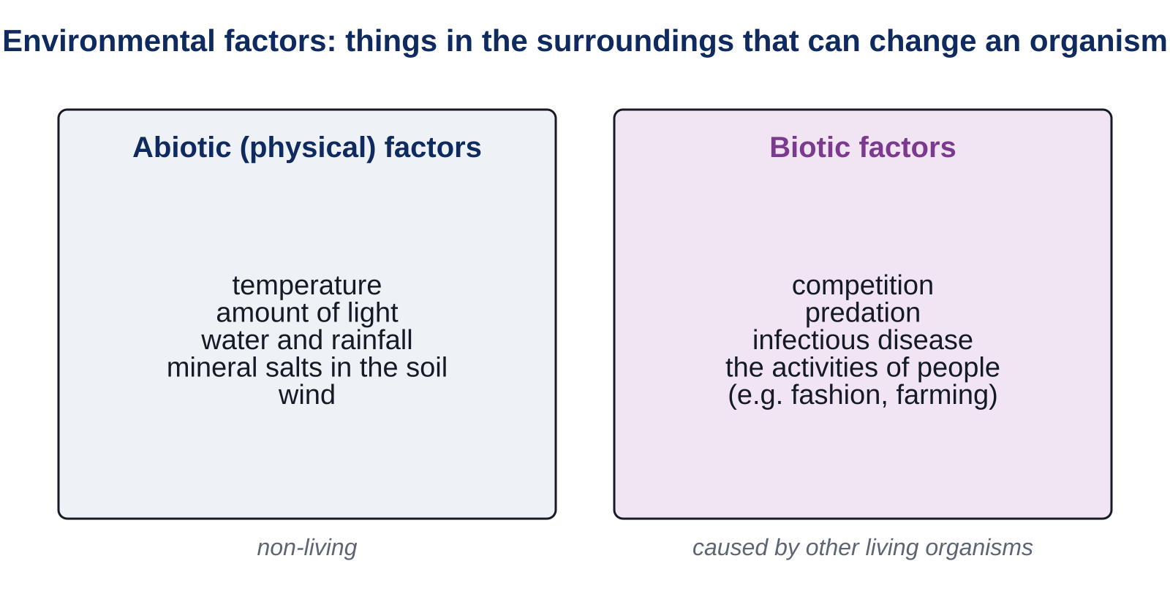
Environmental factors
LEARN
An organism's surroundings are its environment.
Environmental factors can change an organism.
Abiotic (physical) factors are non-living: temperature, light, water, mineral salts.
Biotic factors are the activities of other organisms: competition, predation, infectious disease.
Key idea Abiotic = non-living parts of the surroundings. Biotic = caused by other living things.
Key words environment · abiotic factor · biotic factor
Notes:
Go back to the pumpkin list: sort it into abiotic (light, water, warmth, mineral salts) and biotic (no weeds competing, no pests, the grower's care). Ask: what abiotic and biotic factors are in this classroom right now?

Slide 6
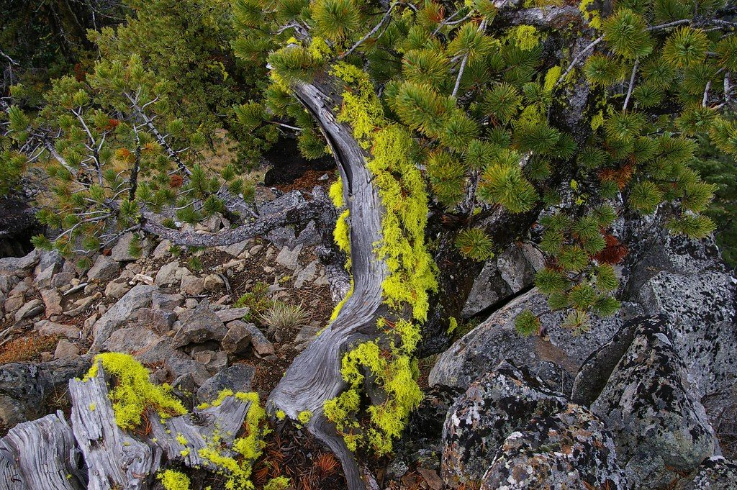
Environmental variation
LEARN
The features of an organism are its characteristics.
Variation is the difference between the characteristics of organisms.
Environmental variation is caused by the environment.
Examples: a scar (caused by a sharp object), a hairstyle (fashion), a tree bent by the wind, a pale plant grown in the dark.
A tree bent and stunted by the wind (krummholz)
Image: brewbooks, CC BY-SA 2.0, via Wikimedia Commons
Key idea Environmental variation is not passed on to offspring.
Key words characteristic · variation · environmental variation
Notes:
A scar is caused by a physical factor; a hairstyle by other people (a biotic factor). Ask students for two more examples each. Stress: the wind-bent tree's seeds will grow into straight trees in a sheltered place.

Slide 7
Continuous or discontinuous?
LEARN
Continuous variation
Discontinuous variation
Can have any value between two points.
Examples: height, mass, leaf length, pumpkin size.
Put the measurements into groups.
Bar chart with no gaps between the bars.
Often gives a bell shape (a normal distribution).
Only a limited set of values.
Examples: blood group, scar or no scar, number of petals.
Count how many in each group.
Bar chart with gaps between the bars.
Key idea Ask: could the value be anything in between? If yes, it is continuous.
Key words continuous variation · discontinuous variation
Notes:
Pumpkin mass can be any value from tiny to enormous: continuous. Whether a plant has a scar on its stem is yes or no: discontinuous. Show the chart shapes on the worksheet when students plot the potato data.

Slide 8
Quick check
CHECK
Mini whiteboards or fingers. One answer each, then we check.
Q1 Temperature: abiotic or biotic factor?
Q2 A scar on your hand: environmental or inherited variation?
Q3 Hand span: continuous or discontinuous variation?
Q4 Whether a person can roll their tongue: continuous or discontinuous?
Q5 Predation: abiotic or biotic factor?
Notes:
Answers: abiotic; environmental; continuous; discontinuous; biotic. Ask a student to give a reason for Q3 and Q4 using 'any value' or 'limited set of values'.

Slide 9
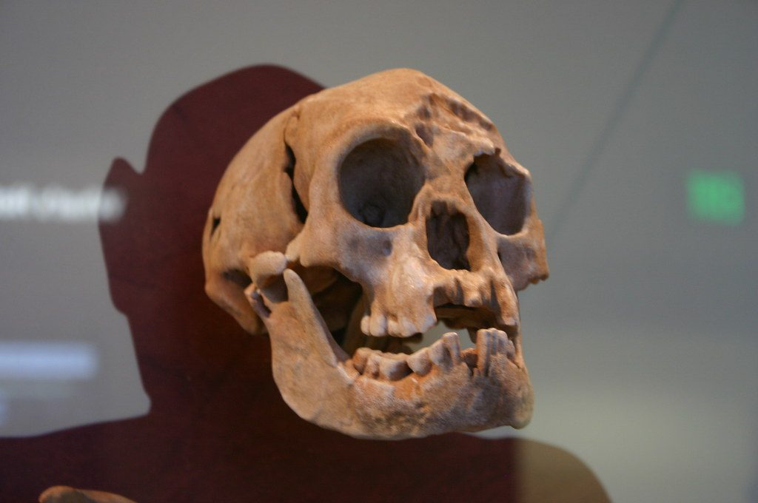
Species and classification
LEARN
Classification is sorting organisms into groups. The smallest group is the species.
Members of a species can reproduce together, and their offspring can also reproduce.
Environmental variation can make classification difficult.
Flores Island, 2003: adult human bones just over 1 m tall. Our species with a poor diet (no iodine), or a different, extinct species?
A skull from Flores Island, Indonesia
Image: Ryan Somma, CC BY-SA 2.0, via Wikimedia Commons
Key idea Same species = can breed together and the offspring can breed too.
Key words species · classification
Notes:
Some scientists think the Flores people were our species but did not grow tall because their diet lacked iodine (an environmental factor). Others think they were a separate species, now extinct. Ask: what evidence would help decide? (DNA from the bones, more skeletons, teeth and bone structure.)

Slide 10
Your turn: the potato data
DO
14
min
1
Core: match the key words, sort the factors, then tally and plot the potato masses on the grid.
2
Grouped continuous data: the bars touch. Label both axes and give the chart a title.
3
Stretch: examples of environmental variation; continuous or discontinuous; why do the potatoes vary?
4
Challenge: the seashore plants and the Flores Island bones.
5
Finished? Write a question for the class in the My thinking box.
Work alone first. Check your bar chart with a partner before Stretch.
Notes:
The potato data are on the worksheet. Common errors: leaving gaps between bars for grouped continuous data; forgetting units (g) on the axis label. Circulate and check tallies add up to 20.

Slide 11
Same species or not?
THINK AND REFLECT
Seashore plants: 10 cm tall with pink flowers. On a nearby island: over 50 cm tall with dark purple flowers. Seeds from both were grown in a laboratory. They all grew to look the same. What does this tell you?
Sentence frames
The plants from the two areas are probably ___ because ___.
The differences in height and colour were caused by ___.
This makes it difficult to ___ because ___.
Notes:
Expected: the plants are the same species. The differences were environmental variation (wind, soil, light, salt). This makes it difficult to identify species from how plants look in the wild. Link back to the Flores bones.

Slide 12
Exit ticket
EXIT TICKET
4
min
On your worksheet exit ticket. Work alone. Hand it in as you leave.
1. Give one abiotic factor and one biotic factor in a pond.
2. Is a scar an example of inherited or environmental variation?
3. Is foot length continuous or discontinuous variation? Give a reason.
Notes:
Answers: e.g. temperature or light (abiotic) and predation or competition (biotic); environmental; continuous, because foot length can be any value between two points. Collect the strips: they show who has the continuous/discontinuous idea before Lesson 2 adds inherited variation.

Slide 13
What we learned
SUMMARY
Environmental factors are abiotic (non-living) or biotic (other organisms).
Environmental variation is caused by the surroundings and is not inherited.
Continuous variation can take any value; discontinuous variation has a limited set of values.
A species is a group that can breed together; environmental variation can make classifying organisms difficult.
Next lesson Inherited variation: why offspring look like their parents, and why brothers and sisters are not identical.
Notes:
Homework: Workbook pages 3 and 4 (9Aa). Students with the Chinese key words sheet may answer in either language but should use the English key words.

