Slide 1
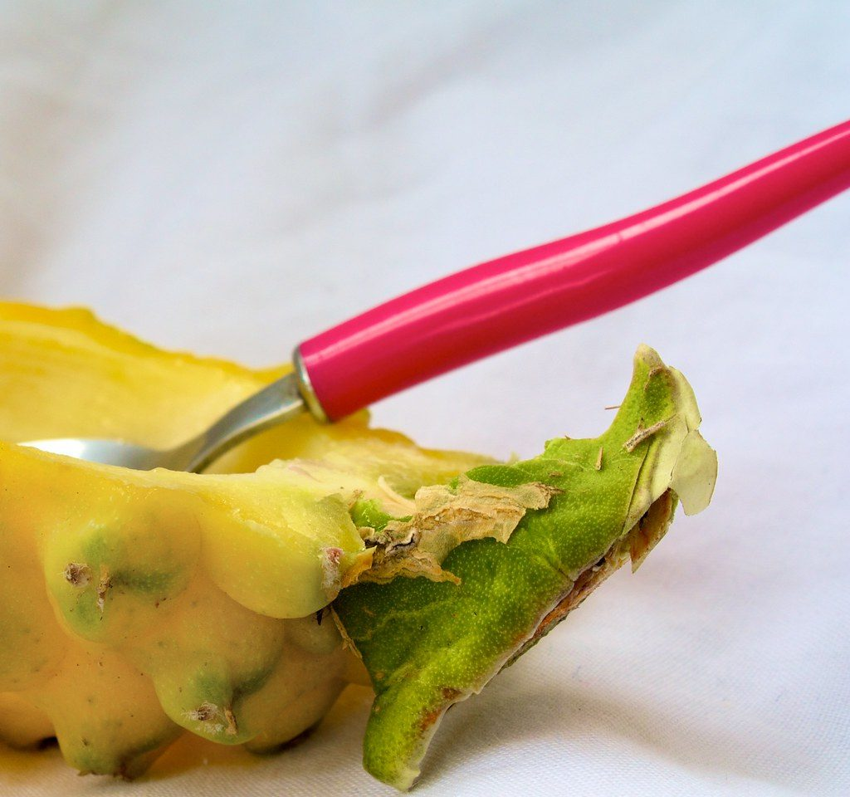
Inherited variation
YEAR 9 SCIENCE · 9A GENETICS AND EVOLUTION · LESSON 2 OF 7
Why do offspring look like their parents, and why are brothers and sisters not identical?
Exploring Science International 9 · Student Book pages 8 to 9 · Workbook pages 5 to 6
Notes:
Last lesson: variation caused by the environment. Today: variation that is inherited, where it comes from, and how we plot it.

Slide 2
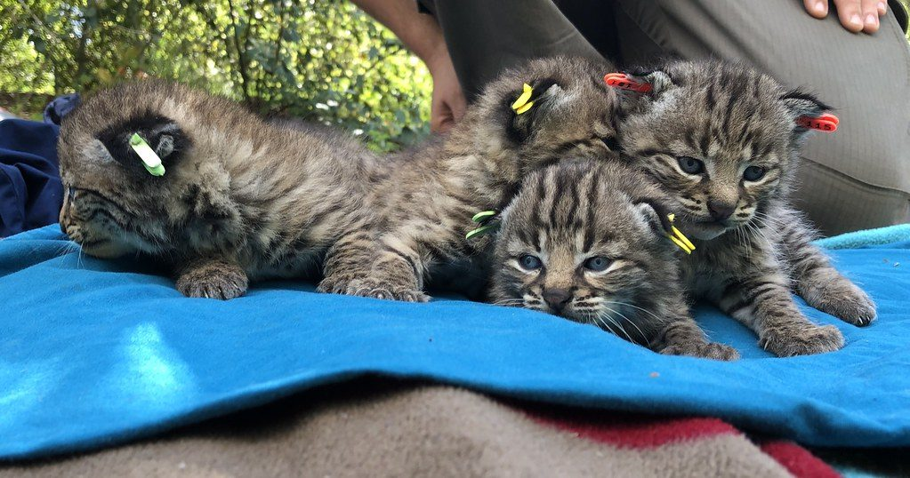
Do Now: a litter of kittens
DO NOW
4
min
1. Give two ways these kittens vary from each other.
2. Which of these differences did they inherit from their parents?
3. From last lesson: is a scar inherited or environmental variation?
Kittens from one litter
Image: Santa Monica Mountains National Recreation Area, Public domain, via Wikimedia Commons
Notes:
Expected: coat colour and pattern, size, eye colour. Coat colour and pattern are inherited; size is partly inherited and partly how much they have eaten. A scar is environmental. Four minutes, in books.

Slide 3
Today
TODAY
Today I can ...
I can give examples of inherited variation and explain how sexual reproduction causes it.
I can sort inherited variation into continuous and discontinuous, and recognise a normal distribution.
Key words today
inherited variation
offspring
genetic information
gene
nucleus
gamete
fertilisation
zygote
continuous variation
discontinuous variation
normal distribution
Meanings are in the key words box on your worksheet.
Notes:
Read each goal aloud. Point out that six of today's key words are about how inherited variation is passed on: genetic information, gene, nucleus, gamete, fertilisation, zygote.

Slide 4
Dragon fruit
HOOK
Dragon fruit come in different skin colours, flesh colours and sizes. Give three examples of inherited variation in dragon fruit.
Then decide: which of these could a grower change by giving the plants more water or light?
A yellow-skinned dragon fruit (pitaya) with white flesh
Image: Tijs Zwinkels, CC BY-SA 2.0, via Wikimedia Commons
Notes:
Skin colour (pink or yellow), flesh colour (white, red), seed pattern and shape are inherited. Size and sweetness can be changed by the environment (water, light, warmth), so they are caused by both. Collect answers in one minute.

Slide 5
Inherited variation
LEARN
Offspring get a mixture of characteristics from their parents. We say they inherit them.
Inherited variation: natural eye colour, dimpled chin, blood group.
Environmental variation (a scar, a hairstyle) is not inherited.
Some characteristics are caused by both: tall parents have tall children only if the children eat well.
Kittens inherit coat colour from both parents
Image: Santa Monica Mountains National Recreation Area, Public domain, via Wikimedia Commons
Key idea Inherited characteristics are passed on in genetic information from both parents.
Key words inherited variation · offspring
Notes:
Ask for three inherited characteristics of their own. Push on 'both': height, skin colour and body mass are inherited and affected by the environment. A learned skill such as speaking Chinese is environmental only.

Slide 6
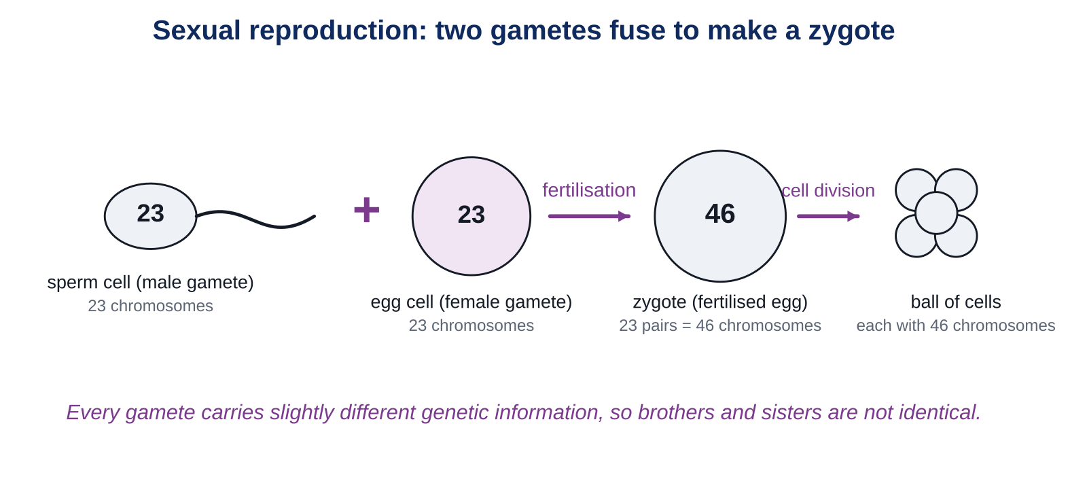
Where inherited variation comes from
LEARN
Genetic information is stored in genes, in the nucleus of each cell.
In sexual reproduction two gametes (one male, one female) fuse at fertilisation to make a zygote.
The zygote has genetic information from both parents.
Every gamete is slightly different, so brothers and sisters are not identical.
Key idea Two different gametes fuse, so each offspring gets its own mixture of the parents' genetic information.
Key words genetic information · gene · nucleus · gamete · fertilisation · zygote
Notes:
Walk through the diagram left to right: sperm cell, egg cell, fertilisation, zygote, cell division. Ask: why can two children of the same parents have different eye colours? Because each gamete carries a different selection of the parent's genetic information.

Slide 7
Inherited variation can be continuous or discontinuous
LEARN
Discontinuous (inherited)
Continuous (inherited and environment)
Blood group: A, B, AB or O. Nothing in between.
Dimpled chin: yes or no.
Tongue rolling, attached ear lobes.
Usually caused by genes only.
Bar chart with gaps.
Height, hand span, skin colour.
Any value between two points.
Affected by genes and by diet, sunlight or exercise.
Group the data; bars touch.
Often a bell shape.
Key idea Discontinuous: a limited set of values. Continuous: any value, and usually many genes plus the environment.
Key words continuous variation · discontinuous variation
Notes:
Shoe size is a good trap: feet show continuous variation, but shoes only come in certain sizes, so shoe size is discontinuous. Students meet this on the worksheet.

Slide 8
Discontinuous data: blood groups
LEARN
Only four possible values, so the bars have gaps.
Which blood group is most common?
Roughly what percentage of this sample has group A?
Could anyone be 'between' A and B?
Key idea Discontinuous data go on a bar chart with gaps between the bars.
Key words discontinuous variation
Notes:
Answers: group O; 1750 out of 5000 is 35%; no, blood group has a limited set of values. The Scotland figures are typical of the UK population.

Slide 9
Continuous data: a normal distribution
LEARN
Heights are grouped, so the bars touch.
Join the tops of the bars: a bell shape. This is a normal distribution.
Most students are near the middle; very tall and very short students are rare.
Key idea Grouped continuous data often give a bell-shaped normal distribution.
Key words continuous variation · normal distribution
Notes:
Ask which group holds the most students (160 to 164 cm) and how many students are 175 cm or taller (12). Students draw a curve like this on the worksheet Challenge.

Slide 10
Quick check
CHECK
Genes, environment, or both? Then continuous or discontinuous?
Q1 Natural eye colour
Q2 Being able to speak Chinese
Q3 A dimpled chin
Q4 Human height
Q5 Blood group
Notes:
Answers: eye colour: genes, discontinuous; speaking Chinese: environment, discontinuous (learned); dimpled chin: genes, discontinuous; height: both, continuous; blood group: genes, discontinuous.

Slide 11
Your turn: class survey and worksheet
DO
13
min
1
Class survey: hands up for tongue rolling (can or cannot) and ear lobes (attached or free). Record the totals in the Core tally table.
2
In pairs, measure your hand span to the nearest 0.5 cm; the teacher collects the class list for the Stretch grid.
3
Core: gap fill, the cause of each characteristic, the survey.
4
Stretch: blood group bar chart; foot length and shoe size; why brothers and sisters differ.
5
Challenge: tomatoes, and the height histogram.
Use the key words. Chinese answers are fine for the reasons; use the English key words.
Notes:
Run the survey fast: count hands for each category and write the totals on the board. Write the hand spans on the board as students call them out, so the Stretch plot has real class data. If the class is small, use the sample data on the worksheet.

Slide 12
Tall parents, short child?
THINK AND REFLECT
Two tall parents have a child who is shorter than both of them. Use the words genetic information, gametes and environment to explain how this can happen.
Sentence frames
The child inherited genetic information from ___, but each gamete carries ___.
Height is also affected by ___, for example ___.
So the child could be shorter because ___.
Notes:
Expected: each gamete carries a different selection of the parents' genetic information, so the child may inherit instructions for shorter height; height is also affected by the environment (diet, illness, exercise). Praise answers that use both ideas.

Slide 13
Exit ticket
EXIT TICKET
3
min
On your worksheet exit ticket. Work alone. Hand it in as you leave.
1. Where in a cell is genetic information stored?
2. Name the cell formed when two gametes fuse.
3. Blood group: is it continuous or discontinuous, and inherited or environmental?
Notes:
Answers: in the nucleus (in genes); a zygote; discontinuous and inherited. Students who get Q3 wrong need the 'limited set of values' idea again in Lesson 3.

Slide 14
What we learned
SUMMARY
Offspring inherit a mixture of characteristics because two different gametes fuse at fertilisation.
Genetic information is stored in genes in the nucleus; the zygote has information from both parents.
Inherited variation can be discontinuous (blood group) or continuous (height, which the environment also affects).
Grouped continuous data give a bell shape: a normal distribution.
Next lesson Probability: how we use statistics and probability to describe variation and predict inherited conditions.
Notes:
Homework: Workbook pages 5 and 6 (9Ab Inherited variation and More variation).

