Slide 1
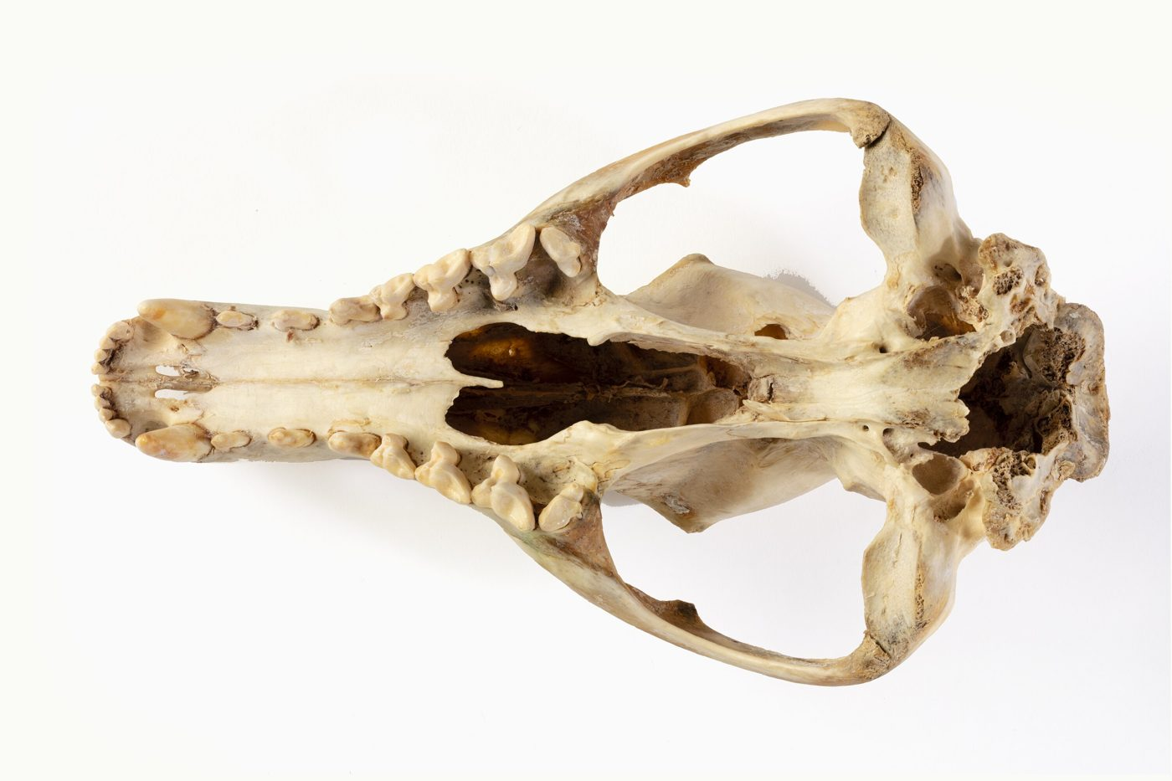
Genes, adaptation and extinction
YEAR 9 SCIENCE · 9A GENETICS AND EVOLUTION · LESSON 6 OF 7
How can genetic information cause extinction?
Exploring Science International 9 · Student Book pages 16 to 17 · Workbook pages 11 to 12
Notes:
This lesson links adaptations (from genes) to environmental change. It prepares the ground for natural selection next lesson: here the question is why a species declines when it is no longer well adapted.

Slide 2
Do Now: the day the dinosaurs died
DO NOW
4
min
About 65 million years ago a giant meteorite hit the Earth near Mexico, throwing up so much dust that it blocked out sunlight. 75% of species became extinct.
1. State one physical environmental factor that the meteorite changed.
2. Explain the effect this had on plants.
3. Explain the effect this had on animals.
Notes:
Light (and temperature) fell. Plants could not photosynthesise, so many died. Animals that ate plants starved, then the predators that ate them. Evidence: a 180 km wide crater near Mexico formed at this time.

Slide 3
Today
TODAY
Today I can ...
I can explain how changes in abiotic and biotic factors can make a species endangered or extinct, using the idea of adaptations.
I can describe ways of preserving biodiversity, including nature reserves, breeding programmes and gene banks.
Key words today
adaptation
endangered
extinct
abiotic factor
biotic factor
competition
native species
biodiversity
nature reserve
breeding programme
gene bank
Meanings are in the key words box on your worksheet.
Notes:
Read the goals. Remind students that abiotic and biotic factors were Lesson 1's key words; today they are the causes of extinction.

Slide 4
The last thylacine
HOOK
Thylacines were killed in Tasmania to protect sheep. The last one died in a zoo in 1936. Which environmental factor caused this extinction: abiotic or biotic?
Talk to a partner: name two other human activities that can make a species extinct.
The skull of a thylacine, a species hunted to extinction (Museums Victoria)
Image: Photographer: Rodney Start, CC BY 4.0, via Wikimedia Commons
Notes:
Biotic: hunting is an activity of other organisms (people). Other human activities: clearing habitats for farms and towns, using poisons, bringing in new species that compete or carry disease, fishing too much.

Slide 5
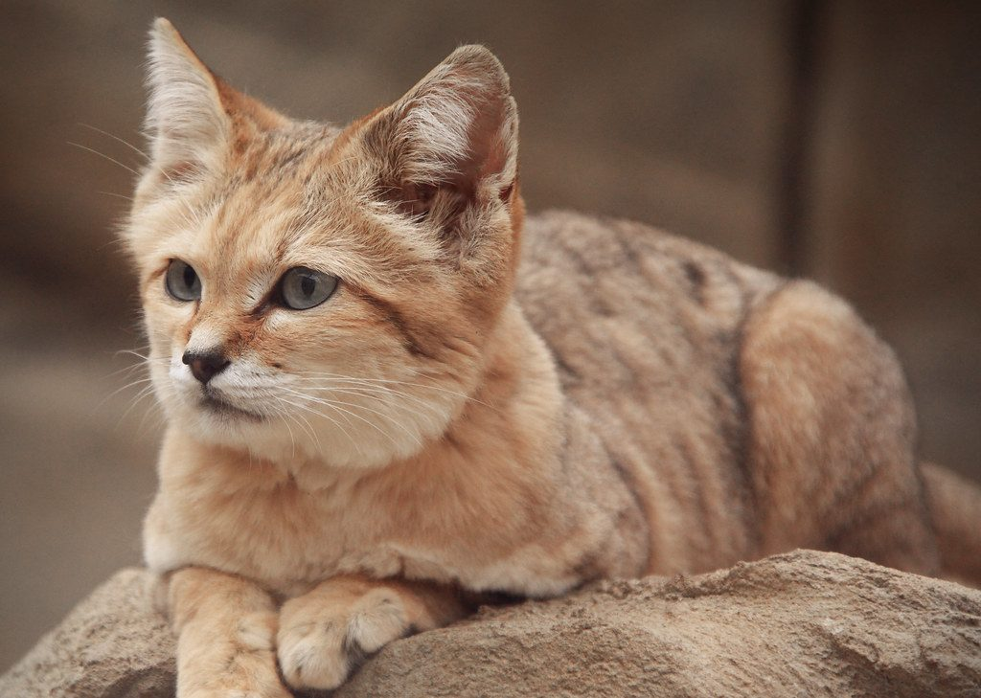
Adaptations, genes and change
LEARN
The adaptations of an organism are due to its genes.
If the ecosystem changes, a species may no longer be well adapted to the new conditions.
Its numbers fall: it becomes endangered, and may become extinct.
Changes in abiotic factors: rainfall, temperature, light. Changes in biotic factors: competition, disease, human activities (hunting, clearing habitats, poisons).
A sand cat's fur matches the sand it hunts on
Image: charlieishere@btinternet.com, CC BY 2.0, via Wikimedia Commons
Key idea A species cannot change its genes to fit a new environment; if it is no longer well adapted, it declines.
Key words adaptation · endangered · extinct
Notes:
Sand cats are camouflaged against sand. Ask: if the desert got greener, would the camouflage still work? This links to the gap fill at Core. Stress that an individual cannot choose to change its adaptations.

Slide 6
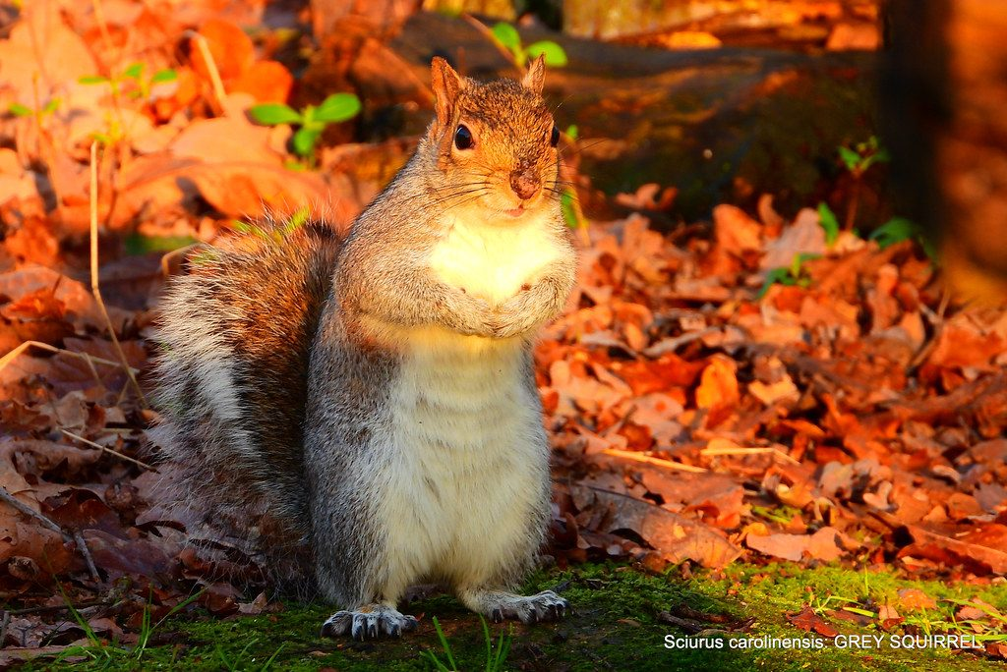
Grey squirrels and red squirrels
LEARN
Red squirrels are native to the UK. Greys were brought from the USA in the 1870s; now reds are rare.
Greys store more body fat, so more survive a long winter.
Greys can digest unripe acorns; reds cannot. Greys eat the acorns first, so reds get less food.
Greys carry squirrel pox, which does not harm greys but kills reds.
The grey squirrel was brought to the UK from the USA in the 1870s
Image: pete. #hwcp, CC BY 2.0, via Wikimedia Commons
Key idea When food is limited, the better adapted competitor survives and reproduces more, and its population grows faster.
Key words competition · native species · biotic factor
Notes:
These are inherited differences between the two species: the greys' genes give them more fat storage and the ability to digest unripe acorns. Competition and disease are both biotic factors.

Slide 7
Two squirrels, many shared adaptations
LEARN
Both species
Differences
Eyes on the side of the head: all-round vision to spot predators.
Long, bushy tail for balance.
Long, strong hind legs for leaping.
Sharp claws for gripping tree trunks.
Greys are bigger and store more fat: better in long winters.
Greys digest unripe acorns: eat them before the reds.
Greys carry squirrel pox, which kills reds.
Reds are lighter: better on thin, flexible conifer branches, and eat small conifer seeds.
Key idea Which species is 'better adapted' depends on the habitat: reds still do well in conifer forests.
Key words adaptation · competition
Notes:
Ask the Stretch question now: why might reds be better adapted to conifer forests than greys? Smaller, lighter animals can move on thin flexible branches and handle small seeds.

Slide 8
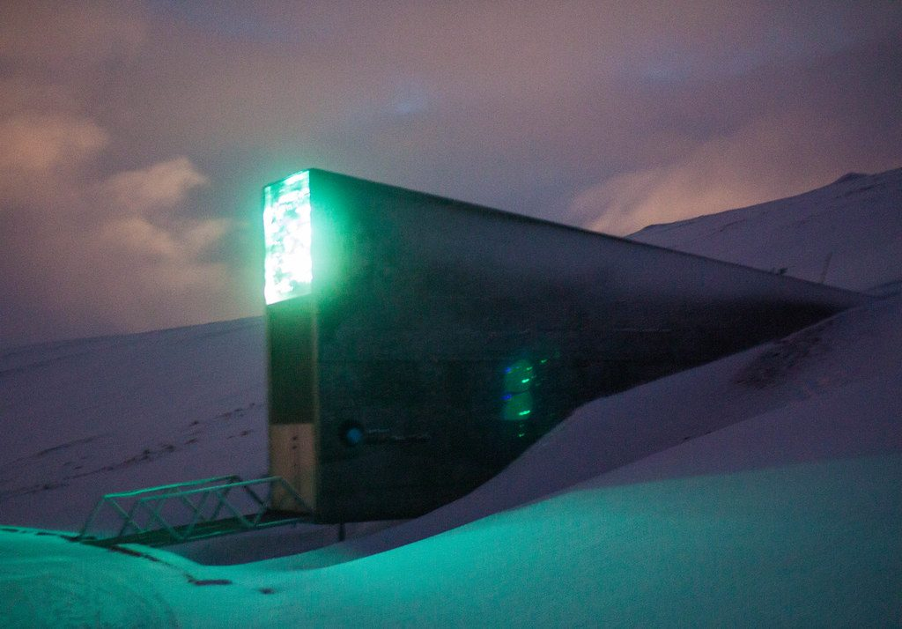
Preserving biodiversity
LEARN
Biodiversity is the number of different species.
Extinctions upset ecosystems and food webs, and we lose species we could use (food, medicines).
Ways to preserve biodiversity: ban hunting of certain animals, set up nature reserves, run breeding programmes.
Gene banks store seeds, gametes or cells at low temperatures, so a species can be produced again if it becomes extinct in the wild.
The Svalbard Global Seed Vault stores seeds from around the world
Image: the tinz, CC BY 2.0, via Wikimedia Commons
Key idea Protect the habitat, protect the animals, and keep a frozen back-up of the genes.
Key words biodiversity · nature reserve · breeding programme · gene bank
Notes:
The Svalbard vault in the Arctic holds over a million seed samples. Ask: why keep seeds cold? (They stay alive for decades without growing.) Why is a gene bank not enough on its own? (A species also needs a habitat to live in.)

Slide 9
Quick check
CHECK
Mini whiteboards. Short answers.
Q1 What does 'endangered' mean?
Q2 Hunting: abiotic or biotic factor?
Q3 Give one adaptation that red and grey squirrels share.
Q4 Why do grey squirrels get more acorns than reds?
Q5 Give one way of preserving biodiversity.
Notes:
Answers: in danger of becoming extinct; biotic; e.g. bushy tail for balance; they can digest unripe acorns so they eat them first; nature reserves, breeding programmes, hunting bans, gene banks.

Slide 10
Your turn: adaptation and extinction
DO
13
min
1
Core: match the environment words; sand cat gap fill; native species and competition; resources plants compete for.
2
Stretch: explain the squirrel story with adaptations and genes; reds in conifer forests; the sundew and rising temperature.
3
Challenge: Haast's eagle and the moa; how a gene bank works and what it cannot do.
4
Use 'better adapted' and 'genes' in every explanation.
A good explanation says what changed, why the species was no longer well adapted, and what happened to its numbers.
Notes:
The sundew question (Stretch 3): warmer temperature means more evaporation, the bog dries, and a plant with tiny roots cannot get enough water. The Haast's eagle question is about losing its prey (a biotic factor).

Slide 11
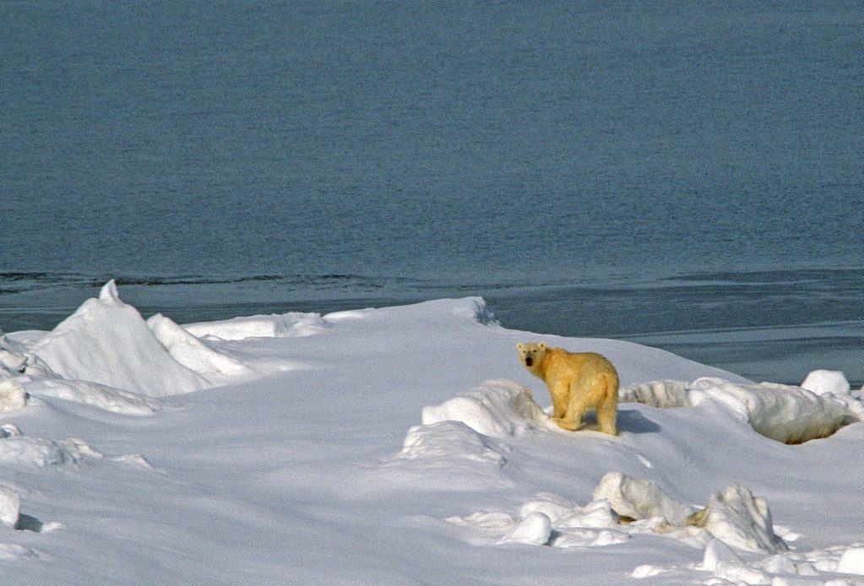
Polar bears and a warming world
THINK AND REFLECT
Polar bears hunt seals from the sea ice. Global warming is making the Arctic sea ice melt earlier each year. Predict the effect on the polar bear population and explain your reasoning.
Sentence frames
I predict the population will ___ because ___.
The abiotic factor that is changing is ___.
Polar bears are adapted to ___, so when ___ they cannot ___.
A polar bear on sea ice
Image: Gregory 'Slobirdr' Smith, CC BY-SA 2.0, via Wikimedia Commons
Notes:
Expected: the population falls because less sea ice means less time to hunt seals, so bears starve and have fewer cubs; the abiotic factor is temperature (and ice cover). Their adaptations (white fur, fat layer, hunting on ice) do not help when the ice is gone.

Slide 12
Exit ticket
EXIT TICKET
3
min
On your worksheet exit ticket. Work alone. Hand it in as you leave.
1. What does it mean if a species is endangered?
2. Give one biotic factor that can cause a species to become extinct.
3. Give one way of preserving biodiversity and say how it works.
Notes:
Answers: in danger of becoming extinct; e.g. competition from a new species, disease, hunting, habitat clearing; e.g. a gene bank stores seeds or gametes cold so the species can be grown again; a nature reserve protects the habitat; a breeding programme increases numbers in captivity.

Slide 13
What we learned
SUMMARY
Adaptations come from genes. When abiotic or biotic factors change, a species may no longer be well adapted and can become endangered or extinct.
Competition, disease and human activities are biotic factors that can cause extinction; the grey squirrel out-competes the red.
Biodiversity is the number of different species; losing species damages ecosystems and food webs.
We preserve biodiversity with hunting bans, nature reserves, breeding programmes and gene banks.
Next lesson Natural selection and evolution: how the environment 'selects' the inherited variations that survive, and how new species form.
Notes:
Homework: Workbook pages 11 and 12 (9Ad).

