Slide 1
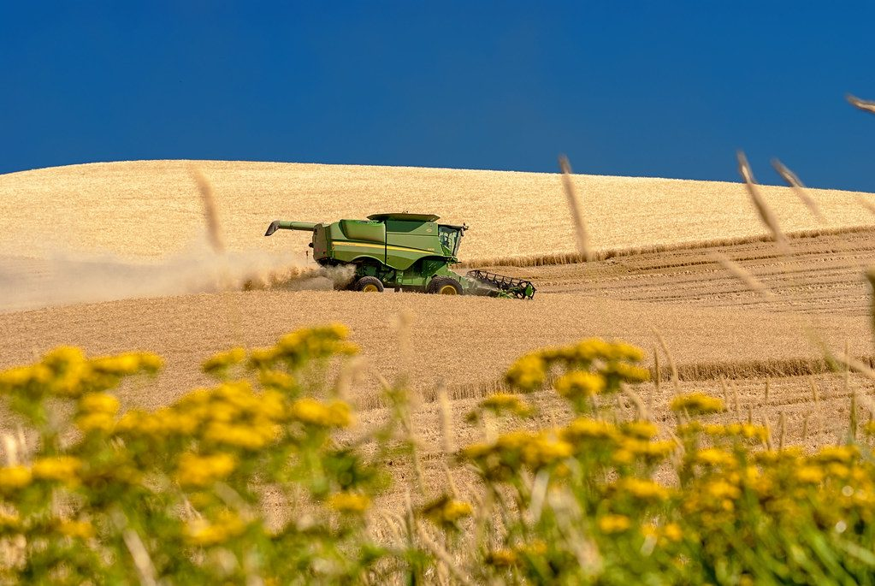
Reactions in plants
YEAR 9 SCIENCE · 9B PLANT GROWTH · LESSON 1 OF 7
How does a wheat plant turn air, water and light into a harvest?
Exploring Science International 9 · Student Book pages 21 to 23 · Workbook pages 15 to 16
Notes:
Welcome to 9B, Plant growth. We start on a farm: a farmer's yield depends on two chemical reactions inside every plant. Today we meet both of them.

Slide 2
Do Now: on a farm
DO NOW
4
min
Farmers want as much useful product (yield) from their crops as possible.
1. What process do wheat plants use to make their own food?
2. Name the gas that plants take in for this process.
3. Suggest the effect of a very cloudy year on the wheat harvest.
Harvesting wheat
Image: Knowles Gallery, CC BY 2.0, via Wikimedia Commons
Notes:
Four minutes in books. Answers: photosynthesis; carbon dioxide; less light means less photosynthesis, so less glucose, less growth and a smaller harvest. This recaps Year 8 and tells you who remembers the word equation.

Slide 3
Today
TODAY
Today I can ...
I can write the word and symbol equations for photosynthesis and aerobic respiration, and say where and when each happens in a plant.
I can explain how limiting factors slow photosynthesis and why roots need oxygen.
Key words today
photosynthesis
aerobic respiration
chlorophyll
chloroplast
glucose
reactant
product
limiting factor
phloem
yield
Meanings are in the key words box on your worksheet.
Notes:
Read each goal aloud. Point out the key words box on the worksheet; students with the Chinese key words sheet have the same words with Chinese beside them.

Slide 4
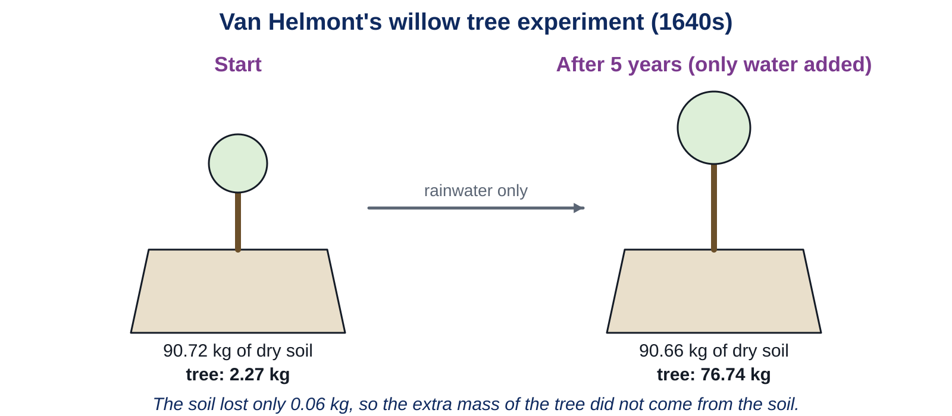
Where did the tree come from?
HOOK
Aristotle thought roots sucked up soil for plants to eat. Van Helmont grew a willow for five years, adding only rainwater. The soil lost 0.06 kg. The tree gained over 74 kg. Where did the extra mass come from?
Vote with a partner: soil, water, air or light?
Van Helmont's experiment, 1640s
Notes:
Do not confirm yet. Most of the mass came from carbon dioxide in the air (carbon atoms in glucose, starch and cellulose) plus water. The experiment disproves Aristotle but van Helmont himself wrongly concluded it was all water. Students evaluate that claim in Challenge 2.

Slide 5
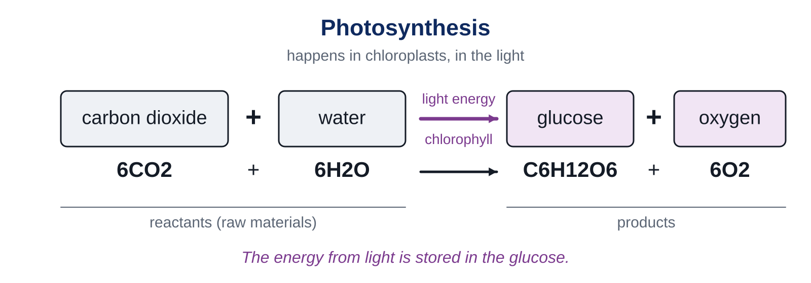
Photosynthesis
LEARN
Plants make their own food: glucose. The reactants are carbon dioxide and water; the products are glucose and oxygen.
Key idea Light supplies the energy and chlorophyll captures it, but light is not a substance, so it is not a reactant.
Key words photosynthesis · reactant · product · glucose
Notes:
Students copy the word equation and the symbol equation. Say it aloud: carbon dioxide plus water makes glucose plus oxygen. Point out 6CO2 and 6H2O on the left, C6H12O6 and 6O2 on the right: the atoms are the same on both sides.

Slide 6
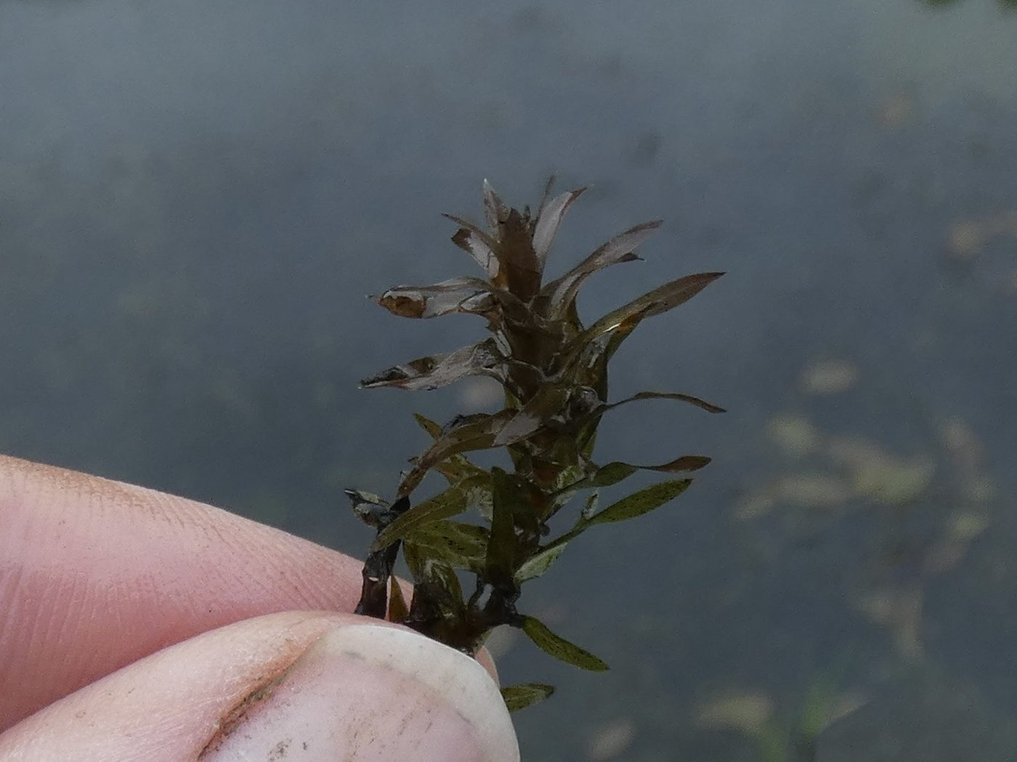
Light, chlorophyll and limiting factors
LEARN
Chlorophyll, inside chloroplasts, captures the energy transferred by light.
That energy is stored in the glucose.
Less light, or too little carbon dioxide or water, slows photosynthesis.
A variable that slows the rate is a limiting factor.
More oxygen bubbles from pondweed means faster photosynthesis.
Canadian pondweed (Elodea), used to measure photosynthesis by counting oxygen bubbles
Image: Sean Hartnett, CC BY 4.0, via Wikimedia Commons
Key idea Rate of photosynthesis is limited by light, carbon dioxide, water and temperature.
Key words chlorophyll · chloroplast · limiting factor
Notes:
Ask: a farmer in a greenhouse adds lamps and pumps in carbon dioxide. Why? Answer: to remove limiting factors so the crop grows faster. Counting bubbles from pondweed is the standard way to measure the rate; the book's question 6 asks for three limiting factors.

Slide 7
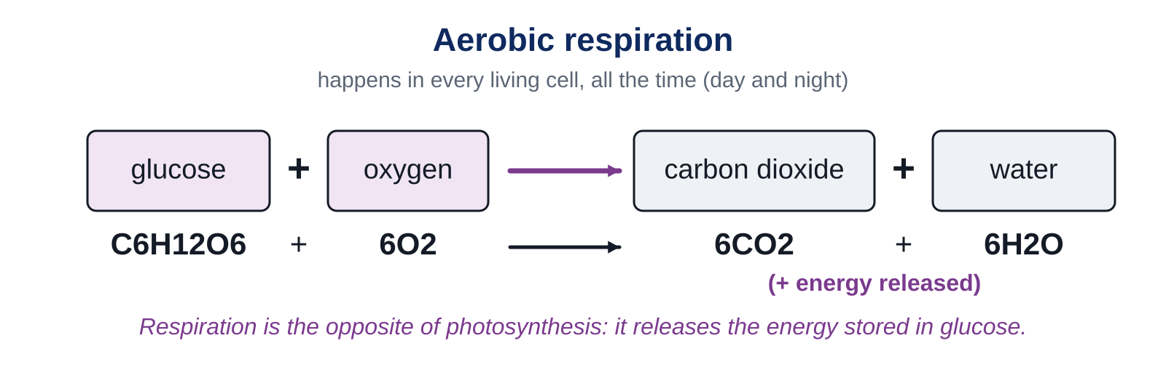
Aerobic respiration
LEARN
Every living cell needs energy. Aerobic respiration releases the energy stored in glucose, using oxygen.
Key idea Photosynthesis only in the light, in cells with chloroplasts. Respiration in every cell, all day and all night.
Key words aerobic respiration
Notes:
Copy the word equation. Respiration is the reverse of photosynthesis. The energy released is transferred to ATP molecules, which store it until the cell needs it. Ask: does a root cell photosynthesise? No, no chloroplasts, no light. Does it respire? Yes.

Slide 8
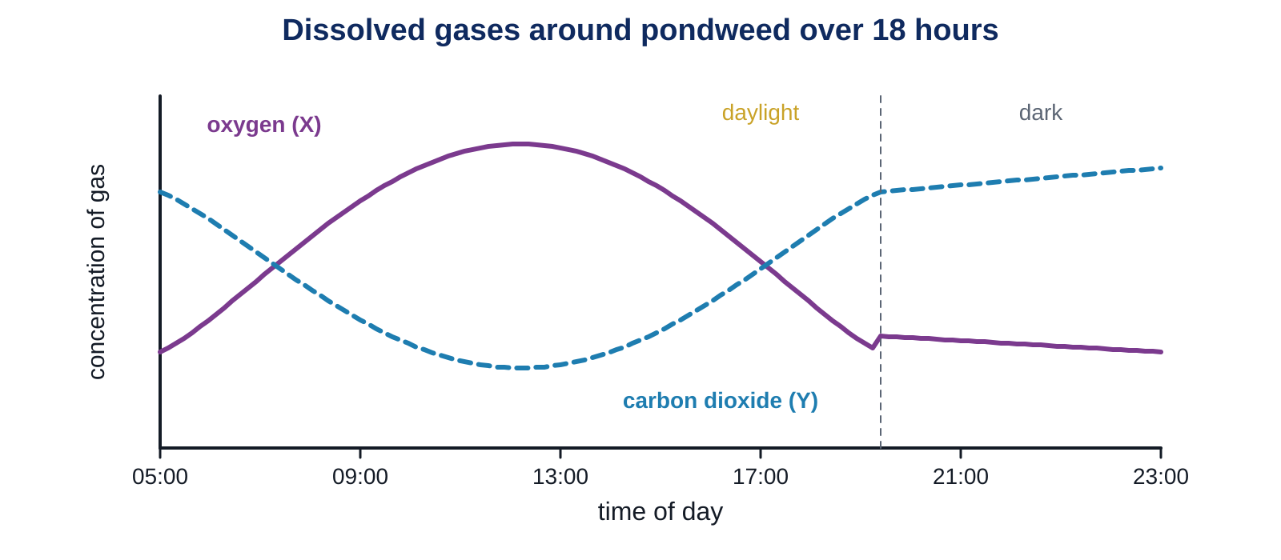
Gases around pondweed over 18 hours
LEARN
Which line is oxygen, X or Y? Why does X rise during the day and fall after dark?
Key idea In daylight a plant makes more oxygen than it uses, so oxygen is given off. At night it only respires, so oxygen falls and carbon dioxide rises.
Notes:
X is oxygen: it rises while the plant photosynthesises in the light and falls at night when only respiration happens. Y is carbon dioxide: used up in the day, released at night. The crossing point is when photosynthesis and respiration are equal.

Slide 9
Moving sugar, and roots that breathe
LEARN
Glucose is turned into sugars that dissolve in water.
Phloem vessels, chains of living cells, carry the sugar solution to every part of the plant.
Root cells use this sugar for respiration. They get oxygen from air spaces in the soil.
Waterlogged soil has no air, so roots cannot respire and the plant can die.
Key idea Roots do not photosynthesise, but they respire, so they need sugar from the phloem and oxygen from the soil.
Key words phloem · yield
Notes:
Link to yield: a flooded field means dead roots and a lost harvest. Next lesson looks at how roots, stems and leaves are adapted. Workbook page 16 has the variegated leaf question: photosynthesis only in the green parts, respiration in all cells.

Slide 10
Quick check
CHECK
Mini whiteboards. One answer each, then we check.
Q1 Name the two reactants of photosynthesis.
Q2 Where in a plant cell does photosynthesis happen?
Q3 Does respiration happen in the light, in the dark, or both?
Q4 A plant in a dim room grows slowly. Name the limiting factor.
Q5 Which tissue carries sugar solution around a plant?
Notes:
Answers: carbon dioxide and water; in the chloroplasts; both (all the time); light; phloem. Ask a student to say the respiration equation from memory.

Slide 11
Your turn
DO
14
min
1
Core: complete both word equations, sort the statements, match the key words, then do the van Helmont calculations.
2
Stretch: read the pondweed graph, explain the limiting factors and the flooded roots.
3
Challenge: the energy flow chart and the water claim.
4
Finished? Write a question for the class in the My thinking box.
Use the key words box. Check your equations with a partner before Stretch.
Notes:
Circulate and check the equations first: a wrong equation now will be copied into every later lesson. Core 4: soil change 0.06 kg, tree change 74.47 kg.

Slide 12
The flooded field
THINK AND REFLECT
A farmer's wheat field floods for two weeks in spring. Explain why the wheat plants may die. Use the words roots, oxygen and respiration.
Sentence frames
Roots need ___ for ___.
When the soil is flooded, ___ because ___.
Without energy from respiration, the root cells ___.
Notes:
Expected: roots need oxygen for aerobic respiration to release energy; flooded soil has no air spaces so no oxygen reaches the roots; root cells cannot release energy, so they stop working and die, and the plant dies. Praise students who add that the leaves still photosynthesise but the sugar cannot be used in the roots.

Slide 13
Exit ticket
EXIT TICKET
4
min
On your worksheet exit ticket. Work alone. Hand it in as you leave.
1. Write the word equation for photosynthesis.
2. Where in a plant cell does photosynthesis happen?
3. Why do plants in a field only photosynthesise during the day?
Notes:
Answers: carbon dioxide + water makes glucose + oxygen; in the chloroplasts; photosynthesis needs light, which is only available in the day. Collect the strips.

Slide 14
What we learned
SUMMARY
Photosynthesis: carbon dioxide + water makes glucose + oxygen, using light energy captured by chlorophyll.
Aerobic respiration: glucose + oxygen makes carbon dioxide + water, releasing energy, in every living cell all the time.
A limiting factor (light, carbon dioxide, water, temperature) slows the rate of photosynthesis.
Phloem carries sugar solution to the roots, which also need oxygen from the soil.
Next lesson How roots, stems and leaves are adapted to get water, mineral salts, light and carbon dioxide.
Notes:
Homework: Workbook pages 15 and 16. Remind students that the word equations will be used in every lesson of this unit.

