Slide 1
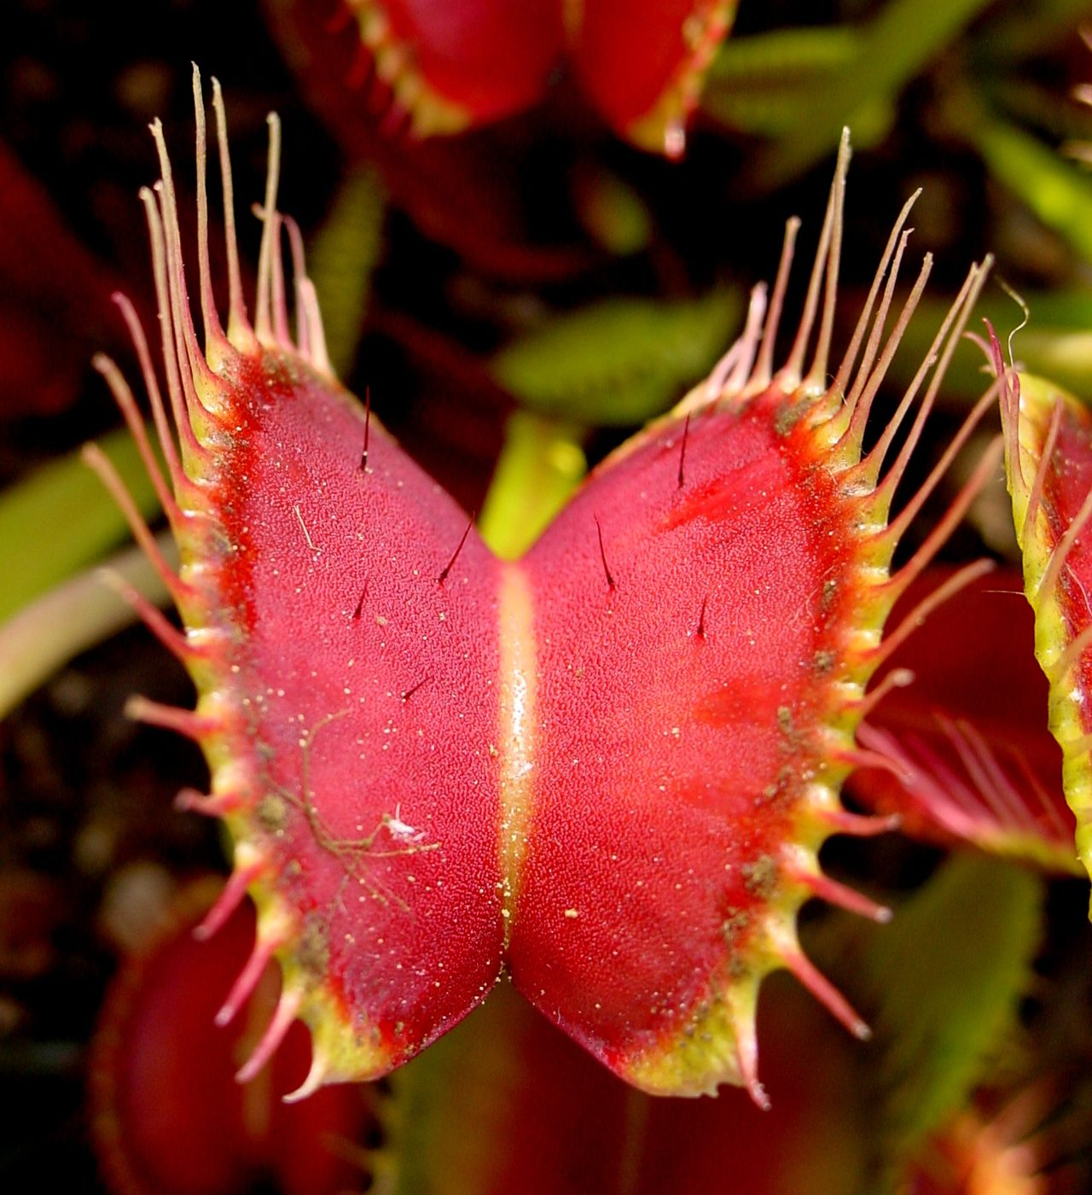
Plant adaptations: roots, stems and leaves
YEAR 9 SCIENCE · 9B PLANT GROWTH · LESSON 2 OF 7
How is a plant built to collect water, mineral salts, light and carbon dioxide?
Exploring Science International 9 · Student Book pages 24 to 25 · Workbook pages 17
Notes:
Lesson 2 of 9B. Last lesson: the two reactions. This lesson: the structures that supply them, from root hair to palisade cell.

Slide 2
Do Now: where do the reactants come from?
DO NOW
4
min
1. Write the word equation for photosynthesis.
2. Which reactant comes from the air, and which comes from the soil?
3. Name two other things a plant needs that it gets from the soil.
Notes:
Answers: carbon dioxide + water makes glucose + oxygen; carbon dioxide from the air, water from the soil; mineral salts such as nitrates, magnesium and potassium (accept 'nutrients'). Many students will say 'food' for question 3: challenge it, the plant makes its own food.

Slide 3
Today
TODAY
Today I can ...
I can describe what plants need from the soil and the air, and how roots, root hair cells and xylem are adapted to supply water and mineral salts.
I can explain how a leaf and its palisade cells are adapted for photosynthesis.
Key words today
mineral salts
nitrate
magnesium
potassium
root hair cell
xylem
wilt
palisade cell
epidermis
cuticle
surface area
Meanings are in the key words box on your worksheet.
Notes:
Read each goal aloud. Point to the key words box on the worksheet.

Slide 4
Why does a plant eat flies?
HOOK
The Venus flytrap grows in bogs where the soil contains very few mineral salts. What does it get from a fly that it cannot get from the soil?
Talk to a partner. Then: suggest why a hair has to be touched more than once before the trap shuts.
A Venus flytrap. The trap shuts when a hair is touched twice.
Image: Noah Elhardt, CC BY-SA 2.5, via Wikimedia Commons
Notes:
The fly supplies mineral salts, especially nitrates (nitrogen for proteins) and potassium. The plant still makes its own glucose by photosynthesis; the fly is not its energy source. Touching twice stops the trap wasting energy shutting on raindrops or dust.

Slide 5
What plants need from mineral salts
LEARN
Mineral salt | What the plant uses it for | Sign of shortage
nitrates (nitrogen) | making proteins, so cells can grow | small, poor growth
magnesium | making chlorophyll | yellow leaves
potassium | root cells absorbing water properly | weak growth, wilting
Carbon, hydrogen and oxygen come from water and carbon dioxide.
Mineral salts dissolve in soil water and enter through the roots.
Key idea Mineral salts are not food: they are building materials. Nitrates build proteins; magnesium builds chlorophyll.
Key words mineral salts · nitrate · magnesium · potassium
Notes:
Students copy the table. Ask: what happens to photosynthesis in a plant short of magnesium? Less chlorophyll, so less energy captured, so less glucose and slower growth. This is Stretch 3 on the worksheet.

Slide 6
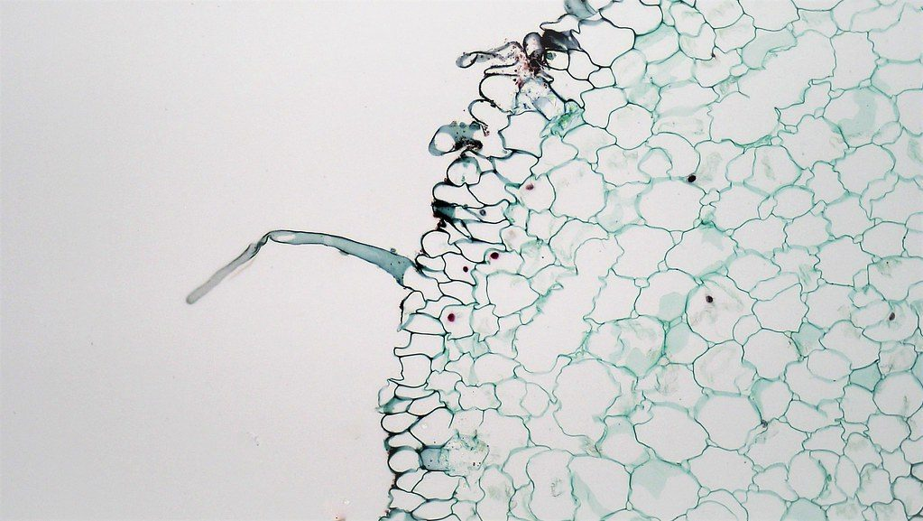
Roots: collecting water and mineral salts
LEARN
Roots hold the plant in place and absorb water with dissolved mineral salts.
Roots are branched and spread out to reach water in a large volume of soil.
Root hair cells have a long extension: a large surface area to absorb water quickly.
Water passes to xylem vessels: long hollow tubes formed when chains of xylem cells die.
Xylem carries water and mineral salts up to the leaves.
Root hairs on a seedling
Image: bccoer, CC0, via Wikimedia Commons
Key idea Large surface area = faster absorption. Hollow dead cells = a pipe.
Key words root hair cell · xylem · surface area
Notes:
Hold a bunch of fine string next to a single thick rope: which has more surface? Root hairs work the same way. Xylem is made of dead cells: the end walls break down, leaving a continuous tube.

Slide 7
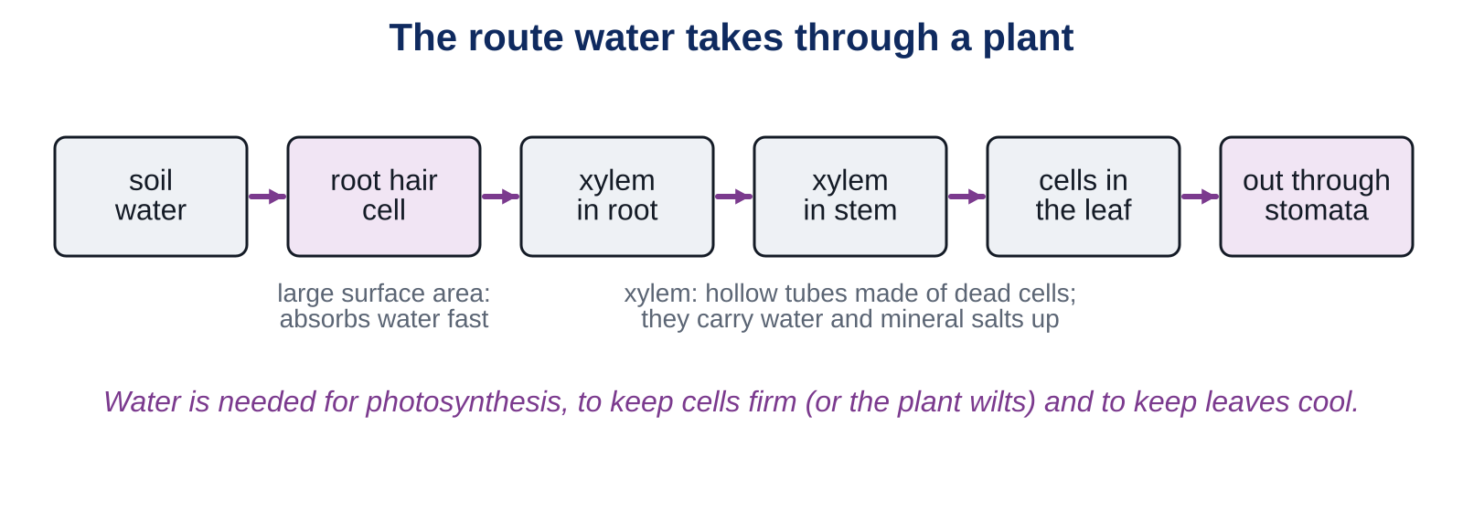
The route of water through a plant
LEARN
Water is needed for photosynthesis, to keep leaves cool, and to fill cells so they stay firm.
Key idea Too little water: the cells sag, the leaves droop and the plant wilts. Water the plant and the cells fill again.
Key words xylem · wilt
Notes:
Trace the route aloud: soil water, root hair cell, xylem in the root, xylem in the stem, leaf cells, out through the stomata as water vapour (next lesson). Show a wilted and a watered pot plant if you have them.

Slide 8
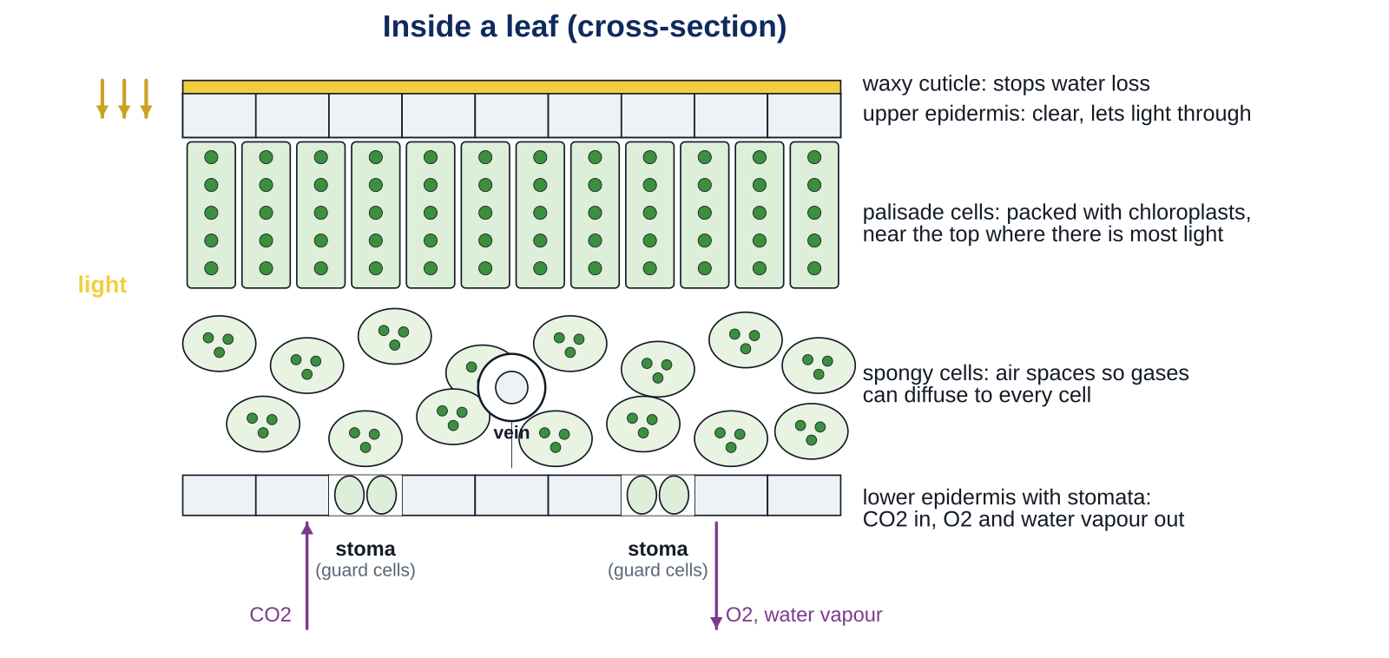
Inside a leaf
LEARN
Leaves are broad and thin. Which layer has the most chloroplasts, and why is it near the top?
Key idea Palisade cells sit near the upper surface, where there is most light, and are packed with chloroplasts.
Key words palisade cell · epidermis · cuticle
Notes:
Answer: the palisade layer, just under the clear upper epidermis, because light arrives from above. The spongy layer has air spaces for gases, the vein carries water in (xylem) and sugar out (phloem), and the stomata are mostly underneath. Next lesson looks at the stomata in detail.

Slide 9
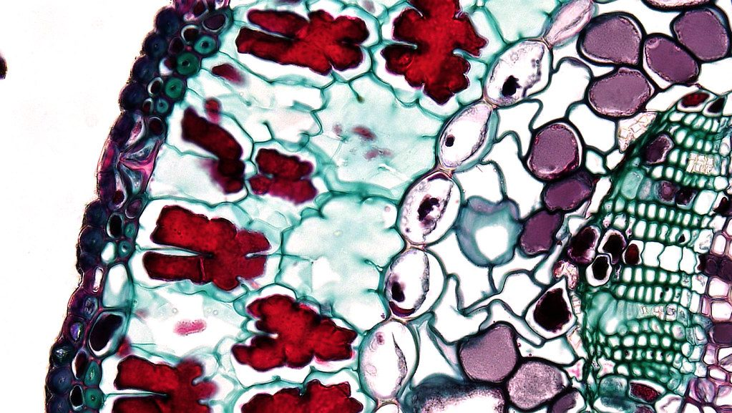
Leaves: catching light
LEARN
Broad leaves have a large surface area to trap light.
Leaves are arranged so the upper ones do not shade the lower ones too much.
The epidermis makes a waxy cuticle that stops the leaf losing too much water.
Palisade cells contain many chloroplasts, where photosynthesis happens.
In dim light the chloroplasts move nearer the surface; in bright light they move away to avoid damage.
Chloroplasts inside leaf cells (microscope)
Image: bccoer, CC0, via Wikimedia Commons
Key idea Shape fits function: broad and thin for light, a cuticle to keep water in, palisade cells full of chloroplasts.
Key words palisade cell · cuticle · surface area
Notes:
Optional activity for the Do phase: trace a leaf on squared paper and count the squares to estimate its surface area. Compare a sun leaf and a shade leaf from the same tree: shade leaves are often larger and thinner.

Slide 10
Quick check
CHECK
Mini whiteboards. One answer each, then we check.
Q1 Which mineral salt supplies nitrogen for making proteins?
Q2 A plant has yellow leaves. Which element is it short of?
Q3 How are root hair cells adapted to absorb water quickly?
Q4 Which tissue carries water up the stem, xylem or phloem?
Q5 Which leaf cells contain the most chloroplasts?
Notes:
Answers: nitrates; magnesium; a long extension gives a large surface area; xylem; palisade cells. Ask a student to say the difference between xylem (water up, dead cells) and phloem (sugar solution, living cells).

Slide 11
Your turn
DO
14
min
1
Core: complete the table of what plants need, match the leaf parts, then fill the gaps on the route of water.
2
Stretch: explain the adaptations of xylem and root hair cells, wilting and recovery, and the yellow leaves.
3
Challenge: the Venus flytrap and how a leaf supplies its palisade cells.
4
Optional with your partner: trace a leaf on squared paper and estimate its surface area in cm².
Use the key words box. Every answer about an adaptation should say what the structure is like AND what that lets it do.
Notes:
Model one adaptation answer on the board: 'Root hair cells have a long thin extension (what it is like), which gives a large surface area, so water is absorbed faster (what it does).' Insist on both halves.

Slide 12
Wilt and recover
THINK AND REFLECT
A pot plant is left without water for a week and wilts. Two hours after watering it stands up straight again. Explain both changes.
Sentence frames
Without water, the cells ___ so the leaves ___.
After watering, water travels from the ___ through the ___ to the leaves.
The cells fill up again and become ___.
Notes:
Expected: without water the cells sag (lose their firmness) so the leaves droop; after watering, water is absorbed by root hair cells and carried up in the xylem; the cells fill with water, become firm, and hold the leaves up. Lesson 3 adds how water leaves through the stomata.

Slide 13
Exit ticket
EXIT TICKET
4
min
On your worksheet exit ticket. Work alone. Hand it in as you leave.
1. Name the mineral salt a plant needs to make proteins.
2. How are root hair cells adapted to absorb water?
3. Why do palisade cells contain so many chloroplasts?
Notes:
Answers: nitrates; a long extension gives a large surface area so water is absorbed quickly; they are near the top of the leaf where there is most light, and chloroplasts are where photosynthesis happens. Collect the strips.

Slide 14
What we learned
SUMMARY
Plants need nitrates (proteins), magnesium (chlorophyll) and potassium (absorbing water) from mineral salts in the soil.
Root hair cells have a large surface area; xylem vessels are hollow tubes of dead cells that carry water and mineral salts up.
Water is needed for photosynthesis, cooling and keeping cells firm; too little and the plant wilts.
Leaves are broad and thin, with a waxy cuticle and palisade cells packed with chloroplasts near the top.
Next lesson Gas exchange: how stomata let carbon dioxide in and oxygen and water vapour out.
Notes:
Homework: Workbook page 17. Bring in a leaf next lesson if you want to look at its stomata under the microscope.

