Slide 1
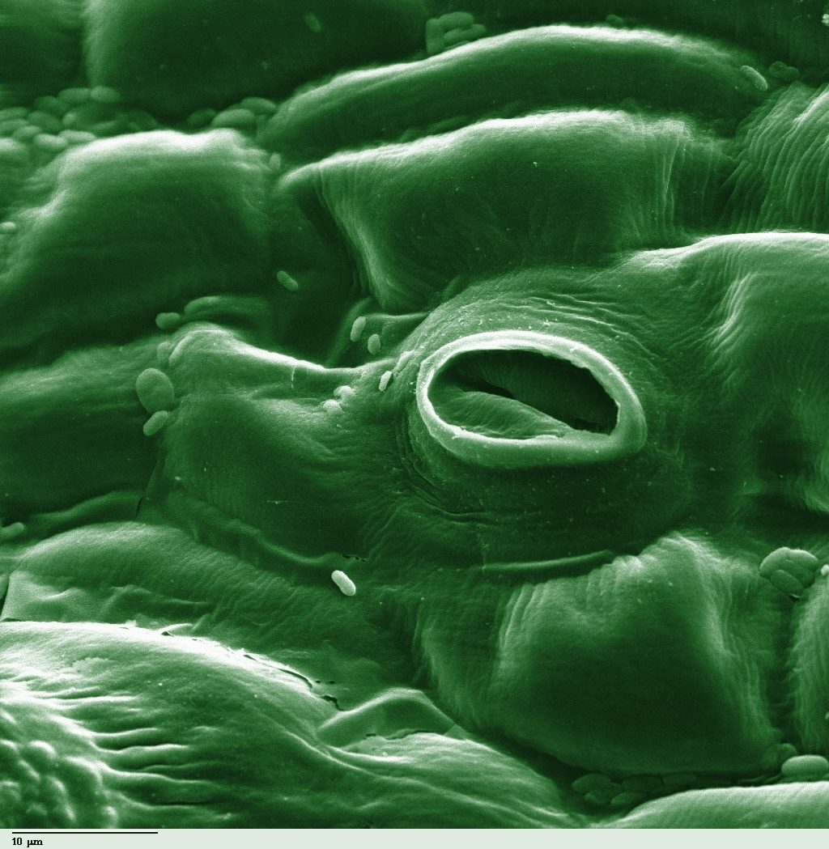
Gas exchange in leaves
YEAR 9 SCIENCE · 9B PLANT GROWTH · LESSON 3 OF 7
A leaf has thousands of tiny doors. Who opens them, and what goes in and out?
Exploring Science International 9 · Student Book pages 25 · Workbook pages 18
Notes:
Lesson 3 of 9B. Last lesson: water, mineral salts and light. Today: carbon dioxide in, oxygen and water vapour out, through stomata.

Slide 2
Do Now: a leaf under the microscope
DO NOW
4
min
1. What is this hole in the leaf surface called?
2. Name two gases that pass through it.
3. Predict when the hole is shut: day or night?
A hole in the lower surface of a tomato leaf
Image: Photohound, Public domain, via Wikimedia Commons
Notes:
Answers: a stoma (plural stomata); carbon dioxide and oxygen (also water vapour); shut at night. Most students will have met stomata in Year 8. The two curved cells either side are the guard cells.

Slide 3
Today
TODAY
Today I can ...
I can describe how stomata and guard cells control gas exchange in a leaf.
I can explain how temperature and concentration difference affect diffusion, and why a plant loses more water on a hot day.
Key words today
stomata
guard cell
diffusion
concentration
gas exchange
water vapour
evaporation
wilt
epidermis
Meanings are in the key words box on your worksheet.
Notes:
Read each goal aloud. Point out that today has a short practical, so the Do phase is longer.

Slide 4
Same water, same light. Why did this one wilt?
HOOK
Two identical pot plants were given the same light and the same water. One was kept in a cool room and one in a hot room. The one in the hot room wilted. Why?
Talk to a partner. We come back to this at the end.
Notes:
Do not answer yet. Expected by the end: at a higher temperature particles move faster, so water evaporates faster inside the leaf and water vapour diffuses out faster through the stomata; the roots cannot replace it fast enough, so the cells sag and the plant wilts.

Slide 5
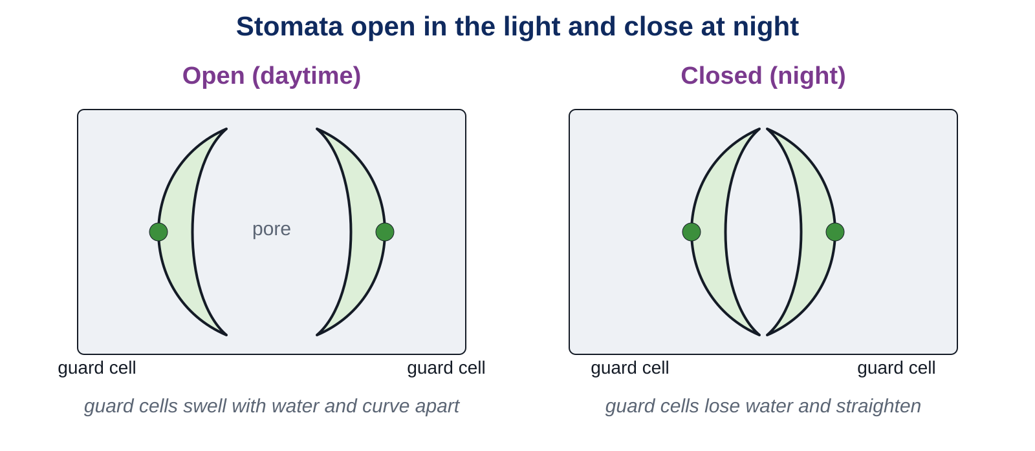
Stomata and guard cells
LEARN
Stomata are tiny holes in the epidermis, mostly on the lower surface. Each is opened and closed by a pair of guard cells.
Key idea Open in the light, when the plant needs carbon dioxide for photosynthesis. Shut at night, which saves water.
Key words stomata · guard cell · epidermis
Notes:
Guard cells swell with water and curve apart in the light, opening the pore; they lose water and straighten at night, closing it. Ask: why would a plant want its stomata shut at night? No photosynthesis, so no need for carbon dioxide, and shutting saves water.

Slide 6
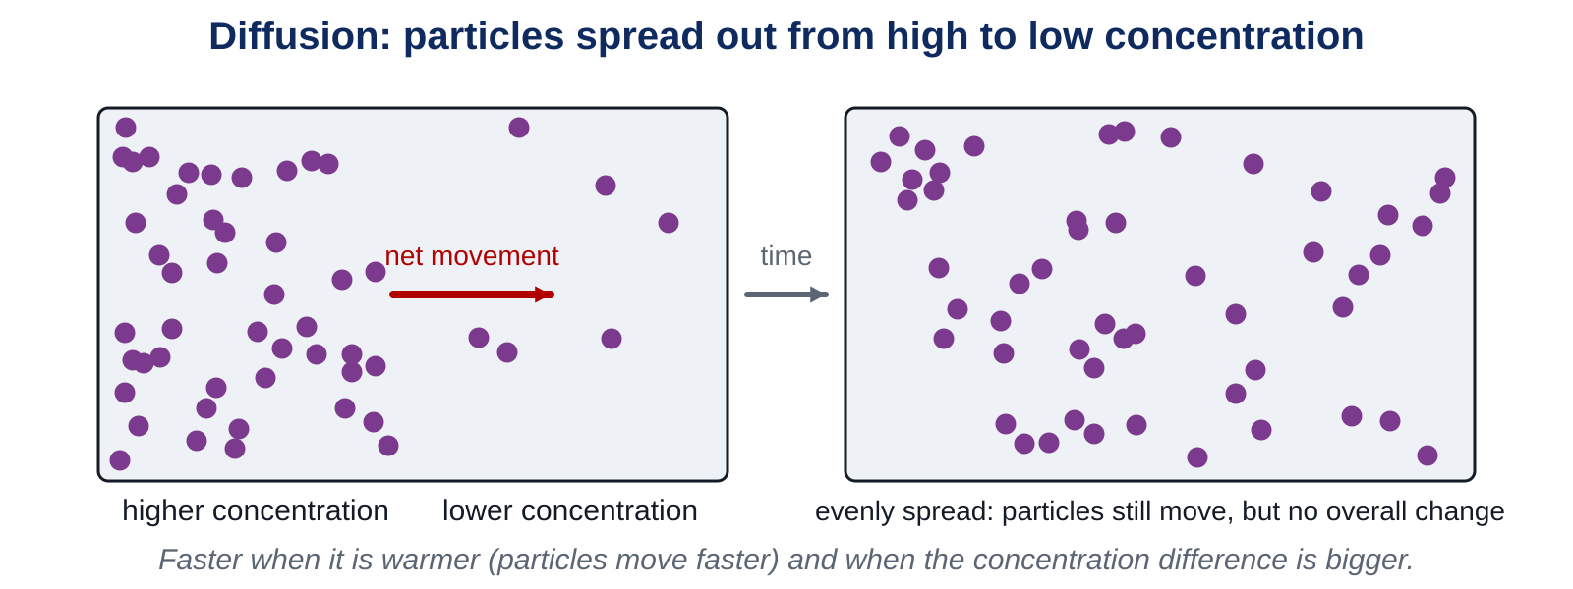
Diffusion
LEARN
Particles move randomly all the time. Overall they spread from where they are more concentrated to where they are less concentrated.
Key idea Diffusion is faster at higher temperatures (particles move faster) and when the concentration difference is bigger.
Key words diffusion · concentration
Notes:
Spray a little scent at the front and ask who smells it first. No one pulls the particles across the room: they spread by themselves. Stress that particles still move once they are evenly spread; there is just no overall change.

Slide 7
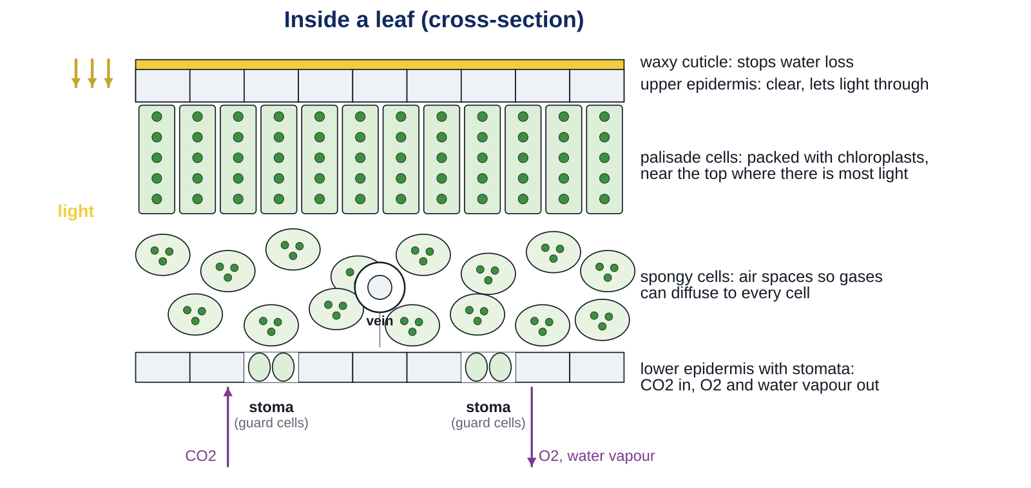
Gas exchange in a leaf
LEARN
In the light, photosynthesis uses up carbon dioxide inside the leaf, so its concentration falls.
Carbon dioxide diffuses in from the air through open stomata.
Oxygen made by photosynthesis builds up and diffuses out.
Leaves are thin, so gases do not have to diffuse far to reach every cell.
This swapping of gases is gas exchange.
Key idea Photosynthesis keeps the carbon dioxide concentration inside the leaf low, so carbon dioxide keeps diffusing in.
Key words gas exchange · stomata · diffusion
Notes:
Follow one carbon dioxide molecule: air, through a stoma, into an air space in the spongy layer, into a palisade cell, into a chloroplast. Ask: what happens to the direction of oxygen movement at night? Reversed: the plant respires, so oxygen diffuses in and carbon dioxide out.

Slide 8
Losing water
LEARN
Water evaporates from the cells inside the leaf.
Water vapour diffuses out through open stomata.
This is faster when it is hot (particles move faster) and when the air outside is dry or windy (bigger concentration difference).
If the roots cannot replace the water, the cells sag and the plant wilts.
Key idea Open stomata let carbon dioxide in but water out. Closing them at night saves water.
Key words water vapour · evaporation · wilt
Notes:
Link to the hook. Why does wind speed up water loss? It blows away the water vapour near the leaf, so the concentration outside stays low and the difference stays large. The waxy cuticle stops water leaving anywhere except the stomata.

Slide 9
Quick check
CHECK
Mini whiteboards. One answer each, then we check.
Q1 Which cells open and close a stoma?
Q2 Is a stoma usually open or shut at night?
Q3 Diffusion: from low to high concentration, or high to low?
Q4 Name two things that make diffusion faster.
Q5 In the light, which gas diffuses INTO a leaf?
Notes:
Answers: guard cells; shut; high to low; higher temperature and a bigger concentration difference; carbon dioxide. Then the safety slide before the practical.

Slide 10
Safety: nail varnish peel
SAFETY
Clear nail varnish gives off fumes: keep the lid on when not in use and keep it away from any flame.
Do not sniff the varnish. Open a window if the room smells strongly.
Wash your hands at the end.
Carry the microscope with two hands. Do not touch the lamp.
Scissors: cut away from your fingers.
Notes:
Read each line aloud. One bottle of varnish per pair, lids on between uses. Nobody with a strong reaction to solvents should paint; they view the prepared slide instead.

Slide 11
Looking at stomata
PRACTICAL
Aim To see stomata and guard cells on the lower surface of a leaf and count them.
Equipment
Method
leaf with a smooth underside
clear nail varnish
clear sticky tape
scissors
microscope slide
microscope
worksheet
Paint a thin layer of clear nail varnish on the lower surface of the leaf, about 1 cm square.
Leave it to dry for about 5 minutes. Do the Core questions while you wait.
Press a piece of clear sticky tape over the dry varnish, then peel the tape off slowly. The varnish layer comes with it.
Stick the tape, varnish side down, on a microscope slide.
Look at it on low power, then medium power. Find a stoma with its two guard cells.
Draw one stoma and its guard cells. Count the stomata you can see in the field of view, three times, and record the counts.
Safety Varnish lids on. Away from flames. Wash hands at the end.
Notes:
The peel is a print of the epidermis: the stomata show as pairs of sausage-shaped guard cells. If a pair cannot get a clear peel, use the prepared slide. Counts in the field of view vary; the mean goes into Challenge 2.

Slide 12
Your turn
DO
16
min
1
While the varnish dries: Core 1 to 3 on the worksheet.
2
View your peel: draw one stoma with its guard cells and record three counts (Core 4).
3
Stretch: why stomata open and close; the hot-day passage; the windy day.
4
Challenge: why stomata are mostly underneath; estimate the stomata on a whole leaf.
Clear up: slides in the tray, varnish lids on, microscope on low power, hands washed.
Notes:
Time check: varnish on by minute 2, viewing by minute 8, questions from minute 10. Keep the prepared slide on a spare microscope so everyone sees a clear stoma.

Slide 13
Back to the hot room
THINK AND REFLECT
The plant in the hot room wilted. Use particles, evaporation, diffusion and stomata to explain why.
Sentence frames
When the temperature is higher, particles move ___.
So water evaporates inside the leaf ___ and water vapour diffuses out through the stomata ___.
The roots cannot replace the water fast enough, so the cells ___ and the plant ___.
Notes:
Expected: faster; faster, faster; sag, wilts. Push further: what could the plant do to reduce the loss? Close its stomata, which also stops carbon dioxide getting in, so photosynthesis slows.

Slide 14
Exit ticket
EXIT TICKET
4
min
On your worksheet exit ticket. Work alone. Hand it in as you leave.
1. What is the job of the guard cells?
2. Name two gases that are exchanged between a leaf and the air through its stomata.
3. Explain why a leaf loses more water on a hot day than on a cool day.
Notes:
Answers: they open and close the stomata; carbon dioxide and oxygen (or water vapour); at a higher temperature particles move faster, so evaporation and diffusion of water vapour out of the stomata are faster. Collect the strips.

Slide 15
What we learned
SUMMARY
Stomata are tiny holes in the leaf, opened and closed by guard cells: open in the light, shut at night.
Gases move in and out by diffusion, from high to low concentration; faster when it is warmer and when the difference is bigger.
Photosynthesis uses carbon dioxide inside the leaf, so carbon dioxide diffuses in; oxygen diffuses out.
Water vapour also diffuses out through open stomata; on a hot, dry or windy day the plant can wilt.
Next lesson What plants make from glucose: starch, lipids and proteins, and how we test for them.
Notes:
Homework: Workbook page 18. Remind students the stoma drawing needs a label for the guard cells and the pore.

