Slide 1
Plant products: starch, lipids and proteins
YEAR 9 SCIENCE · 9B PLANT GROWTH · LESSON 4 OF 7
Wood, oil, protein, starch: how can one sugar become all of them?
Exploring Science International 9 · Student Book pages 26 to 27 · Workbook pages 19
Notes:
Lesson 4 of 9B. Photosynthesis makes glucose; this lesson follows what the plant builds from it, and we test a leaf for starch.

Slide 2
Do Now: potato and iodine
DO NOW
4
min
1. What colour change would you see if you added iodine solution to a slice of potato?
2. Which substance in the potato causes this change?
3. Which substance made in photosynthesis was used to make it?
Notes:
Answers: orange-brown to blue-black; starch; glucose. Show the real thing if you have a potato: it takes ten seconds and every student remembers it.

Slide 3
Today
TODAY
Today I can ...
I can describe how plants use glucose to make starch, cellulose, lipids and proteins, and explain why nitrates are needed.
I can test a leaf for starch and explain what happens when a seed germinates.
Key words today
starch
polymer
cellulose
lipid
protein
amino acid
enzyme
nitrate
germination
iodine solution
Benedict's solution
Meanings are in the key words box on your worksheet.
Notes:
Read each goal aloud. Point out the safety slide later: hot water and ethanol.

Slide 4
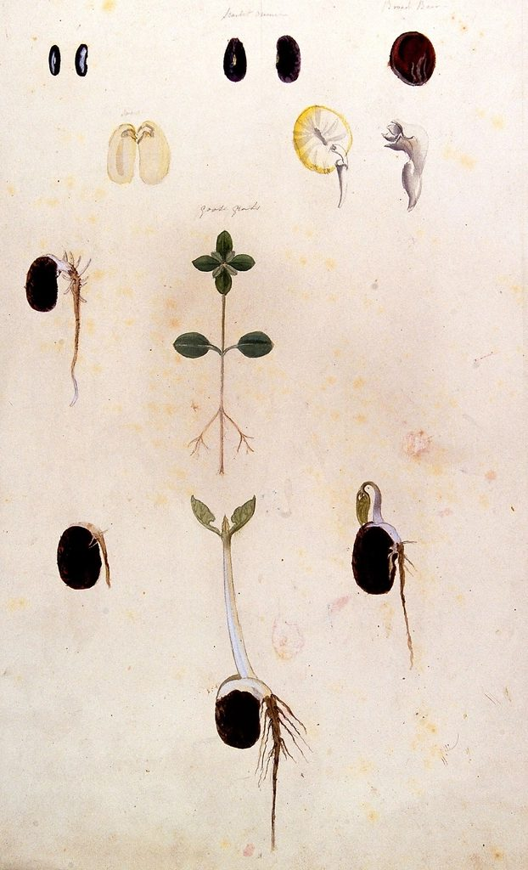
One sugar, a whole plant
HOOK
The wood of a tree, the oil in a sunflower seed, the protein in a bean, the starch in a potato: all of it was built from glucose made in photosynthesis. How can one sugar become so many different things?
Talk to a partner: what else does the plant need, apart from glucose?
Germinating seeds (botanical drawing)
Image: unknown, CC0, via Wikimedia Commons
Notes:
Expected ideas: the plant joins glucose molecules into long chains (polymers), changes them into other substances, and adds elements from mineral salts, especially nitrogen from nitrates for proteins. All life on Earth depends on this: photosynthetic organisms also keep the balance of carbon dioxide and oxygen in the air.

Slide 5
Carbohydrates: starch and cellulose
LEARN
Glucose molecules are linked together to form starch, a polymer.
Starch stays in the chloroplasts until photosynthesis stops, then it is broken down into sugars and carried in the phloem.
In storage organs such as potatoes, and in seeds, sugars are turned back into starch.
Sugars are also used to make cellulose, the polymer that builds cell walls.
Key idea Starch is insoluble, so it is a good store; sugars are soluble, so they can be transported.
Key words starch · polymer · cellulose
Notes:
Ask: when is starch broken down in the chloroplasts, day or night? At night, when photosynthesis has stopped and the sugar is needed elsewhere. Starch does not dissolve, so it does not draw water into the cell; that is why plants store starch rather than glucose.

Slide 6
Lipids and proteins
LEARN
Lipids are fats and oils. They do not dissolve in water.
Plants use lipids for the waterproof cuticle, for cell membranes, and as energy stores in seeds and in fruits such as avocado.
Proteins are polymers: long chains of amino acids.
To make amino acids a plant needs nitrogen, which comes from nitrates in the soil.
All enzymes are proteins, including the enzymes for photosynthesis and respiration.
Key idea No nitrates, no amino acids, no proteins, no enzymes: the plant cannot grow.
Key words lipid · protein · amino acid · enzyme · nitrate
Notes:
Humans use plant lipids too: cooking oil, margarine, biodiesel. Why do fruits contain oils? To encourage animals to eat the fruit and spread the seeds. Seeds store lipids and protein to supply the seedling before its leaves open.

Slide 7
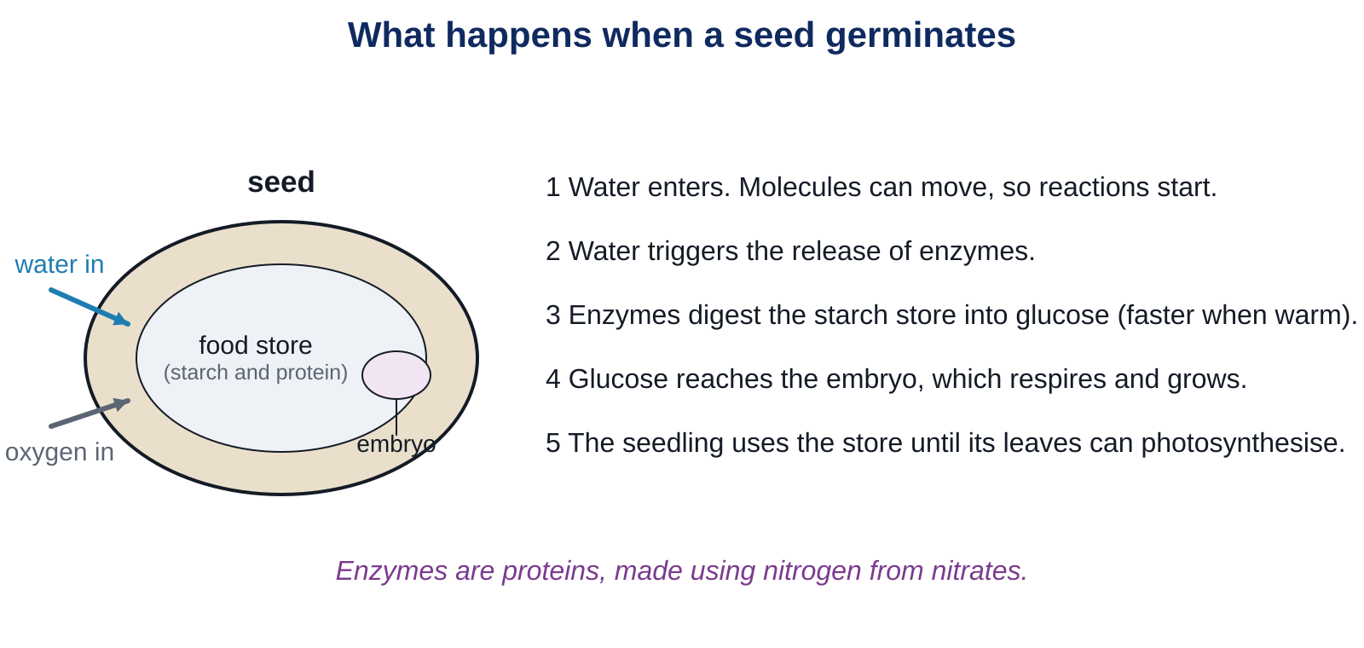
A seed germinates
LEARN
A seed stores starch and protein. What has to happen before the embryo can use the store?
Key idea Water starts everything: enzymes digest the starch to glucose, the embryo respires and grows. Enzymes work faster when it is warm.
Key words germination · enzyme
Notes:
Walk through the five steps. Ask: why do gardeners sow seeds in spring, not winter? Warmth makes the enzymes work faster. Why does a seed need oxygen? For aerobic respiration to release energy for growth.

Slide 8
Testing for starch and glucose
LEARN
Iodine solution turns from orange-brown to blue-black with starch.
Only the green parts of a variegated leaf go blue-black: starch is made where there is chlorophyll.
Benedict's solution is blue. Heated with glucose it turns green, then orange-red.
Both tests are used to check what a seed or a leaf contains.
Key idea Starch: iodine, blue-black. Glucose: Benedict's, heated, orange-red.
Key words iodine solution · Benedict's solution
Notes:
Explain the practical they are about to do: the leaf is boiled briefly to kill it, the chlorophyll is removed with warm ethanol so the colour change shows, then iodine is added. Benedict's must be heated in a water bath; it is on the Stretch questions, not done today.

Slide 9
Quick check
CHECK
Mini whiteboards. One answer each, then we check.
Q1 Which polymer do plants make from glucose as an energy store?
Q2 Which polymer builds plant cell walls?
Q3 What are proteins made of?
Q4 Which mineral salt supplies the nitrogen for amino acids?
Q5 What colour does iodine solution turn with starch?
Notes:
Answers: starch; cellulose; amino acids; nitrates; blue-black. Then the safety slide.

Slide 10
Safety: testing a leaf for starch
SAFETY
Goggles on for the whole practical. Iodine stains skin and clothes and irritates eyes.
Hot water comes from the kettle. Carry the beaker with two hands and keep it on the bench.
Ethanol is flammable. Heat it ONLY by standing the boiling tube in the hot water. No Bunsen burners in the room today.
Use forceps to move the leaf. Do not touch the hot leaf or the hot tube.
Wash your hands at the end and report any spill at once.
Notes:
Read every line aloud. Check there are no flames anywhere in the room before any ethanol is poured. Fill the beakers with hot (not boiling) water yourself.

Slide 11
Testing a variegated leaf for starch
PRACTICAL
Aim To find out which parts of a variegated leaf contain starch.
Equipment
Method
variegated leaf from a plant kept in bright light
beaker of hot water
boiling tube with about 2 cm depth of ethanol
forceps
white tile
iodine solution and dropper
goggles
worksheet
Draw the leaf on the worksheet. Mark which parts are green and which are white.
Hold the leaf with forceps and dip it in the hot water for 30 seconds. This kills the leaf and softens it.
Put the leaf in the boiling tube of ethanol. Stand the tube in the beaker of hot water for about 5 minutes, until the leaf is pale and the ethanol is green.
Take the leaf out with forceps and dip it in the hot water again to soften it.
Spread the leaf on the white tile. Cover it with drops of iodine solution.
Wait one minute. Draw the result and label where it went blue-black.
Safety Goggles on. Ethanol only in the water bath, never near a flame. Forceps for the leaf.
Notes:
Expected result: the parts that were green turn blue-black (starch present); the white parts stay orange-brown (no chlorophyll, no photosynthesis, no starch). While tubes stand in the hot water, students do Core 2 and 3. Everything in the tray at the end; ethanol back in the labelled container.

Slide 12
Plenty of light, still not growing
THINK AND REFLECT
A tomato plant in a greenhouse gets lots of light, water and carbon dioxide, but the soil has very few nitrates. Explain why it grows badly even though it photosynthesises well.
Sentence frames
The plant can make ___ by photosynthesis, but ___.
Without nitrates it cannot make ___, so it cannot make ___.
Enzymes are ___, so ___.
Notes:
Expected: it can make glucose, but glucose is not enough to build new cells; without nitrates it cannot make amino acids, so no proteins; enzymes are proteins, so even photosynthesis and respiration slow down. This is why farmers add nitrate fertiliser, which is next lesson.

Slide 13
Exit ticket
EXIT TICKET
4
min
On your worksheet exit ticket. Work alone. Hand it in as you leave.
1. Which solution tests for starch, and what colour does it turn?
2. Why do seeds need a store of starch?
3. What are enzymes made of, and which mineral salt do plants need to make them?
Notes:
Answers: iodine solution, blue-black; the starch is digested to glucose for respiration and growth until the seedling's leaves can photosynthesise; enzymes are proteins, made from amino acids, which need nitrogen from nitrates. Collect the strips.

Slide 14
What we learned
SUMMARY
Glucose is joined into starch (an energy store) and cellulose (cell walls); sugars are moved in the phloem.
Lipids make the cuticle, cell membranes and energy stores in seeds and fruits.
Proteins are chains of amino acids, which need nitrogen from nitrates; all enzymes are proteins.
A germinating seed uses water, enzymes and respiration to turn its stored starch into growth.
Iodine tests for starch (blue-black); Benedict's tests for glucose (orange-red when heated).
Next lesson Growing crops: how farmers use fertilisers, pesticides and new varieties to get a bigger yield.
Notes:
Homework: Workbook page 19. Remind students to finish the leaf drawing with labels.

