Slide 1
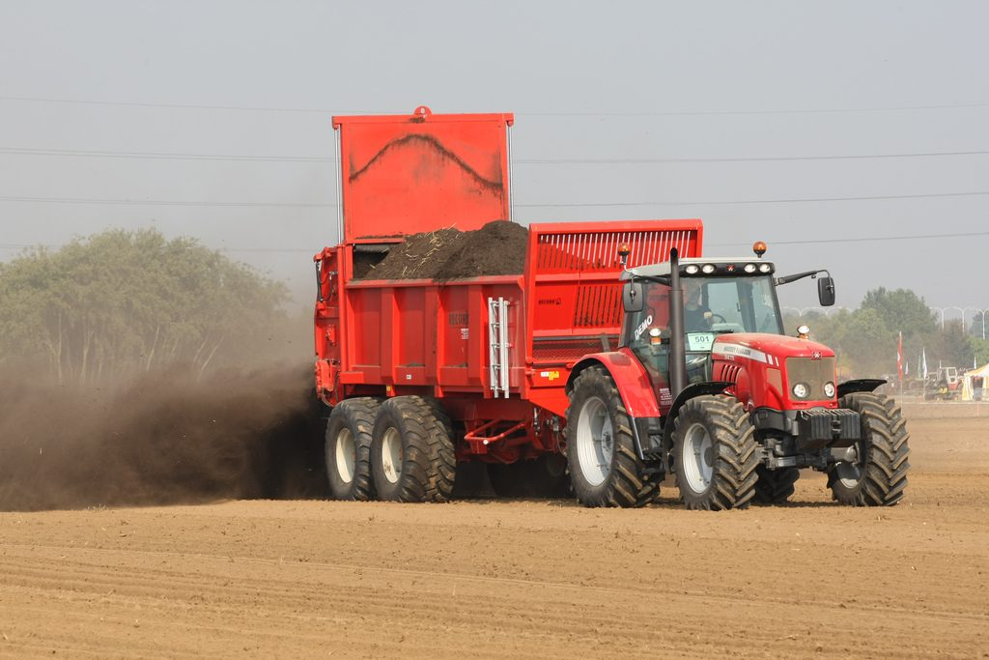
Growing crops
YEAR 9 SCIENCE · 9B PLANT GROWTH · LESSON 5 OF 7
How do farmers get the biggest harvest from the same field?
Exploring Science International 9 · Student Book pages 28 to 31 · Workbook pages 20 to 22
Notes:
Lesson 5 of 9B. We move from the plant to the farm: what a farmer does to raise the yield, and the problems that come with it (next lesson).

Slide 2
Do Now: more from the same field
DO NOW
4
min
1. What does the yield of a crop mean?
2. Name three things a crop plant needs that a farmer can provide.
3. Suggest why a farmer might remove a hedge from the edge of a field.
Spreading fertiliser
Image: eutrophication&hypoxia, CC BY 2.0, via Wikimedia Commons
Notes:
Answers: the amount of useful product from the crop; e.g. water, mineral salts (fertiliser), light (greenhouse), warmth, protection from pests; to make space for big machines and more crop. Keep question 3 in mind for next lesson: hedges are habitats.

Slide 3
Today
TODAY
Today I can ...
I can explain how fertilisers, pesticides, greenhouses and machines increase crop yield, and how pests and population growth change the food supply.
I can describe how new varieties are made by cross-breeding and selective breeding, and interpret the results of a fertiliser investigation.
Key words today
yield
fertiliser
manure
decomposer
pesticide
insecticide
fungicide
herbicide
weed
variety
selective breeding
Meanings are in the key words box on your worksheet.
Notes:
Read each goal aloud. Point to the key words box on the worksheet; three of today's words end in -cide, which means 'kills'.

Slide 4
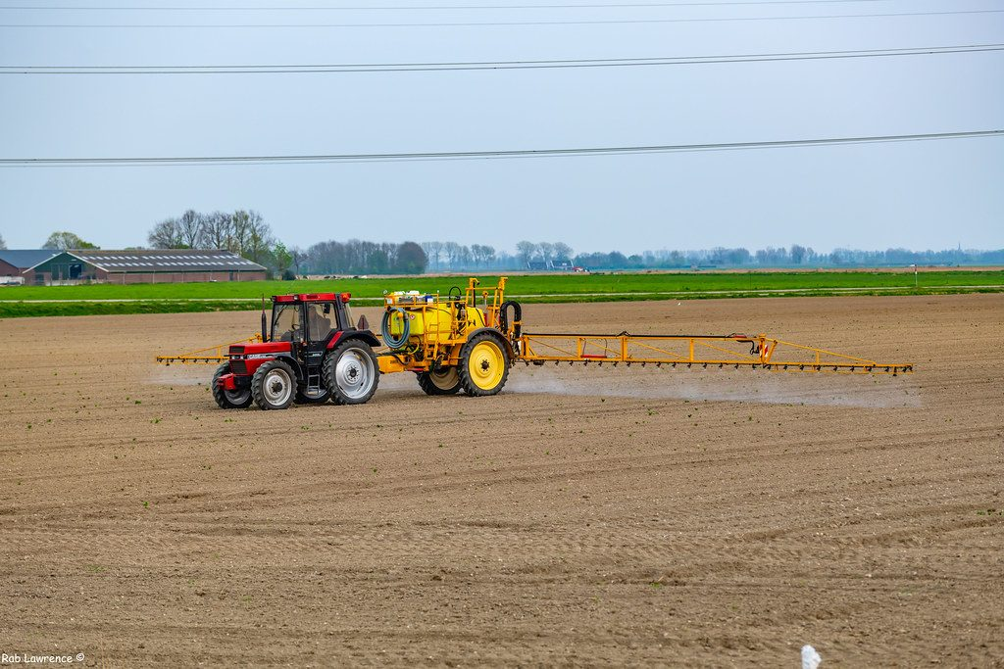
35 per cent more food
HOOK
Farms in the UK today produce 35% more food from each square metre of land than they did in 1973. How?
Talk to a partner. Make a list of everything a farmer could change.
Spraying a crop
Image: Rab ., CC BY 2.0, via Wikimedia Commons
Notes:
Build a list on the board: fertilisers, pesticides, better varieties, machines, greenhouses, irrigation, removing hedges. The Challenge question asks students to explain three of these, so leave the list up.

Slide 5
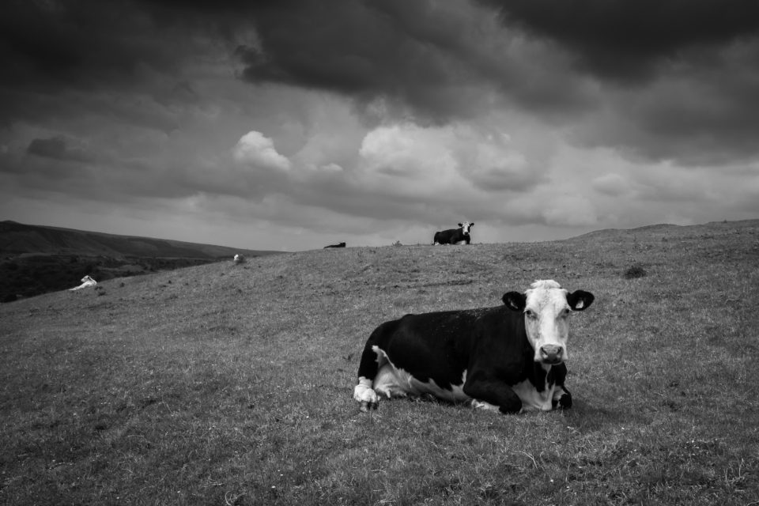
Fertilisers and the best conditions
LEARN
Fertilisers contain mineral salts that help plants grow: nitrates, phosphates and potassium.
Artificial fertilisers are cheap, dissolve in water and act fast.
Manure (animal waste) is natural: decomposers break it down and release the mineral salts slowly.
Greenhouses protect crops from changes in abiotic factors such as temperature, wind and rain.
Machines plant and harvest faster than people; forests and hedges are cleared to make room for them.
Manure from farm animals is a natural fertiliser
Image: Ian Livesey, CC0, via Wikimedia Commons
Key idea Fertiliser supplies the mineral salts a plant builds with; the plant still makes its own food.
Key words fertiliser · manure · decomposer
Notes:
Ask: too little phosphate gives poor root growth; what does too little nitrate give? Poor growth and yellow leaves (proteins and chlorophyll). Manure is spread before planting so the decomposers have time; artificial fertiliser is sprayed on the growing crop because it works at once.

Slide 6
A fertiliser investigation
LEARN
Four groups each grew 20 bean plants in identical pots, one plant per pot.
Each group added a different number of drops of the same liquid fertiliser.
Describe the trend from 2 to 6 drops.
What happened with 8 drops?
Key idea More fertiliser helps up to a point; too much can harm the plants. There is an optimum amount.
Key words yield · fertiliser
Notes:
Trend: growth increases as fertiliser increases from 2 to 6 drops; at 8 drops growth is lower. Why might too much fertiliser harm a plant? Too concentrated a solution around the roots can stop them absorbing water (link to osmosis in 9C). Students plot this chart on the worksheet.

Slide 7
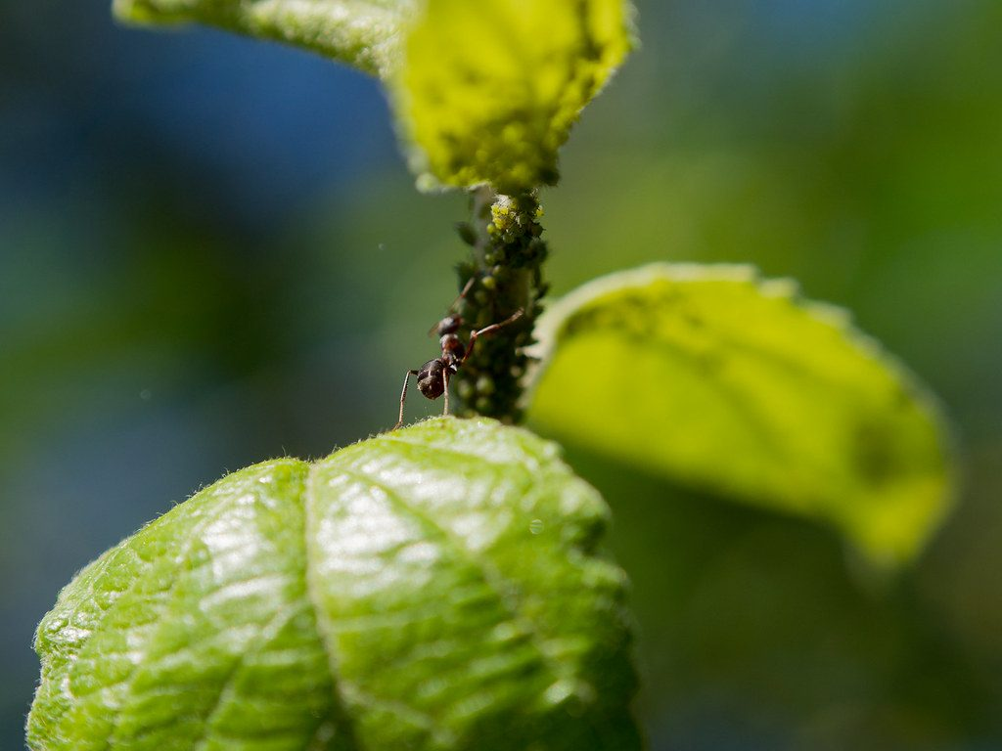
Pesticides
LEARN
Pests are organisms that damage crops. Pesticides kill them.
Insecticides kill insect pests such as aphids.
Fungicides kill fungi that cause plant diseases such as rust.
Herbicides (weedkillers) kill weeds, which compete with the crop for water, light and mineral salts.
Selective herbicides kill broad-leaved weeds but not narrow-leaved crops such as wheat.
Aphids suck sugary sap from the phloem
Image: Ivan Radic, CC BY 2.0, via Wikimedia Commons
Key idea -cide means 'kills': insecticide, fungicide and herbicide are all pesticides.
Key words pesticide · insecticide · fungicide · herbicide · weed
Notes:
Why does killing aphids raise the yield? Aphids take the sugar solution from the phloem, so less sugar reaches the grain or fruit. Selective herbicides are expensive: farmers in low-income countries may weed by hand instead (Stretch 2).

Slide 8
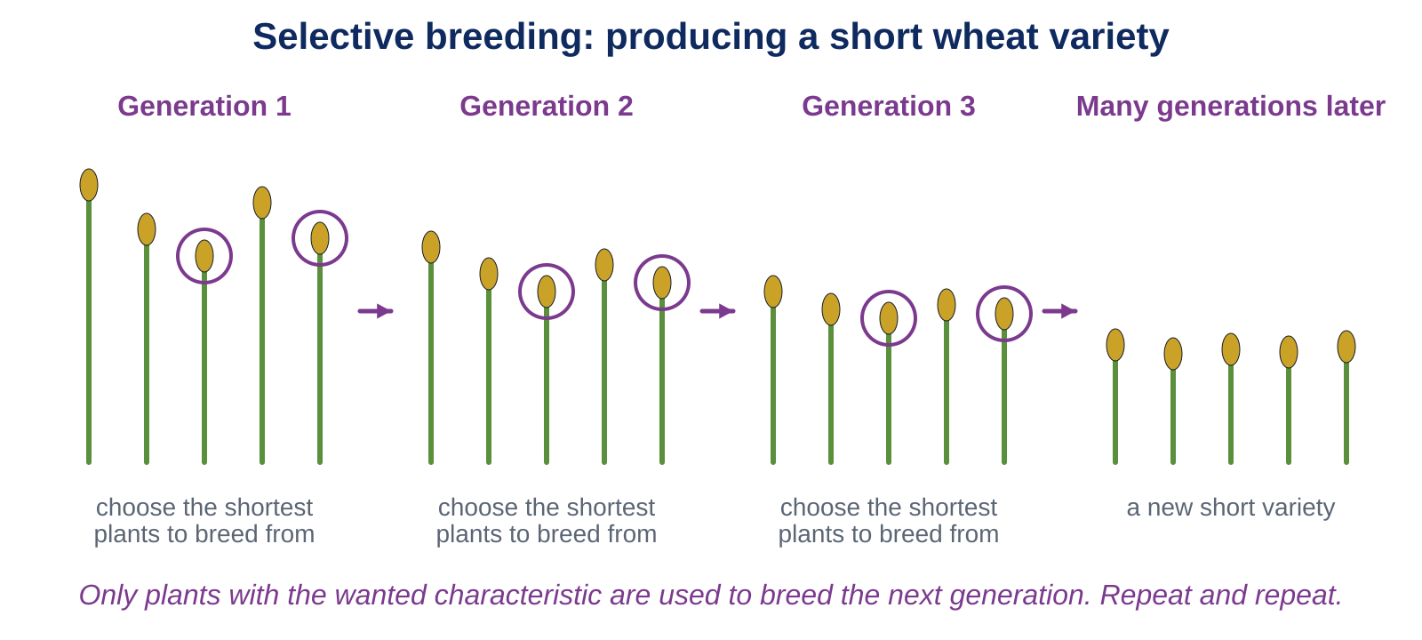
New varieties
LEARN
A variety is a group of plants bred to have certain characteristics, such as resistance to rust disease or short stems that do not blow over.
Key idea Cross-breeding: two varieties bred together to combine their characteristics. Selective breeding: only the best plants are used to breed, generation after generation.
Key words variety · selective breeding
Notes:
Walk through the diagram: choose the shortest plants, breed them, choose the shortest of their offspring, repeat. Modern wheat is short and rust-resistant; a 1950s variety is tall and gets rust, so it is no longer grown. Challenge 1 uses the same idea with apples.

Slide 9
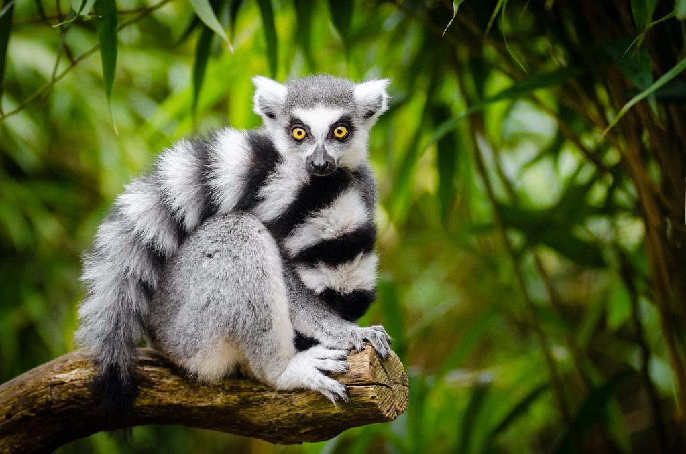
Food supply and wild plants
LEARN
In low-income countries many families grow their own crops. More people in the family, or more pests, means less food for each person.
Selective herbicides cost money, so some farmers weed by hand.
Farming can also destroy the habitats of wild plants. Endemic species, found nowhere else, are most at risk.
The IUCN Red List classifies species from least concern to critically endangered.
Before land is farmed, a plant ecologist may carry out an ecological audit.
The ring-tailed lemur is listed as Endangered on the IUCN Red List
Image: Mathias Appel, CC0, via Wikimedia Commons
Key idea Raising the food supply and protecting wild plants both matter; an ecological audit helps decide where farming can expand.
Key words yield
Notes:
An ecological audit records which species are present, how many there are, where they are and which are endangered; the evidence goes into a report that can recommend Key Biodiversity Area status. The My thinking question asks what the audit should record.

Slide 10
Quick check
CHECK
Mini whiteboards. One answer each, then we check.
Q1 Which type of pesticide kills weeds?
Q2 Name two mineral salts found in fertilisers.
Q3 Which fertiliser works more slowly, manure or artificial fertiliser? Why?
Q4 In the bean investigation, which number of drops gave the most growth?
Q5 What is a variety?
Notes:
Answers: herbicide; nitrates, phosphates, potassium (any two); manure, because decomposers must break it down first; 6 drops; a group of plants bred to have certain characteristics.

Slide 11
Your turn
DO
14
min
1
Core: match the pesticides, plot the bean plant results on the grid and describe the trend, then fill the gaps on fertilisers.
2
Stretch: aphids and yield; selective herbicides; improving the investigation.
3
Challenge: breeding a yellow sweet apple; 35% more food since 1973.
4
Finished? Answer the My thinking question about the ecological audit.
Bar chart: the four groups are separate categories, so leave gaps between the bars. Label both axes with units.
Notes:
Check the charts: category axis labelled with the number of drops, height axis in cm, bars with gaps. The common error is joining the tops of the bars with a line as if it were continuous data.

Slide 12
Advice for the farmer
THINK AND REFLECT
Group 4 added 8 drops and got less growth than group 3 with 6 drops. What would you advise a farmer about how much fertiliser to use? What would you change in the investigation to be more sure?
Sentence frames
I would advise the farmer to ___ because ___.
To be more sure, I would ___ because ___.
One thing we do not know is ___.
Notes:
Expected: use a medium amount (about 6 drops' worth), because more fertiliser reduced growth and costs money; repeat with more plants or more groups, test amounts between 6 and 8 drops, and measure for longer than a week. Also: we do not know the yield (beans), only the height.

Slide 13
Exit ticket
EXIT TICKET
4
min
On your worksheet exit ticket. Work alone. Hand it in as you leave.
1. What do fertilisers contain that helps plants grow?
2. What do herbicides kill, and why does this help the crop?
3. Describe one step in selective breeding.
Notes:
Answers: mineral salts such as nitrates, phosphates and potassium; weeds, which compete with the crop for water, light and mineral salts; choose only the plants with the wanted characteristic to breed from (and repeat over many generations). Collect the strips.

Slide 14
What we learned
SUMMARY
Yield is raised by fertilisers (mineral salts), greenhouses, machines and clearing land.
Too much fertiliser can reduce growth: there is an optimum amount.
Pesticides kill pests: insecticides, fungicides and herbicides; selective herbicides spare narrow-leaved crops.
New varieties come from cross-breeding and selective breeding over many generations.
Farming must be balanced against protecting wild plants, especially endemic species.
Next lesson Farming problems: fertiliser in rivers, persistent pesticides, single varieties and the carbon cycle.
Notes:
Homework: Workbook pages 20 to 22. Page 22 is the ecological audit report template; it can be done in pairs.

