Slide 1
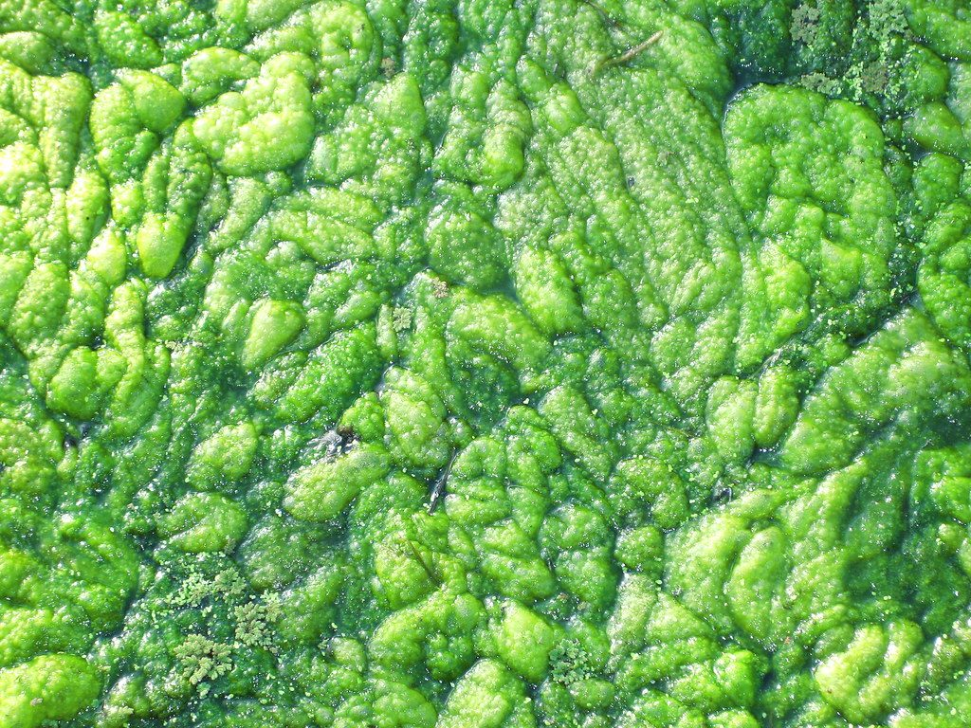
Farming problems and the carbon cycle
YEAR 9 SCIENCE · 9B PLANT GROWTH · LESSON 6 OF 7
If fertilisers and pesticides raise the yield, what is the cost?
Exploring Science International 9 · Student Book pages 32 to 33 · Workbook pages 23 to 24
Notes:
Lesson 6 of 9B. Last lesson: how farmers raise yield. This lesson: the damage those methods can do, and how the carbon cycle links farming to the whole planet.

Slide 2
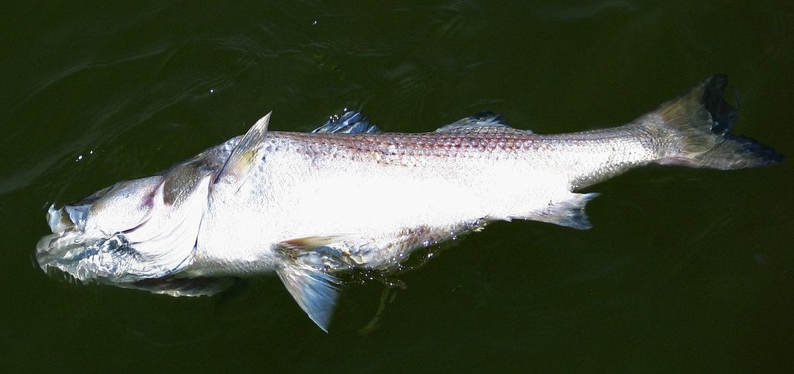
Do Now: the dead fish
DO NOW
4
min
1. What do fish need from the water for respiration?
2. Name one farm chemical that rain can wash into a river or lake.
3. Suggest how these fish died.
Fish killed in a lake
Image: eutrophication&hypoxia, CC BY 2.0, via Wikimedia Commons
Notes:
Answers: oxygen (dissolved in the water); fertiliser (or pesticide, manure); most students will say 'poisoned': keep that idea for the hook, because the real chain is longer and more interesting.

Slide 3
Today
TODAY
Today I can ...
I can explain how fertilisers, pesticides and clearing land can harm wild organisms, including eutrophication and bioaccumulation.
I can use the carbon cycle to explain how farming and burning fuels change the carbon dioxide in the air, and suggest ways to farm more sustainably.
Key words today
habitat
eutrophication
algae
decomposer
persistent
bioaccumulation
food web
biodiversity
carbon cycle
combustion
global warming
sustainable development
Meanings are in the key words box on your worksheet.
Notes:
Read each goal aloud. Point out the carbon cycle key words; students met photosynthesis and respiration in Lesson 1.

Slide 4
Nobody poisoned the pond
HOOK
After a wet spring, a pond next to a farm turned bright green. Within two weeks the fish were dead. Nobody poisoned the pond. What happened?
Talk to a partner: what made the water green, and why would that kill fish?
An algal bloom
Image: suavehouse113, CC BY 2.0, via Wikimedia Commons
Notes:
Collect ideas. The green is algae, fed by fertiliser washed off the field. The fish died of a lack of oxygen, not poison. The next slide gives the full chain.

Slide 5
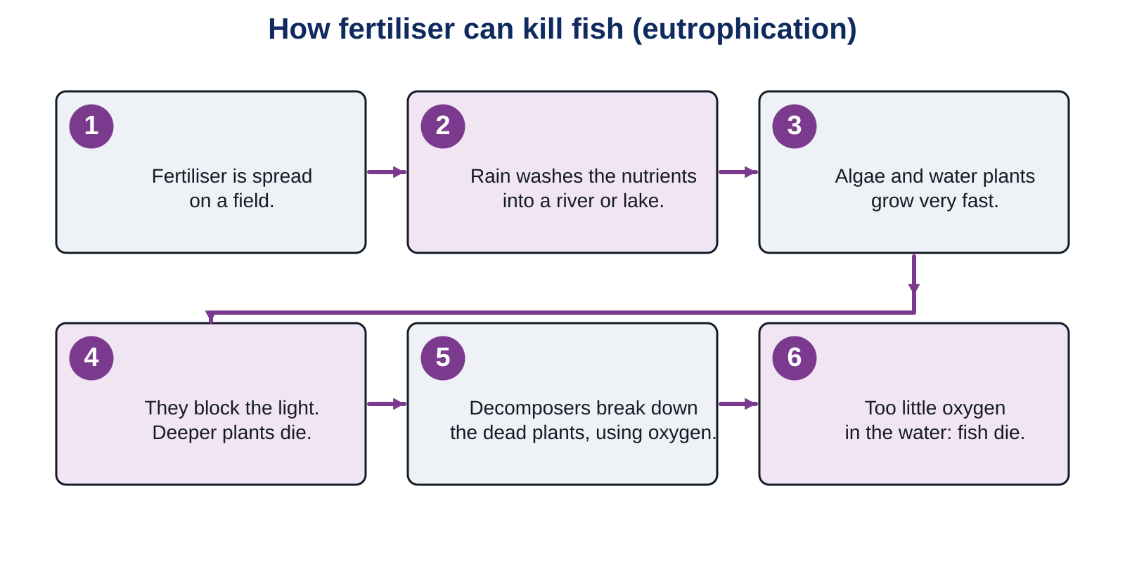
Eutrophication
LEARN
A very rich supply of nutrients in the water sets off a chain that ends with no oxygen for the fish.
Key idea Fertiliser feeds the algae; the decomposers that break down the dead plants use up the oxygen; the fish suffocate.
Key words eutrophication · algae · decomposer
Notes:
Walk through the six steps and have students repeat the chain back in pairs. Manure causes the same problem and can also carry harmful microorganisms. Core 1 on the worksheet asks them to put the steps in order.

Slide 6
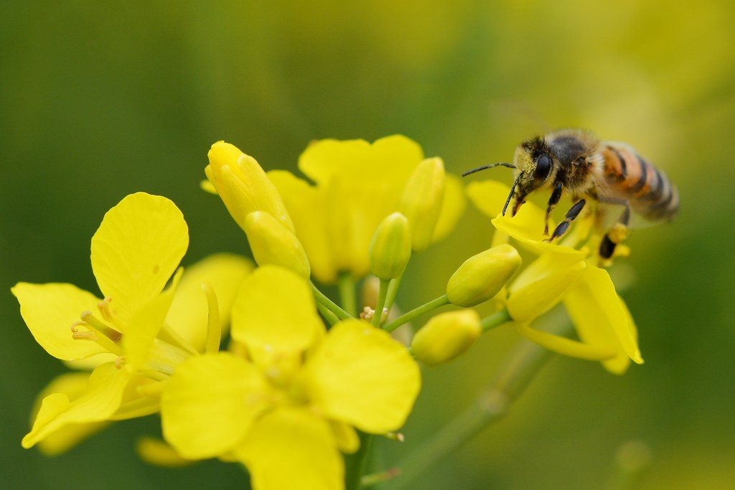
Pesticide problems
LEARN
Insecticides can kill helpful insects: the ones that pollinate crops and the ones that eat pests.
Some insecticides are persistent: they do not break down in the environment.
Predators eat many animals that each contain a little insecticide, so the top predator gets a large amount. This is bioaccumulation.
In 2014 the EU banned some neonicotinoid insecticides on flowering crops because they made nectar and pollen poisonous to bees.
Selective herbicides also kill the broad-leaved plants in hedges.
A bee on rapeseed
Image: Gilles San Martin, CC BY-SA 2.0, via Wikimedia Commons
Key idea A persistent pesticide does not stay where it was sprayed: it travels up the food chain.
Key words persistent · bioaccumulation
Notes:
Why rapeseed and not wheat? Rapeseed flowers and is visited by bees; wheat is wind-pollinated, so bees do not collect from it. Bioaccumulation is why top predators such as birds of prey were harmed by DDT in the 1950s and 1960s.

Slide 7
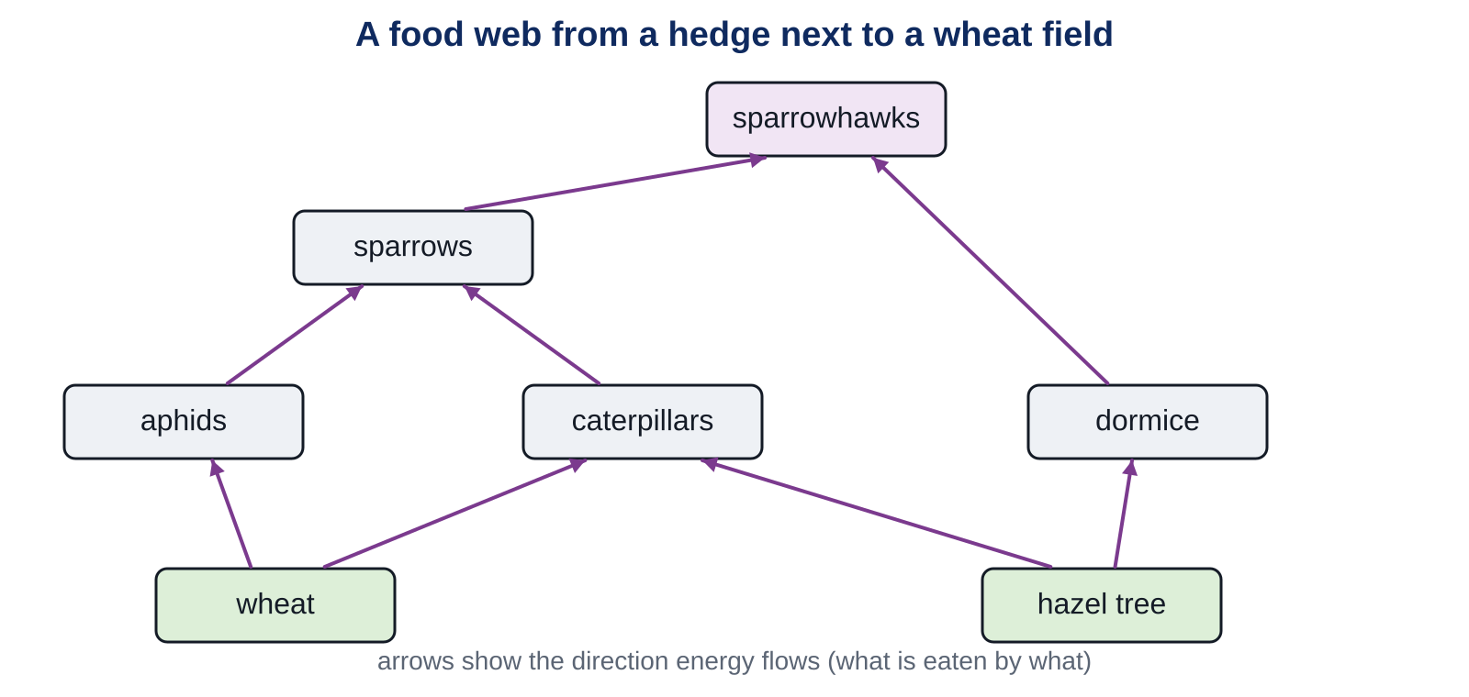
A food web from a hedge next to a wheat field
LEARN
What happens to each population if the farmer sprays the wheat with a general insecticide? With a selective herbicide?
Key idea Remove one link in a food web and the effects spread to organisms that were never sprayed.
Key words food web
Notes:
General insecticide: aphids and caterpillars fall; sparrows have less food and fall; sparrowhawks fall; dormice may rise a little (less competition for hazel) but sparrowhawks hunt them more. Selective herbicide: broad-leaved hedge plants and the hazel suffer, so caterpillars and dormice fall, and so on up the web. Core 2 on the worksheet.

Slide 8
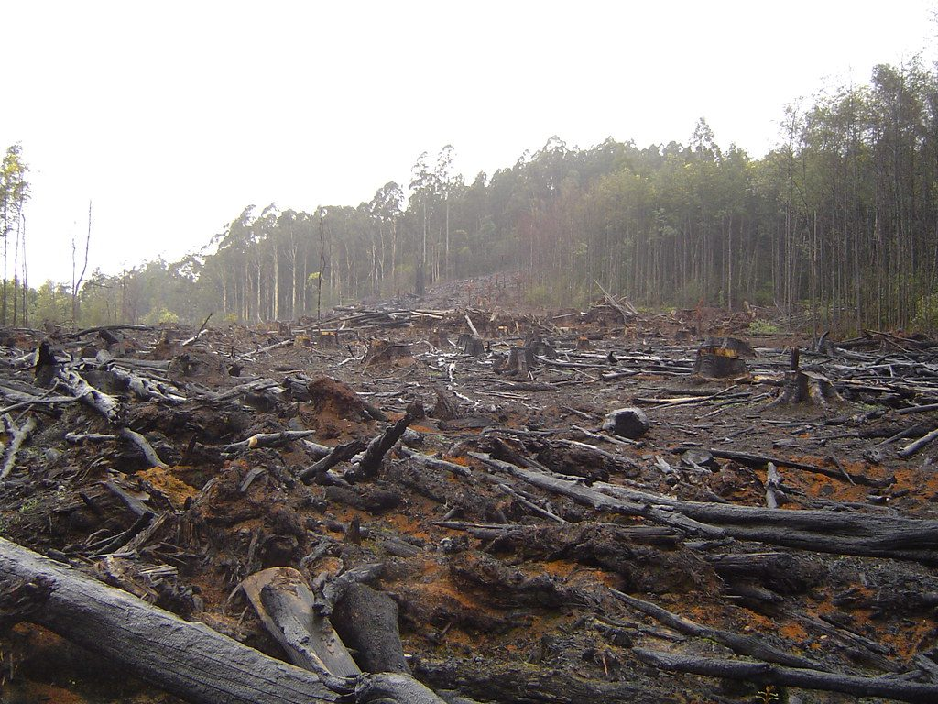
Clearing land and single varieties
LEARN
Clearing land for crops or machines destroys habitats, so populations of wild organisms fall.
Farmers often plant one variety over a huge area. All the plants are identical, so if one gets a disease, all of them do.
In 19th century Ireland most people lived on one potato variety. Between 1845 and 1852 a disease wiped it out and over a million people starved.
A single variety reduces biodiversity: the food webs are smaller and the area takes longer to recover after a disaster.
Forest cleared for farmland
Image: crustmania, CC BY 2.0, via Wikimedia Commons
Key idea Low biodiversity is fragile. One disease, one pest or one drought can take everything.
Key words habitat · biodiversity
Notes:
Link back to Lesson 5: selective breeding makes varieties uniform, which is exactly what makes them vulnerable. A huge area of wheat for many years also uses up the same mineral salts, which is the workbook's rapeseed question.

Slide 9
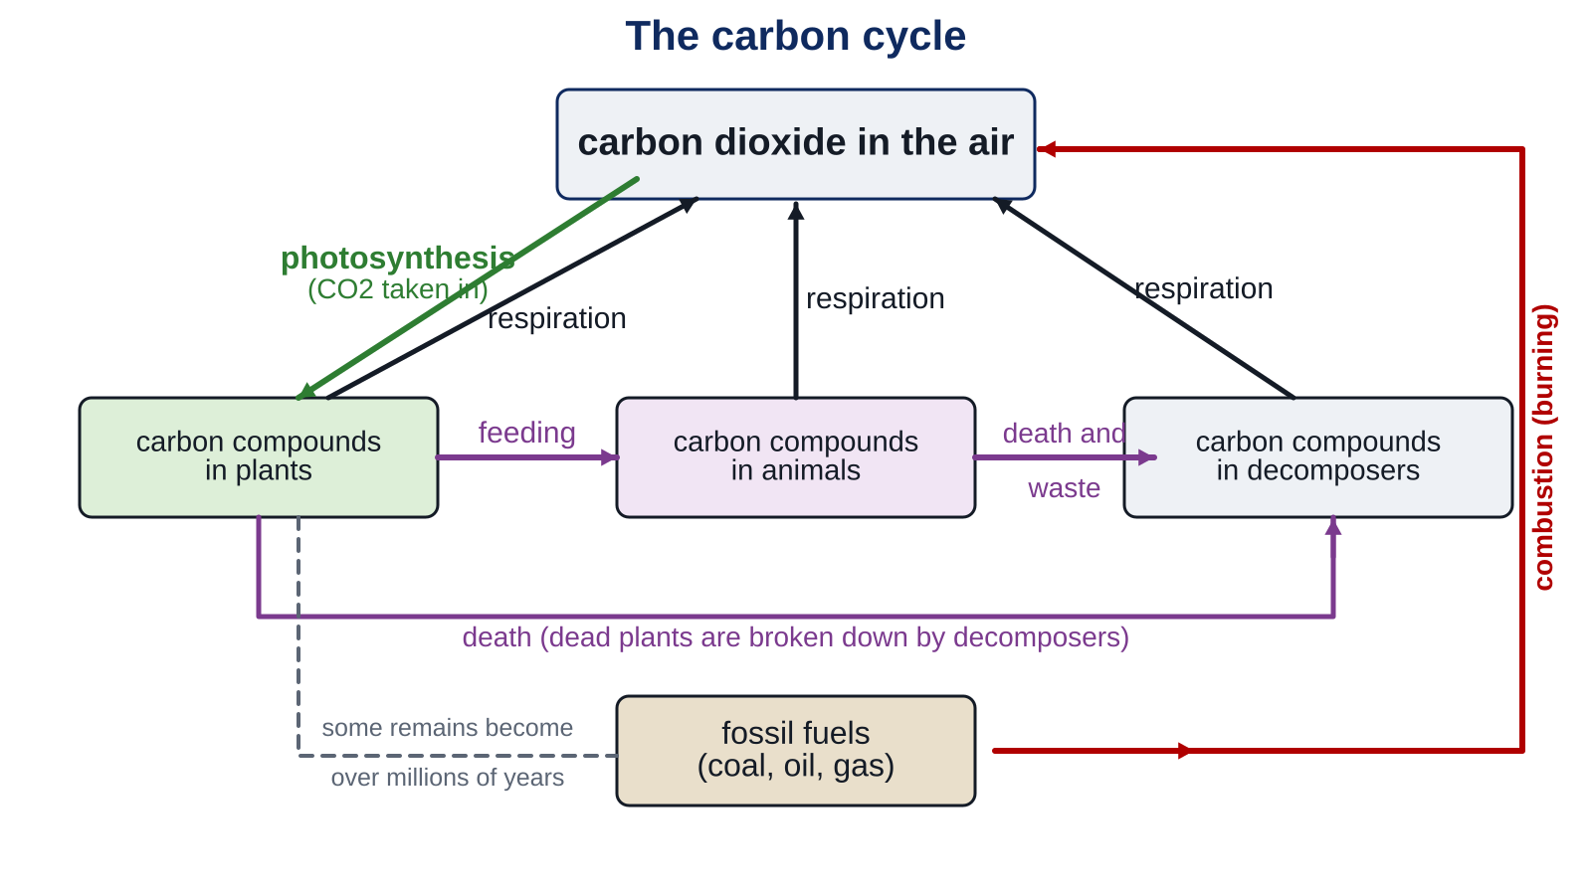
The carbon cycle
LEARN
Photosynthesis removes carbon dioxide from the air. Respiration, decomposers and combustion put it back.
Key idea Burning fossil fuels and cutting down forests have raised carbon dioxide in the air for 200 years, which is thought to cause global warming.
Key words carbon cycle · combustion · global warming
Notes:
Trace one carbon atom: in the air, into a wheat plant by photosynthesis, into a person who eats bread, back to the air by respiration. Carbon is stored in trees for a long time; in crops it returns quickly when they are eaten or burnt. Cutting forests removes a store and stops photosynthesis; burning them adds carbon dioxide at once.

Slide 10
Quick check
CHECK
Mini whiteboards. One answer each, then we check.
Q1 Which organisms use up the oxygen in a lake after an algal bloom?
Q2 What does persistent mean for a pesticide?
Q3 Which process removes carbon dioxide from the air?
Q4 Name two processes that release carbon dioxide into the air.
Q5 Why is planting one variety over a huge area risky?
Notes:
Answers: decomposers (bacteria); it does not break down in the environment; photosynthesis; respiration, combustion (also decomposition); if one plant gets a disease, all the identical plants do.

Slide 11
Your turn
DO
14
min
1
Core: number the eutrophication steps, predict the changes in the hedge food web, match the carbon cycle processes.
2
Stretch: bacteria and fish; nitrates and algae; deforestation and carbon dioxide.
3
Challenge: the Irish potato famine; bioaccumulation and the neonicotinoid ban.
4
Finished? The My thinking question is about cement.
Every explanation should be a chain: this happens, so this happens, so this happens.
Notes:
Model a chain answer on the board for the fish: fertiliser in the water, so algae grow fast, so light is blocked, so plants die, so decomposers use oxygen, so fish die. Insist on 'so' or 'because' links in every Stretch answer.

Slide 12
Should farmers stop using fertilisers?
THINK AND REFLECT
Fertilisers raise yields and feed people, but they can wash into rivers. Should farmers stop using them? Give one point for each side, then decide.
Sentence frames
One reason to keep using fertilisers is ___.
One problem is ___, because ___.
A sustainable solution could be ___.
Notes:
Expected: for: higher yields, more food, cheaper food; against: eutrophication, cost; sustainable solutions: use less and only when the crop needs it, keep a strip of unploughed land by rivers, use manure carefully, grow clover to add nitrates. This is the idea of sustainable development: meeting our needs without destroying habitats.

Slide 13
Exit ticket
EXIT TICKET
4
min
On your worksheet exit ticket. Work alone. Hand it in as you leave.
1. What does eutrophication mean?
2. Name two processes that release carbon dioxide into the air.
3. Why is it risky to plant one variety of crop over a very large area?
Notes:
Answers: a very rich supply of nutrients in water, causing fast growth of algae and plants (leading to fish deaths); respiration, combustion, decomposition (any two); all the plants are identical, so one disease can kill the whole crop. Collect the strips.

Slide 14
What we learned
SUMMARY
Fertiliser washed into water causes eutrophication: algae grow, plants die, decomposers use the oxygen, fish die.
Persistent pesticides build up along food chains (bioaccumulation) and can kill pollinators and pest predators.
Clearing land and growing single varieties reduce biodiversity and make food webs fragile.
Photosynthesis removes carbon dioxide; respiration, decomposers and combustion return it. Fossil fuels and deforestation are raising it.
Sustainable development means producing what we need without destroying habitats.
Next lesson Bias and validity: can we trust a graph, and is organic farming better?
Notes:
Homework: Workbook pages 23 and 24. The carbon cycle on page 24 uses the same diagram letters as the book.

