Slide 1
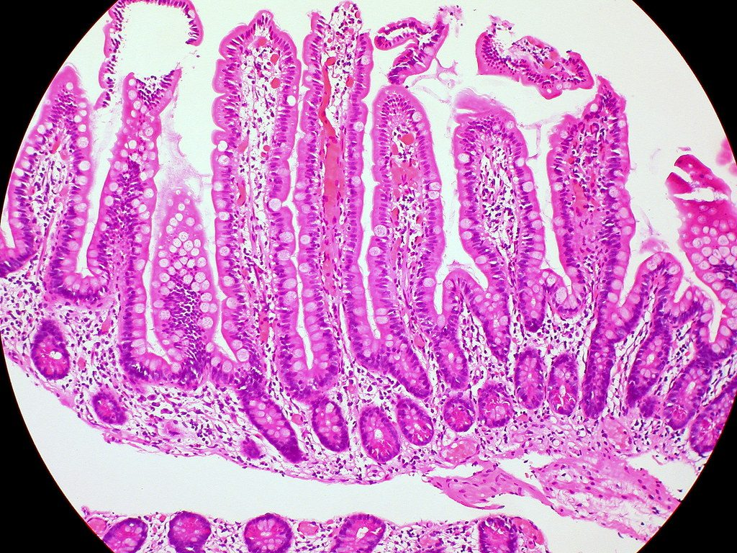
In and out: surface area, diffusion and osmosis
YEAR 9 SCIENCE · 9C THREAT FROM DISEASE · LESSON 7 OF 7
How do substances get into and out of cells, and why does size matter?
Exploring Science International 9 · Student Book pages 50 to 52 · Workbook pages 36 to 38
Notes:
Last lesson of 9C. It brings together diffusion (Year 7), surface area and osmosis, and ends with the Combatting pandemics review. If you can, cut and measure the potato strips and put them into the two liquids right after the Do Now, so they have 25 minutes to change.

Slide 2
Do Now: a 1 cm cube
DO NOW
4
min
A cube has sides of 1 cm.
1. Calculate its surface area. (It has 6 faces.)
2. Calculate its volume.
3. Which gas diffuses into cells so they can respire?
Notes:
Four minutes, in books. Surface area 6 x 1 cm2 = 6 cm2; volume 1 cm3; oxygen. If strips are being set up now, one student per group measures the length of each strip (mm) and records it in Core 3 before the strips go into the liquids.

Slide 3
Today
TODAY
Today I can ...
I can calculate a surface area : volume ratio and explain why it matters for cells and organisms.
I can describe how osmosis happens through a partially permeable membrane and use it to explain what I see.
Key words today
surface area
volume
ratio
diffusion
concentration gradient
osmosis
partially permeable membrane
cell membrane
unicellular
villi
pandemic
Meanings are in the key words box on your worksheet.
Notes:
Read each goal aloud. Point out the key words box on the worksheet. The Chinese key words version has the same words with Chinese beside them.

Slide 4
A deadly flat surface
HOOK
In the Second World War, one in six Allied soldiers who died in the tropics was killed by tropical sprue, a disease that flattens the lining of the small intestine. Why would a flatter lining be deadly?
Talk to a partner: what does the small intestine do, and how does a flat lining stop it?
Villi lining the small intestine (microscope view)
Image: euthman, CC BY 2.0, via Wikimedia Commons
Notes:
The small intestine absorbs digested food into the blood by diffusion. Villi (finger-like folds) give it a large surface area. Tropical sprue flattens them, so far less food and fewer vitamins diffuse into the blood: the soldiers developed deficiency diseases such as anaemia (too little vitamin B12).

Slide 5
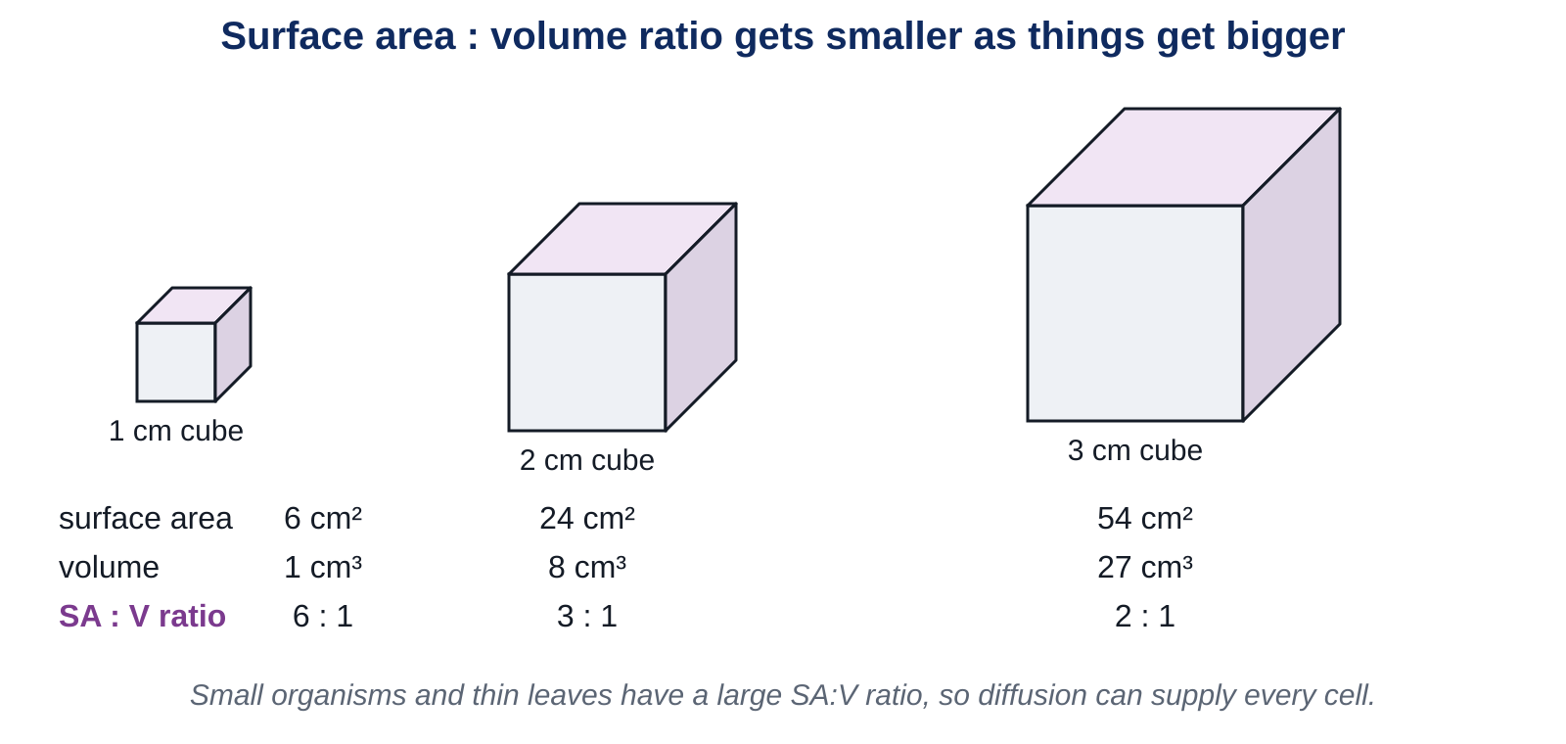
Surface area : volume ratio
LEARN
Surface area / volume gives the SA:V ratio. Compare the three cubes.
Key idea As an object gets bigger, its surface area : volume ratio gets smaller.
Notes:
1 cm cube: 6 cm2 / 1 cm3 = 6:1. 2 cm cube: 24 / 8 = 3:1. 3 cm cube: 54 / 27 = 2:1. The volume grows faster than the surface. Ask: which cube has the most surface for each cm3 inside? (The smallest.) Cuboid formula for the worksheet: SA = 2(l x h) + 2(l x w) + 2(w x h); V = l x w x h.

Slide 6
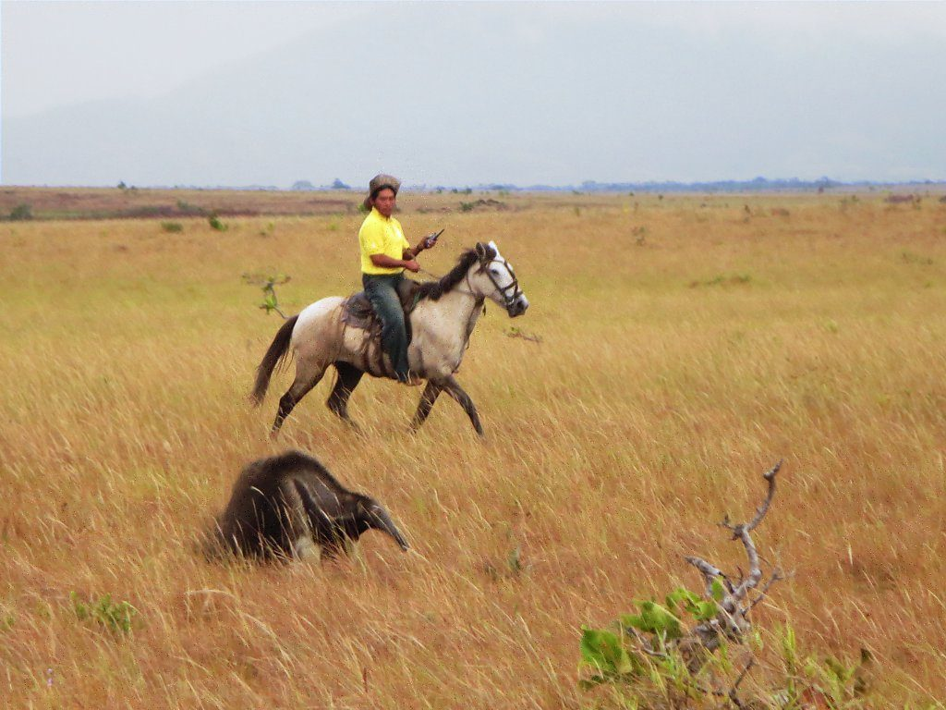
Why the ratio matters
LEARN
A unicellular organism has enough surface for diffusion to supply its whole volume.
Large organisms have too little outside surface, so they have organs with large surface areas (villi, lungs, leaves) and transport systems.
Small animals have a larger SA:V ratio, so they lose energy (cool down) faster and must eat more for their size.
A silky anteater (under 400 g) eats up to 5000 ants a day; a giant anteater (40 kg) eats 30 000.
A giant anteater (about 40 kg)
Image: D-Stanley, CC BY 2.0, via Wikimedia Commons
Key idea Large surface area : volume ratio = fast exchange with the surroundings.
Key words unicellular · villi · surface area
Notes:
Many unicellular organisms split in two when they reach a certain size, because their SA:V ratio would otherwise become too small for diffusion to supply the inside. The anteater calculation is in the Challenge: ants per gram of body mass.

Slide 7
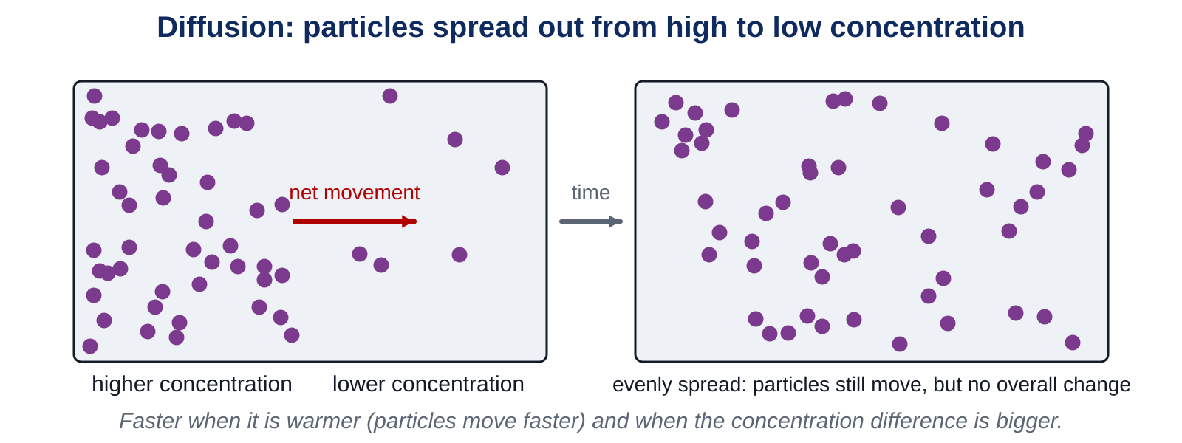
Diffusion: a reminder
LEARN
All particles move randomly. Where there is a concentration gradient, more particles move from the higher concentration to the lower than the other way.
Key idea Diffusion is faster when it is warmer and when the concentration difference is bigger.
Notes:
Particles never stop moving; once they are evenly spread there is no net movement, but diffusion of individual particles continues. Link: oxygen diffuses out of a leaf faster on a hot day (faster particles) and a windy day (the wind removes oxygen from outside the leaf, keeping the concentration gradient steep).

Slide 8
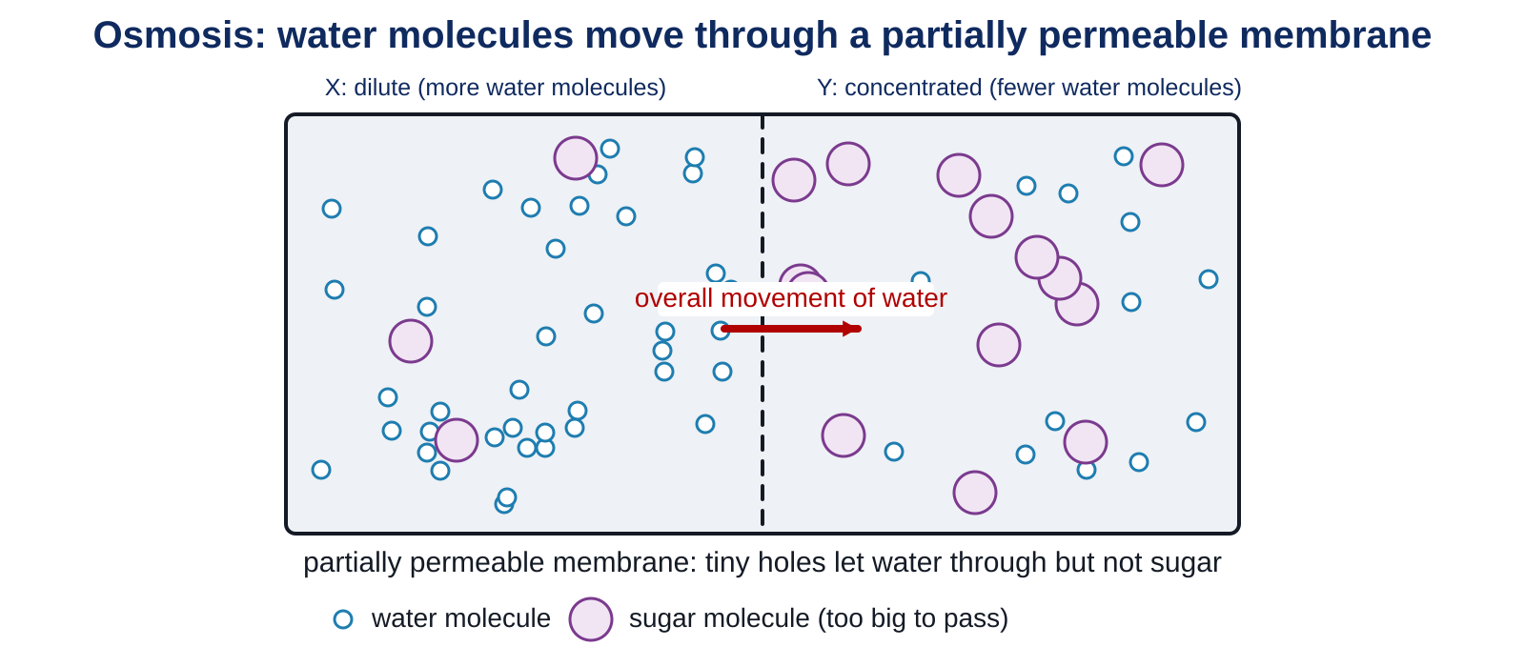
Osmosis
LEARN
Some membranes have tiny holes that let small molecules (water) through but not large ones (sugar). They are partially permeable.
Key idea Osmosis is the diffusion of water molecules through a partially permeable membrane, from where there are more water molecules to where there are fewer.
Notes:
Side X is dilute (more water molecules), side Y is concentrated. Water moves both ways, but more goes from X to Y, so the level on Y rises. Like diffusion, osmosis is faster when warmer and with a bigger concentration difference. Cell membranes are partially permeable: a cell in pure water gains water; a cell in strong salt solution loses it (the potato practical).

Slide 9
Safety: potato strips
SAFETY
Cut potato with a cork borer or knife on a board, cutting away from your fingers, or use the strips your teacher has prepared.
Salt solution is harmless to touch but slippery on the floor. Wipe up spills at once.
Do not eat the potato. Wash your hands at the end.
Notes:
Read the three lines aloud. Groups that are not confident with knives use pre-cut strips. Keep the tubes labelled W (water) and S (salt).

Slide 10
Osmosis in potato strips
PRACTICAL
Aim Find out what happens to potato tissue in pure water and in strong salt solution.
Equipment
Method
two potato strips of equal size
two tubes or beakers, labelled W and S
pure water and strong salt solution
ruler (mm), paper towel, optional balance
Measure the length of each strip to the nearest mm (and the mass, if you have a balance). Record in Core 3.
Put strip A into water (W) and strip B into salt solution (S). Note the time.
Work on the worksheet while you wait (at least 15 minutes).
Take the strips out, blot them gently and measure again.
Calculate the change in length (and mass). Feel each strip: firm or floppy?
Explain the changes using osmosis and the words partially permeable membrane.
Safety Knives on a board, cutting away from fingers. Wipe up spills. Wash hands.
Notes:
Expected: the strip in water gets slightly longer, heavier and firmer (water enters the cells by osmosis); the strip in salt solution gets shorter, lighter and floppy (water leaves the cells). If time is short, measure at the start of the exit ticket. The plasmolysis photo on the worksheet shows the same thing in cells.

Slide 11
Combatting pandemics: unit review
CHECK
Mini whiteboards. Choose A, B, C or D. Then check any wrong answers with the Student Book.
Q1 Which disease is caused by a pathogen? A measles B type 1 diabetes C cardiovascular disease D lung cancer
Q2 Which cells give immunity to a repeat infection? A phagocytes B red blood cells C platelets D memory lymphocytes
Q3 Which part of the nervous system contains receptor cells? A brain B sense organ C spinal cord D effector
Q4 Which word describes a chemical messenger in the body? A enzyme B hormone C carbohydrate D lipid
Q5 Which word describes an organism containing a gene from another species? A mutant B hybrid C transgenic D pathogen
Q6 A cell is placed in pure water. In which direction does water flow? A from cell into water B in both directions equally C from water into cell D no flow
Notes:
Answers: A, D, B, B, C, C. These are the six questions on Workbook page 38. Students correct any errors using the Student Book and their notes, then explain the correction to a partner.

Slide 12
Why pandemics spread faster now
THINK AND REFLECT
In 1918 a flu pandemic took months to cross the world. In 2020 a new virus reached every continent within weeks. Explain why rapid international travel makes a pandemic more likely.
Sentence frames
A pandemic is ___.
An infected person can ___ before they ___, so ___.
To slow a pandemic, countries could ___.
Notes:
Expected: a pandemic is a disease spreading across the whole world. An infected person can fly to another country before symptoms appear, so the pathogen reaches many countries and millions of people within days; the chain of infection is long and fast. Slowing it: testing travellers, quarantine, vaccination, hygiene, reducing travel during outbreaks.

Slide 13
Exit ticket
EXIT TICKET
4
min
On your worksheet exit ticket. Work alone. Hand it in as you leave.
1. What is osmosis?
2. A 2 cm cube has a surface area of 24 cm2 and a volume of 8 cm3. State its surface area : volume ratio.
3. Give one reason why rapid international travel makes a pandemic more likely.
Notes:
Answers: the diffusion of water molecules through a partially permeable membrane from where there are more water molecules to where there are fewer; 24 : 8 = 3 : 1; an infected person can travel to another country before they know they are ill, carrying the pathogen with them.

Slide 14
What we learned in 9C
SUMMARY
Surface area : volume ratio gets smaller as organisms get bigger, so large organisms need organs with big surfaces and transport systems.
Diffusion is the net movement of particles down a concentration gradient; faster when warmer and when the gradient is steeper.
Osmosis is the diffusion of water through a partially permeable membrane.
Unit review: pathogens, immunity, nerves and hormones, treatments, statistics and ecology all help us understand and fight disease.
Next lesson End of 9C. Revise the unit with Workbook pages 27 to 38 and the key words boxes on your worksheets.
Notes:
Homework: Workbook pages 36 to 38 (9Ce In and out; Combatting pandemics). Collect the potato results if they were measured late.

