Slide 1
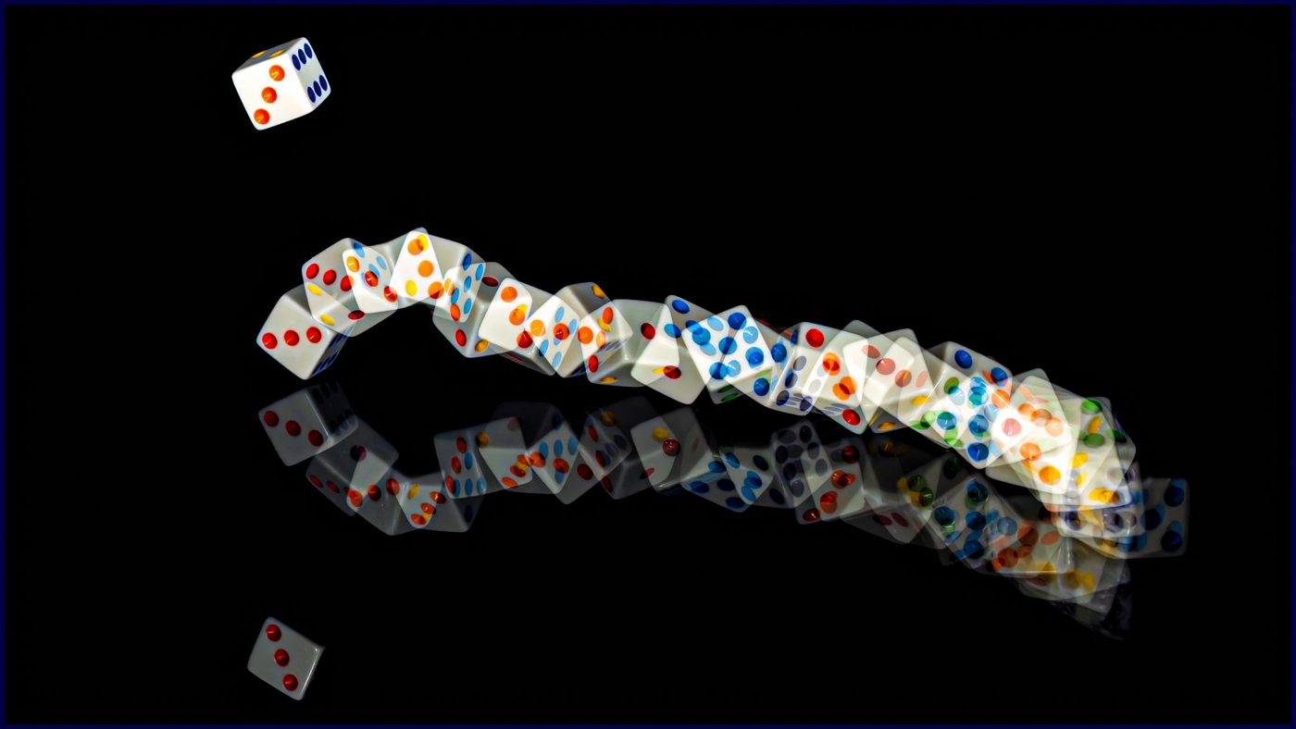
Probability and statistics
YEAR 9 SCIENCE · 9A GENETICS AND EVOLUTION · LESSON 3 OF 7
How do scientists use statistics and probability?
Exploring Science International 9 · Student Book pages 10 to 11 · Workbook pages 7
Notes:
A Working Scientifically lesson. The maths is revision; the science is using it to describe variation and to predict inherited conditions, which leads into genetic counselling in Lesson 5.

Slide 2
Do Now: chance of rain
DO NOW
4
min
A weather app says there is a 76% chance of rain between 11:00 and 12:00 tomorrow.
1. What do you think 76% means here?
2. Write 76% as a fraction and as a decimal.
3. Is rain certain? How do you know?
Notes:
Expected: if that hour happened 100 times over, it would rain on about 76 occasions; 76/100 (or 19/25) and 0.76; not certain, because certain would be 100%. Four minutes, in books.

Slide 3
Today
TODAY
Today I can ...
Key words today
I can explain what probability is and write a probability as a percentage, a fraction and a decimal.
statistics collecting, analysing and presenting data
sample a small part of a group that is measured to estimate the whole group
mean the sum of the values divided by the number of values
median the middle value when the values are in order
mode the most common value in a set
probability the chance of something happening
percentage a number out of 100, shown with the % sign
fraction a part of a whole, written as one number over another, e.g. 1/4
decimal a number written with a decimal point, e.g. 0.25
experimental probability a probability worked out from the results of an experiment
theoretical probability a probability worked out by reasoning about all the possible outcomes
I can calculate an experimental probability from results and compare it with a theoretical probability.
Notes:
Read the goals. Mean, median and mode are maths words the students know; today they are used on science data.

Slide 4
Are you interested in dinosaurs?
HOOK
A company asked 113,867 people in Japan how interested they were in dinosaurs. 25% said 'interested' and 10% said 'uninterested'. Why ask so many people, and what could the company do with the answers?
Talk to a partner. Would 20 people have been enough?
Notes:
The sample is large so that the results represent the whole population; the findings could decide whether to use dinosaurs in an advert. Twenty people might all be from one school or one age group. This is statistics: collecting, analysing and presenting data to draw conclusions and make predictions.

Slide 5
What statistics is for
LEARN
Statistics is collecting, analysing and presenting data.
Collect data: use a sample to estimate values for a whole population.
Draw conclusions: calculate averages (mean, median, mode); find patterns with graphs.
Present findings and make predictions.
Example: sleeve lengths of 12 men: 86, 88, 90, 90, 91, 92 cm. Mode 90, median 90, mean 89.5.
Key idea Mean: add up and divide. Median: middle value in order. Mode: most common value.
Key words statistics · sample · mean · median · mode
Notes:
Work the example on the board (the list is six values for speed: mean = 537 divided by 6 = 89.5). A clothing company uses this to decide how many shirts of each size to make.

Slide 6
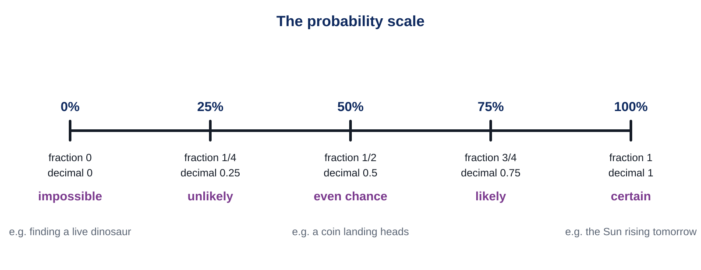
Probability
LEARN
Probability is the chance of something happening.
0% (0) is impossible; 100% (1) is certain; 50% (1/2, 0.5) is an even chance.
To change a percentage to a decimal: write it over 100 and divide. 52% = 52/100 = 0.52.
With one dice: probability of a 1 is 1/6; of 'not 1' is 5/6.
Key idea The same probability can be written as a percentage, a fraction or a decimal.
Key words probability · percentage · fraction · decimal
Notes:
Point along the scale. Ask for the probability of the Sun rising tomorrow (certain) and of finding a live dinosaur (impossible). Check conversions: 25% = 1/4 = 0.25.

Slide 7
Experimental or theoretical?
LEARN
Experimental probability
Theoretical probability
Worked out from results.
Flip a coin 100 times: 52 heads, so 52/100 = 52%.
Gets closer to the true value with more trials.
Used when we cannot reason out every outcome, e.g. weather.
Worked out by reasoning about all the outcomes.
A fair coin: 1/2. One dice: 1/6 for each number.
Inheritance: if one parent has achondroplasia, each child has a 50% chance.
Does not change because of earlier results.
Key idea Experimental comes from doing it; theoretical comes from thinking about it. With many trials they get close.
Key words experimental probability · theoretical probability
Notes:
Achondroplasia is an inherited condition in which people do not grow very tall (up to about 130 cm). Neither parent: 0.003%; one parent: 50%; both parents: 75%. The worksheet Challenge uses these numbers.

Slide 8
Probability from a normal distribution
LEARN
A shopper picked at random is much more likely to need 90 cm sleeves than 95 cm.
Probability of needing 95 cm: 20 out of 102, about 20%.
In a normal distribution the mean, median and mode are the same value.
Key idea A bell-shaped graph tells you how likely each value is.
Key words normal distribution · mean · median · mode
Notes:
Ask: is a random shopper more likely to need 85 cm or 95 cm sleeves? (About the same: 18 and 20.) Which value is the mean, median and mode here? (90 cm.)

Slide 9
Quick check
CHECK
Mini whiteboards. Write the answer, then we check.
Q1 Write 25% as a fraction.
Q2 Write 0.75 as a percentage.
Q3 What is the theoretical probability of rolling a 6 with one dice?
Q4 Write 'impossible' as a decimal.
Q5 A coin landed heads 48 times in 100 flips. What is the experimental probability of heads?
Notes:
Answers: 1/4; 75%; 1/6 (about 17%); 0; 48/100 = 0.48 = 48%.

Slide 10
Investigation: two dice
PRACTICAL
Aim Find the experimental probability of each score (2 to 12) when two dice are thrown and added.
Equipment
Method
Two dice
Worksheet tally table (Core question 3)
Calculator (optional)
Throw both dice and add the two numbers to get the score.
Record a tally mark next to that score. Repeat until you have 50 throws.
Count the tallies to find the frequency of each score.
Experimental probability = frequency divided by 50. Write it as a fraction, a decimal and a percentage.
Compare your result for a score of 7 with the theoretical probability 6/36 (about 17%).
Safety No hazards. Keep dice on the desk; share the throwing and the recording.
Notes:
Fifteen minutes. Pairs: one throws, one records, swap at 25 throws. If time is short, stop at 30 throws and divide by 30. Pool the class results on the board for a bigger sample: the experimental probabilities get closer to the theoretical values.

Slide 11
Is the third child certain?
THINK AND REFLECT
If one parent has achondroplasia, each child has a 50% chance of inheriting it. A couple already has two children without it. Is their third child certain to have it?
Sentence frames
The probability for the third child is still ___ because ___.
Each child is a separate event, like ___.
'Certain' would mean a probability of ___.
Notes:
Expected: still 50%; each fertilisation is a separate event, like a new coin flip; certain would be 100%. Link to Lesson 5: a genetic counsellor explains these probabilities to families.

Slide 12
Exit ticket
EXIT TICKET
3
min
On your worksheet exit ticket. Work alone. Hand it in as you leave.
1. What is probability?
2. Write 5% as a decimal.
3. A bag has 20 red, 10 green, 5 blue and 15 yellow beads. Bilal takes one bead. Give the probability that it is blue as a fraction and as a percentage.
Notes:
Answers: the chance of something happening; 0.05; 5/50 = 1/10 = 10%.

Slide 13
What we learned
SUMMARY
Statistics means collecting, analysing and presenting data; a large random sample represents the population.
Probability is the chance of something happening: 0 (impossible) to 1 (certain), written as a percentage, fraction or decimal.
Experimental probability comes from results; theoretical probability from reasoning about the outcomes.
In a normal distribution the mean, median and mode are the same, and values near the middle are most likely.
Next lesson DNA: how the structure of DNA was discovered, and how DNA, chromosomes and genes fit together.
Notes:
Homework: Workbook page 7 (9Ab Probability).

