Slide 1
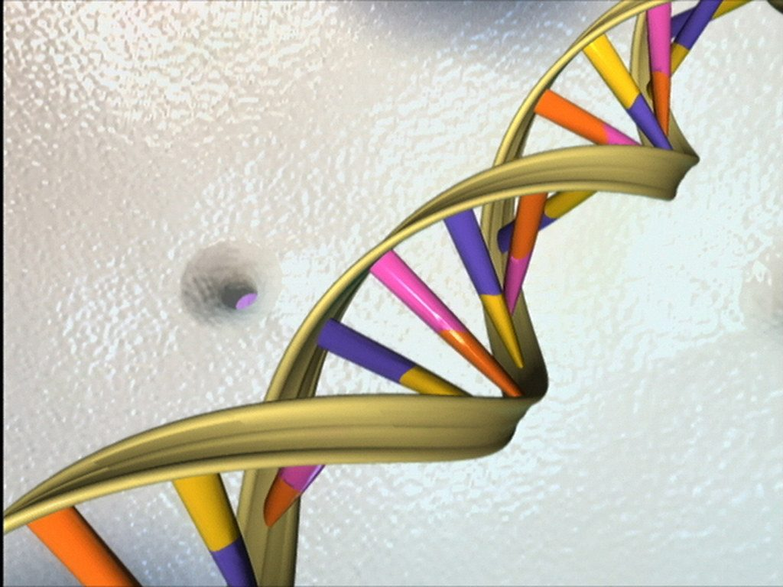
DNA, chromosomes and genes
YEAR 9 SCIENCE · 9A GENETICS AND EVOLUTION · LESSON 4 OF 7
How is genetic information stored?
Exploring Science International 9 · Student Book pages 12 to 13 · Workbook pages 8 to 9
Notes:
Today the students meet the molecule behind inherited variation. The story of 1953 shows how scientists share evidence and test models; the second half gives the cell to gene hierarchy they need for the rest of the unit.

Slide 2
Do Now: the secret of life
DO NOW
4
min
28 February 1953, Cambridge. Two men interrupt people eating lunch: 'We have discovered the secret of life!'
1. What do you think they had discovered?
2. Where in a cell is genetic information stored?
3. Guess: how many chromosomes are in one human body cell?
Notes:
The men were James Watson and Francis Crick; they had built a cardboard model of DNA. Genetic information is in the nucleus. Human body cells have 46 chromosomes. Four minutes, in books.

Slide 3
Today
TODAY
Today I can ...
Key words today
I can outline how the structure of DNA was discovered and say what each scientist did.
DNA the very long molecule that stores genetic information
double helix the shape of a DNA molecule: two strands twisted into a spiral
chromosome a structure in the nucleus made of one long DNA molecule
gene a section of DNA that carries the instructions for one characteristic
genetic information the instructions for inherited characteristics
nucleus the part of a cell that contains the chromosomes
sex chromosomes the pair of chromosomes that decides sex: XX (female) or XY (male)
gamete a sex cell (sperm or egg) with 23 chromosomes
zygote the fertilised egg cell, with 46 chromosomes
X-ray a type of radiation used to make images, including of molecules
model a simpler representation of something that scientists test against evidence
I can describe how DNA, chromosomes, genes and genetic information are linked, and give the number of chromosomes in body cells and gametes.
Notes:
Read the goals. The names Franklin, Wilkins, Watson and Crick come up all lesson; write them on the board.

Slide 4
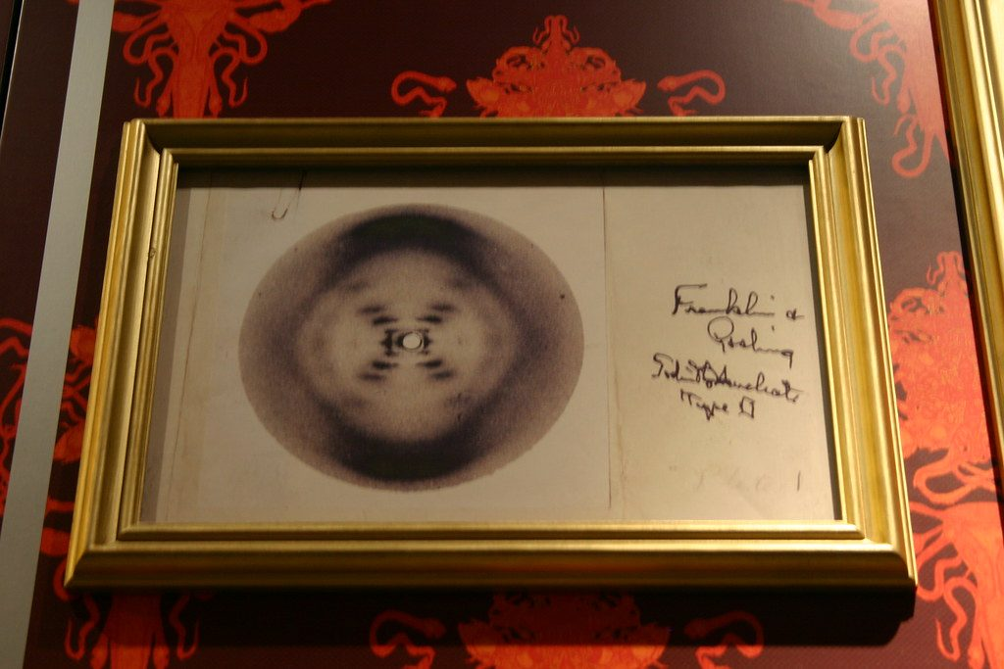
A blurry X
HOOK
In 1952 Rosalind Franklin took an X-ray photo of DNA. It looked like a blurry X. When James Watson saw it, he knew at once that DNA must be a spiral. Why was seeing another scientist's data so important?
Talk to a partner: what could Watson and Crick do with the photo that they could not do without it?
A copy of Rosalind Franklin's X-ray photograph of DNA (Photo 51)
Image: Ryan Somma, CC BY-SA 2.0, via Wikimedia Commons
Notes:
Only spiral (helix) molecules make an X pattern in an X-ray photo. The photo gave Watson and Crick the evidence they needed to finish their model. Scientists build on each other's data; the question of whether the photo should have been shown without Franklin's permission comes back in Think and Reflect.

Slide 5
Discovering the structure of DNA
LEARN
Watson and Crick used their own data and other scientists' data to build a model of DNA.
Franklin told them their first model was wrong.
Franklin and Wilkins took X-ray photos of DNA; Wilkins showed one to Watson in 1953.
Watson and Crick published the double helix model in Nature on 25 April 1953. Wilkins then spent years testing and correcting it.
The double helix: two strands twisted into a spiral
Image: National Institutes of Health (NIH), Public domain, via Wikimedia Commons
Key idea A scientific model is built from evidence, shared, tested and corrected.
Key words DNA · double helix · X-ray · model
Notes:
Stress the sequence: model, told it was wrong, new evidence, better model, published, tested. If you have a pipe-cleaner, twist two strands together to show a double helix.

Slide 6
Who did what
LEARN
Scientist | What they did
Rosalind Franklin | Took very clear X-ray photos of DNA; told Watson and Crick their first model was wrong
Maurice Wilkins | Took X-ray photos; showed Franklin's photo to Watson; tested and corrected the model for years
James Watson | Saw from the photo that DNA was a spiral; built the double helix model with Crick
Francis Crick | Built the model with Watson; worked out the shape from the X-ray evidence
All four published their work in the same edition of Nature.
Watson, Crick and Wilkins shared the Nobel Prize in 1962.
Franklin had died in 1958. Nobel Prizes are not given after death.
Key idea Discoveries are usually made by groups of scientists sharing evidence.
Key words X-ray · model
Notes:
Students fill in a matching question on this at Core. The Think and Reflect slide asks whether the discovery should carry only Watson and Crick's names.

Slide 7
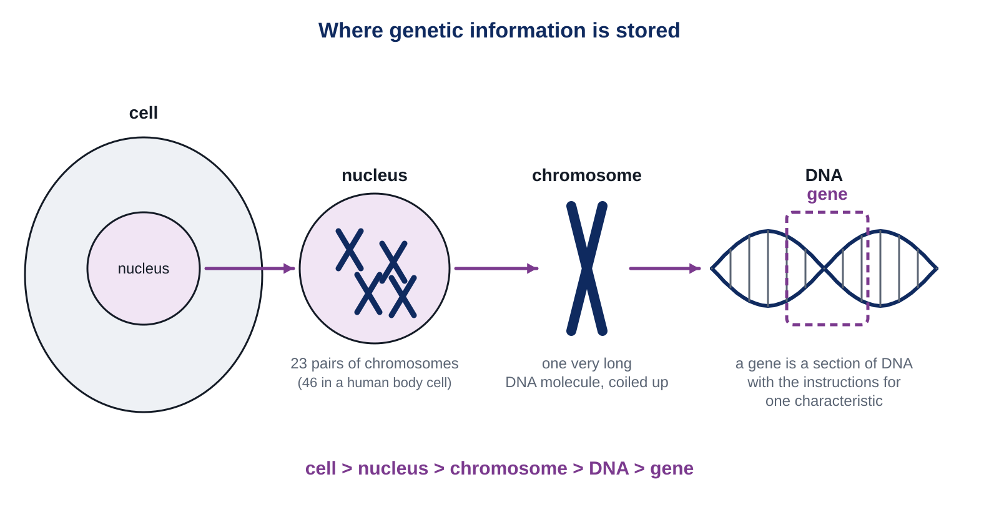
From cell to gene
LEARN
DNA is found in chromosomes, inside the nucleus of a cell.
Each chromosome contains one enormously long DNA molecule.
Genes are sections of a DNA molecule. Genetic information is stored in genes.
Genes control inherited characteristics. A few (ABO blood group) depend on one gene; most depend on many genes.
Key idea cell > nucleus > chromosome > DNA > gene
Key words nucleus · chromosome · DNA · gene · genetic information
Notes:
Say the chain out loud together, biggest to smallest. Check: which is bigger, a gene or a chromosome? (A chromosome: it holds thousands of genes along its DNA.)

Slide 8
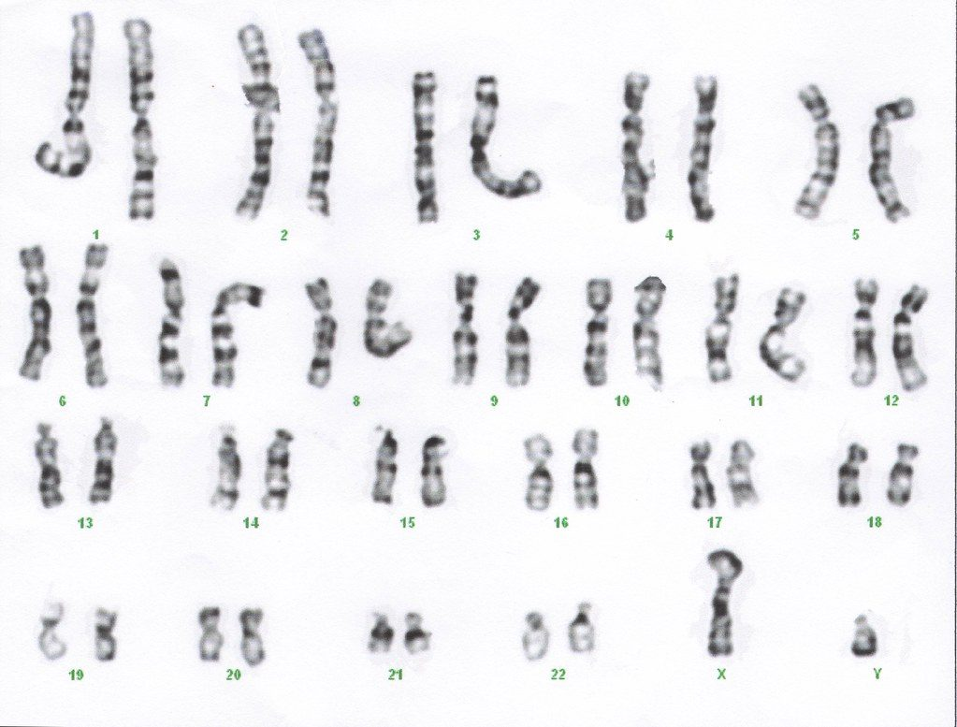
Counting chromosomes
LEARN
Most human cells contain 23 pairs of chromosomes: 46 in all.
Both chromosomes in a pair carry the same genes and are the same size, except the sex chromosomes: XX (female), XY (male). Y is much smaller.
Gametes contain only 23 chromosomes. When two gametes fuse, the zygote has 46.
Cell division then copies the 46 chromosomes into every new cell.
The chromosomes of one human cell, sorted into pairs
Image: Can H., CC BY 2.0, via Wikimedia Commons
Key idea Body cells: 46 (23 pairs). Gametes: 23. Zygote: 23 + 23 = 46.
Key words sex chromosomes · gamete · zygote
Notes:
Point to pair 23 on the karyotype: is this cell from a male or a female? (If X and a smaller Y are shown, male.) Each gene therefore has two copies in a body cell, one on each chromosome of the pair.

Slide 9
Quick check
CHECK
Mini whiteboards. Short answers.
Q1 How many chromosomes are in a human sperm cell?
Q2 How many chromosomes are in a human heart muscle cell?
Q3 What long molecule does a chromosome contain?
Q4 Who took the X-ray photos of DNA?
Q5 A cell has an X and a Y chromosome. Male or female?
Notes:
Answers: 23; 46; DNA; Rosalind Franklin (and Maurice Wilkins); male.

Slide 10
Your turn: DNA and chromosomes
DO
13
min
1
Core: match the scientists; write the numbers; order cell, nucleus, chromosome and gene by size; read the karyotype.
2
Stretch: plot the chromosome numbers of five animals in a logical order, then judge the conclusion about birds and mammals.
3
Challenge: draw the links between DNA, chromosomes, genes and genetic information; explain how scientists share data.
4
Use the key words box: DNA, chromosome, gene, nucleus.
Numbers to remember: 46 in a body cell, 23 in a gamete, 1 DNA molecule per chromosome.
Notes:
Common errors: ordering the bar chart randomly (ask for ascending order or grouped by animal type); saying a gamete has 46 chromosomes. The conclusion question (one bird in the data) is about sample size: one chicken cannot tell you about all birds.

Slide 11
Whose discovery?
THINK AND REFLECT
Textbooks often call the double helix 'Watson and Crick's model'. Franklin's X-ray photo was shown to Watson without her permission, and she died before the Nobel Prize. Should the discovery carry only two names?
Sentence frames
I think the discovery should be called ___ because ___.
The evidence that mattered most was ___, which came from ___.
Today, scientists should share data by ___.
Notes:
There is no single right answer; expect students to say that all four contributed and that the X-ray evidence was essential. Today data are shared openly through published papers with named authors, and using someone's unpublished data without permission is not acceptable.

Slide 12
Exit ticket
EXIT TICKET
3
min
On your worksheet exit ticket. Work alone. Hand it in as you leave.
1. Where in a cell is DNA found?
2. How many chromosomes are there in a human body cell, and in a human gamete?
3. What is a gene?
Notes:
Answers: in the chromosomes in the nucleus; 46 and 23; a section of DNA that carries the instructions (genetic information) for a characteristic.

Slide 13
What we learned
SUMMARY
The double helix structure of DNA was worked out in 1953 by Watson and Crick, using X-ray evidence from Franklin and Wilkins.
DNA is in the chromosomes in the nucleus; each chromosome is one long DNA molecule; genes are sections of DNA that carry genetic information.
Human body cells have 23 pairs (46) of chromosomes; gametes have 23; a zygote has 46.
The sex chromosomes are XX in females and XY in males.
Next lesson Genetic counselling: how genetic tests work and how a counsellor explains probabilities to a family.
Notes:
Homework: Workbook pages 8 and 9 (9Ac DNA).

