Slide 1
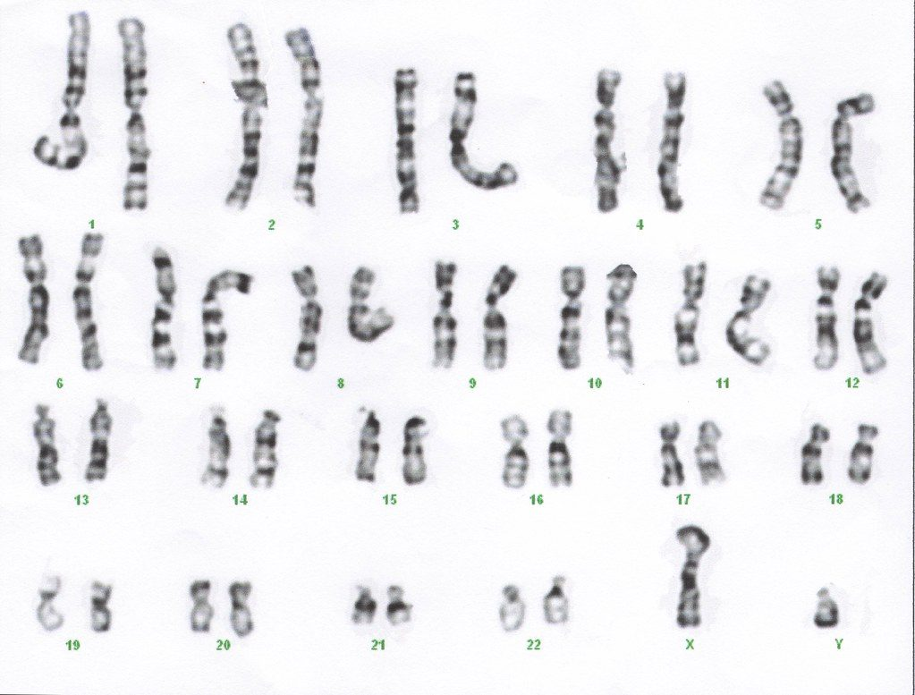
Genetic counselling
YEAR 9 SCIENCE · 9A GENETICS AND EVOLUTION · LESSON 5 OF 7
What can a genetic test tell a family, and who helps them understand it?
Exploring Science International 9 · Student Book pages 14 to 15 · Workbook pages 10
Notes:
A STEM lesson applying genes, chromosomes and probability (Lessons 3 and 4). The role is the genetic counsellor: a real job in hospitals that needs biology and the skill of explaining probability simply and kindly.

Slide 2
Do Now: spot the difference
DO NOW
4
min
DNA stores information as a code of four letters: A, T, C and G. Two people had the same gene read:
P: CTT CTC GGA TCG CGG GAA ATA TTC
R: CTT CTC GGA TCG CCG GAA ATA TTC
1. Find the difference. 2. What could a change in a gene do to a person? 3. Recap: what is a gene?
Notes:
The fifth group differs: CGG in P, CCG in R. A changed sequence can mean the gene makes a protein that does not work properly, which can cause a disorder. A gene is a section of DNA carrying the instructions for a characteristic.

Slide 3
Today
TODAY
Today I can ...
Key words today
I can describe what a genetic test looks at and why babies and families may be tested.
genetic test a test that looks at a person's DNA sequence or chromosomes
genetic counsellor a person trained to explain genetic test results and the chances of passing on a condition
genetic disorder a condition caused by a faulty gene or an unusual set of chromosomes
DNA sequence the order of the four letters (A, T, C, G) along a DNA molecule
faulty gene a gene whose sequence has changed so that it no longer works properly
haemoglobin the protein in red blood cells that carries oxygen
sickle cell disease a genetic disorder in which faulty haemoglobin makes red blood cells sickle-shaped
cystic fibrosis a genetic disorder in which thick mucus builds up in the lungs and gut
Down's syndrome a condition caused by an extra copy of chromosome 21
probability the chance of something happening, e.g. 25% or 1/4
chromosome a structure in the nucleus made of one long DNA molecule
I can use probability and my knowledge of genes and chromosomes to explain a genetic test result simply, as a genetic counsellor would.
Notes:
Read the goals. Several key words are the names of conditions; students need to recognise them, not memorise their medical details.

Slide 4
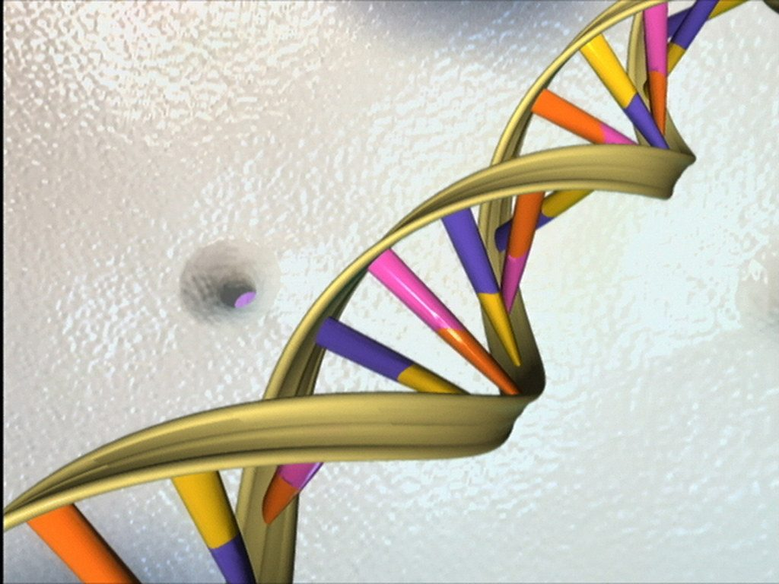
The heel-prick test
HOOK
In many countries, every newborn baby has a few drops of blood taken from its heel in the first week. The blood is tested for several genetic disorders. Why test a baby who looks healthy?
Talk to a partner: what could doctors do differently if they knew early?
Genetic tests read the sequence of a gene
Image: National Institutes of Health (NIH), Public domain, via Wikimedia Commons
Notes:
Finding a disorder early means treatment, diet or medicines can start before damage is done. Some disorders have no symptoms at first. Lead into the worksheet question about finding a faulty gene in a baby rather than a child.

Slide 5
Reading a gene: sequences and faulty proteins
LEARN
Person | Sequence of part of the haemoglobin gene | Protein made
V (normal) | TAC CAC GTA GAC TGA GGA CTC CTC | normal
W | TAC CAC GTA GAC TGA GGA CTC CTC | normal
X | TAC CAC GTA GAC TGA GGA CAC CTC | faulty
Y | TAC CAC GTA GAC TGA GGA TTC CTC | faulty
Z | TAC CAC GTA GAC TGA GGA CTC CTC | normal
A gene is a sequence of DNA letters.
A changed sequence can make a faulty protein.
Faulty haemoglobin causes sickle cell disease.
Which sequences differ from V?
Key idea Change the sequence, change the protein, and a disorder can result.
Key words DNA sequence · faulty gene · haemoglobin
Notes:
X and Y differ from V in the seventh group of letters. Haemoglobin is the protein in red blood cells that carries oxygen; in sickle cell disease the faulty protein makes the cells stiff and sickle-shaped so they block small blood vessels.

Slide 6
Genetic tests
LEARN
A genetic test looks at the sequence of a gene, or at a person's chromosomes.
Tests are done on newborn babies, on people with symptoms, and on couples who want to start a family.
A chromosome test can show an extra chromosome: an extra chromosome 21 causes Down's syndrome.
Tests are becoming cheaper and faster, so they are used more and more.
A chromosome test sorts the chromosomes of one cell into pairs
Image: Can H., CC BY 2.0, via Wikimedia Commons
Key idea Genetic tests read DNA sequences or count and check chromosomes.
Key words genetic test · genetic disorder · chromosome
Notes:
Ask what a normal human chromosome test shows (23 pairs, 46). Down's syndrome: 47 chromosomes, three copies of chromosome 21; people with Down's syndrome have learning difficulties and some have heart problems, and many live full lives into their 60s.

Slide 7
What a genetic counsellor does
LEARN
Explains test results in simple words.
Works out and explains the probability of passing a condition on.
Example: both parents carry a faulty CFTR gene. Each child has a 25% (1 in 4) chance of cystic fibrosis.
Explains the options. The family decides; the counsellor does not decide for them.
Key idea The counsellor explains the science and the chances; the decision belongs to the family.
Key words genetic counsellor · probability · cystic fibrosis
Notes:
Cystic fibrosis: thick mucus in the lungs and gut; treated with physiotherapy and medicines. Stress the 25% is for each child separately, like each throw of the dice in Lesson 3.

Slide 8
Explaining a probability result
LEARN
A test report says: 'The patient has one copy of the E4 variant of the APOE gene. The probability of Alzheimer's disease before 85 is 20%, compared with 13% for the general population.'
How would you explain this simply?
Is the patient certain to get the disease?
Key idea Most test results are probabilities, not certainties: 20% means 80% do not develop the disease.
Key words probability · genetic test
Notes:
Model a simple explanation: 'Out of 100 people like you, about 20 would develop the disease before 85, compared with about 13 out of 100 people in general. So your chance is higher than average, but most people with this result do not get the disease.'

Slide 9
Quick check
CHECK
Mini whiteboards. Short answers.
Q1 What two things can a genetic test look at?
Q2 How many chromosomes does a person with Down's syndrome have in each body cell?
Q3 Both parents carry a faulty gene; each child has a 25% chance. Write 25% as a fraction.
Q4 Does a 20% probability mean the disease is certain?
Q5 Who makes the final decision after genetic counselling?
Notes:
Answers: a gene's DNA sequence, or the chromosomes; 47; 1/4; no, 80 out of 100 would not develop it; the family (the patient).

Slide 10
Your turn: be the genetic counsellor
DO
13
min
1
Core: find the changed sequence; match the terms; explain why early testing helps; predict how many of four children have cystic fibrosis.
2
Stretch: explain an extra chromosome 21 using gametes; explain the APOE result in simple words.
3
Challenge: write what you would say to a person with an unusual chromosome result who wants a family; evaluate testing every baby.
4
Write as a counsellor would: simple words, honest probabilities, kind tone.
Use 'out of 100' to explain any percentage.
Notes:
Model one sentence of counsellor language on the board. Circulate for Core 4: students often say 'exactly one child'; push for 'each child has a 1 in 4 chance, so it could be none or more than one'.

Slide 11
Would you want to know?
THINK AND REFLECT
A genetic test can tell you your chance of getting a disease that has no cure. Would you want to know your result? Why might some people choose not to be tested?
Sentence frames
I would / would not want to know because ___.
Knowing the result could help someone to ___.
Some people might not want to know because ___.
Notes:
Both views are valid: knowing can help people plan, change their lifestyle or join research; not knowing avoids worry about something that may never happen and that cannot be prevented. Keep the discussion general; do not ask about students' own families.

Slide 12
Exit ticket
EXIT TICKET
3
min
On your worksheet exit ticket. Work alone. Hand it in as you leave.
1. What does a genetic test look at?
2. Both parents carry a faulty gene and each child has a 25% chance of the disorder. Write 25% as a fraction and as a decimal.
3. Give one thing a genetic counsellor does.
Notes:
Answers: a person's DNA (the sequence of a gene) or their chromosomes; 1/4 and 0.25; explains test results, works out and explains probabilities, explains the options.

Slide 13
What we learned
SUMMARY
A gene is a sequence of DNA letters; a changed sequence can make a faulty protein and cause a genetic disorder.
A genetic test reads a gene's sequence or checks a person's chromosomes; babies, patients and couples are tested.
Many results are probabilities: 20% means 20 out of 100, not certain.
A genetic counsellor explains results and probabilities simply; the family makes the decision.
Next lesson Genes and extinction: how changes in the environment can make a species endangered or extinct.
Notes:
Homework: Workbook page 10 (9Ac Genetic counselling).

