Slide 1
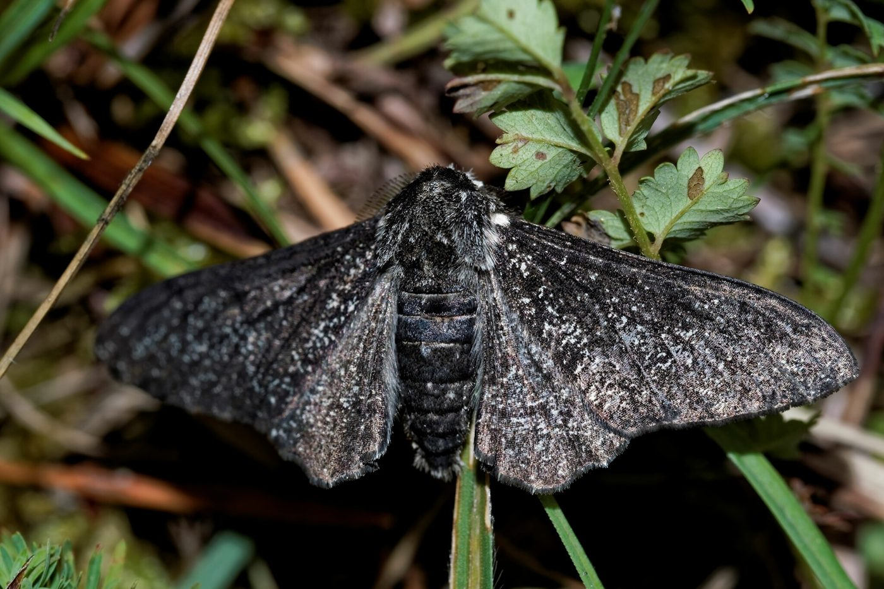
Natural selection and evolution
YEAR 9 SCIENCE · 9A GENETICS AND EVOLUTION · LESSON 7 OF 7
What is Darwin's theory of evolution?
Exploring Science International 9 · Student Book pages 18 to 20 · Workbook pages 13 to 14
Notes:
The last lesson of 9A. Everything so far comes together: inherited variation (genes), environmental change, adaptations and survival. Keep the language careful: organisms do not try to adapt; the environment selects.

Slide 2
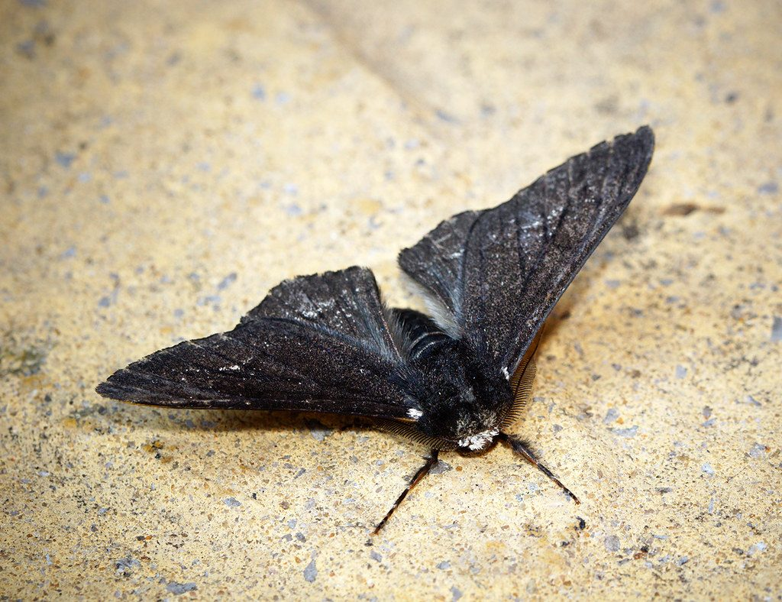
Do Now: pale or dark?
DO NOW
4
min
Peppered moths show inherited variation: most are pale and speckled, but some have genes that make them black.
1. What causes inherited variation?
2. Which form would a bird spot more easily on a pale tree? On a tree blackened by soot?
3. What is a species?
A pale peppered moth on a lichen-covered tree
Image: Bennyboymothman, CC BY 2.0, via Wikimedia Commons
Notes:
Inherited variation is caused by genes (genetic information from the gametes). A bird spots the dark moth on a pale tree and the pale moth on a black tree. A species is a group that can breed together to produce offspring that can also breed.

Slide 3
Today
TODAY
Today I can ...
Key words today
I can explain how natural selection works on inherited variation when the environment changes, using the peppered moth and the Salton Sea tilapia.
natural selection organisms better adapted to their environment are more likely to survive, reproduce and pass on their genes
evolution a change over time in the characteristics of organisms, sometimes making a new species
inherited variation differences between individuals caused by genes, passed on to offspring
gene a section of DNA that carries the instructions for one characteristic
reproduce to produce offspring
generation all the offspring born at about the same time; parents, children and grandchildren are three generations
hypothesis an idea, based on observations, that can be tested
theory an explanation that has been tested many times and is accepted by scientists
species a group of organisms that can breed together to produce offspring that can also breed
camouflage colours or patterns that make an organism hard to see
cloning making a new organism with exactly the same genetic information as another
I can describe the theory of evolution by natural selection and explain how natural selection can produce a new species.
Notes:
Read the goals. Warn students that the word 'theory' means something stronger in science than in everyday talk; this comes back in My thinking.

Slide 4
Manchester, 1850 to 1895
HOOK
In the 1850s most peppered moths around Manchester were pale. By 1895, 98% of them were black. Many factories had been built in those years. What happened?
Talk to a partner: what did the factories change, and who eats moths?
A dark (carbonaria) peppered moth
Image: Thierry Arbault, CC BY 4.0, via Wikimedia Commons
Notes:
Factories produced huge amounts of soot that turned buildings and trees black. Birds could easily spot the pale moths on the black trees and ate more of them; the black moths were harder to see, so more survived and reproduced. Keep the full explanation for the next slide.

Slide 5
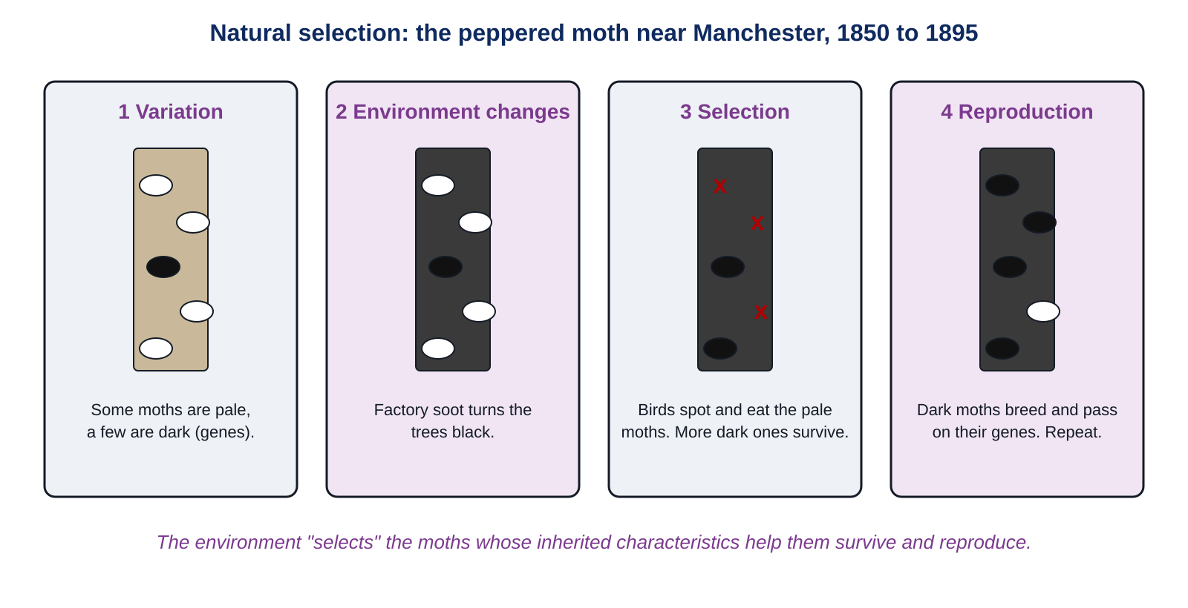
Natural selection: the peppered moth
LEARN
Variation: a few moths had genes that made them black.
The environment changed: soot made the trees black.
Birds spotted and ate more pale moths. More black moths survived and reproduced, passing on their genes.
Each generation had more black moths. The environment 'selected' the black variation.
Key idea Natural selection: the environment selects the inherited variations that survive and are passed on.
Key words natural selection · inherited variation · gene · reproduce · generation
Notes:
Walk through the four panels. Ask: did any moth change colour during its life? No. Did the moths decide to turn black? No. The black genes were already there in a few moths; soot made them an advantage.

Slide 6
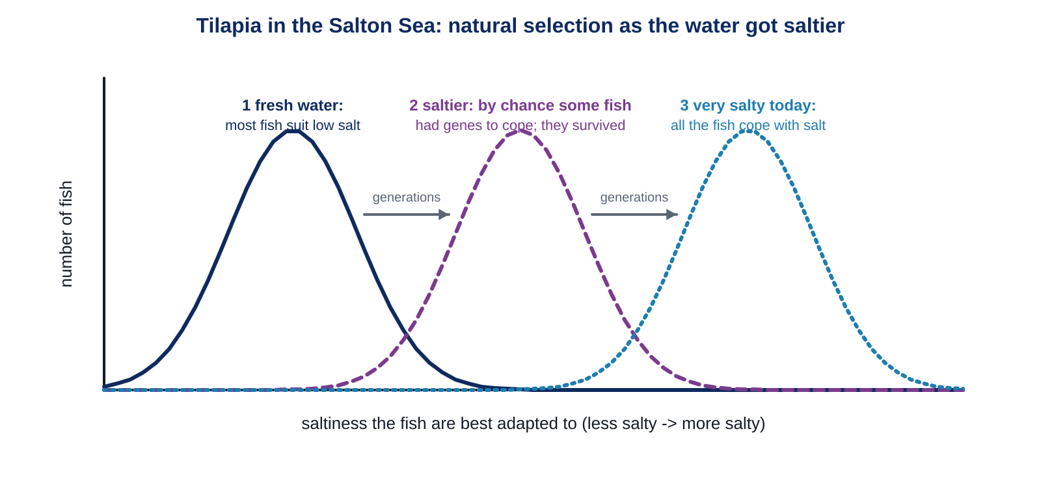
Salty seas: the Salton Sea tilapia
LEARN
The Salton Sea in California formed in 1905 and slowly became 25% saltier than the Pacific Ocean. Most fish species died out.
By chance, some tilapia had genetic variations that helped them cope with salt.
More of these fish survived and reproduced, so the next generation had more salt-tolerant fish.
This repeated as the sea got saltier. Today all Salton Sea tilapia cope with very salty water.
Key idea Environmental change happens over and over; natural selection shifts the whole population, generation by generation.
Key words natural selection · generation · inherited variation
Notes:
Read the three curves left to right. Tilapia from a freshwater lake die if put in Salton Sea water: the Salton Sea population has become better adapted. The shoreline of the Salton Sea is made of the bones of millions of fish that did not survive.

Slide 7
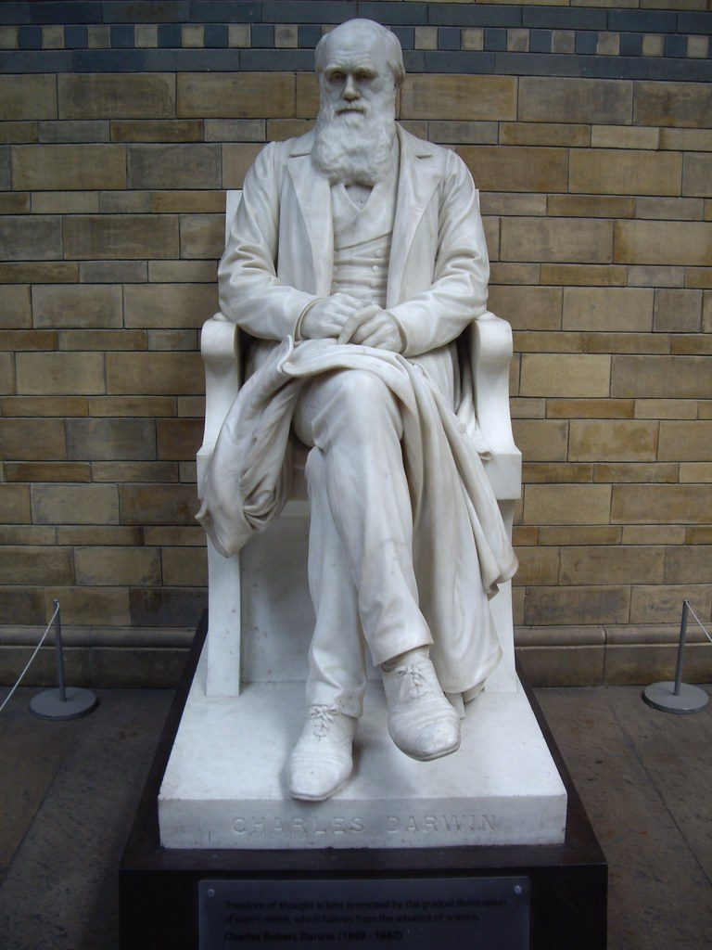
Darwin, Wallace and evolution
LEARN
Evolution is a change over time in the characteristics of organisms.
Charles Darwin and Alfred Russel Wallace both developed the hypothesis that natural selection causes evolution.
Tested many times with evidence, it is now the theory of evolution by natural selection.
Darwin's theory says a population can evolve into a new species. Many scientists think some dinosaurs evolved into birds over millions of years.
A statue of Charles Darwin (1809 to 1882)
Image: virtusincertus, CC BY 2.0, via Wikimedia Commons
Key idea A hypothesis becomes a theory when it has been tested many times and the evidence supports it.
Key words evolution · hypothesis · theory · species
Notes:
Wallace (1823 to 1913) reached the same idea independently; the two published together in 1858. Microraptor, a dinosaur with feathers and four wings, lived 125 to 120 million years ago. New species: two populations separated for long enough can no longer breed together.

Slide 8
Lamarck or Darwin? Long-legged wading birds
LEARN
Lamarck would say (not accepted)
Darwin would say
Birds that waded deeper got more fish.
When fish were scarce, the birds stretched their legs a bit.
They passed their stretched legs to their offspring.
Over time, legs got longer and longer.
Birds varied in leg length because of their genes.
When fish were scarce, longer-legged birds waded deeper and got more fish.
More of them survived and reproduced, passing on long-leg genes.
Each generation had more long-legged birds.
Key idea Changes made during an organism's life (stretching, training, a scar) are not inherited. Only genes are passed on.
Key words natural selection · inherited variation
Notes:
Students write Darwin's version at Stretch. Test the idea: if a parent trains hard and builds big muscles, are the children born with big muscles? No. Environmental variation is not inherited.

Slide 9
Quick check
CHECK
Mini whiteboards. Short answers.
Q1 What causes inherited variation?
Q2 In the 1890s, which moth was better camouflaged on a sooty tree?
Q3 Does natural selection change an individual moth, or the population over generations?
Q4 What is the difference between a hypothesis and a theory?
Q5 A cloned mammoth would have the same what as the original?
Notes:
Answers: genes; the dark moth; the population over generations; a hypothesis is a testable idea, a theory has been tested many times and is supported by evidence; the same genetic information (DNA).

Slide 10
A model of natural selection (5 minutes, optional)
DO
5
min
1
Scatter 20 white and 20 black paper 'moths' on the black sheet.
2
One student is the bird: pick up as many moths as you can in 10 seconds.
3
Count the survivors of each colour. Each survivor 'reproduces': add one moth of the same colour.
4
Repeat for three generations and record the numbers. Then try the white sheet.
5
Predict first: which colour will increase on each sheet?
A model is a simpler version of the real thing. What does the model leave out?
Notes:
Based on Oak National Academy's cocktail-stick model. The model leaves out: moths moving, more than one predator, the slow build-up of soot, and the fact that real inheritance is not exact copying. If time is short, describe the model and go straight to the worksheet.

Slide 11
Your turn: natural selection
DO
8
min
1
Core: what causes inherited variation; put the lizard story in order; explain the peppered moths and predict what has happened since the factories closed.
2
Stretch: write Darwin's explanation of the long-legged birds; explain how salt tolerance was selected in the tilapia.
3
Challenge: how two separated populations become different species; mammoth chromosomes, thick hair and why dinosaurs cannot be cloned.
4
Use the four steps: variation, environment changes, survival and reproduction, next generation.
Never write 'the moths changed colour to survive'. Write 'more of the moths that were already dark survived'.
Notes:
The lizard ordering (Core 2) is the clearest check of the four-step logic. Watch for Lamarckian language in the explanations and correct it with the frame on the footer.

Slide 12
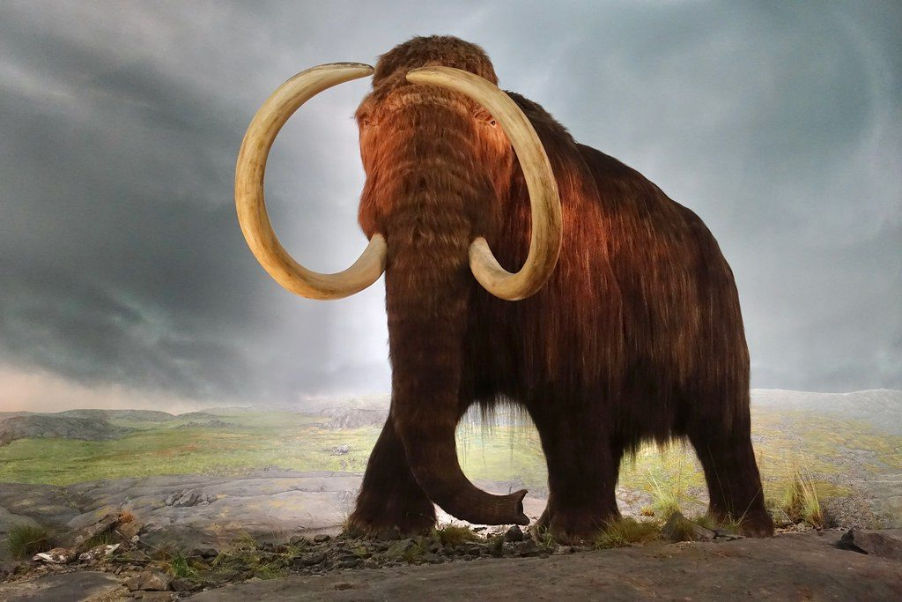
Should we bring back the mammoth?
THINK AND REFLECT
Woolly mammoths became extinct about 4000 years ago, probably because of hunting and a warming Earth. DNA survives in frozen mammoth remains, and some scientists think we could clone a mammoth. Should we? Could we clone a dinosaur?
Sentence frames
Cloning a mammoth could help us to ___, but ___.
A cloned mammoth might not behave naturally because ___.
We could not clone a dinosaur because ___.
A model of a woolly mammoth
Image: jurvetson, CC BY 2.0, via Wikimedia Commons
Notes:
Points: it could help us understand how warming affects endangered species; but a cloned mammoth raised by elephants may not behave naturally, so the experiment may not be valid, and its habitat is gone. Dinosaur DNA decomposed long ago (65 million years), so there is nothing to clone.

Slide 13
Exit ticket
EXIT TICKET
3
min
On your worksheet exit ticket. Work alone. Hand it in as you leave.
1. What is natural selection?
2. What is evolution?
3. Explain why dark peppered moths became more common near Manchester in the 1800s.
Notes:
Answers: organisms with inherited characteristics that suit the environment are more likely to survive, reproduce and pass on their genes; a change over time in the characteristics of organisms; soot blackened the trees, birds ate more pale moths, more dark moths survived and reproduced, so each generation had more dark moths.

Slide 14
What we learned in 9A
SUMMARY
Variation is environmental (not inherited) or inherited (genes, from two gametes fusing at fertilisation).
Genetic information is in genes, on DNA, in chromosomes, in the nucleus: 46 chromosomes in a body cell, 23 in a gamete.
Adaptations come from genes; when the environment changes a species can become endangered or extinct.
Natural selection: the environment selects the inherited variations that survive and reproduce; over many generations this is evolution, and it can produce new species.
Next lesson End of unit: revise with Workbook page 14 (Recreating animals) and the key words from all seven lessons. Next unit: 9B Plant growth.
Notes:
Unit review: use the exit tickets from all seven lessons to pick the ideas to revisit. The workbook's Recreating animals page (14) revisits species, chromosomes, adaptations and evolution through the mammoth.

