Slide 1
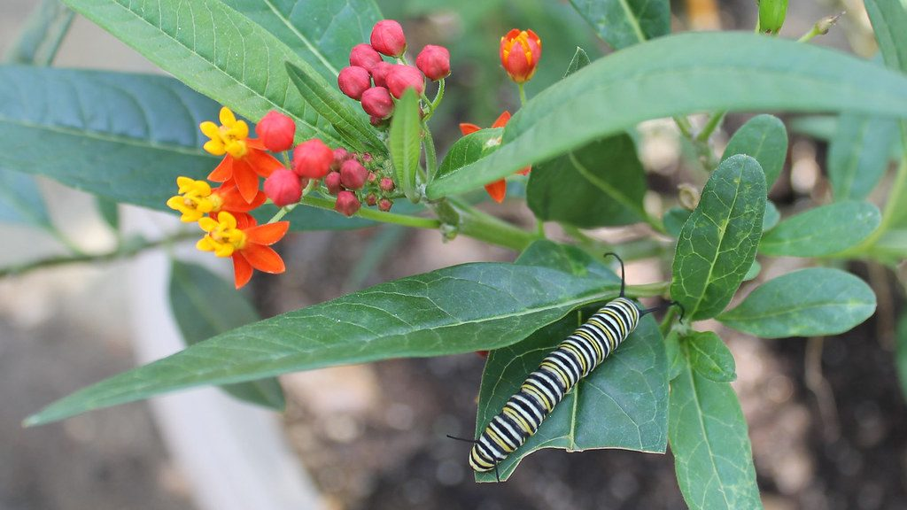
Bias, validity and organic farming
YEAR 9 SCIENCE · 9B PLANT GROWTH · LESSON 7 OF 7
Can you trust this graph? Is organic farming really better?
Exploring Science International 9 · Student Book pages 34 to 36 · Workbook pages 25 to 26
Notes:
Last lesson of 9B. Two things today: the working scientifically skills of spotting bias and judging validity, and the organic versus intensive farming debate, which is where those skills get used. The lesson ends with a review quiz of the whole unit.

Slide 2
Do Now: monarchs and milkweed
DO NOW
4
min
Monarch butterflies lay their eggs only on milkweed plants. HT soybean is a variety that is not killed by the herbicide glyphosate, which kills milkweed.
1. Predict what happens to milkweed where HT soybean is grown.
2. Predict the effect on monarch butterflies.
3. Suggest one other reason why monarch numbers could fall.
A monarch butterfly on milkweed
Image: sillarsclass, CC BY 2.0, via Wikimedia Commons
Notes:
Answers: farmers can spray glyphosate on the whole field, so milkweed is killed; fewer places to lay eggs, so fewer monarchs; other reasons: deforestation in Mexico where they spend the winter, new weather patterns, disease. The point: more than one cause is possible, which matters for validity later.

Slide 3
Today
TODAY
Today I can ...
Key words today
I can identify bias in graphs and arguments, explain where accidental bias comes from, and say whether a conclusion is valid.
bias a shift away from the true meaning or value, on purpose or by mistake
balanced considering the points for and against something equally
systematic error an error that shifts every reading by the same amount, e.g. a wrongly printed scale
random error an error that changes from one reading to the next, e.g. stopping a clock late once
sample a small part of a whole that is measured to estimate the whole
valid does what it is supposed to do; a valid conclusion uses only the results
conclusion what the results of an investigation show
organic farming farming with natural fertilisers, very few pesticides and crop rotation
intensive farming farming with artificial fertilisers, pesticides and large fields to get the biggest yield
biological control using living organisms to reduce the number of pests
crop rotation growing different crops in a field in different years
I can compare organic and intensive farming and explain biological control.
Notes:
Read each goal aloud. This lesson's key words are mostly about how scientists think, not about plants.

Slide 4
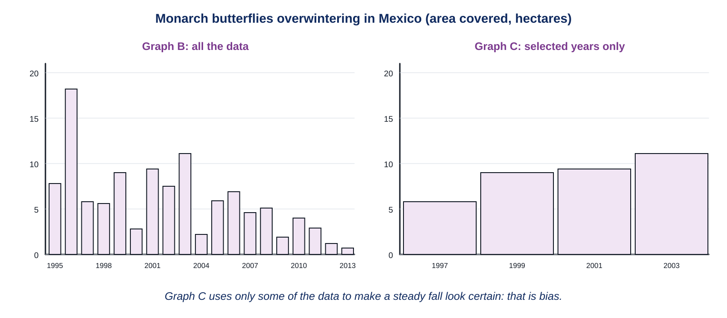
Two graphs, one set of data
HOOK
Both graphs come from the same counts of monarch butterflies in Mexico. What is graph C trying to make you believe? How did its author do it?
Talk to a partner. Which figures from graph B would you pick to show a steady fall?
Graph B shows every year; graph C shows four of them
Notes:
Graph C picks 1997, 1999, 2001 and 2003, leaving out the years that went up, so it shows a steady decrease that the full data do not support. Someone who wants to blame HT soybean might draw it; so might someone selling a different herbicide. That is intentional bias.

Slide 5
Bias on purpose
LEARN
Bias is a shift away from the true meaning or value. It can be deliberate or accidental.
Intentional bias: choosing only the data that support your idea, like graph C.
A balanced account considers the points for and against something equally.
Bias also appears in words: an advert that lists only advantages is not balanced.
Ask: who made this, and what do they want me to think?
Key idea Selected data can show a pattern that the full data do not. Always ask what was left out.
Key words bias · balanced
Notes:
Use the HT soybean table in the book: advantages (easier weed control, fewer sprayings, glyphosate is not persistent) and disadvantages (expensive, glyphosate-resistant weeds, HT soybean growing as a weed). The cartoon farmer who only quotes the advantages is biased. Challenge 1 asks for a balanced paragraph.

Slide 6
Bias by accident
LEARN
Systematic error
Sampling bias
Every reading is shifted by the same amount.
A thermometer with a wrongly printed scale reads 1 °C too high every time.
A mass balance not set to zero.
Repeating the readings does not remove it.
Samples must be taken at random.
Choosing 'interesting' areas, or areas likely to give the expected result, biases the estimate.
Counting butterflies only on the parts of trunks you can reach misses the ones higher up.
The Mexican scientists used a computer to choose sample areas at random.
Key idea A random error changes from reading to reading; a systematic error is the same every time, so it hides inside the mean.
Key words systematic error · random error · sample
Notes:
Show the two thermometers if you have them: one reads high every time; averaging does not help. Contrast with a random error, such as pressing the stopwatch late once: repeating and taking a mean reduces it.

Slide 7
Is it valid?
LEARN
Something is valid if it does what it is supposed to do.
A fair test is valid because only the independent variable affects the results.
Results are valid if they measure what they were supposed to measure.
A valid conclusion uses only the results of the investigation, and all of them.
'More HT soybean, fewer monarchs' is not a valid conclusion: the percentage planted tells us nothing about milkweed, and other causes were not ruled out.
Key idea Valid conclusion = all the results, only the results, and no causes that were never tested.
Key words valid · conclusion
Notes:
Core 1 uses the bean plant data from Lesson 5 with 10 drops added: the valid conclusion is the one that describes the whole pattern (growth rises up to a point, then falls), not 'more fertiliser gives more growth'. Stretch 1 is the German insect study: traps a metre above the ground miss insects that live higher or lower, and 24 years of one method may not represent all of Germany.

Slide 8
Organic or intensive?
LEARN
 | Organic farming | Intensive farming
fertiliser | natural: manure, clover in the rotation | artificial fertilisers
pesticides | a few natural ones (sulfur, copper sulfate), biological control | many artificial pesticides
fields | small, with hedges and trees around them | large, for big machines
biodiversity | higher | lower
yield per field | lower; needs more land for the same food | higher
cost of food | higher | lower
Key idea Organic farms have more biodiversity; intensive farms grow more food on less land. Neither is simply better.
Key words organic farming · intensive farming · crop rotation
Notes:
Students copy the table (Core 3 sorts statements the same way). Organic farmers rotate crops so one crop, such as clover, adds nitrates to the soil. Some people buy organic food because they think it is healthier; the book says there is little evidence for that.

Slide 9
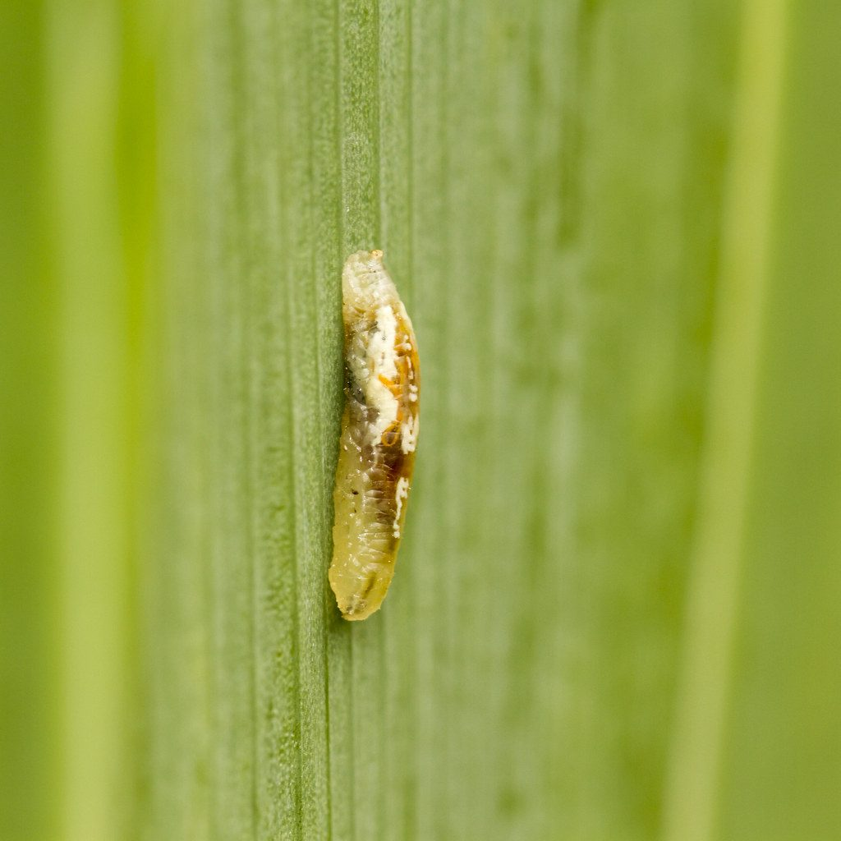
Biological control
LEARN
Biological control uses other organisms to reduce pests.
Hoverfly larvae eat aphids. Ladybirds do too.
Hedges and trees give these helpful predators somewhere to live, and give insect-eating birds a home.
No pesticide means no harm to pollinators and no bioaccumulation.
But it is slower, and the pests are never removed completely.
A hoverfly larva eating aphids
Image: The Manic Macrographer, CC BY 2.0, via Wikimedia Commons
Key idea A hedge is not wasted land: it houses the predators that protect the crop for free.
Key words biological control
Notes:
Stretch 3 asks which type of farm attracts more insect-eating birds: the organic one, because hedges and trees give nesting places and there are more insects to eat. Link to Lesson 6: a general insecticide would kill the hoverfly larvae as well as the aphids.

Slide 10
Your turn
DO
13
min
1
Core: choose the valid conclusion for the bean plant data and give your reason; match the kinds of error and bias; sort the farming statements.
2
Stretch: the German insect study; how graph C is biased and who might draw it; insect-eating birds.
3
Challenge: a balanced paragraph about HT soybean; organic versus intensive yields.
4
Finished? The My thinking question is about a website claim.
A balanced paragraph has at least two points for and two against, then a decision.
Notes:
Check Core 1 early: the common wrong choice is 'seedling height increases as the amount of fertiliser increases', which ignores the fall at 8 and 10 drops.

Slide 11
The farmer's report
THINK AND REFLECT
A farmer wants permission to plough a wild meadow. The report to the council has a graph showing profits rising every year, and a list of benefits. How would you check this report for bias and validity?
Sentence frames
I would check whether ___, because ___.
The report might be biased because ___.
A balanced report would also include ___.
Notes:
Expected: check whether all the years are on the graph; who wrote it and what they gain; whether the disadvantages (habitat loss, species in the meadow, eutrophication risk) are included; whether the profit data measure what they claim. This is the ecological audit from Lesson 5 seen from the other side.

Slide 12
9B unit review quiz
CHECK
Mini whiteboards. Eight questions from the whole unit, then we check and you tick your gaps.
Q1 Write the word equation for photosynthesis.
Q2 Which cells open and close the stomata?
Q3 Name the mineral salt plants need to make proteins.
Q4 What colour does iodine solution turn with starch?
Q5 What is the difference between an insecticide and a herbicide?
Q6 Put these in order: algae grow, fish die, fertiliser washes into the lake, decomposers use oxygen.
Q7 Name two processes that release carbon dioxide into the air.
Q8 What makes a conclusion valid?
Notes:
Answers: carbon dioxide + water makes glucose + oxygen; guard cells; nitrates; blue-black; insecticide kills insects, herbicide kills weeds (both pesticides); fertiliser washes in, algae grow, decomposers use oxygen, fish die; respiration and combustion (or decomposition); it uses all the results and only the results. Students note any question they got wrong as a revision target.

Slide 13
Exit ticket
EXIT TICKET
3
min
On your worksheet exit ticket. Work alone. Hand it in as you leave.
1. What is bias?
2. Give one example of a systematic error.
3. Give one difference between organic farming and intensive farming.
Notes:
Answers: a shift away from the true meaning or value, deliberate or accidental; e.g. a thermometer with a wrongly printed scale, a balance not set to zero; e.g. organic uses natural fertilisers and few pesticides, intensive uses artificial fertilisers and many pesticides. Collect the strips and the quiz gaps.

Slide 14
What we learned in 9B
SUMMARY
Bias is a shift from the truth: intentional (selected data) or accidental (systematic error, poor sampling).
A valid conclusion uses all the results and only the results, and does not claim causes that were never tested.
Organic farms: natural fertilisers, few pesticides, biological control, more biodiversity, lower yield per field.
Intensive farms: artificial fertilisers and pesticides, large fields, higher yield, more risk to rivers and food webs.
Across 9B: plants make glucose by photosynthesis and build everything else from it; farming is about supplying what plants need without wrecking what else lives there.
Next lesson 9C Threat from disease: pathogens, immunity and how the body is controlled.
Notes:
Homework: Workbook pages 25 and 26, and the review quiz gaps. Page 26 asks students to write one new fact for each topic from the start of the unit.

