Slide 1

Threat from disease
YEAR 9 SCIENCE · 9C THREAT FROM DISEASE · LESSON 1 OF 7
What makes us ill, and why do we live so much longer than people did 180 years ago?
Exploring Science International 9 · Student Book pages 37 to 38 · Workbook pages 27 to 28
Notes:
Welcome to 9C, Threat from disease. This unit covers what causes disease, how the body fights it, how we treat it, and the ecology and cell biology that explain outbreaks. Today: the big picture of disease.

Slide 2
Do Now: living longer
DO NOW
4
min
In England and Wales in the 1840s, the median age of death was 46. Today it is 83.
1. Suggest two reasons why people live longer today.
2. Name one disease caused by a microorganism.
3. What is a microorganism?
Notes:
Four minutes, in books. Expected reasons: clean water and sewers, better food, vaccines, medicines such as antibiotics, hospitals. A microorganism is a living thing too small to see without a microscope. Accept flu, cholera, chickenpox, malaria, Covid-19 and so on.

Slide 3
Today
TODAY
Today I can ...
Key words today
I can explain how hygiene, diet, immunisation and medicines have helped people live longer.
disease something that makes you ill
pathogen a microorganism that causes disease
infectious disease a disease caused by a pathogen that can pass from person to person (communicable)
non-communicable cannot be passed from person to person
deficiency disease a disease caused by a lack of a nutrient in the diet
genetic disease a disease caused by a fault in the DNA
lifestyle disease a disease made more likely by the way we live, e.g. smoking
autoimmune disease a disease in which the body's own white blood cells attack it
symptom an obvious effect of a disease, e.g. a rash
hygiene keeping things clean so pathogens do not spread
immunisation giving a vaccine to protect against a disease
I can give examples of the five types of disease and say which ones can be passed from person to person.
Notes:
Read each goal aloud. Point out the key words box on the worksheet. Students with the Chinese key words sheet have the same words with Chinese beside them.

Slide 4
The Broad Street pump, 1854
HOOK
In one London street, hundreds of people died of cholera in a few days. Dr John Snow mapped every death. Almost all the victims drank from one water pump. What did he suspect?
Talk to a partner: how could water make people ill?
The John Snow pub on Broadwick (Broad) Street, Soho, next to the site of the cholera pump
Image: Ewan-M, CC BY-SA 2.0, via Wikimedia Commons
Notes:
Snow suspected the water carried the disease. The pump's well was next to a leaking cesspit, so sewage with cholera bacteria got into the drinking water. The handle was removed and the outbreak stopped. This is hygiene: keeping drinking water separate from sewage.

Slide 5
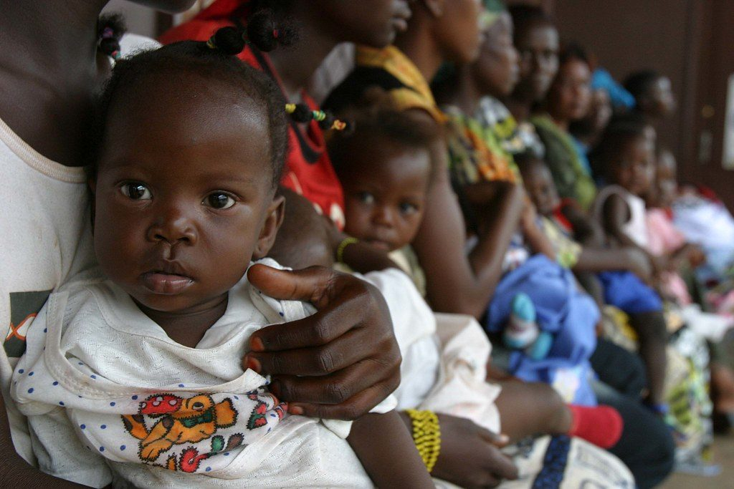
Why do we live longer?
LEARN
Hygiene keeps drinking water separate from sewage, which contains pathogens (cholera, typhoid).
Better diet: healthier bodies fight disease better.
Immunisation protects against particular diseases. Polio paralysed or killed about half a million people a year in the 1940s; today there are a few hundred cases.
Medicines, including antibiotics for bacterial diseases.
Oral polio vaccine being given to a child
Image: hdptcar, CC BY 2.0, via Wikimedia Commons
Key idea Hygiene, diet, immunisation and medicines have cut deaths from infectious diseases.
Key words hygiene · pathogen · immunisation
Notes:
Polio is caused by a virus that attacks the nervous system, so signals cannot reach muscles and the person cannot move. An international immunisation programme has almost wiped it out. Ask: which of these four changes could a single family do for itself, and which need a whole town?

Slide 6
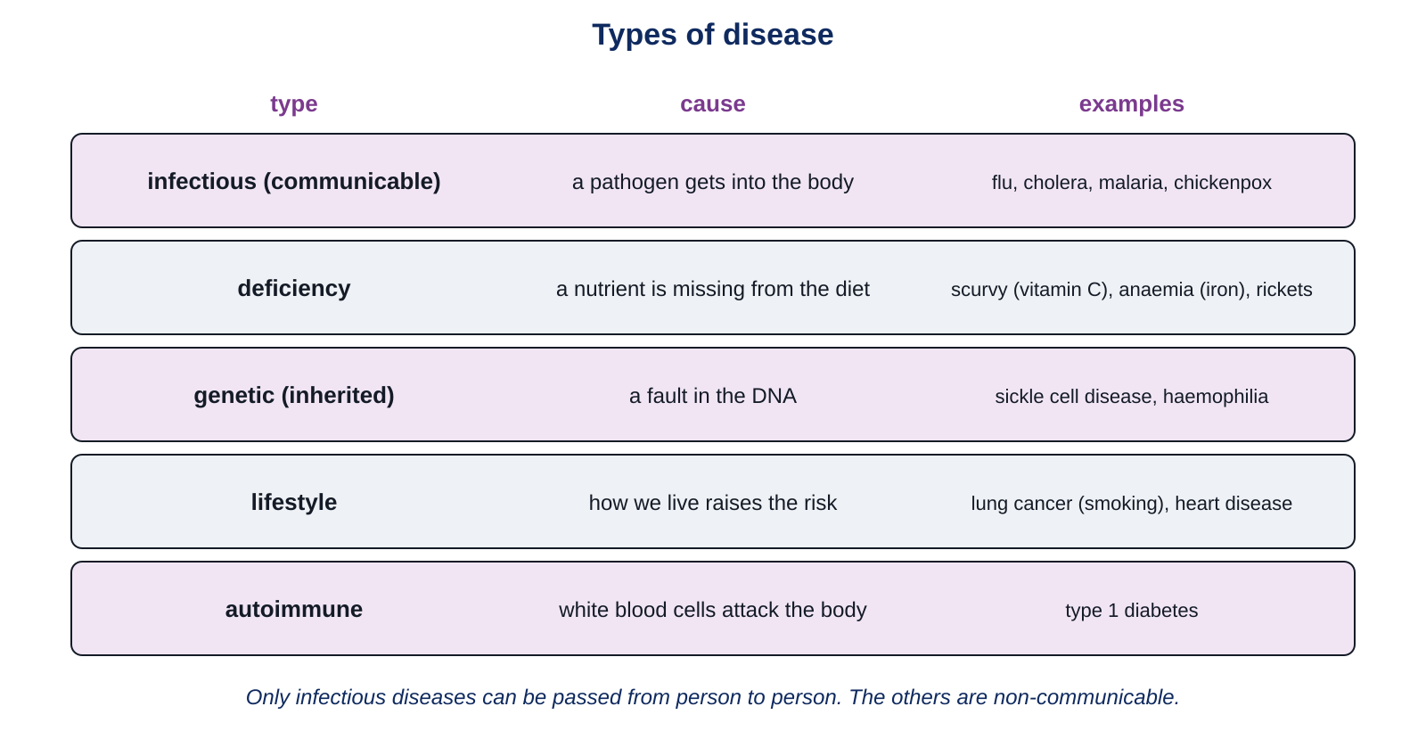
Five types of disease
LEARN
A disease is something that makes you ill. Diseases have many different causes.
Key idea Only infectious diseases can be passed from person to person. The other four types are non-communicable.
Notes:
Go through each row: infectious (a pathogen gets in), deficiency (a nutrient is missing), genetic (a fault in the DNA, present from birth), lifestyle (smoking, poor diet, too little exercise raise the risk), autoimmune (the immune system attacks the body, e.g. type 1 diabetes). Ask students to name one more example for the first two rows.

Slide 7
Pathogens and symptoms
LEARN
Pathogens are microorganisms that get into the body and change how it works.
They include bacteria, fungi, protoctists and viruses.
The obvious effects of a disease are its symptoms: a rash, a raised temperature, a cough.
In richer countries, most deaths are now from changes inside the body, not from infections.
Key idea A pathogen is a microorganism that causes disease.
Key words pathogen · symptom · infectious disease
Notes:
Bacteria, fungi and protoctists are three kingdoms of living organisms. Viruses are not classed as living: they cannot do anything on their own and must get inside a cell to copy themselves. Chickenpox is a virus; athlete's foot is a fungus; malaria is a protoctist carried by mosquitoes; cholera is a bacterium.

Slide 8
Quick check
CHECK
Mini whiteboards. One answer each, then we check.
Q1 Scurvy is caused by too little vitamin C. Which type of disease is it?
Q2 Flu is caused by a virus. Which type of disease is it?
Q3 Can you catch type 1 diabetes from a friend? Yes or no.
Q4 Name one kingdom of organisms that includes pathogens.
Q5 Give one symptom of chickenpox.
Notes:
Answers: deficiency; infectious (communicable); no, it is autoimmune and non-communicable; bacteria, fungi or protoctists (viruses are not a kingdom of living things); a rash or spots, itching, a raised temperature.

Slide 9
Your turn: sorting diseases
DO
14
min
1
Core: match each type of disease to its example, then tick communicable or non-communicable.
2
Core: fill the gaps using the word bank; decide what type of disease anaemia is.
3
Stretch: write definitions; explain why polio stops muscles working.
4
Challenge: why are most deaths in richer countries now non-communicable? How do medicines get into cells?
5
Finished? Answer the My thinking question.
Use the key words box. Write the type of disease, not just the name of the disease.
Notes:
The match question has one example for each type. Common error: calling cardiovascular disease infectious because it is common. Circulate and ask students to say the cause of each disease out loud.

Slide 10
A changing threat
THINK AND REFLECT
In richer countries, the main causes of death are now non-communicable diseases such as heart disease and cancer, not infections. Why has this changed over the last 180 years?
Sentence frames
Fewer people die from infections because ___.
More people now die from ___ because they live long enough to ___.
One thing we could do about lifestyle diseases is ___.
Notes:
Expected: hygiene, vaccines and antibiotics have cut deaths from infectious diseases, so people live longer, and diseases of older age (heart disease, cancer) become the main causes of death; lifestyle factors (smoking, diet, exercise) also matter. Keep the discussion factual and avoid singling out anyone's family habits.

Slide 11
Exit ticket
EXIT TICKET
4
min
On your worksheet exit ticket. Work alone. Hand it in as you leave.
1. What is a pathogen?
2. Give one example of a non-communicable disease and explain why it is non-communicable.
3. Name two types of microorganism that can be pathogens.
Notes:
Answers: a microorganism that causes disease; e.g. scurvy (lack of vitamin C) or sickle cell disease (faulty gene) or type 1 diabetes (immune system attacks the body): none is caused by a pathogen, so it cannot pass from person to person; bacteria, viruses, fungi, protoctists. Collect the strips before students leave.

Slide 12
What we learned
SUMMARY
People live longer because of hygiene, better diet, immunisation and medicines.
Pathogens are microorganisms (bacteria, viruses, fungi, protoctists) that cause infectious diseases.
Deficiency, genetic, lifestyle and autoimmune diseases are non-communicable: they cannot be passed on.
Symptoms are the obvious effects of a disease.
Next lesson Immunity and vaccination: how white blood cells destroy pathogens, and why you only get measles once.
Notes:
Homework: Workbook pages 27 and 28 (9Ca Threat from disease; Diseases). Students with the Chinese key words sheet may answer in either language but should use the English key words.

