Slide 1
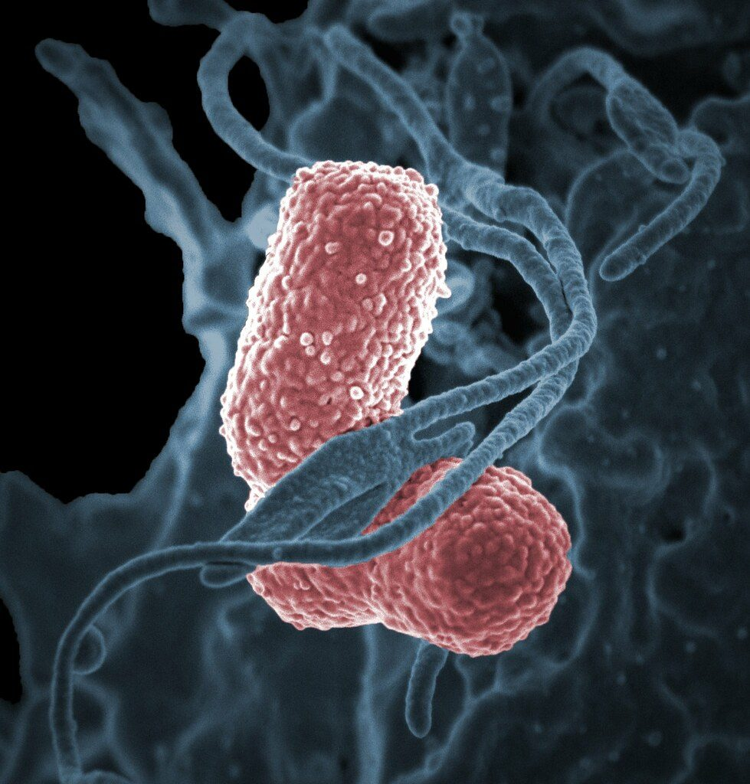
Immunity and vaccination
YEAR 9 SCIENCE · 9C THREAT FROM DISEASE · LESSON 2 OF 7
How does your body beat a pathogen, and how can a vaccine make you immune without the disease?
Exploring Science International 9 · Student Book pages 39 to 41 · Workbook pages 29 to 30
Notes:
Lesson 2 of 9C. Last lesson: what causes disease. Today: what the body does about it, and how vaccines use the same system. The Challenge links to the Veterinary science STEM pages.

Slide 2
Do Now: once is enough
DO NOW
4
min
Many people had chickenpox as a small child.
If a friend has it now, they will almost certainly not catch it again.
1. Suggest why you only get chickenpox once.
2. What is a pathogen? (last lesson)
3. Name two things your body does to fight an infection.
Notes:
Four minutes, in books. Do not confirm answers yet; collect ideas on the board (white blood cells, antibodies, 'the body remembers'). A pathogen is a microorganism that causes disease. Q3: any sensible idea: white blood cells, raised temperature, skin as a barrier, coughing and sneezing.

Slide 3
Today
TODAY
Today I can ...
Key words today
I can describe how phagocytes and lymphocytes destroy microorganisms in the body.
white blood cell a blood cell that fights pathogens
phagocyte a white blood cell that surrounds, ingests and digests microorganisms
lymphocyte a white blood cell that makes antibodies
antibody a protein that sticks to one type of pathogen
specific fits only one type of pathogen
memory cell a lymphocyte that stays in the body ready to make antibodies quickly
immune protected against a disease, so you do not become ill with it
vaccine a substance containing parts of a pathogen, given to make a person immune
virus a very small pathogen that can only copy itself inside a cell
dose the amount of a medicine given at one time
half-life the time for the amount of a medicine in the body to fall by half
I can explain why you only get many infectious diseases once, and how vaccination protects people and communities.
Notes:
Read each goal aloud. Point out the key words box on the worksheet. The Chinese key words version has the same words with Chinese beside them.

Slide 4
Caught in the act
HOOK
These bacteria have got into your blood. Phagocytes, a type of white blood cell, are on their way. What do you think happens next?
Talk to a partner: what does your body do in the days after a pathogen gets in?
Bacteria (coloured electron micrograph)
Image: National Institutes of Health (NIH), Public domain, via Wikimedia Commons
Notes:
The phagocyte surrounds the bacteria, takes them inside itself (ingests them) and digests them with enzymes. Phagocytes work on any pathogen. The other kind of white blood cell, lymphocytes, are more particular, as we will see.

Slide 5
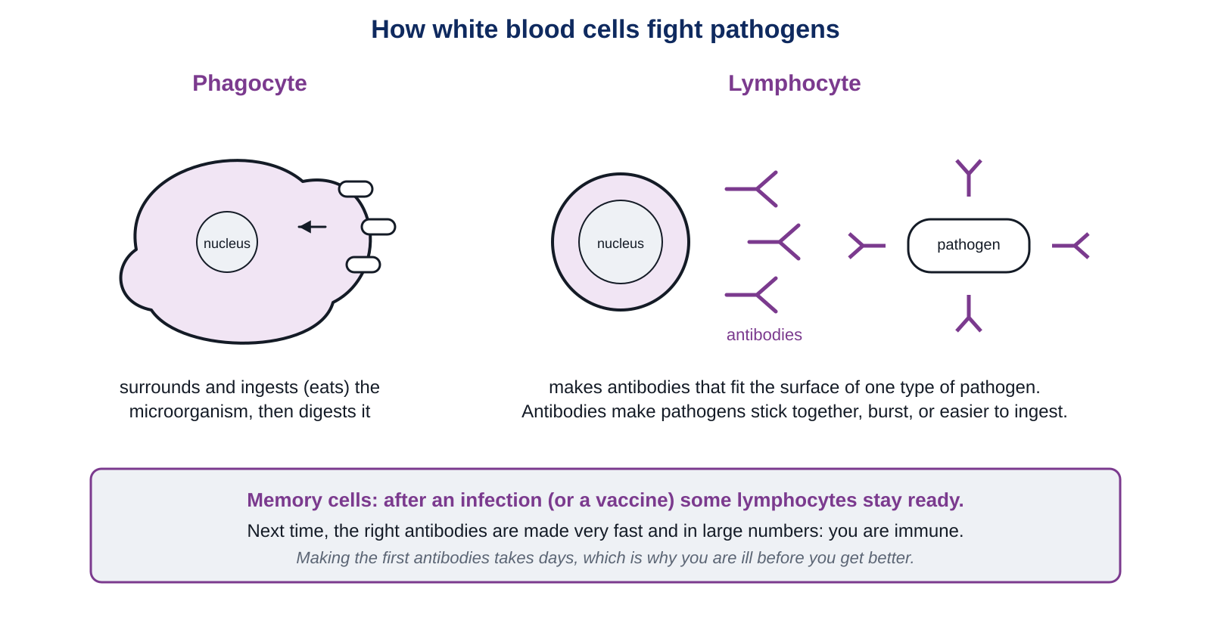
Two kinds of white blood cell
LEARN
Your blood carries two main types of white blood cell that attack pathogens in different ways.
Key idea Phagocytes ingest pathogens. Lymphocytes make antibodies that fit the surface of one type of pathogen.
Notes:
Left: a phagocyte surrounds and ingests a microorganism, then digests it. Right: a lymphocyte makes antibodies, proteins that stick to the outside of the pathogen. Antibodies can make pathogens burst, stick together in clumps, or be easier for phagocytes to ingest. Point out the memory cells box: we come back to it.

Slide 6
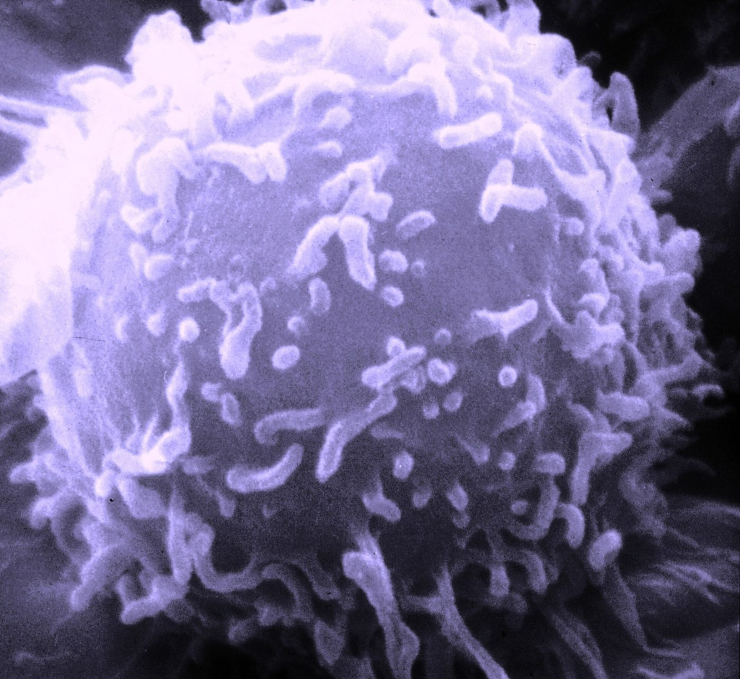
Why you are ill before you get better
LEARN
Each type of pathogen has a different surface, so it needs a different antibody.
Lymphocytes must make new, specific antibodies for each new pathogen.
This takes days. Meanwhile the pathogen multiplies and you feel ill.
Once there are enough antibodies, the pathogens are destroyed and you recover.
A lymphocyte (electron micrograph)
Image: Unknown photographer/artist (False color modifications made by myself--DO11.10), Public domain, via Wikimedia Commons
Key idea Antibodies are specific: each type fits only one type of pathogen.
Key words lymphocyte · antibody · specific
Notes:
Use a key and lock: one antibody fits one pathogen. Ask: if you are immune to measles, are you immune to chickenpox? No: different surface, different antibody needed. That is why a child can have measles and still get chickenpox.

Slide 7
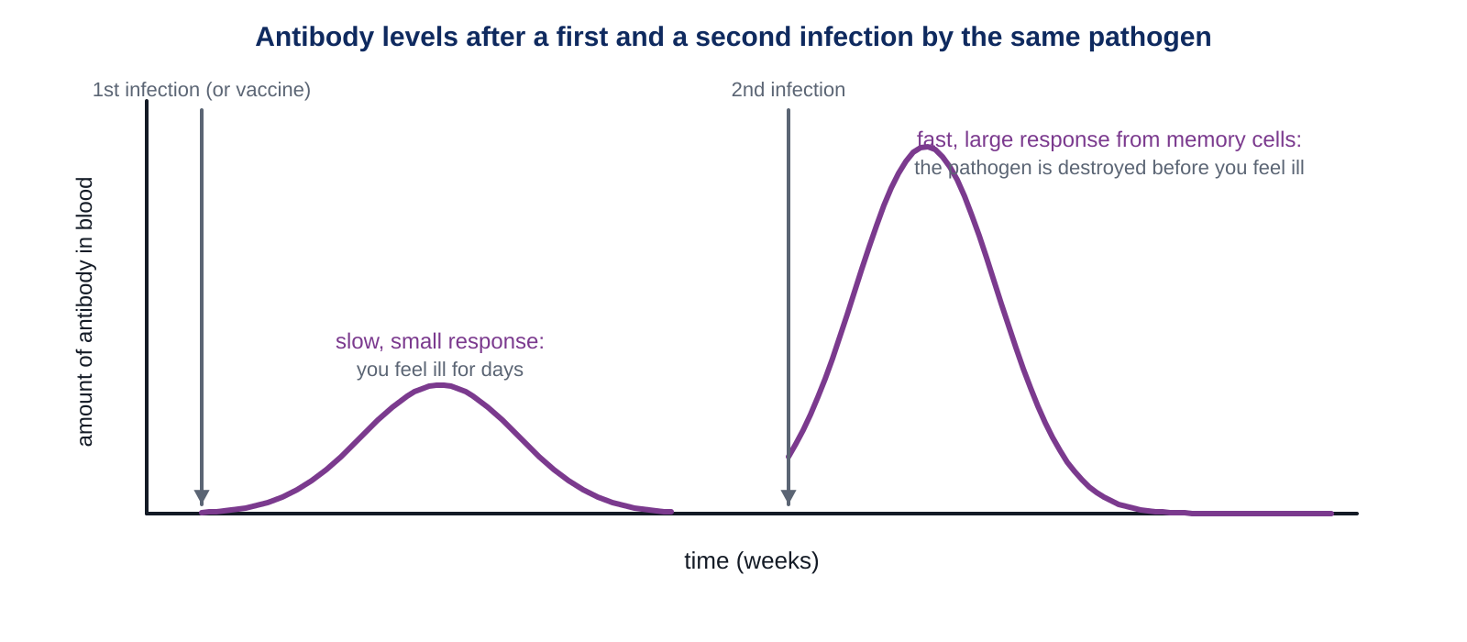
Memory cells make you immune
LEARN
After an infection, some lymphocytes stay in the body as memory cells.
Key idea The second time the same pathogen gets in, memory cells make antibodies fast and in large numbers: the pathogen is destroyed before you feel ill. You are immune.
Notes:
Compare the two curves: the first response is slow and small, so you are ill for days. The second is fast and large, so the pathogen never gets a chance to multiply. This is why you only get measles once. Ask: where could a vaccine fit on this graph? (It gives the first response without the disease.)

Slide 8
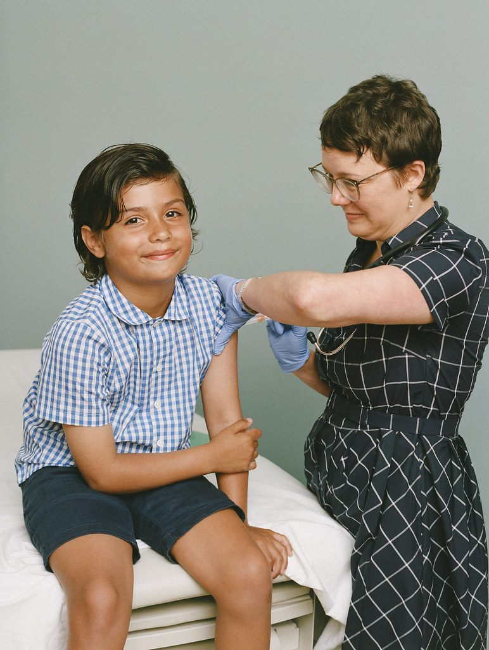
Vaccines
LEARN
A vaccine contains parts of the surface coating of a pathogen (or a dead or weakened form).
Lymphocytes make antibodies and memory cells against it, without you having the disease.
If most people in a community are vaccinated, the pathogen cannot spread, which also protects people who cannot be vaccinated.
Viruses are not living: they can only copy themselves inside a cell.
A vaccination
Image: SELF Magazine, CC BY 2.0, via Wikimedia Commons
Key idea Vaccination makes you immune without being ill.
Key words vaccine · immune · virus
Notes:
The vaccine cannot cause the disease because it does not contain a working pathogen, but the surface parts are enough for lymphocytes to make the right antibody and memory cells. Community protection: a pathogen needs a chain of people to pass through; vaccinated people break the chain. Antibiotics do not work on viruses (Lesson 4).

Slide 9
Quick check
CHECK
Mini whiteboards. One answer each, then we check.
Q1 Which type of white blood cell ingests (eats) microorganisms?
Q2 What do lymphocytes make?
Q3 Why do you only get measles once?
Q4 Does a measles vaccine protect you against chickenpox? Yes or no, and why.
Q5 What does a vaccine contain?
Notes:
Answers: phagocytes; antibodies (proteins that stick to pathogens); memory cells stay ready and make the right antibodies very quickly the second time, so you are immune; no, antibodies are specific and chickenpox has a different surface; parts of the pathogen's surface coating (or a dead or weakened pathogen).

Slide 10
Your turn: fighting infection
DO
14
min
1
Core: complete the gap fill with the word bank, match the key words, then decide true or false.
2
Stretch: measles and chickenpox; how a vaccine protects a child; why viruses are not living.
3
Challenge: a vet's antibiotic dose. Use the half-life to work out when the ball python needs its next dose.
4
Finished? Answer the My thinking question about flu vaccines.
Use the words phagocyte, lymphocyte, antibody and memory cell correctly: they are not the same thing.
Notes:
Half-life hint for Challenge: 10 mg/kg falls to 5 after one half-life (64 hours), then to 2.5 after two (128 hours). 128 hours is about 5.3 days, so a new dose is needed by day 5. Circulate and check the gap fill first.

Slide 11
Protecting the whole community
THINK AND REFLECT
In a town, 95% of children are vaccinated against measles. The other 5% cannot be: some are babies, some are too ill. Why are those 5% also protected?
Sentence frames
A pathogen spreads when ___.
Vaccinated people cannot ___, so the pathogen ___.
The unvaccinated 5% are protected because ___.
Notes:
Expected: measles spreads from person to person; vaccinated people do not become ill or pass it on, so the chain of infection is broken and the virus rarely reaches an unvaccinated person. This only works when most people are vaccinated. Link to the polio story from Lesson 1.

Slide 12
Exit ticket
EXIT TICKET
4
min
On your worksheet exit ticket. Work alone. Hand it in as you leave.
1. Name the two types of white blood cell and say what each one does.
2. Why do you only get measles once?
3. What does a vaccine contain, and why does it not give you the disease?
Notes:
Answers: phagocytes ingest and digest microorganisms, lymphocytes make antibodies; memory cells remain after the first infection and make the specific antibodies very quickly next time; parts of the pathogen's surface coating (or a dead or weakened pathogen) that cannot cause the disease but still trigger antibodies and memory cells.

Slide 13
What we learned
SUMMARY
Phagocytes ingest and digest pathogens; lymphocytes make specific antibodies.
Making antibodies for a new pathogen takes days, which is why you are ill before you get better.
Memory cells make the second response fast and large: you are immune.
Vaccines contain parts of a pathogen and make you immune without the disease; vaccinating most of a community protects everyone.
Next lesson Control systems: how nerves and hormones carry messages around the body, and why polio and chickenpox viruses attack nerve cells.
Notes:
Homework: Workbook pages 29 and 30 (9Ca Diseases; Veterinary science). The model of half-life on page 30 can be designed at home and tried in a later lesson if time allows.

