Slide 1
Control systems: nerves and hormones
YEAR 9 SCIENCE · 9C THREAT FROM DISEASE · LESSON 3 OF 7
How does your body know what is happening around it, and how does it respond?
Exploring Science International 9 · Student Book pages 42 to 43 · Workbook pages 31
Notes:
Lesson 3 of 9C. Link from Lesson 1: the polio virus attacks the nervous system, and the chickenpox virus hides in nerve cells. Today: how the nervous and hormonal systems control the body.

Slide 2
Do Now: the hot pan
DO NOW
4
min
You touch a hot pan and pull your hand away before you even feel the pain.
1. Which organ detected the heat?
2. Which organ moved your hand?
3. Which organ system connects them?
Notes:
Four minutes, in books. Skin (the receptor cells in it) detects the heat; muscles in the arm move the hand; the nervous system connects them. Some students will say 'brain' for Q3: accept it and build on it.

Slide 3
Today
TODAY
Today I can ...
Key words today
I can describe how the nervous system detects a stimulus and produces a response.
nervous system the organ system that senses changes and makes the body respond rapidly
central nervous system the brain and spinal cord (CNS)
nerve an organ that carries impulses between the CNS and the rest of the body
stimulus a change that can be detected, e.g. light, sound, touch
receptor a cell in a sense organ that detects a stimulus
impulse an electrical signal that travels along a nerve
effector a muscle or gland that carries out a response
hormone a chemical messenger made in a gland and carried in the blood
gland an organ that makes and releases a substance, e.g. a hormone
target organ an organ that responds to a particular hormone
insulin a hormone from the pancreas that makes cells take up glucose from the blood
I can describe how hormones affect the body and compare the nervous and hormonal systems.
Notes:
Read each goal aloud. Point out the key words box on the worksheet. The Chinese key words version has the same words with Chinese beside them.

Slide 4
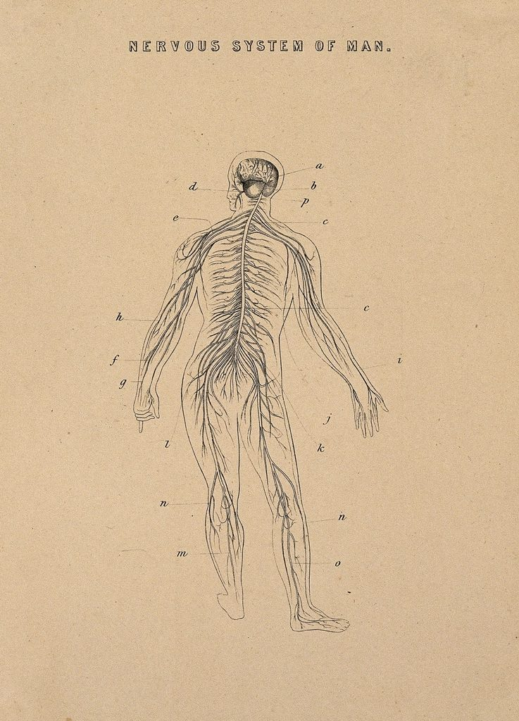
Fast and slow messages
HOOK
A message along a nerve can travel at over 100 metres per second. The message that makes a child grow taller takes years. Why does the body need two different kinds of messenger?
Talk to a partner: name one fast response and one slow change in your body.
An old anatomical drawing of the human nervous system
Image: unknown, CC0, via Wikimedia Commons
Notes:
Fast responses: blinking, pulling away from heat, catching a ball. Slow changes: growing, puberty, digesting a meal, feeling nervous for an hour before a test. Fast needs a direct wire (nerves); slow and widespread needs a chemical that reaches many organs (hormones).

Slide 5
The nervous system
LEARN
Organs: the brain and spinal cord (the central nervous system, CNS) and the nerves.
Receptor cells in sense organs (eyes, ears, skin) detect stimuli.
A receptor produces electrical impulses that travel along nerves to the CNS.
The brain processes the information and sends impulses to effectors: muscles contract, glands release substances.
Key idea stimulus, receptor, nerve, CNS, nerve, effector, response.
Key words central nervous system · receptor · impulse · effector
Notes:
All these organs are made of nerve tissue, built from nerve cells. A stimulus is any change the body can detect. Ask students to name the sense organ for light (eye), sound (ear), temperature and touch (skin), chemicals in food (tongue) and in the air (nose).

Slide 6
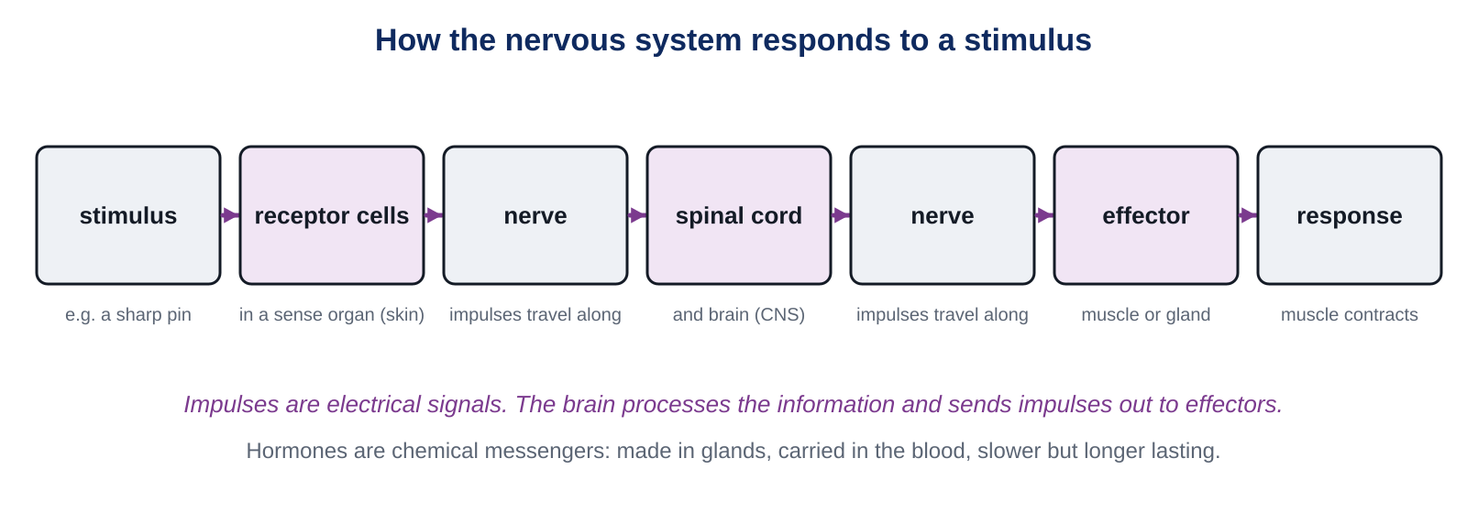
Picking up a pen
LEARN
Touch receptors in your fingers detect the pen; impulses travel to the CNS and back out to the muscles that lift your hand.
Key idea Impulses are electrical signals. They travel along nerves, usually to the brain via the spinal cord, and back out to an effector.
Notes:
Walk through the boxes left to right with the pen example. Students complete the same pathway in order on the worksheet (Core question 4). Point out that the hormone line at the bottom of the diagram is the second system, coming next.

Slide 7
Hormones: chemical messengers
LEARN
Hormones are chemicals made in glands and released into the blood.
Target organs respond to a hormone by changing what they do.
Adrenaline (adrenal glands) increases heart rate and breathing rate.
Insulin (pancreas) makes muscle and liver cells take up glucose from the blood.
Growth hormone (pituitary gland) controls growth; thyroxine (thyroid) controls the rate of many body processes.
Key idea Hormones travel in the blood and act on target organs.
Key words hormone · gland · target organ · insulin
Notes:
The blood carries a hormone everywhere, but only target cells respond to it. One hormone can trigger another: a hormone from the ovaries (oestrogen) makes the pituitary release the hormone that triggers ovulation. Keep this slide brisk; the table on the next slide does the comparing.

Slide 8
Comparing the two systems
LEARN
 | Nervous system | Hormonal system
messenger | electrical impulses along nerves | chemical messengers (hormones) in the blood
speed | short, rapid response | longer, slower response
acts on | only the effector connected to the nerve | many target organs at the same time
example | pulling your hand from a hot pan | adrenaline preparing the body for danger
Nerves: fast and local.
Hormones: slower, longer lasting and widespread.
Having both means we can respond in different ways to different stimuli.
Key idea Two control systems let the body respond in different ways.
Notes:
Ask: which system would you use to catch a falling ruler? (Nervous.) Which keeps blood glucose steady after lunch? (Hormonal: insulin.) Students meet this table again on the worksheet (Stretch 2) and in the Think task.

Slide 9
Quick check
CHECK
Mini whiteboards. One answer each, then we check.
Q1 Which sense organ detects light?
Q2 Name the two organs of the central nervous system.
Q3 Where are hormones made?
Q4 Which hormone makes cells take up glucose from the blood?
Q5 Which system gives the faster response: nervous or hormonal?
Notes:
Answers: the eye; the brain and the spinal cord; in glands; insulin; the nervous system.

Slide 10
Reaction time: the ruler drop
PRACTICAL
Aim Measure how quickly your nervous system responds to a stimulus.
Equipment
Method
30 cm ruler
a partner
the results table on your worksheet (Core 3)
Rest your forearm on the desk with your hand over the edge, thumb and finger open about 3 cm apart.
Your partner holds the ruler so the 0 cm mark is level with the top of your thumb.
Without warning, your partner lets go. Catch the ruler as fast as you can.
Read the distance (cm) at the top of your thumb and record it.
Repeat five times, then calculate the mean. Swap over.
Which part of the pathway was the receptor, the CNS and the effector?
Safety Stay seated. Drop the ruler between the fingers, never throw it. Keep feet clear.
Notes:
Seven minutes, then the worksheet. A shorter distance means a faster reaction. The eye is the receptor, the brain and spinal cord process, the hand muscles are the effector. Extension: does the reaction get faster with practice? Does talking to your partner slow it down?

Slide 11
Which system is best?
THINK AND REFLECT
You tread on something sharp. Suggest which control system is better for responding to this stimulus, and explain why.
Sentence frames
The ___ system is better because the response needs to be ___.
The receptors in the ___ send impulses along ___ to the ___.
The ___ system would be too ___ because ___.
Notes:
Expected: the nervous system, because the response (lifting the foot) must be rapid and only involves one effector; impulses travel from receptors in the skin along nerves to the spinal cord and back to the leg muscles. Hormones would be too slow and would act on many organs.

Slide 12
Exit ticket
EXIT TICKET
4
min
On your worksheet exit ticket. Work alone. Hand it in as you leave.
1. Name the two organs of the central nervous system.
2. What is a hormone, and how does it travel round the body?
3. Give one difference between a nervous response and a hormonal response.
Notes:
Answers: brain and spinal cord; a chemical messenger made in a gland, carried in the blood to target organs; nervous responses are faster and act on one effector, hormonal responses are slower, longer lasting and act on many target organs.

Slide 13
What we learned
SUMMARY
Receptors detect stimuli and send impulses along nerves to the brain and spinal cord (the CNS).
The CNS sends impulses to effectors: muscles contract, glands release substances.
Hormones are chemical messengers made in glands, carried in the blood to target organs.
Nervous responses are fast and local; hormonal responses are slower, longer and widespread.
Next lesson Treating diseases: antibiotics, antivirals and how transgenic bacteria make human insulin.
Notes:
Homework: Workbook page 31 (9Cb Control systems). Students who did not finish the reaction time mean can complete it at home with a family member.

