Slide 1
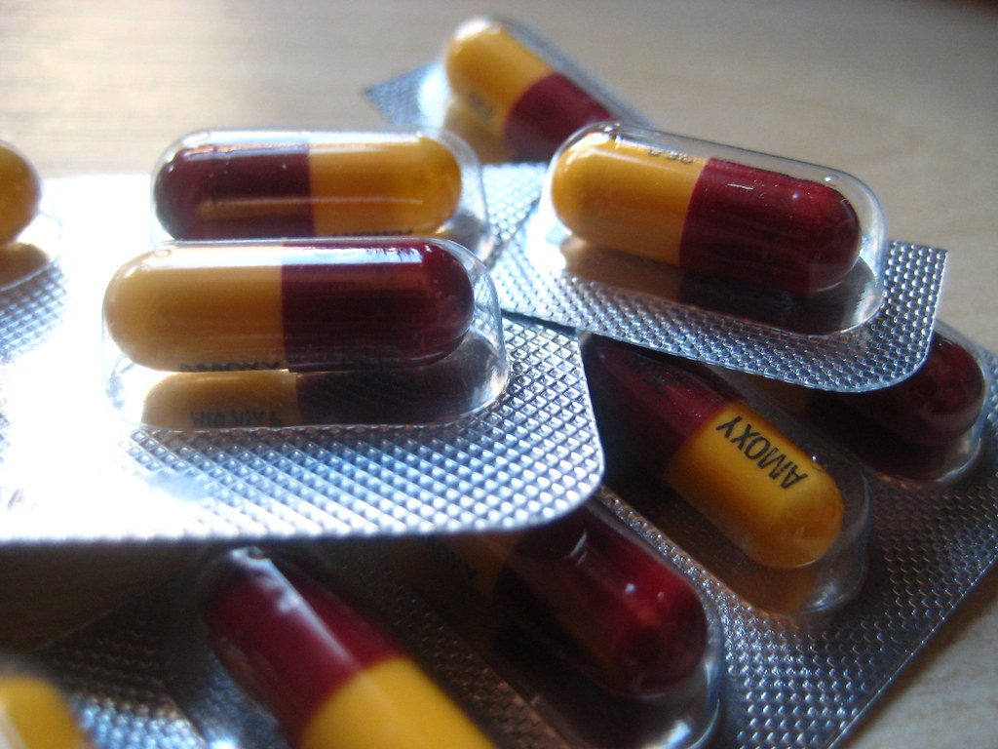
Treating diseases
YEAR 9 SCIENCE · 9C THREAT FROM DISEASE · LESSON 4 OF 7
Which medicine for which disease, and how do bacteria make human insulin?
Exploring Science International 9 · Student Book pages 44 to 45 · Workbook pages 32
Notes:
Lesson 4 of 9C. Lessons 1 and 2 covered types of disease and immunity. Today: treating disease, from antibiotics to transgenic bacteria. The fermenter links to 9Cc in the Student Book.

Slide 2
Do Now: which treatment?
DO NOW
4
min
1. An ear infection is caused by bacteria. Would you give an antibiotic or an antiviral?
2. Scurvy is caused by too little vitamin C. How would you treat it?
3. A vaccine prevents a disease. Can it treat someone who already has it?
Notes:
Four minutes, in books. Antibiotic (kills bacteria); give vitamin C in the diet (fresh fruit and vegetables); no, a vaccine makes memory cells before infection, it is prevention not treatment. Keep answers on the board for the Learn slides.

Slide 3
Today
TODAY
Today I can ...
Key words today
I can explain which medicines treat which types of disease, and why antibiotics do not work on viruses.
drug a substance that affects how the body works
medicine a drug used to treat or prevent disease
antibiotic a medicine that kills bacteria
antiviral a medicine that stops viruses replicating (copying themselves)
genetic disorder a disease caused by faulty genes that a person is born with
autoimmune disease a disease in which white blood cells attack the body's own cells
insulin a hormone made in the pancreas that lowers blood glucose
transgenic contains DNA from more than one species
fermenter a large container in which microorganisms are grown
sterilise kill all the microorganisms in or on something
aseptic free from unwanted microorganisms
I can explain how large amounts of human hormones are made quickly using genetically modified bacteria in a fermenter.
Notes:
Read each goal aloud. Point out the key words box on the worksheet. The Chinese key words version has the same words with Chinese beside them.

Slide 4
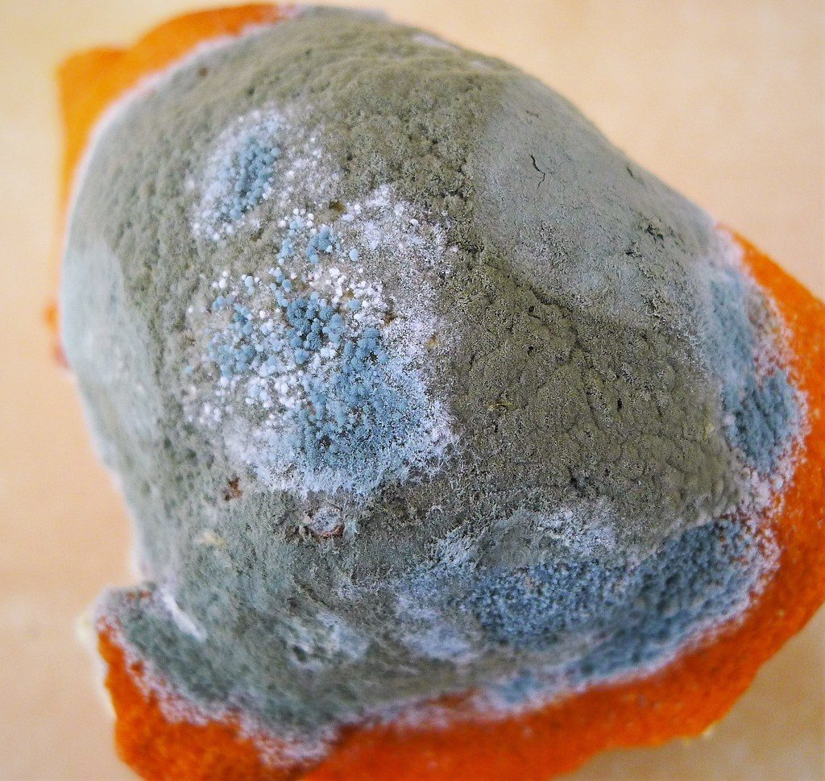
The forgotten dish
HOOK
In 1928, Alexander Fleming noticed that a mould had killed the bacteria growing around it on a dish he had forgotten to wash up. What had the mould made?
Talk to a partner: why might a mould make a substance that kills bacteria?
Penicillium mould growing on an orange
Image: gailhampshire, CC BY 2.0, via Wikimedia Commons
Notes:
The mould (Penicillium) made penicillin, the first antibiotic. Moulds and bacteria compete for food, so a chemical that kills bacteria gives the mould an advantage. Antibiotics have saved millions of lives since the 1940s, but they only work on bacteria.

Slide 5
Drugs and medicines
LEARN
A drug is any substance that affects how the body works.
Medicines are drugs used to treat or prevent disease.
Antibiotics kill bacteria. Antivirals stop viruses replicating.
Vaccines prevent infections. Deficiency diseases are treated by adding the missing nutrient to the diet.
Antibiotic capsules
Image: Sheep purple, CC BY 2.0, via Wikimedia Commons
Key idea Antibiotics do not work on viruses.
Key words drug · medicine · antibiotic · antiviral
Notes:
Every medicine is a drug, but not every drug is a medicine (caffeine affects the body but does not treat disease). An antibiotic for flu does nothing and can help bacteria become resistant. Other drugs treat lifestyle diseases such as heart disease.

Slide 6
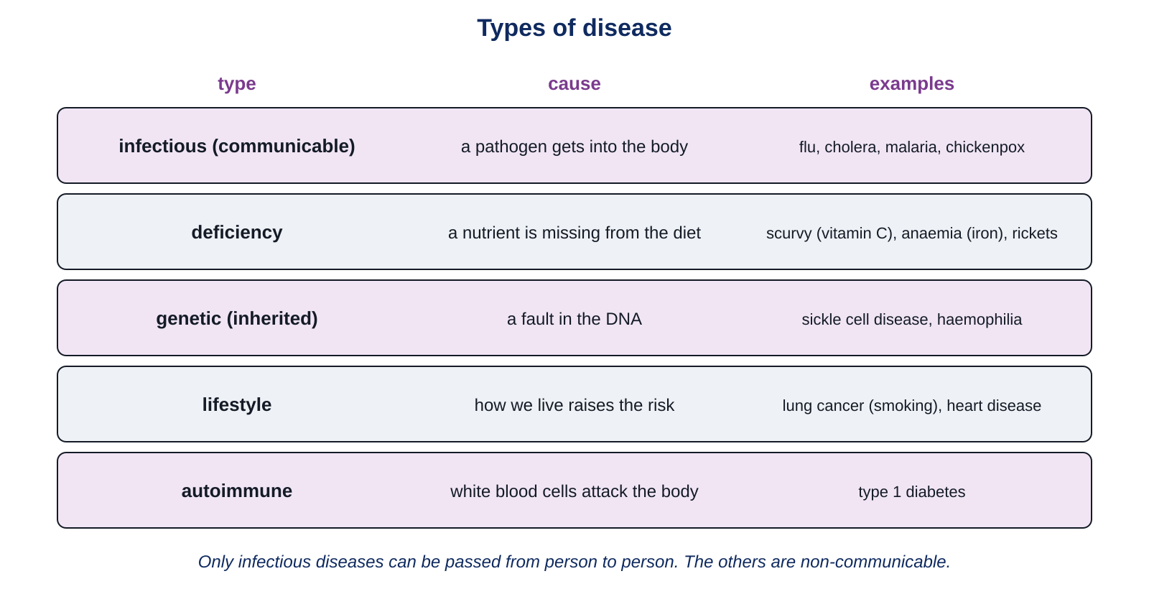
Diseases we cannot cure
LEARN
Genetic disorders: faulty genes from birth, e.g. sickle cell anaemia. Treatment may last a lifetime.
Autoimmune diseases: white blood cells attack the body.
Type 1 diabetes: the insulin-making tissue in the pancreas is destroyed. High blood glucose damages organs.
Treatment: inject the missing hormone.
Key idea Some diseases cannot be cured, but a missing hormone can be replaced.
Key words genetic disorder · autoimmune disease · insulin
Notes:
Remind students of the five types of disease from Lesson 1. Insulin makes cells take up glucose (Lesson 3); without it, glucose stays in the blood at high levels and damages blood vessels, eyes and kidneys. People with type 1 diabetes inject insulin several times a day. Where does that insulin come from? Next slide.

Slide 7
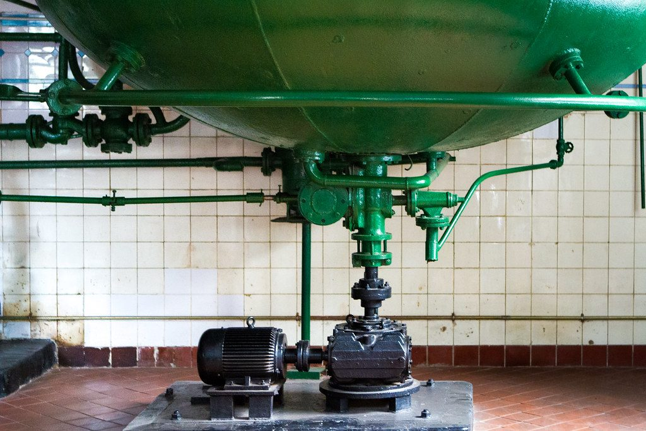
Transgenic bacteria
LEARN
In the past, growth hormone was taken from dead bodies and insulin from cattle: slow and expensive.
Now the human gene for the hormone is cut out of a chromosome and put into the DNA of bacteria.
The transgenic bacteria make the human hormone.
Transgenic means the organism contains DNA from more than one species.
A fermentation tank in a brewery: industrial fermenters look like this
Image: See-ming Lee (SML), CC BY 2.0, via Wikimedia Commons
Key idea A human gene in a bacterium makes the bacterium produce a human protein.
Key words transgenic
Notes:
Genes are sections of DNA (9A). Because every living thing uses the same DNA code, a human gene works inside a bacterium. Genetically modified means the DNA has been altered by scientists; it is transgenic only if DNA from another species was added. Removing a gene makes a GM organism that is not transgenic.

Slide 8
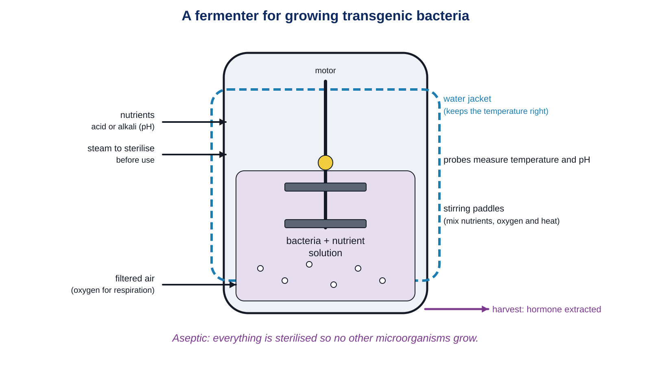
Inside a fermenter
LEARN
Transgenic bacteria are grown in large fermenters so that they reproduce quickly and make a lot of hormone.
Key idea Aseptic: the fermenter and everything put into it are sterilised, so no other microorganisms can grow.
Notes:
Work round the diagram: steam sterilises the fermenter before use; nutrients (including carbohydrates to feed on) and acid or alkali to keep the pH steady go in at the top; filtered air supplies oxygen for respiration; stirring paddles keep the bacteria from sinking and mix nutrients, oxygen and heat; the water jacket keeps the temperature at the best value for the enzymes; probes check temperature and pH; the hormone is harvested at intervals.

Slide 9
Quick check
CHECK
Mini whiteboards. One answer each, then we check.
Q1 Why is a medicine a drug?
Q2 Would an antibiotic cure flu? Yes or no, and why.
Q3 In which organ is insulin made?
Q4 What does 'transgenic' mean?
Q5 Why is the air bubbled into a fermenter filtered first?
Notes:
Answers: a drug is any substance that affects how the body works, and medicines do that to treat or prevent disease; no, flu is caused by a virus and antibiotics only kill bacteria; the pancreas; contains DNA from more than one species; to remove microorganisms from the air so they do not contaminate the fermenter.

Slide 10
Your turn: treating disease
DO
14
min
1
Core: match the medicines to their meanings, then tick the right treatment for each disease.
2
Core: complete the fermenter gap fill with the word bank.
3
Stretch: why medicines are drugs; how transgenic bacteria make growth hormone; type 1 diabetes and organ damage.
4
Challenge: the conditions inside a fermenter and the aseptic precautions; a GM organism that is not transgenic.
5
Finished? Answer the My thinking question about antibiotic resistance.
Say the type of disease first, then the treatment: that is the logic the examiner wants.
Notes:
Common error: giving an antibiotic for every infection. Check the treatment table first. For Stretch 2, students should mention cutting the human gene from a chromosome, putting it into the bacterial DNA, and the bacteria then making the hormone.

Slide 11
No antibiotics for a cold
THINK AND REFLECT
A patient with a bad cold asks the doctor for antibiotics. The doctor says no. The patient is annoyed. What should the doctor say to explain?
Sentence frames
A cold is caused by a ___, and antibiotics only kill ___.
Taking antibiotics when they are not needed can ___.
Instead, the doctor could suggest ___.
Notes:
Expected: colds are caused by viruses; antibiotics kill bacteria, so they would not help; using antibiotics when not needed lets bacteria that survive become resistant, so the medicine stops working for everyone; rest, fluids and letting the immune system (Lesson 2) deal with it. Antivirals exist for some viruses but not usually for colds.

Slide 12
Exit ticket
EXIT TICKET
4
min
On your worksheet exit ticket. Work alone. Hand it in as you leave.
1. What is the difference between an antibiotic and an antiviral?
2. What does 'transgenic' mean?
3. Give one reason why a fermenter is sterilised before use.
Notes:
Answers: antibiotics kill bacteria, antivirals stop viruses replicating; contains DNA from more than one species; so that no other microorganisms grow in it, which could be harmful or reduce hormone production.

Slide 13
What we learned
SUMMARY
Medicines are drugs used to treat or prevent disease: antibiotics kill bacteria, antivirals stop viruses replicating.
Genetic disorders and autoimmune diseases cannot be cured, but missing hormones such as insulin can be replaced.
Transgenic bacteria carry a human gene and make the human hormone.
Fermenters give bacteria the best conditions: sterile, with nutrients, filtered air, stirring and a steady temperature and pH.
Next lesson Medians and quartiles: how scientists use statistics to work out who a medicine helps in a clinical trial.
Notes:
Homework: Workbook page 32 (9Cc Treating diseases). The fermenter questions on that page match the Challenge.

