Slide 1
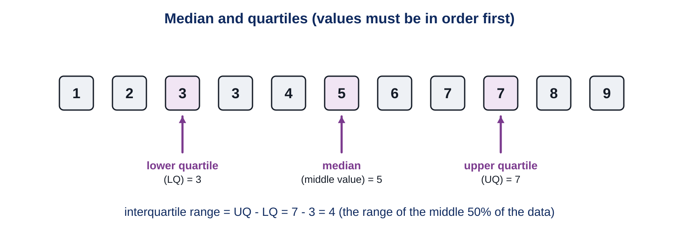
Medians and quartiles
YEAR 9 SCIENCE · 9C THREAT FROM DISEASE · LESSON 5 OF 7
How do scientists tell which patients a medicine really helps?
Exploring Science International 9 · Student Book pages 46 to 47 · Workbook pages 33
Notes:
Lesson 5 of 9C, a Working Scientifically lesson. It uses the clinical trial idea from Lesson 4 and the continuous variation and normal distribution ideas from 9A. Students need rulers for the hand span data.

Slide 2
Do Now: nine pulse rates
DO NOW
4
min
Resting pulse rates (beats per minute) of nine students: 72, 65, 80, 58, 90, 66, 75, 61, 70.
1. Write the values in order, smallest first.
2. Which value is in the middle?
3. Calculate the range (largest minus smallest).
Notes:
Four minutes, in books. Ordered: 58, 61, 65, 66, 70, 72, 75, 80, 90. Middle value (the median) 70. Range 90 minus 58 = 32. Ask: why order them first? Because the middle of the unordered list (90) tells you nothing.

Slide 3
Today
TODAY
Today I can ...
Key words today
I can find the median, the lower and upper quartiles and the interquartile range of a simple data set.
median the middle value when the values are written in order
mean the total of the values divided by the number of values
range the largest value minus the smallest value
quartile a value one quarter or three quarters of the way through the ordered data
lower quartile the value one quarter of the way through the ordered data (LQ)
upper quartile the value three quarters of the way through the ordered data (UQ)
interquartile range UQ minus LQ: the spread of the middle 50% of the data
normal distribution the bell-shaped curve seen when a continuous variable is plotted for a population
continuous variation variation that can take any value in a range, e.g. height
clinical trial a test of a medicine on groups of people
I can use quartiles to compare the variation in two groups and to interpret the results of a medicine trial.
Notes:
Read each goal aloud. Point out the key words box on the worksheet. The Chinese key words version has the same words with Chinese beside them.

Slide 4
Wonder drug or health scare?
HOOK
'Statins are a new wonder drug.' 'Statins in new health scare.' Two headlines about the same medicine. Trials showed statins protect most people from heart attacks, but a few may be harmed. How can scientists tell which patients a drug helps?
Talk to a partner: what would you need to measure, and how would you compare the patients?
Notes:
Expected: measure something about each patient (pulse rate, cholesterol, age), split them into groups, and compare how the drug worked in each group. Splitting a large group fairly needs the median and quartiles: that is today's lesson.

Slide 5
Median and quartiles
LEARN
In a clinical trial, scientists often divide the people into groups, e.g. pulse rate above or below the median. Write the values in order first.
Key idea Median = middle value. Quartiles = one quarter and three quarters of the way through. Interquartile range = UQ minus LQ.
Notes:
Work through the 11 values. Median is the 6th of 11. The lower quartile is the middle of the lower half (3rd value), the upper quartile the middle of the upper half (9th value). With an even number of values the median is halfway between the two middle values. Interquartile range here is 7 minus 3 = 4.

Slide 6
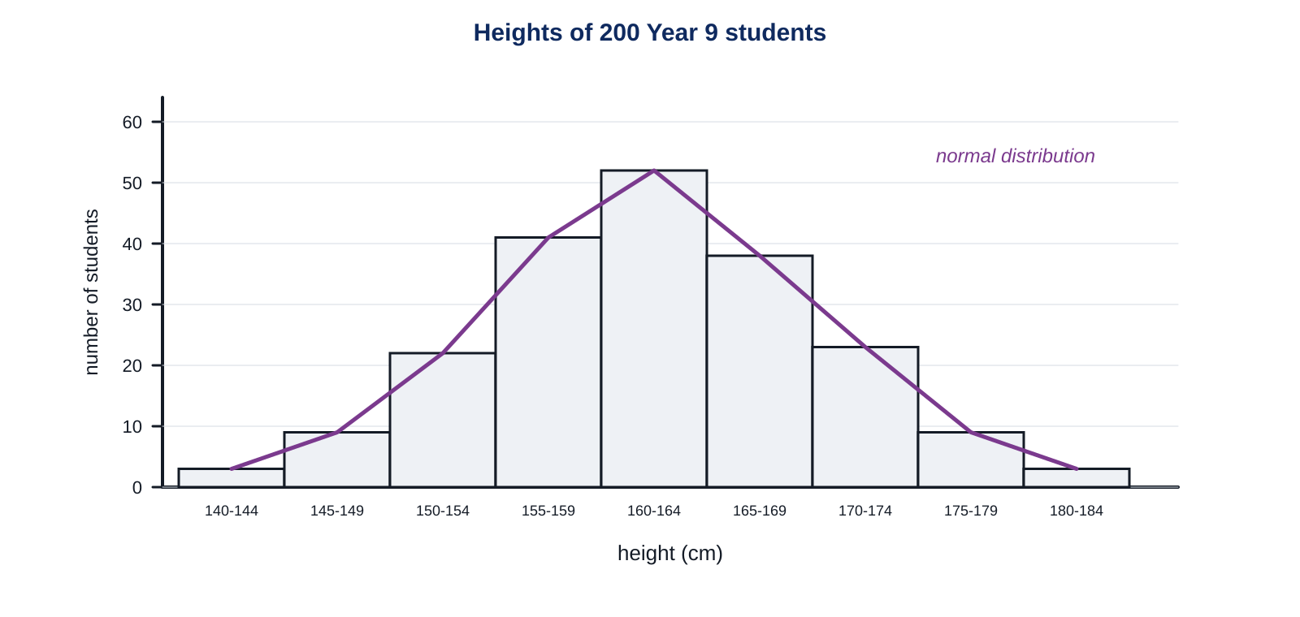
Why use the interquartile range?
LEARN
Height shows continuous variation: a bell-shaped normal distribution.
The interquartile range is the spread of the middle 50% of the data.
It ignores extreme values, so it is better than the range for comparing two groups.
Small interquartile range: little variation. Large: a lot of variation.
Key idea The interquartile range measures variation without being biased by extreme values.
Key words normal distribution · interquartile range · range
Notes:
One very tall student makes the range huge but barely changes the interquartile range. On a normal distribution, the median is in the middle of the bell and the quartiles sit either side of it. Point out that most people are near the median and few are far from it.

Slide 7
Leaves on two trees of the same species
LEARN
Tree A: narrow interquartile range. Most leaves are about the same length.
Tree B: wide interquartile range. A lot of variation.
On which tree would you find leaves much shorter or longer than the others?
Key idea A wide interquartile range means more variation in the population.
Notes:
Both trees have the same median (about 5 cm) but Tree B has far more variation. Answer: Tree B, because its distribution is wider, so more leaves are far from the median. This is the book's diagram E in chart form.

Slide 8
Statins: who does the drug help?
LEARN
Patients were measured for how well they absorb cholesterol and split into quartiles (boundaries 107, 126, 148).
In three quartiles the risk fell. In the top quartile it rose.
Splitting the data shows the drug helps most people, but not everyone.
Key idea Quartiles let scientists compare groups inside a large set of data.
Notes:
Interquartile range of the cholesterol absorption index: 148 minus 107 = 41. Both headlines in the Hook contain some truth: the drug lowers risk for about three quarters of patients but may raise it for the top quartile. This is why doctors test patients before prescribing.

Slide 9
Quick check
CHECK
Mini whiteboards. One answer each, then we check.
Q1 Find the median of 3, 9, 4, 7, 5.
Q2 In the ordered set 1 2 3 3 4 5 6 7 7 8 9, what is the lower quartile?
Q3 UQ is 7 and LQ is 3. What is the interquartile range?
Q4 Does the interquartile range use the smallest and largest values? Yes or no.
Q5 What shape is a normal distribution?
Notes:
Answers: order to 3 4 5 7 9, median 5; 3 (the 3rd value); 4; no, it uses the middle 50% only; a bell shape, symmetrical about the median.

Slide 10
Class data: hand span
PRACTICAL
Aim Collect the hand spans of the class and find the median, quartiles and interquartile range.
Equipment
Method
30 cm ruler
the class table on the board
Stretch 2 on your worksheet
Spread one hand flat on the desk. Measure from the tip of the thumb to the tip of the little finger in cm, to one decimal place.
Write your value on the board.
Copy the class values on to your worksheet in order, smallest first.
Find the median, then the lower and upper quartiles.
Calculate the interquartile range. Is the class data roughly a normal distribution?
Safety No hazards. Measure gently; do not stretch the hand.
Notes:
Six minutes for the data collection, then the worksheet. With 30 values the median is halfway between the 15th and 16th; the quartiles are near the 8th and 23rd values. Accept small differences in method for the quartiles; the idea of quarters matters more than the exact rule at this stage.

Slide 11
Which headline is fairer?
THINK AND REFLECT
'Statins are a new wonder drug' and 'Statins in new health scare' both describe the same trial. Using the quartile results, which headline is fairer? Could both be true?
Sentence frames
The results show that for ___ of the patients the risk ___.
The headline '___' is fairer because ___.
Both could be partly true because ___.
Notes:
Expected: for three quarters of the patients the risk of a heart attack fell by 25 to 38%, so 'wonder drug' describes most patients; the top quartile's risk rose by 16.6%, so 'health scare' describes a minority. A fair report would give both. Link back to bias from 9B if the class has done it.

Slide 12
Exit ticket
EXIT TICKET
4
min
On your worksheet exit ticket. Work alone. Hand it in as you leave.
1. Write these values in order and give the median: 12, 5, 9, 20, 7.
2. The upper quartile is 30 and the lower quartile is 18. Calculate the interquartile range.
3. What does a small interquartile range tell you about a population?
Notes:
Answers: 5, 7, 9, 12, 20, median 9; 12; the individuals show little variation (the middle 50% of values are close together).

Slide 13
What we learned
SUMMARY
Order the values first. The median is the middle value.
Quartiles are one quarter and three quarters of the way through; interquartile range = UQ minus LQ.
The interquartile range measures the variation in the middle 50% and ignores extreme values.
Splitting trial data into quartiles shows who a medicine helps and who it does not.
Next lesson Ecology: how scientists estimate how many organisms live in an area, and how they are spread out.
Notes:
Homework: Workbook page 33 (9Cc Medians and quartiles). Students who did not finish the foot length bar chart complete it for homework.

