Slide 1
Ecology: abundance and distribution
YEAR 9 SCIENCE · 9C THREAT FROM DISEASE · LESSON 6 OF 7
How do scientists count what cannot be counted?
Exploring Science International 9 · Student Book pages 48 to 49 · Workbook pages 34 to 35
Notes:
Lesson 6 of 9C. The book links ecology to disease: during an outbreak, scientists estimate the number of cases from samples in the same way ecologists estimate populations. Today is practical: quadrats on the field, or the paper field indoors if the weather is bad.

Slide 2
Do Now: counting the uncountable
DO NOW
4
min
During a disease outbreak, scientists cannot count every infected person, so they estimate.
1. What does 'estimate' mean?
2. Suggest how you could estimate the number of dandelions on the school field without counting them all.
3. Name one abiotic and one biotic factor that could affect how many dandelions there are.
Notes:
Four minutes, in books. Estimate: an approximate calculation. Count a few small areas and scale up: that is today's method. Abiotic: rainfall, temperature, light, soil. Biotic: competition from grass, being eaten, being mown (a human activity).

Slide 3
Today
TODAY
Today I can ...
Key words today
I can choose suitable apparatus for measuring the abundance and distribution of organisms.
abundance how common a species is in a habitat
distribution how organisms are spread out in an area
population all the organisms of one species in an area
sample a small selected part of the total number
estimate an approximate calculation of something
quadrat a square frame used to sample plants or slow-moving animals
transect a line along which samples are taken
pitfall trap a container sunk into the ground to catch small ground animals
sweep net a net swept through long grass to catch insects
random chosen by chance, not by the person
biodiversity the number of different species in an area
I can use data from a sample to estimate a population size and say how accurate the estimate is.
Notes:
Read each goal aloud. Point out the key words box on the worksheet. The Chinese key words version has the same words with Chinese beside them.

Slide 4
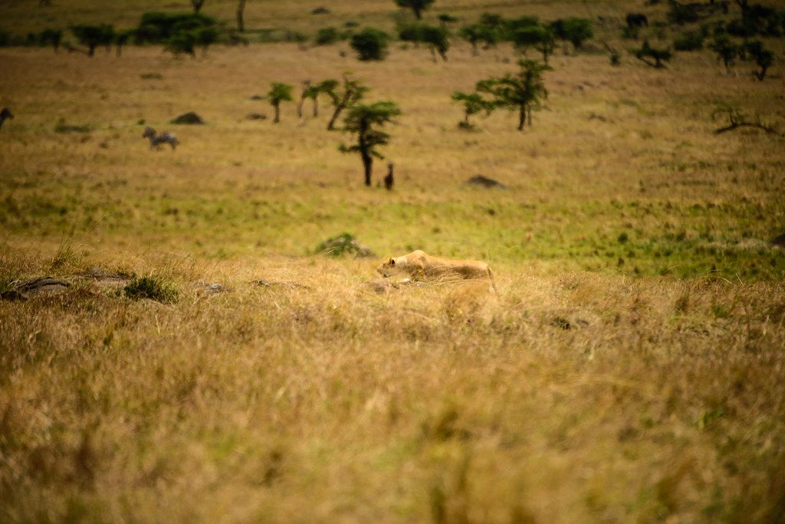
The lions move in
HOOK
Some lions move into an area where gazelles live. What will happen to the gazelle population, and how could an ecologist find out how many gazelles are left?
Talk to a partner: you cannot count every gazelle. What could you do instead?
A lioness stalking prey: predation is a biotic factor
Image: FamilyRalph, CC BY 2.0, via Wikimedia Commons
Notes:
The factor is predation (biotic); the gazelle population is likely to fall, at least at first. Counting: sample areas from a vehicle or drone, count the gazelles in each, scale up to the whole area. Ecologists do exactly this, and so do doctors estimating cases in an outbreak.

Slide 5
Abundance and sampling
LEARN
Abundance is how common a species is in a habitat. It depends on abiotic factors (temperature, rainfall) and biotic factors (predation, competition).
You can rarely count every organism, so you take samples to estimate the population size.
Quadrat: plants and slow-moving animals. Pitfall trap: ground beetles. Sweep net: insects in long grass. Pooter: small insects.
Key idea Choose the method that suits the organism, then sample.
Key words abundance · sample · quadrat · pitfall trap · sweep net
Notes:
A quadrat is a square frame, often 0.5 m by 0.5 m (area 0.25 m2). A pitfall trap is a cup sunk level with the soil. A pooter sucks small insects into a tube. Ask: which method for limpets on a rocky shore? (Quadrat: they hardly move.)

Slide 6
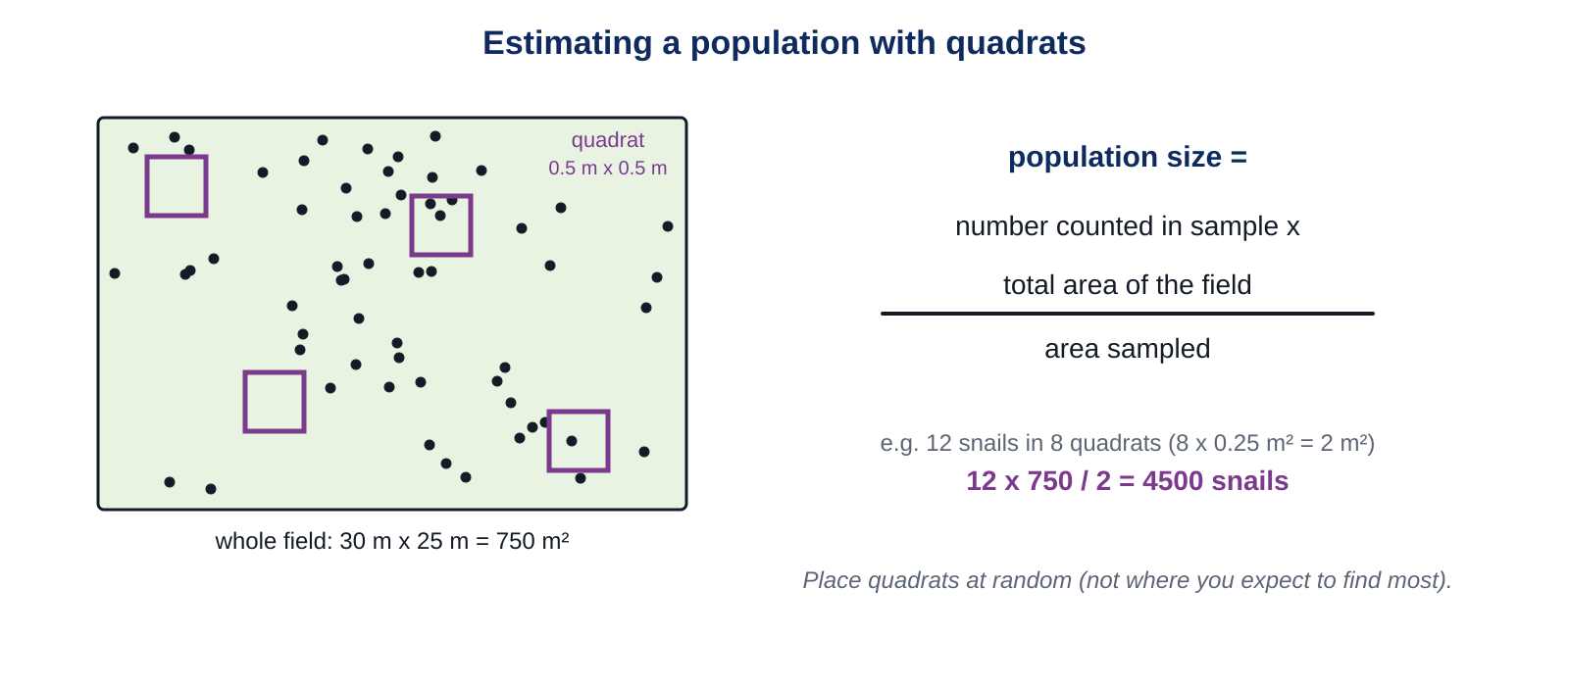
Estimating population size
LEARN
Count the organisms in several quadrats, then scale up to the whole area.
Key idea population size = number counted in the sample x total area of the habitat / area sampled
Notes:
Work the example on the diagram: 12 snails in 8 quadrats, 8 x 0.25 = 2 m2 sampled, field 750 m2, so 12 x 750 / 2 = 4500 snails. Then the book's crab example: 3 crabs in one 0.25 m2 quadrat on rocks 60 m by 10 m (600 m2): 3 x 600 / 0.25 = 7200 crabs. Compare with an estimated 7000 limpets: the crabs are slightly more abundant.

Slide 7
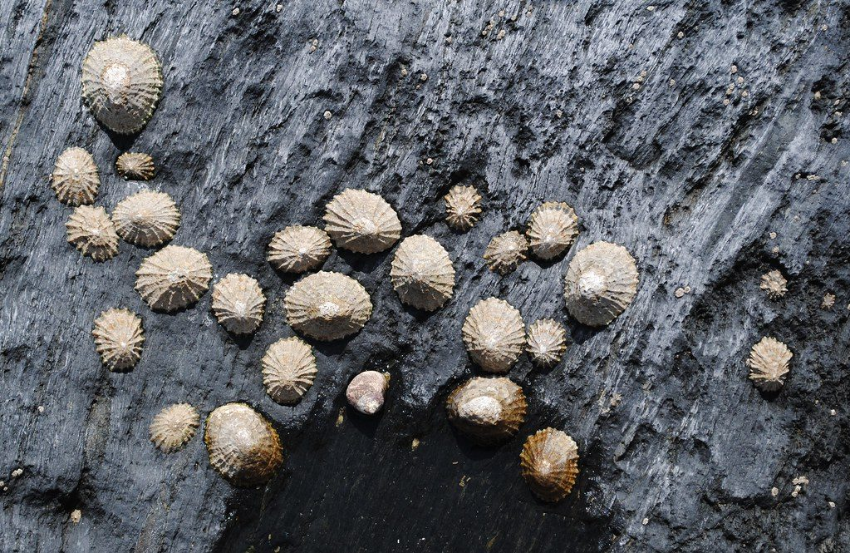
How accurate is the estimate?
LEARN
Accuracy is how close the estimate is to the true value if every organism were counted.
Estimates are more accurate when the sample is larger (but this takes longer), the organisms are easy to find, and they are spread out rather than clumped.
Place quadrats at random, not where you expect to find most. Choosing the spots yourself causes bias.
Limpets on a rocky shore
Image: vic_burton, CC BY-SA 2.0, via Wikimedia Commons
Key idea Random sampling avoids bias.
Key words estimate · random
Notes:
Random placement: use random numbers as coordinates along two tape measures, or throw a quadrat over your shoulder with your eyes shut (less reliable). If the crabs were all in a few rock pools, a quadrat might land on none or on a whole group, so the estimate could be far too low or too high.

Slide 8
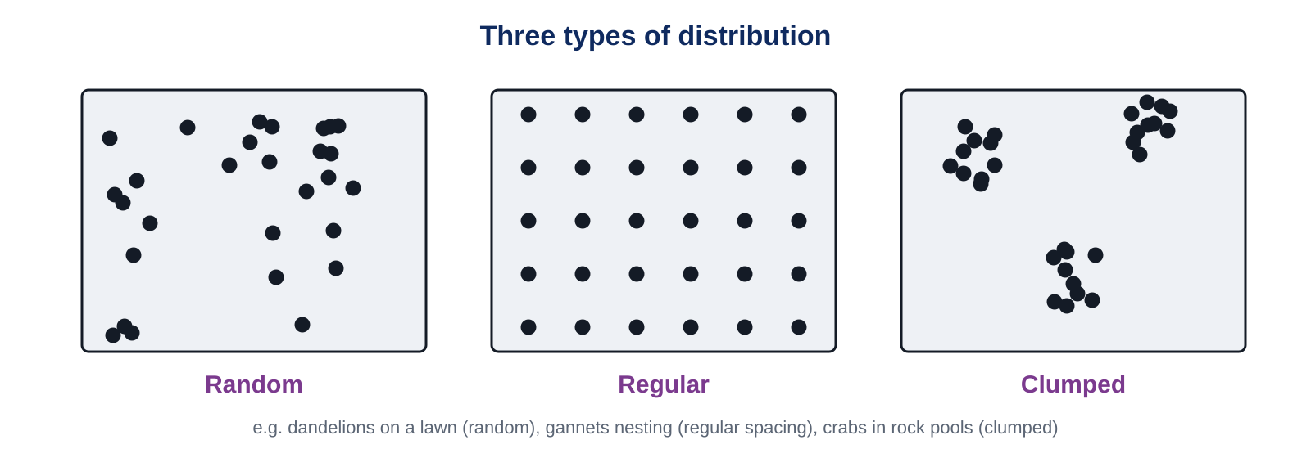
Distribution: how organisms are spread out
LEARN
Distribution can be random, regular or clumped. When it is hard to see, scientists sample along a line: a transect.
Key idea In a transect survey, an evenly distributed organism appears in every sample; a clumped one appears in only some.
Notes:
Examples: dandelions on a lawn (random), gannets nesting the same distance apart (regular), crabs in rock pools (clumped). Counting the number of different species in a survey also tells you the biodiversity of the area.

Slide 9
Quick check
CHECK
Mini whiteboards. One answer each, then we check.
Q1 What is abundance?
Q2 Which method would you use to sample ground beetles?
Q3 3 crabs in a 0.25 m2 quadrat; the rocks cover 600 m2. Estimate the crab population.
Q4 How should you decide where to put your quadrats?
Q5 What word describes organisms that gather in groups?
Notes:
Answers: how common a species is in a habitat; a pitfall trap; 3 x 600 / 0.25 = 7200 crabs; at random, e.g. with random number coordinates; clumped.

Slide 10
Quadrat sampling
PRACTICAL
Aim Estimate the population of one plant species (e.g. dandelion, daisy or clover) in a 10 m by 10 m area of the field.
Equipment
Method
quadrat 0.5 m x 0.5 m (area 0.25 m2)
two tape measures laid along two edges of the area
dice or random number table
worksheet table (Core 4)
indoor version: printed paper field and a card quadrat
Lay the tape measures along two sides of the 10 m by 10 m area.
Generate two random numbers from 0 to 9 for the coordinates. Place the quadrat there.
Count the plants of your species inside the quadrat. Record the count.
Repeat for 8 quadrats in total.
Calculate: total counted x 100 m2 / (8 x 0.25 m2).
Compare your estimate with another group's. Why are they different?
Safety Stay inside the marked area; watch for uneven ground; wash hands afterwards.
Notes:
Nine minutes. Indoors: the paper field has 100 squares; drop the card quadrat using random coordinates and count dots. Groups' estimates will differ because samples are random and small: that is the point of the comparison. Ask how the estimate could be made more accurate (more quadrats).

Slide 11
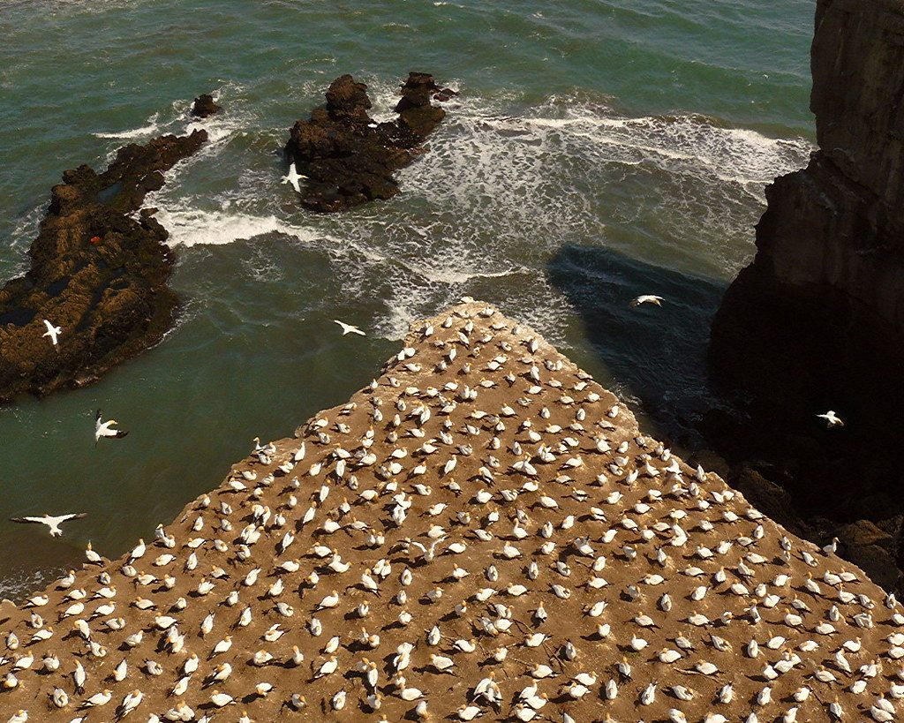
Gannet island
THINK AND REFLECT
Gannets nest on a small island, each pair the same distance from its neighbours. Describe their distribution. How could you estimate the number of gannets nesting on the island?
Sentence frames
The gannets show a ___ distribution because ___.
To estimate the number, I would ___ and then ___.
The estimate would be more accurate if ___.
A gannet colony
Image: SidPix, CC BY 2.0, via Wikimedia Commons
Notes:
Expected: regular distribution (evenly spaced nests). Photograph the island from the air, count the nests in several sample squares of the photo and scale up to the whole area, or count one section and multiply. More accurate with more sample squares and a clear photo.

Slide 12
Exit ticket
EXIT TICKET
4
min
On your worksheet exit ticket. Work alone. Hand it in as you leave.
1. Why do ecologists take samples instead of counting every organism?
2. 5 daisies were found in one 0.25 m2 quadrat. The lawn is 40 m2. Estimate the daisy population.
3. Give one reason why quadrats should be placed at random.
Notes:
Answers: it is impossible or takes too long to find and count every organism; 5 x 40 / 0.25 = 800 daisies; to avoid bias (choosing spots where you expect many or few organisms makes the estimate too high or too low).

Slide 13
What we learned
SUMMARY
Abundance is how common a species is; you estimate it from samples with the right method: quadrat, pitfall trap, sweep net, pooter.
Population size = number in sample x total area / area sampled.
Estimates are more accurate with larger, random samples of organisms that are easy to find.
Distribution can be random, regular or clumped; a transect shows distribution along a line.
Next lesson In and out: why surface area matters for cells and organisms, and how water moves by osmosis.
Notes:
Homework: Workbook pages 34 and 35 (9Cd Ecology). The rainforest and oil palm transect question matches the Challenge.

