Slide 1
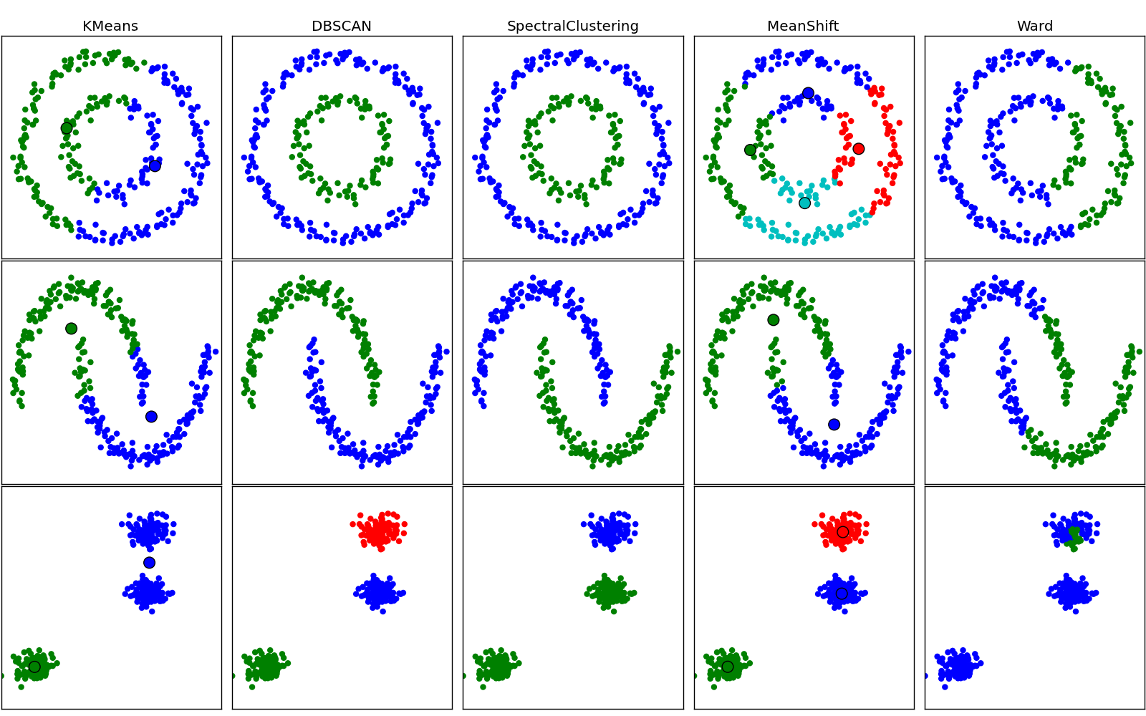
About
Density-based
Clustering…

Slide 2
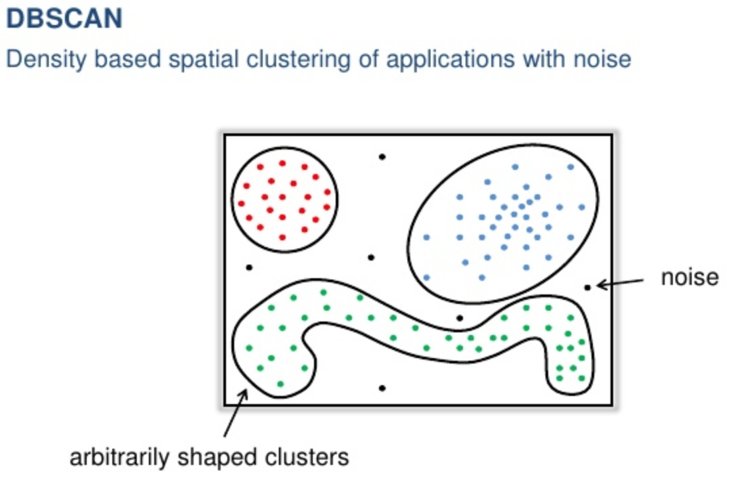

Slide 3
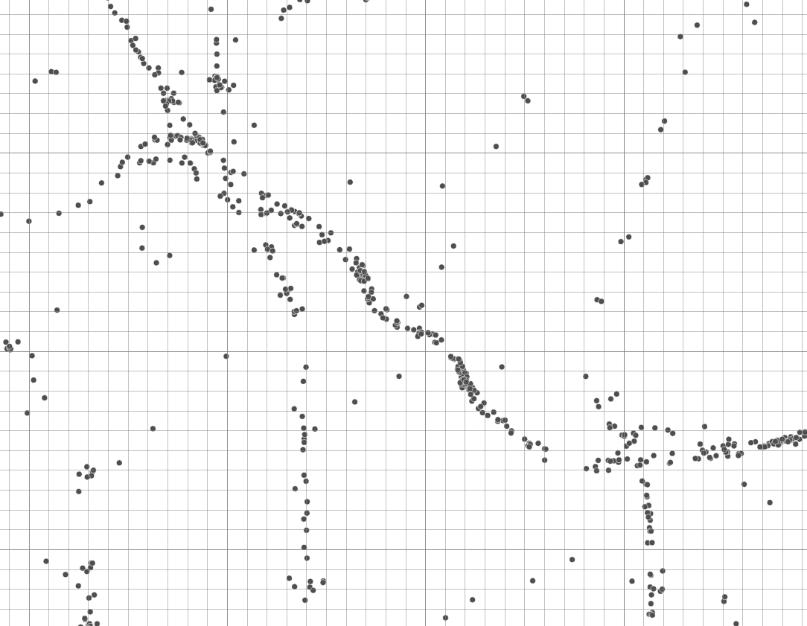
Your human eyes are great at finding patterns…
Notes:
So why is clustering useful?
The previous example was a quick way to burn down a haystack of data and find specific needles based on very specific questions.
But in many cases, we need to not just burn down the haystack, but actually characterize the haystack. All fatal accidents are important.

Slide 4
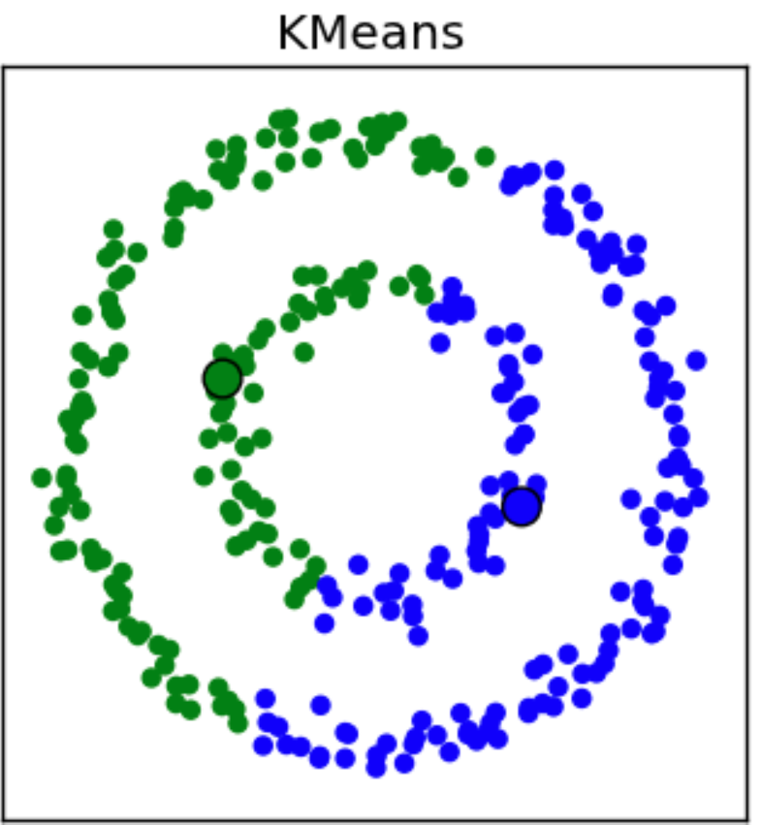
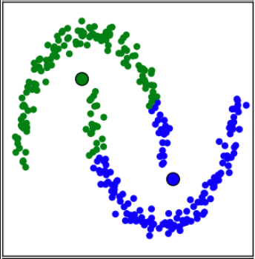
… but computers have difficulties.
Notes:
So why is clustering useful?
The previous example was a quick way to burn down a haystack of data and find specific needles based on very specific questions.
But in many cases, we need to not just burn down the haystack, but actually characterize the haystack. All fatal accidents are important.

Slide 5
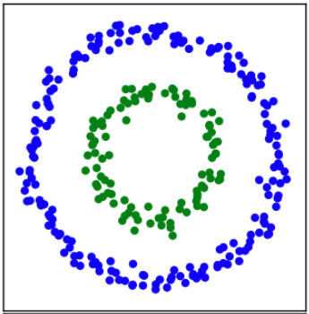
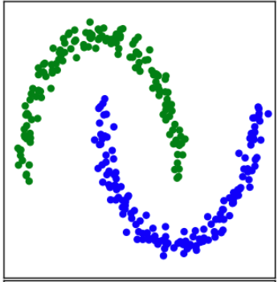
DBSCAN, or density-based clustering is much better at finding these patterns
Notes:
So why is clustering useful?
The previous example was a quick way to burn down a haystack of data and find specific needles based on very specific questions.
But in many cases, we need to not just burn down the haystack, but actually characterize the haystack. All fatal accidents are important.

Slide 6
Why is Density-based Clustering useful?
Notes:
So why is clustering useful?
The previous example was a quick way to burn down a haystack of data and find specific needles based on very specific questions.
But in many cases, we need to not just burn down the haystack, but actually characterize the haystack. All fatal accidents are important.

Slide 7
We need data-specific spatial structure.
Notes:
So why is clustering useful?
Clustering is the grouping of observations based on similarity in attributes or location. It helps us organize unstructured data. Most data is spatially unstructured.

Slide 8
Similarity within groups;
Variance between different groups…
Notes:
So why is clustering useful?
Clustering is the grouping of observations based on similarity in attributes or location. It helps us organize unstructured data. Most data is spatially unstructured.

Slide 9
In this case, we use spatial density to create spatial structure
Notes:
So why is clustering useful?
Clustering is the grouping of observations based on similarity in attributes or location. It helps us organize unstructured data. Most data is spatially unstructured.

Slide 10


