Slide 1
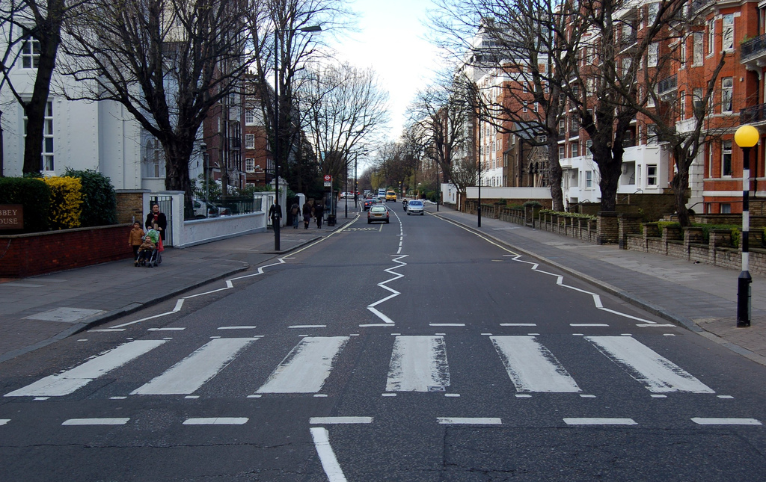

A Data Crosswalk to Translate Expertise to Code

Slide 2
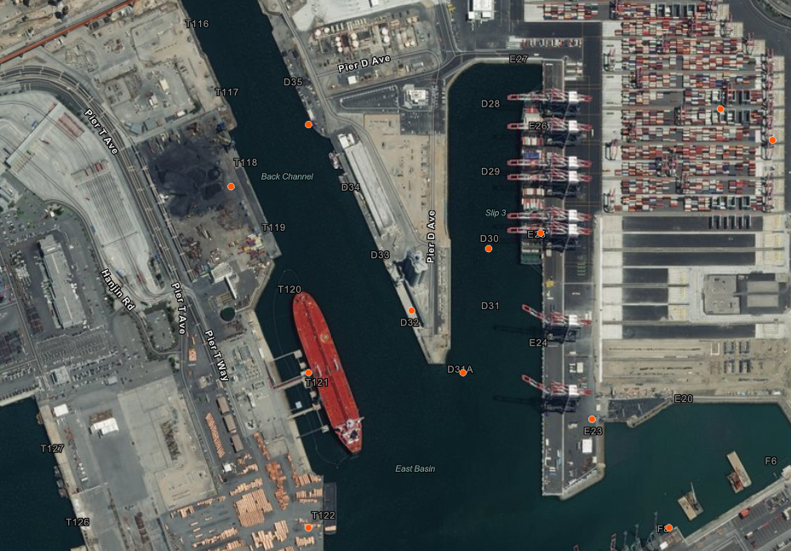
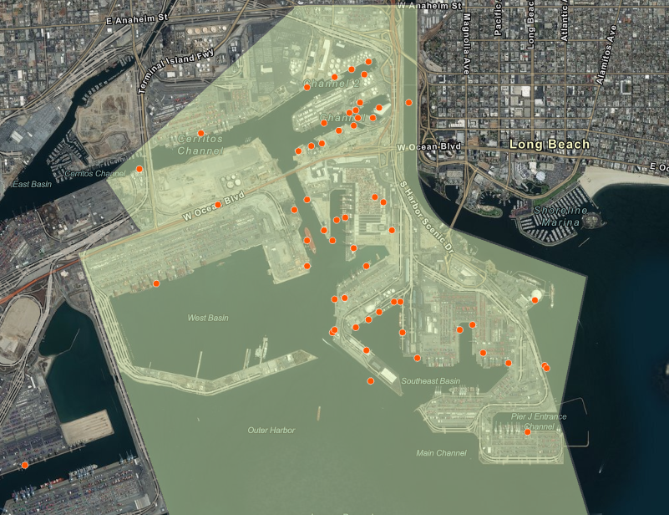
Translating Dock Typology to Ports

Slide 3


Calculating Port Typology Metrics
Total Docks by Typology
Percentages by Typology
…

Slide 4
Maps
Data or Information?

Slide 5

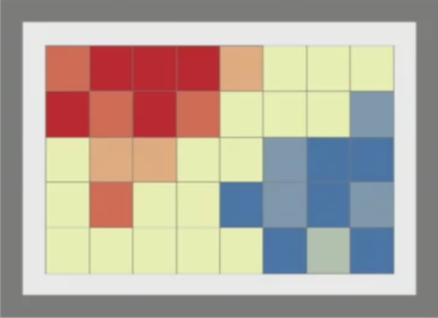
Build an Information Product

Slide 6
A Data Crosswalk to Translate Expertise to Code

Slide 7
Simple Keyword Parsing Example
Paper & Allied Products | Primary Non-Ferrous Metal Products | Passenger
Paper & Allied Products | Primary Non-Ferrous Metal Products | Passenger
Cruise, Marina, Ferry
Break-Bulk
Bulk

Slide 8
Upscaling Dock Typology to Ports

Slide 9
Calculating Port Typology Metrics
Total Docks by Typology
Percentages by Typology
…

Slide 10
Build an Information Product

