Slide 1
Updates to the AirNow Process
EPA & esri
May 9th, 2019
Notes:
Esri Corporate Template-Light v3.4
16:9 version – January 29, 2017
For more templates, sample files, and icons, see https://compass.esri.com/resources/presentations/Pages/Main.aspx
To add footer text in Windows
On the Home tab, under Insert, click Text, and then click Header and Footer.
Click the Slide tab, select the Footer check box, and then type the footer text that you want.
Click either Apply or Apply to All.
To add footer text on a Mac
On the View menu, select Header and Footer.
Select the Footer check box and then type the footer text that you want.
Click either Apply or Apply to All.
If footers don't appear on the slides
If footers don't appear on title slides, in the Header and Footer dialog box make sure the Don't show on title slide check box is not selected.
If the footers are missing from other slides, the placeholders for these items might have been removed from specific slide layouts or the slide master.

Slide 2
The goal
To help people understand how clean or polluted outdoor air is, and help them take action to protect their health.

Slide 3
AirNow Goal

Slide 4
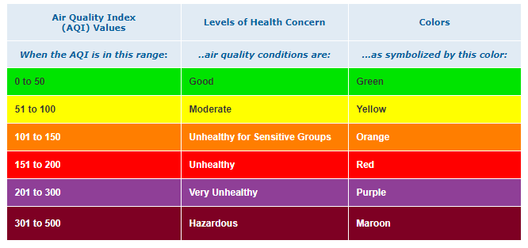
Air Quality Index (AQI) simplifies all the pollutant metrics into an understandable measure for the public
AirNow Goal

Slide 5
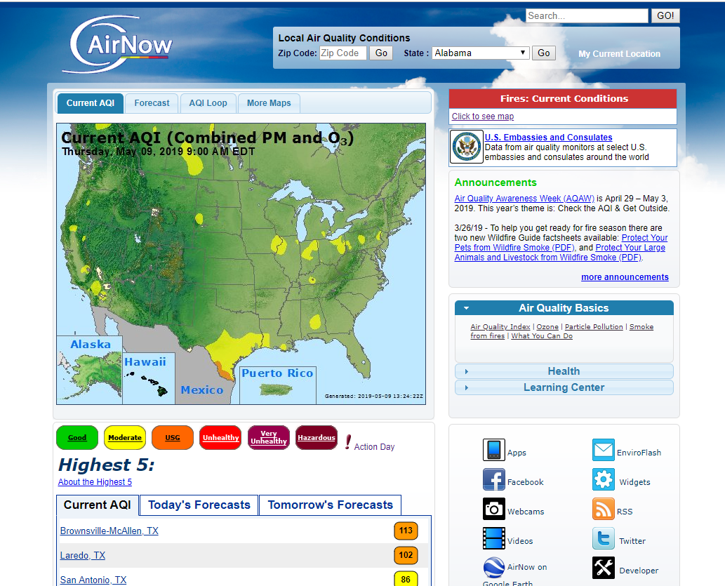
AQI maps help the public gain a general sense of air quality across the country
AirNow Goal

Slide 6
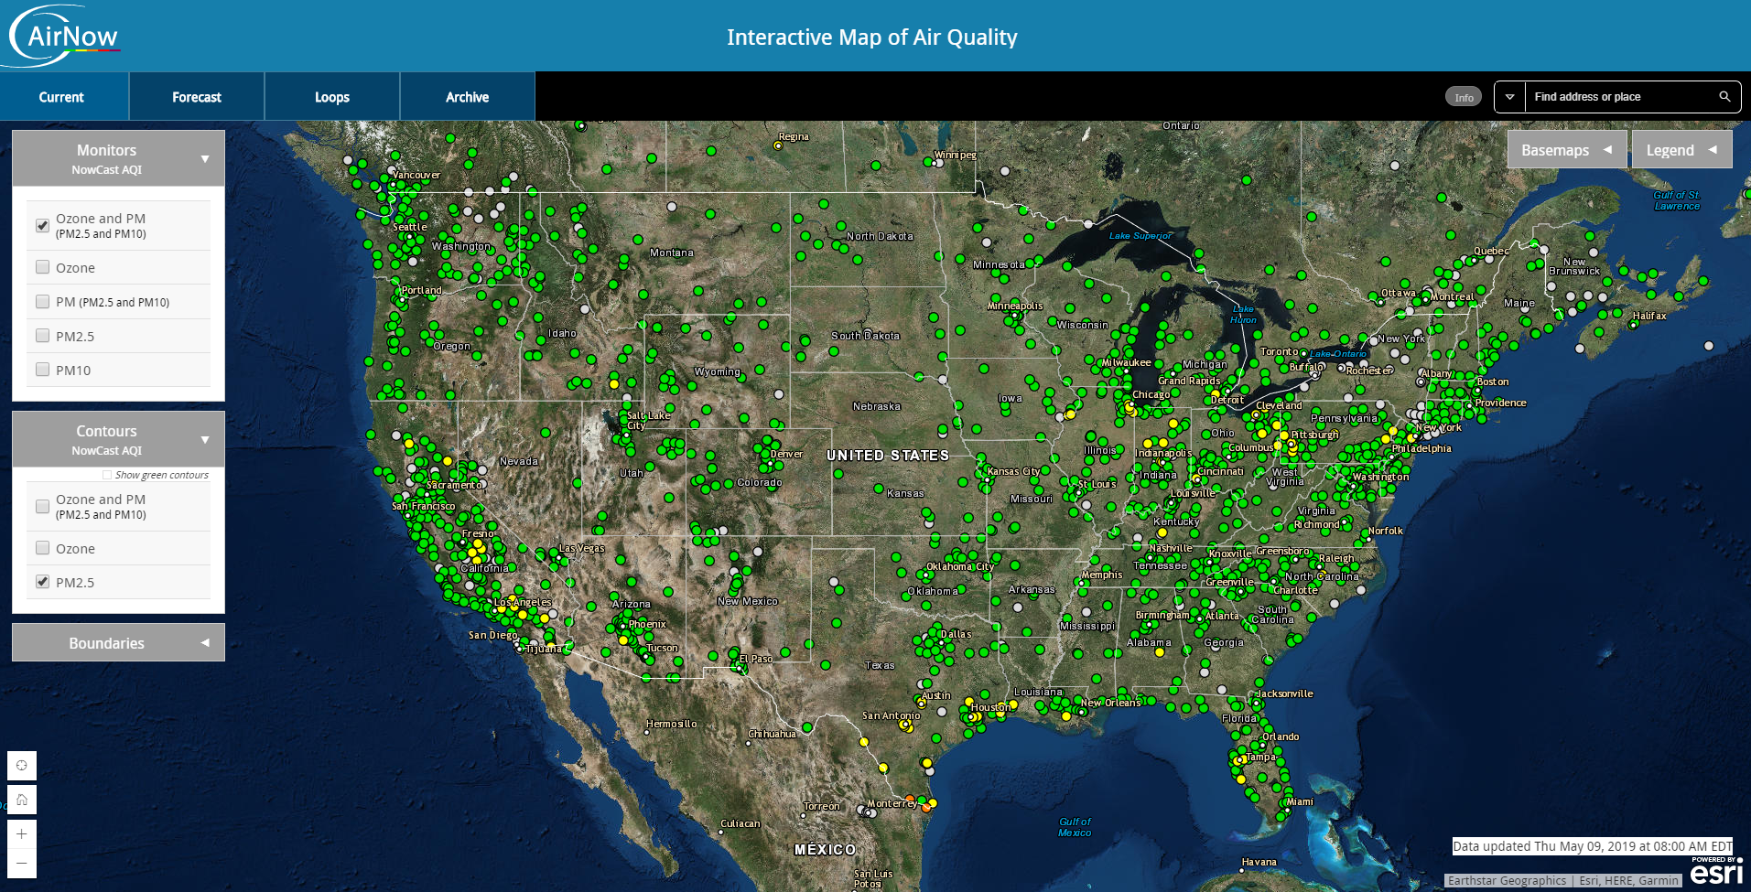
Interactive AQI maps help the public better find the information they need
AirNow Goal

Slide 7
Other applications help the public use AQI data to make informed decisions
AirNow Goal
AirCompare
Social Media
Feeds
Publications
AQI Calculator
Story Maps

Slide 8
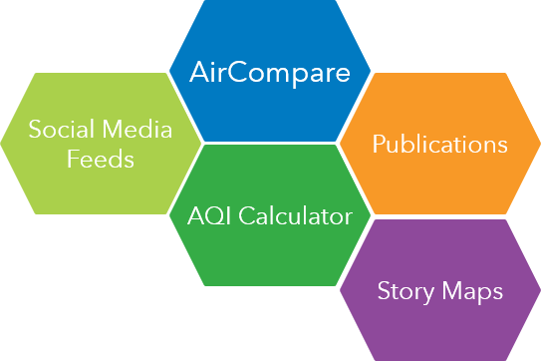
This is how the process works today
AirNow Goal

Slide 9
but there are challenges
interpolation
needs to improve
automation
needs to be
updated
interactive
maps
need to be
updated
AirNow Goal
additional
data
needs to be
integrated

Slide 10
why are these challenges? *
In some cases public receives inaccurate air quality information.
Example: Colorado Air Pollution Control Division and Breckenridge
interpolation
needs to improve
automation
needs to be
updated
Interpolation is automated off-site; any changes require the process to occur in a method that encourages rapid iteration and testing.
interactive
maps
need to be
updated
There are new ways to display information products, including maps, charts, and initiatives.
additional
data
needs to be
integrated
Additional data sources, such as topography and citizen science sensors are needed to improve modeling methods.
* Requires validation from everyone involved in project

Slide 11
so let’s consider some solutions
interpolation
needs to improve
automation
needs to be
updated
interactive
maps
need to be
updated
additional
data
needs to be
integrated

Slide 12
current focus is
interpolation and automation
interpolation
needs to improve
automation
needs to be
updated
interactive
maps
need to be
updated
additional
data
needs to be
integrated

Slide 13
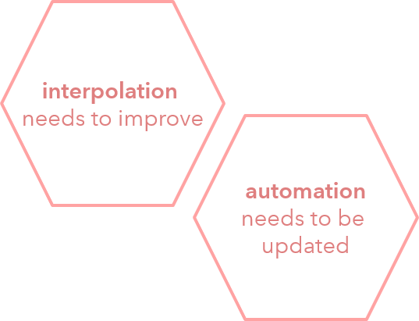




solution in progress uses
three components
Python notebook environment to prototype
GeoProcessing tools to examine data in ArcGIS Pro
Schedulable python scripts to run process

Slide 14
Python notebook environment to prototype
GeoProcessing tools to examine data in ArcGIS Pro
Schedulable python scripts to run process
Take notes
Iterate and test
Share information on process
Educate
Share
Test interpolation methods with supplemental data
Prototype downstream analyses
Build visualizations
Publish services
Establish a server-side process
Schedulable via crontab or Windows Scheduled Task
Gathers data, performs selected interpolation, archives data
Closely tied to Jupyter Notebook process to allow rapid improvements

Slide 15
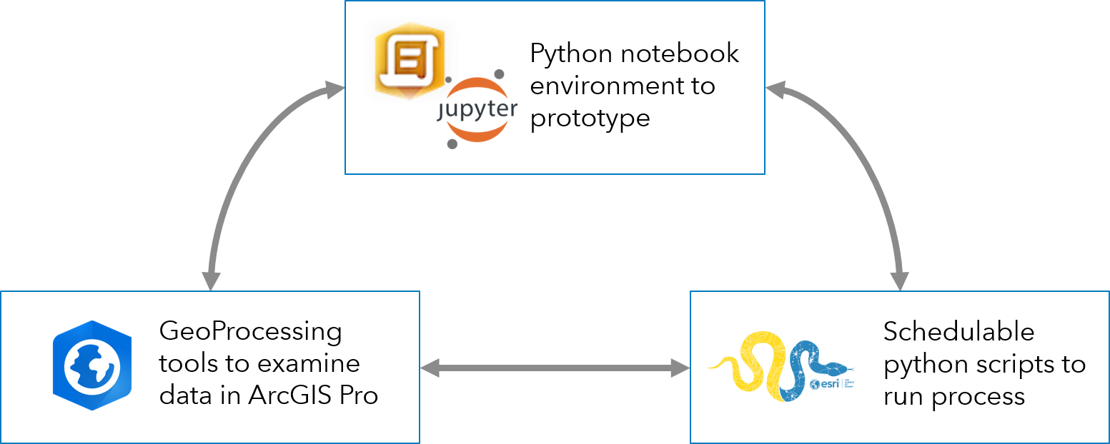
demo

Slide 16



