Slide 1
多表查询
Notes:
Schedule: Timing Topic
55 minutes Lecture
55 minutes Practice
110 minutes Total

Slide 2





从多个表中获取数据
EMP
DEPT
…
…
Notes:
Data from Multiple Tables
Sometimes you need to use data from more than one table. In the slide example, the report displays data from two separate tables.
Employee IDs exist in the EMPLOYEES table.
Department IDs exist in both the EMPLOYEES and DEPARTMENTS tables.
Location IDs exist in the DEPARTMENTS table.
To produce the report, you need to link the EMPLOYEES and DEPARTMENTS tables and access data from both of them.

Slide 3
笛卡尔集
笛卡尔集会在下面条件下产生:
  省略连接条件
  所有表中的所有行互相连接
为了避免笛卡尔集， 可以在 WHERE 加入有效的连接条件。
Notes:
Cartesian Products
When a join condition is invalid or omitted completely, the result is a Cartesian product, in which all combinations of rows are displayed. All rows in the first table are joined to all rows in the second table.
A Cartesian product tends to generate a large number of rows, and the result is rarely useful. You should always include a valid join condition in a WHERE clause, unless you have a specific need to combine all rows from all tables.
Cartesian products are useful for some tests when you need to generate a large number of rows to simulate a reasonable amount of data.

Slide 4
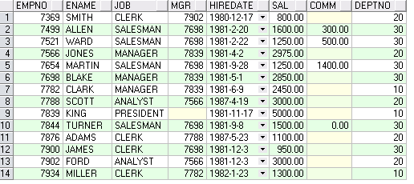

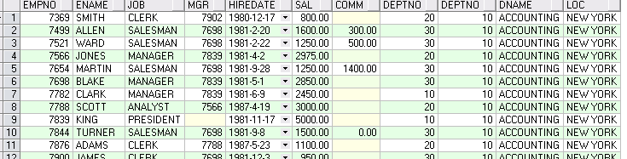
笛卡尔集
EMP (14行)
DEPT (4行)
笛卡尔集:
14x4=56行
…
Notes:
Cartesian Products (continued)
A Cartesian product is generated if a join condition is omitted. The example on the slide displays employee last name and department name from the EMPLOYEES and DEPARTMENTS tables. Because no WHERE clause has been specified, all rows (20 rows) from the EMPLOYEES table are joined with all rows (8 rows) in the DEPARTMENTS table, thereby generating 160 rows in the output.
SELECT last_name, department_name dept_name
FROM employees, departments;
Instructor Note
Demo: 4_cart.sql
Purpose: To illustrate executing a Cartesian product
…

Slide 5
连接的类型
  Oracle 提供的连接 (8i 或更早):
  适用于SQL: 1999的连接:
Equijoin
Non-equijoin
Outer join
Self join
Cross joins
Natural joins
Using clause
Full or two sided outer joins
Arbitrary join conditions for outer joins
Notes:
Types of Joins
The Oracle9i database offers join syntax that is SQL: 1999 compliant. Prior to the 9i release, the join syntax was different from the ANSI standards. The new SQL: 1999 compliant join syntax does not offer any performance benefits over the Oracle proprietary join syntax that existed in prior releases.
Instructor Note
Do not get into details of all the types of joins now. Explain each join one by one, as is done in the following slides.

Slide 6
Oracle 连接
使用连接在多个表中查询数据。
在 WHERE 字句中写入连接条件。
在表中有相同列时，在列名之前加上表名前缀，使用表名可以提高效率。
表可以使用别名。
SELECT table1.column, table2.column
FROM table1 t1, table2 t2
WHERE table1.column1 = table2.column2;
Notes:
Defining Joins
When data from more than one table in the database is required, a join condition is used. Rows in one table can be joined to rows in another table according to common values existing in corresponding columns, that is, usually primary and foreign key columns.
To display data from two or more related tables, write a simple join condition in the WHERE clause.
In the syntax:
table1.column denotes the table and column from which data is retrieved
table1.column1 = is the condition that joins (or relates) the tables together
table2.column2
Guidelines
When writing a SELECT statement that joins tables, precede the column name with the table name for clarity and to enhance database access.
If the same column name appears in more than one table, the column name must be prefixed with the table name.
To join n tables together, you need a minimum of n-1 join conditions. For example, to join four tables, a minimum of three joins is required. This rule may not apply if your table has a concatenated primary key, in which case more than one column is required to uniquely identify each row.
For more information, see Oracle9i SQL Reference, “SELECT.”

Slide 7


等值连接
EMPLOYEES
DEPARTMENTS
…
…
外键
主键
Notes:
Equijoins
To determine an employee’s department name, you compare the value in the DEPARTMENT_ID column in the EMPLOYEES table with the DEPARTMENT_ID values in the DEPARTMENTS table. The relationship between the EMPLOYEES and DEPARTMENTS tables is an equijoin—that is, values in the DEPARTMENT_ID column on both tables must be equal. Frequently, this type of join involves primary and foreign key complements.
Note: Equijoins are also called simple joins or inner joins.
Instructor Note
Explain the use of a decision matrix for simplifying writing joins. For example, if you want to display the name and department number of all the employees who are in the same department as Goyal, you can start by making the following decision tree:
Columns to Display Originating Table Condition
last_name employees last_name='Goyal'
department_name departments employees.department_id =
departments.department_id
Now the SQL statement can be easily formulated by looking at the decision matrix. The first column gives the column list in the SELECT statement, the second column gives the tables for the FROM clause, and the third column gives the condition for the WHERE clause.

Slide 8
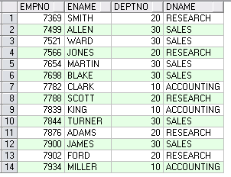
等值连接
SELECT e.empno, e.ename,
e.deptno, d.dname,
FROM emp e, dept d
WHERE e.deptno = d.deptno
Notes:
Retrieving Records with Equijoins
In the slide example:
The SELECT clause specifies the column names to retrieve:
employee last name, employee number, and department number, which are columns in the EMPLOYEES table
department number, department name, and location ID, which are columns in the DEPARTMENTS table
The FROM clause specifies the two tables that the database must access:
EMPLOYEES table
DEPARTMENTS table
The WHERE clause specifies how the tables are to be joined:
EMPLOYEES.DEPARTMENT_ID = DEPARTMENTS.DEPARTMENT_ID
Because the DEPARTMENT_ID column is common to both tables, it must be prefixed by the table name to avoid ambiguity.

Slide 9


非等值连接
EMP
SAL_GRADES
EMPLOYEES表中的列工资
应在JOB_GRADES表中的最高
工资与最低工资之间
…
Notes:
Non-Equijoins
A non-equijoin is a join condition containing something other than an equality operator.
The relationship between the EMPLOYEES table and the JOB_GRADES table has an example of a non-equijoin. A relationship between the two tables is that the SALARY column in the EMPLOYEES table must be between the values in the LOWEST_SALARY and HIGHEST_SALARY columns of the JOB_GRADES table. The relationship is obtained using an operator other than equals (=).

Slide 10
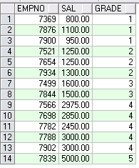
非等值连接
SELECT e.empno, e.sal, g.grade
FROM emp e, salgrade g
WHERE e.sal
BETWEEN g.losal AND g.hisal
Notes:
Non-Equijoins (continued)
The slide example creates a non-equijoin to evaluate an employee’s salary grade. The salary must be between any pair of the low and high salary ranges.
It is important to note that all employees appear exactly once when this query is executed. No employee is repeated in the list. There are two reasons for this:
None of the rows in the job grade table contain grades that overlap. That is, the salary value for an employee can lie only between the low salary and high salary values of one of the rows in the salary grade table.
All of the employees’ salaries lie within the limits provided by the job grade table. That is, no employee earns less than the lowest value contained in the LOWEST_SAL column or more than the highest value contained in the HIGHEST_SAL column.
Note: Other conditions, such as <= and >= can be used, but BETWEEN is the simplest. Remember to specify the low value first and the high value last when using BETWEEN.
Table aliases have been specified in the slide example for performance reasons, not because of possible ambiguity.
Instructor Note
Explain that BETWEEN … AND … is actually translated by the Oracle server to a pair of AND conditions (a >= lower limit) and (a <= higher limit) and IN ( … ) is translated by the Oracle server to a set of OR conditions (a = value1 OR a = value2 OR a = value3 ). So using BETWEEN … AND … , IN(…) has no performance benefits; the benefit is logical simplicity.

Slide 11

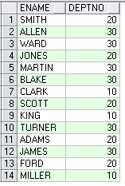
外连接
DEPT
EMP
40号部门没有员工
Notes:
Returning Records with No Direct Match with Outer Joins
If a row does not satisfy a join condition, the row will not appear in the query result. For example, in the equijoin condition of EMPLOYEES and DEPARTMENTS tables, employee Grant does not appear because there is no department ID recorded for her in the EMPLOYEES table. Instead of seeing 20 employees in the result set, you see 19 records.
SELECT e.last_name, e.department_id, d.department_name
FROM employees e, departments d
WHERE e.department_id = d.department_id;
…

Slide 12
外连接语法
使用外连接可以查询不满足连接条件的数据。
外连接的符号是 (+)。
SELECT table1.column, table2.column
FROM table1, table2
WHERE table1.column(+) = table2.column;
SELECT table1.column, table2.column
FROM table1, table2
WHERE table1.column = table2.column(+);
Notes:
Using Outer Joins to Return Records with No Direct Match
The missing rows can be returned if an outer join operator is used in the join condition. The operator is a plus sign enclosed in parentheses (+), and it is placed on the “side” of the join that is deficient in information. This operator has the effect of creating one or more null rows, to which one or more rows from the nondeficient table can be joined.
In the syntax:
table1.column = is the condition that joins (or relates) the tables together.
table2.column (+) is the outer join symbol, which can be placed on either side of the
WHERE clause condition, but not on both sides. (Place the outer
join symbol following the name of the column in the table without the matching rows.)
Instructor Note
Demo: 4_ejoin.sql
Purpose: To illustrate an equijoin leading to an outer join.

Slide 13
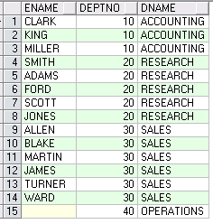
外连接
SELECT e.ename, d.deptno, d.dname
FROM emp e, dept d
WHERE e.deptno(+) = d.deptno ;
Notes:
Using Outer Joins to Return Records with No Direct Match (continued)
The slide example displays employee last names, department ID’s and department names. The Contracting department does not have any employees. The empty value is shown in the output shown.
Outer Join Restrictions
The outer join operator can appear on only one side of the expression—the side that has information missing. It returns those rows from one table that have no direct match in the other table.
A condition involving an outer join cannot use the IN operator or be linked to another condition by the OR operator.
Instructor Note
The UNION operator works around the issue of being able to use an outer join operator on one side of the expression. The ANSI full outer join also allows you to have an outer join on both sides of the expression. It is discussed later in this lesson.
Demo: 4_ojoin.sql
Purpose: To illustrate an outer join.

Slide 14


自连接
EMP (WORKER)
EMP (MANAGER)
…
…
WORKER 表中的MANAGER_ID 和 MANAGER 表中的MANAGER_ID相等
Notes:
Joining a Table to Itself
Sometimes you need to join a table to itself. To find the name of each employee’s manager, you need to join the EMPLOYEES table to itself, or perform a self join. For example, to find the name of Whalen’s manager, you need to:
Find Whalen in the EMPLOYEES table by looking at the LAST_NAME column.
Find the manager number for Whalen by looking at the MANAGER_ID column. Whalen’s manager number is 101.
Find the name of the manager with EMPLOYEE_ID 101 by looking at the LAST_NAME column. Kochhar’s employee number is 101, so Kochhar is Whalen’s manager.
In this process, you look in the table twice. The first time you look in the table to find Whalen in the LAST_NAME column and MANAGER_ID value of 101. The second time you look in the EMPLOYEE_ID column to find 101 and the LAST_NAME column to find Kochhar.
Instructor Note
Show the data from the EMPLOYEES table and point out how each manager is also an employee.

Slide 15
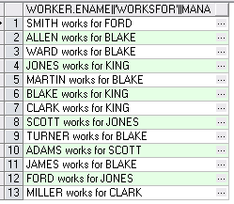
自连接
SELECT worker.ename || ' works for '
|| manager.ename
FROM emp worker, emp manager
WHERE worker.mgr = manager.empno ;
Notes:
Joining a Table to Itself (continued)
The slide example joins the EMPLOYEES table to itself. To simulate two tables in the FROM clause, there are two aliases, namely w and m, for the same table, EMPLOYEES.
In this example, the WHERE clause contains the join that means “where a worker’s manager number matches the employee number for the manager.”
Instructor Note
Point out the following to the students:
The column heading in the result of the query on the slide seems meaningless. A meaningful column alias should have been used instead.
There are only 19 rows in the output, but there are 20 rows in the EMPLOYEES table. This occurs because employee King, who is the president, does not have a manager.

Slide 16
使用SQL: 1999 语法连接
使用连接从多个表中查询数据：
SELECT table1.column, table2.column
FROM table1
[CROSS JOIN table2] |
[NATURAL JOIN table2] |
[JOIN table2 USING (column_name)] |
[JOIN table2
ON(table1.column_name = table2.column_name)] |
[LEFT|RIGHT|FULL OUTER JOIN table2
ON (table1.column_name = table2.column_name)];
Notes:
Defining Joins
Using the SQL: 1999 syntax, you can obtain the same results as were shown in the prior pages.
In the syntax:
table1.column Denotes the table and column from which data is retrieved
CROSS JOIN Returns a Cartesian product from the two tables
NATURAL JOIN Joins two tables based on the same column name
JOIN table
USING column_name Performs an equijoin based on the column name
JOIN table ON
table1.column_name Performs an equijoin based on the condition in the ON clause
= table2.column_name
LEFT/RIGHT/FULL OUTER
For more information, see Oracle9i SQL Reference, “SELECT.”

Slide 17

叉集
使用CROSS JOIN 子句使连接的表产生叉集。
叉集和笛卡尔集是相同的。
SELECT last_name, department_name
FROM employees
CROSS JOIN departments ;
…
Notes:
Creating Cross Joins
The example on the slide gives the same results as the following:
SELECT last_name, department_name
FROM employees, departments;
…

Slide 18
自然连接
NATURAL JOIN 子句，会以两个表中具有相同名字的列为条件创建等值连接。
在表中查询满足等值条件的数据。
如果只是列名相同而数据类型不同，则会产生错误。
Notes:
Creating Natural Joins
It was not possible to do a join without explicitly specifying the columns in the corresponding tables in prior releases of Oracle. In Oracle9i it is possible to let the join be completed automatically based on columns in the two tables which have matching data types and names, using the keywords NATURAL JOIN keywords.
Note: The join can happen only on columns having the same names and data types in both the tables. If the columns have the same name, but different data types, then the NATURAL JOIN syntax causes an error.

Slide 19
使用 USING 子句创建连接
在JOIN 子句创建等值连接时，可以使用 USING 子句指定等值连接中需要用到的列。
使用 USING 可以在有多个列满足条件时进行选择。
不要给选中的列中加上表名前缀或别名。
JOIN 和 USING 子句经常同时使用。
SELECT e.empno, e.ename, d.dname
FROM emp e JOIN dept d
USING (detpno) ;
Notes:
The USING Clause
Natural joins use all columns with matching names and data types to join the tables. The USING clause can be used to specify only those columns that should be used for an equijoin. The columns referenced in the USING clause should not have a qualifier (table name or alias) anywhere in the SQL statement.
For example, this statement is valid:
SELECT l.city, d.department_name
FROM locations l JOIN departments d USING (location_id)
WHERE location_id = 1400;
This statement is invalid because the LOCATION_ID is qualified in the WHERE clause:
SELECT l.city, d.department_name
FROM locations l JOIN departments d USING (location_id)
WHERE d.location_id = 1400;
ORA-25154: column part of USING clause cannot have qualifier
The same restriction applies to NATURAL joins also. Therefore columns that have the same name in both tables have to be used without any qualifiers.

Slide 20
使用ON 子句创建连接
自然连接中是以具有相同名字的列为连接条件的。
可以使用 ON 子句指定额外的连接条件。
ON 子句使语句具有更高的易读性。
Notes:
The ON Condition
Use the ON clause to specify a join condition. This lets you specify join conditions separate from any search or filter conditions in the WHERE clause.

Slide 21
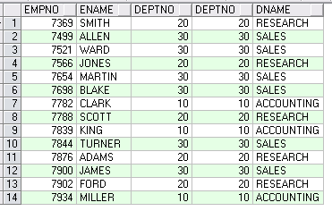
ON 子句
SELECT e.empno, e.ename, e.deptno,
d.deptno, d.dname
FROM emp e JOIN dept d
ON (e.deptno = d.deptno);
Notes:
Creating Joins with the ON Clause
The ON clause can also be used as follows to join columns that have different names:
SELECT e.last_name emp, m.last_name mgr
FROM employees e JOIN employees m
ON (e.manager_id = m.employee_id);
The preceding example is a selfjoin of the EMPLOYEE table to itself, based on the EMPLOYEE_ID and MANAGER_ID columns.
…

Slide 22

使用ON 子句创建多表连接
SELECT employee_id, city, department_name
FROM employees e
JOIN departments d
ON d.department_id = e.department_id
JOIN locations l
ON d.location_id = l.location_id;
…
Notes:
Three-Way Joins
A three-way join is a join of three tables. In SQL: 1999 compliant syntax, joins are performed from left to right so the first join to be performed is EMPLOYEES JOIN DEPARTMENTS. The first join condition can reference columns in EMPLOYEES and DEPARTMENTS but cannot reference columns in LOCATIONS. The second join condition can reference columns from all three tables.
This can also be written as a three-way equijoin:
SELECT employee_id, city, department_name
FROM employees, departments, locations
WHERE employees.department_id = departments.department_id
AND departments.location_id = locations.location_id;
Instructor Note
The example shown can also be accomplished with the USING clause:
SELECT e.employee_id, l.city, d.department_name
FROM employees e
JOIN departments d
USING (department_id)
JOIN locations l
USING (location_id);

Slide 23
内连接 与 外连接
在SQL: 1999中，内连接只返回满足连接条件的数据。
两个表在连接过程中除了返回满足连接条件的行以外还返回左（或右）表中不满足条件的行 ，这种连接称为左（或右） 外联接。
两个表在连接过程中除了返回满足连接条件的行以外还返回两个表中不满足条件的行 ，这种连接称为满 外联接。
Notes:
Joins - Comparing SQL: 1999 to Oracle Syntax

Slide 24
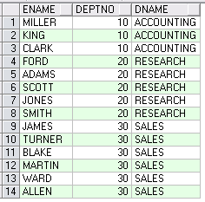
左外联接
SELECT e.ename, e.deptno, d.dname
FROM emp e
LEFT OUTER JOIN dept d
ON (e.deptno = d.deptno) ;
Notes:
Example of LEFT OUTER JOIN
This query retrieves all rows in the EMPLOYEES table, which is the left table even if there is no match in the DEPARTMENTS table.
This query was completed in earlier releases as follows:
SELECT e.last_name, e.department_id, d.department_name
FROM employees e, departments d
WHERE d.department_id (+) = e.department_id;

Slide 25
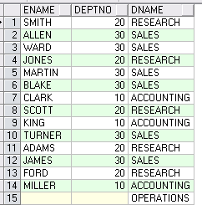
右外联接
SELECT e.ename, e.deptno, d.dname
FROM emp e
RIGHT OUTER JOIN dept d
ON (e.deptno = d.deptno) ;
Notes:
Example of RIGHT OUTER JOIN
This query retrieves all rows in the DEPARTMENTS table, which is the right table even if there is no match in the EMPLOYEES table.
This query was completed in earlier releases as follows:
SELECT e.last_name, e.department_id, d.department_name
FROM employees e, departments d
WHERE d.department_id = e.department_id (+);

Slide 26
满外联接
SELECT e.ename, e.deptno, d.dname
FROM emp e
FULL OUTER JOIN dept d
ON (e.deptno = d.deptno) ;
Notes:
Example of FULL OUTER JOIN
This query retrieves all rows in the EMPLOYEES table, even if there is no match in the DEPARTMENTS table. It also retrieves all rows in the DEPARTMENTS table, even if there is no match in the EMPLOYEES table.
Instructor Note
It was not possible to complete this in earlier releases using outer joins. However, you could accomplish the same results using the UNION operator.
SELECT e.last_name, e.department_id, d.department_name
FROM employees e, departments d
WHERE e.department_id (+) = d.department_id
UNION
SELECT e.last_name, e.department_id, d.department_name
FROM employees e, departments d
WHERE e.department_id = d.department_id (+);

Slide 27

增加连接条件
SELECT e.employee_id, e.last_name, e.department_id,
d.department_id, d.location_id
FROM employees e JOIN departments d
ON (e.department_id = d.department_id)
AND e.manager_id = 149 ;
Notes:
Applying Additional Conditions
You can apply additional conditions in the WHERE clause. The example shown performs a join on the EMPLOYEES and DEPARTMENTS tables, and, in addition, displays only employees with a manager ID equal to 149.

