Slide 1
基于Oracle数据库的
C/S系统开发

Slide 2
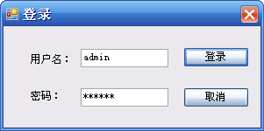
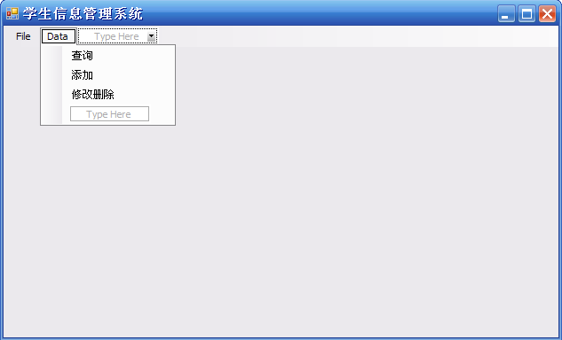
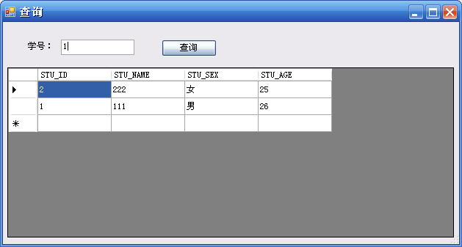
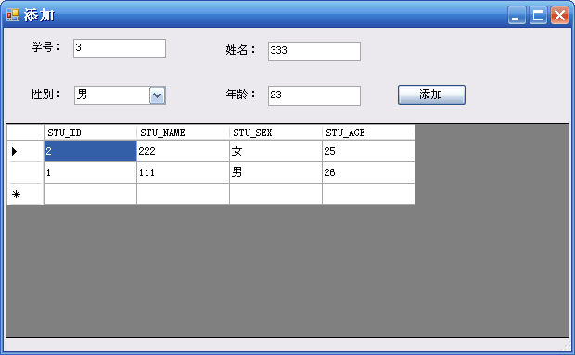
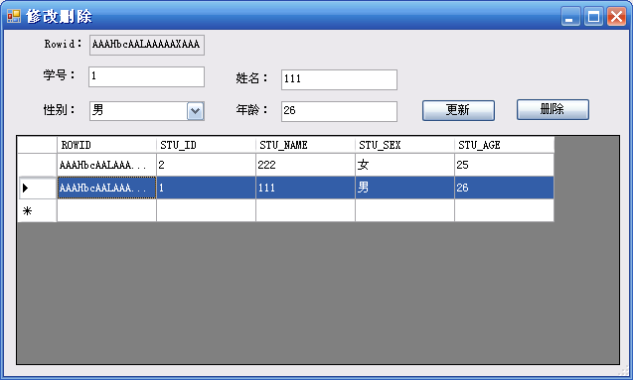
C#实例（学生信息管理系统）

Slide 3
开发步骤
数据库设计
  用户、表空间
  表、视图、索引等对象的设计
  其他PL/SQL程序的设计
系统设计与开发
  界面、功能的设计与实现

Slide 4
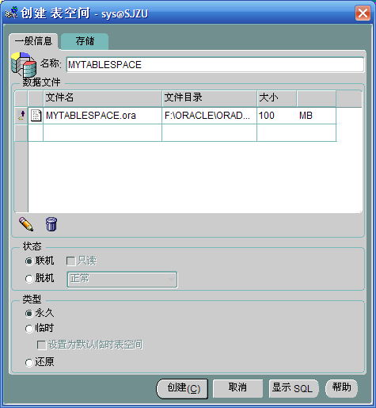
数据库设计
建立表空间（使用sys登录）：
create tablespace 表空间名
datafile 数据文件全路径
……

Slide 5
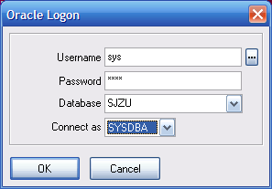
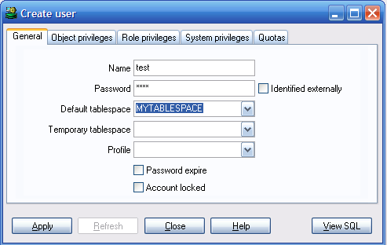
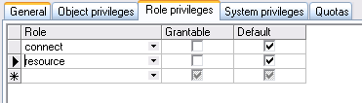
数据库设计
建立用户（使用sys登录）：
用户被创建后，没有任何权限，需要授权。

Slide 6
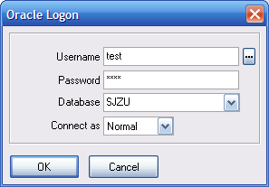
数据库设计
表的设计与建立（使用test登录）：
t_user_info表
t_student_info表
create table t_user_info
(
username varchar2(50) not null,
password varchar2(50) not null
)
create table t_student_info
(
stu_id varchar2(50) not null,
stu_name varchar2(50) not null,
stu_sex varchar2(2) not null,
stu_age number(3) not null
)

Slide 7

数据库设计
表的设计与建立（使用test登录）：
t_user_info初始数据的录入

Slide 8
数据库设计
数据库其他对象的设计
  视图、索引、序列等
  PL/SQL程序

Slide 9
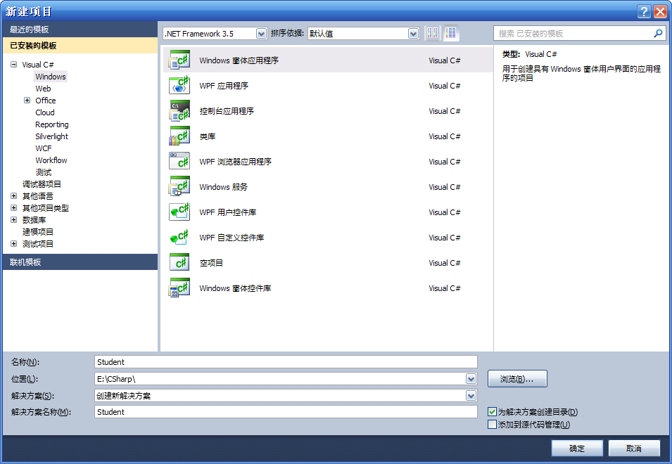
系统设计与开发
新建工程Student。

Slide 10
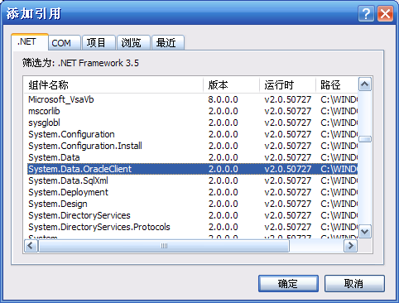
系统设计与开发
添加引用System.Data.OracleClient

Slide 11
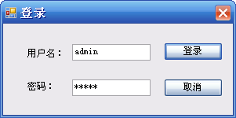
系统设计与开发
登录界面设计
Notes:
窗口的AccessButton直接可以设置回车默认执行某个按钮

Slide 12
系统设计与开发
登录功能流程实现
OracleConnection conn = new OracleConnection("Data Source=sjzu;User ID=test;Password=test");
conn.Open();
string sql = "select * from t_user_info where username='" + tb_username.Text + "' and password='" + tb_password.Text + "'";
OracleDataAdapter da = new OracleDataAdapter(sql, conn);
DataTable dt = new DataTable();
da.Fill(dt);
if (dt.Rows.Count > 0)
{
this.Hide();
frmMain main = new frmMain();
main.Show();
}
else MessageBox.Show(“密码错误");
Notes:
private void btn_login_Click(object sender, EventArgs e)
{
OracleConnection conn = new OracleConnection("Data Source=sjzu;User ID=test;Password=test");
conn.Open();
string sql = "select * from t_user_info where username='" + tb_username.Text + "' and password='" + tb_password.Text + "'";
OracleDataAdapter da = new OracleDataAdapter(sql, conn);
DataTable dt = new DataTable();
da.Fill(dt);
if (dt.Rows.Count > 0)
{
this.Hide();
frmMain main = new frmMain();
main.Show();
}
else
{
login_count++;
if (login_count >= 3)
{
MessageBox.Show("密ü码?错洙误ó达?到?3次?");
Application.Exit();
}
else
{
MessageBox.Show("密ü码?错洙误ó");
}
}
}
private void btn_cancel_Click(object sender, EventArgs e)
{
Application.Exit();
}

Slide 13
系统设计与开发
系统主界面设计
Notes:
private void frmMain_FormClosing(object sender, FormClosingEventArgs e)
{
Application.Exit();
}
private void exitToolStripMenuItem_Click(object sender, EventArgs e)
{
Application.Exit();
}
private void 查é询ˉToolStripMenuItem_Click(object sender, EventArgs e)
{
frmQuery query = new frmQuery();
query.ShowDialog();
}
private void 添加óToolStripMenuItem_Click(object sender, EventArgs e)
{
frmInsert insert = new frmInsert();
insert.ShowDialog();
}
private void 删?除yToolStripMenuItem_Click(object sender, EventArgs e)
{
frmEdit edit = new frmEdit();
edit.ShowDialog();
}

Slide 14
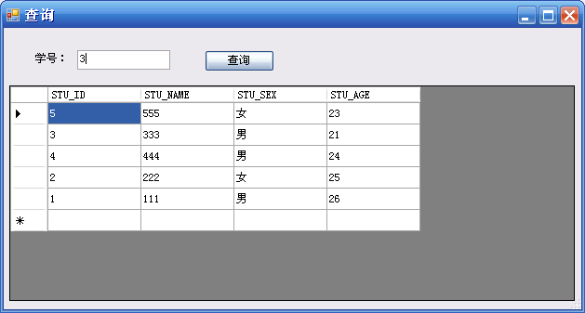
系统设计与开发
查询界面设计
Notes:
private void frmQuery_Load(object sender, EventArgs e)
{
string sql = "select * from t_student_info";
OracleConnection conn = new OracleConnection("Data Source=sjzu;User ID=test;Password=test");
conn.Open();
OracleDataAdapter da = new OracleDataAdapter(sql, conn);
DataTable dt = new DataTable();
da.Fill(dt);
dg_result.DataSource = dt;
conn.Close();
}
private void btn_query1_Click(object sender, EventArgs e)
{
string sql = "select * from t_student_info where stu_id='" + tb_stuid.Text + "'";
OracleConnection conn = new OracleConnection("Data Source=sjzu;User ID=test;Password=test");
conn.Open();
OracleDataAdapter da = new OracleDataAdapter(sql, conn);
DataTable dt = new DataTable();
da.Fill(dt);
dg_result.DataSource = dt;
conn.Close();
}

Slide 15
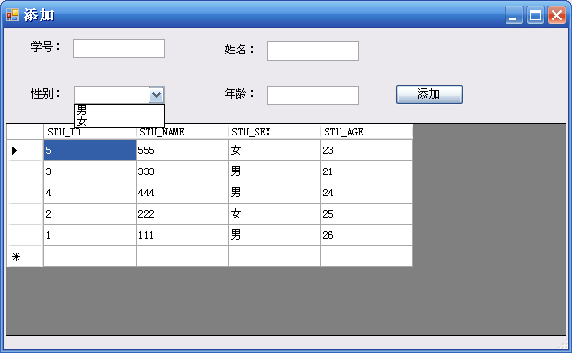
系统设计与开发
添加界面设计
Notes:
private void frmInsert_Load(object sender, EventArgs e)
{
string sql = "select * from t_student_info";
OracleConnection conn = new OracleConnection("Data Source=sjzu;User ID=test;Password=test");
conn.Open();
OracleDataAdapter da = new OracleDataAdapter(sql, conn);
DataTable dt = new DataTable();
da.Fill(dt);
dg_result.DataSource = dt;
conn.Close();
}
private void btn_insert_Click(object sender, EventArgs e)
{
string sql = "insert into t_student_info values('" + tb_stuid.Text+ "','" + tb_name.Text + "','" + cb_sex.Text + "'," + tb_age.Text + ")";
OracleConnection conn = new OracleConnection("Data Source=sjzu;User ID=test;Password=test");
conn.Open();
OracleCommand cmd = new OracleCommand(sql, conn);
cmd.ExecuteNonQuery();
sql = "select * from t_student_info";
OracleDataAdapter da = new OracleDataAdapter(sql, conn);
DataTable dt = new DataTable();
da.Fill(dt);
dg_result.DataSource = dt;
conn.Close();
}

Slide 16
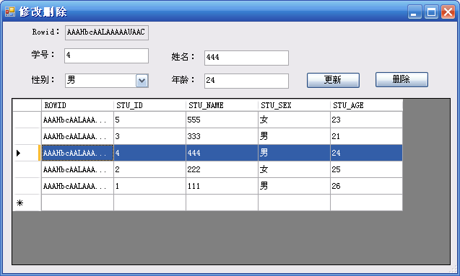
系统设计与开发
删除/修改界面设计
Notes:
private void frmEdit_Load(object sender, EventArgs e)
{
string sql = "select t.rowid,t.* from t_student_info t";
OracleConnection conn = new OracleConnection("Data Source=sjzu;User ID=test;Password=test");
conn.Open();
OracleDataAdapter da = new OracleDataAdapter(sql, conn);
DataTable dt = new DataTable();
da.Fill(dt);
dg_result.DataSource = dt;
conn.Close();
}
private void dg_result_CellMouseClick(object sender, DataGridViewCellMouseEventArgs e)
{
int row = dg_result.CurrentCell.RowIndex;
tb_rowid.Text = dg_result.Rows[row].Cells[0].Value.ToString();
tb_stuid.Text = dg_result.Rows[row].Cells[1].Value.ToString();
tb_name.Text = dg_result.Rows[row].Cells[2].Value.ToString();
cb_sex.Text = dg_result.Rows[row].Cells[3].Value.ToString();
tb_age.Text = dg_result.Rows[row].Cells[4].Value.ToString();
}
private void btn_update_Click(object sender, EventArgs e)
{
string sql = "update t_student_info set stu_id='" + tb_stuid.Text + "',stu_name='" + tb_name.Text + "',stu_sex='" + cb_sex.Text + "',stu_age=" + tb_age.Text + " where rowid='" + tb_rowid.Text + "'";
OracleConnection conn = new OracleConnection("Data Source=sjzu;User ID=test;Password=test");
conn.Open();
OracleCommand cmd = new OracleCommand(sql, conn);
cmd.ExecuteNonQuery();
sql = "select t.rowid,t.* from t_student_info t";
OracleDataAdapter da = new OracleDataAdapter(sql, conn);
DataTable dt = new DataTable();
da.Fill(dt);
dg_result.DataSource = dt;
conn.Close();
}
private void btn_delete_Click(object sender, EventArgs e)
{
string sql = "delete from t_student_info where rowid='" + tb_rowid.Text + "'";
OracleConnection conn = new OracleConnection("Data Source=sjzu;User ID=test;Password=test");
conn.Open();
OracleCommand cmd = new OracleCommand(sql, conn);
cmd.ExecuteNonQuery();
sql = "select t.rowid,t.* from t_student_info t";
OracleDataAdapter da = new OracleDataAdapter(sql, conn);
DataTable dt = new DataTable();
da.Fill(dt);
dg_result.DataSource = dt;
conn.Close();
tb_rowid.Text = "";
tb_stuid.Text = "";
tb_name.Text = "";
cb_sex.Text = "";
tb_age.Text = "";
}

Slide 17
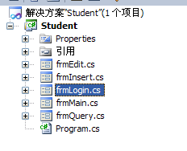
系统设计与开发
最终的项目文件列表
Notes:
private void frmEdit_Load(object sender, EventArgs e)
{
string sql = "select t.rowid,t.* from t_student_info t";
OracleConnection conn = new OracleConnection("Data Source=sjzu;User ID=test;Password=test");
conn.Open();
OracleDataAdapter da = new OracleDataAdapter(sql, conn);
DataTable dt = new DataTable();
da.Fill(dt);
dg_result.DataSource = dt;
conn.Close();
}
private void dg_result_CellMouseClick(object sender, DataGridViewCellMouseEventArgs e)
{
int row = dg_result.CurrentCell.RowIndex;
tb_rowid.Text = dg_result.Rows[row].Cells[0].Value.ToString();
tb_stuid.Text = dg_result.Rows[row].Cells[1].Value.ToString();
tb_name.Text = dg_result.Rows[row].Cells[2].Value.ToString();
cb_sex.Text = dg_result.Rows[row].Cells[3].Value.ToString();
tb_age.Text = dg_result.Rows[row].Cells[4].Value.ToString();
}
private void btn_update_Click(object sender, EventArgs e)
{
string sql = "update t_student_info set stu_id='" + tb_stuid.Text + "',stu_name='" + tb_name.Text + "',stu_sex='" + cb_sex.Text + "',stu_age=" + tb_age.Text + " where rowid='" + tb_rowid.Text + "'";
OracleConnection conn = new OracleConnection("Data Source=sjzu;User ID=test;Password=test");
conn.Open();
OracleCommand cmd = new OracleCommand(sql, conn);
cmd.ExecuteNonQuery();
sql = "select t.rowid,t.* from t_student_info t";
OracleDataAdapter da = new OracleDataAdapter(sql, conn);
DataTable dt = new DataTable();
da.Fill(dt);
dg_result.DataSource = dt;
conn.Close();
}
private void btn_delete_Click(object sender, EventArgs e)
{
string sql = "delete from t_student_info where rowid='" + tb_rowid.Text + "'";
OracleConnection conn = new OracleConnection("Data Source=sjzu;User ID=test;Password=test");
conn.Open();
OracleCommand cmd = new OracleCommand(sql, conn);
cmd.ExecuteNonQuery();
sql = "select t.rowid,t.* from t_student_info t";
OracleDataAdapter da = new OracleDataAdapter(sql, conn);
DataTable dt = new DataTable();
da.Fill(dt);
dg_result.DataSource = dt;
conn.Close();
tb_rowid.Text = "";
tb_stuid.Text = "";
tb_name.Text = "";
cb_sex.Text = "";
tb_age.Text = "";
}

