Slide 1

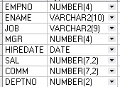


Scott表结构
BONUS
SALGRADE
DEPT
EMP

