Slide 1
1. Introduction To
Artificial intelligence
Autumn 2008
Instructor: Wang Xiaolong
Harbin Institute of Technology, Shenzhen Graduate School
Intelligent Computation Research Center

Slide 2
Course Outline
Why Study AI?
What is AI?
What can AI do?
What tasks require AI?
How to achieve AI?
Branches of AI
AI in China
AI in HIT

Slide 3

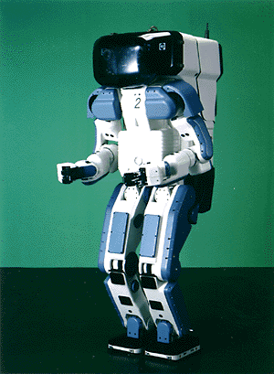

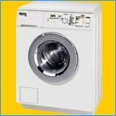
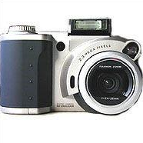

Why Study AI?
Search engines
Science
Medicine/
Diagnosis
Labor
Appliances
What else?

Slide 4
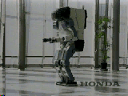
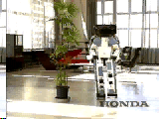
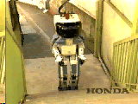
Why Study AI?(Cont.)
Honda Humanoid Robot
Walk
Turn
http://world.honda.com/robot/
Stairs

Slide 5
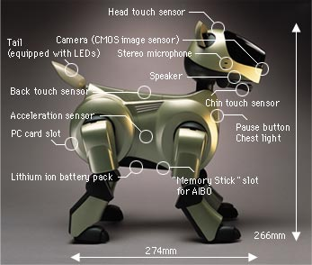
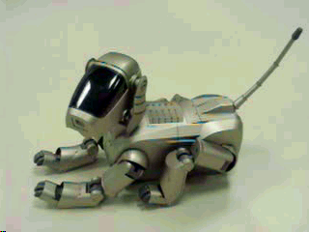
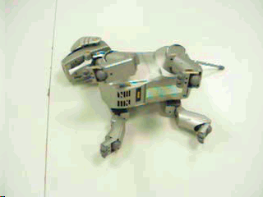
Why Study AI?(Cont.)
Sony AIBO
http://www.aibo.com

Slide 6
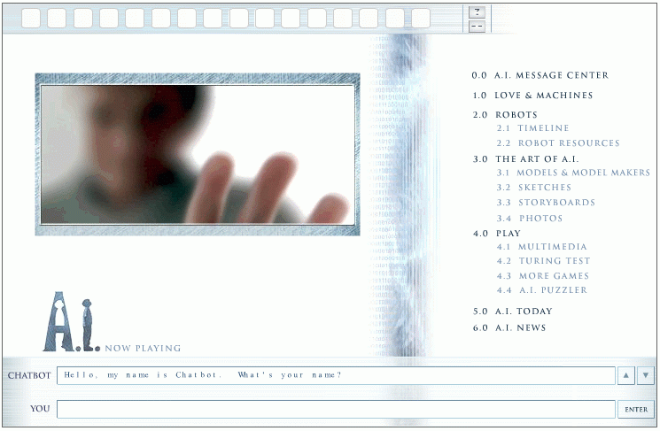
Why Study AI?(Cont.)
Natural Language Question Answering
http://aimovie.warnerbros.com
http://www.ai.mit.edu/projects/infolab/

Slide 7
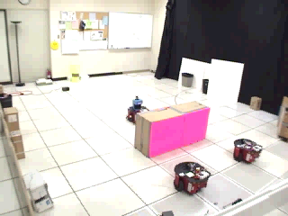
Why Study AI?(Cont.)
Robot Teams
USC robotics Lab

Slide 8
What is AI?
Views of AI fall into four categories:
Systems that think like humans
Systems that think rationally
The exciting new effort to make computers thinks … machine with minds, in the full and literal sense”
(Haugeland 1985)
“The study of mental faculties through the use of computational models”
(Charniak et al. 1985)
Systems that act like humans
Systems that act rationally
“The art of creating machines that perform functions that require intelligence when performed by people” (Kurzweil, 1990)
A field of study that seeks to explain and emulate intelligent behavior in terms of computational processes” (Schalkol, 1990)
The textbook advocates "acting rationally"

Slide 9
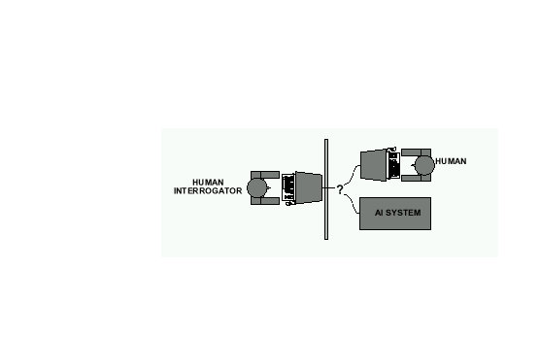
What is AI?(Cont.)
Acting Humanly: The Turing Test
  Alan Turing's 1950 article Computing Machinery and Intelligence discussed conditions for considering a machine to be intelligent.
    “Can machines think?” ←→ “Can machines behave intelligently?”
    The Turing test (The Imitation Game): Operational definition of intelligence.
  Computer needs to possess: Natural language processing, Knowledge representation, Automated reasoning, and Machine learning
  Predicted that by 2000, a machine might have a 30% chance of fooling a lay person for 5 minutes
  Anticipated all major arguments against AI in following 50 years
problems with the Turing Test:
Turing test is not reproducible, constructive, and amenable to mathematic analysis.
What about physical interaction with interrogator and environment?
Are there any problems/limitations to the Turing Test?

Slide 10
What is AI?(Cont.)
Acting Humanly: The Full Turing Test
  Requires physical interaction and needs perception and actuation.
What would a computer need to pass the Turing test?
  Natural language processing: to communicate with examiner.
  Knowledge representation: to store and retrieve information provided before or during interrogation.
  Automated reasoning: to use the stored information to answer questions and to draw new conclusions.
  Machine learning: to adapt to new circumstances and to detect and extrapolate patterns.
  Vision (for Total Turing test): to recognize the examiner’s actions and various objects presented by the examiner.
  Motor control (total test): to act upon objects as requested.
  Other senses (total test): such as audition, smell, touch, etc.

Slide 11
What is AI?(Cont.)
Thinking Humanly: Cognitive Science
  1960 “Cognitive Revolution”: information-processing psychology replaced behaviorism.
  Cognitive science brings together theories and experimental evidence to model internal activities of the brain.
    What level of abstraction? “Knowledge” or “Circuits”?
    How to validate models?
      Predicting and testing behavior of human subjects (top-down)
      Direct identification from neurological data (bottom-up)
      Building computer/machine simulated models and reproduce results (simulation)
Thinking Rationally: Laws of Thought
  Aristotle (~ 450 B.C.) attempted to codify “right thinking”
  What are correct arguments/thought processes?
  E.g., “Socrates is a man, all men are mortal; therefore Socrates is mortal”
  Several Greek schools developed various forms of logic:
  notation plus rules of derivation for thoughts.
Problems:
Uncertainty: Not all facts are certain (e.g., the flight might be delayed).
Resource limitations:
        - Not enough time to compute/process
        - Insufficient memory/disk/etc
        - Etc.

Slide 12
What is AI?(Cont.)
Acting Rationally: The Rational Agent
  Rational behavior: Doing the right thing!
  The right thing: That which is expected to maximize the expected return
  Provides the most general view of AI because it includes:
    Correct inference (“Laws of thought”)
    Uncertainty handling
    Resource limitation considerations (e.g., reflex vs. deliberation)
    Cognitive skills (NLP, AR, knowledge representation, ML, etc.)
  Advantages:
    More general
    Its goal of rationality is well defined
  Rational agents

Slide 13
What Can AI Do?
Quiz: Which of the following can be done at present?
Play a decent game of table tennis?
Drive safely along a curving mountain road?
Drive safely along Telegraph Avenue?
Buy a week's worth of groceries on the web?
Buy a week's worth of groceries at Berkeley Bowl?
Discover and prove a new mathematical theorem?
Converse successfully with another person for an hour?
Perform a complex surgical operation?
Unload a dishwasher and put everything away?
Translate spoken English into spoken Swedish in real time?
Write an intentionally funny story?

Slide 14
What tasks require AI?
“AI is the science and engineering of making intelligent machines which can perform tasks that require intelligence when performed by humans …”
Tasks that require AI:
  Solving a differential equation
  Brain surgery
  Inventing stuff
  Playing Jeopardy
  Playing Wheel of Fortune
  What about walking?
  What about grabbing stuff?
  What about pulling your hand away from fire?
  What about watching TV?
  What about day dreaming?

Slide 15
How to achieve AI?
How is AI research done?
AI research has both theoretical and experimental sides. The experimental side has both basic and applied aspects.
There are two main lines of research:
  One is biological, based on the idea that since humans are intelligent, AI should study humans and imitate their psychology or physiology.
  The other is phenomenal, based on studying and formalizing common sense facts about the world and the problems that the world presents to the achievement of goals.
The two approaches interact to some extent, and both should eventually succeed. It is a race, but both racers seem to be walking. [John McCarthy]

Slide 16
Branches of AI
Logical AI
Search
Natural language processing
pattern recognition
Knowledge representation
Inference From some facts, others can be inferred.
Automated reasoning
Learning from experience
Planning To generate a strategy for achieving some goal.
Epistemology Study of the kinds of knowledge that are required for solving problems in the world.
Ontology Study of the kinds of things that exist. In AI, the programs and sentences deal with various kinds of objects, and we study what these kinds are and what their basic properties are.
Genetic programming
Emotions???
…

Slide 17
Ai in China
Speech input
  863
Natural language processing
Pattern recognition
Machine learning
Machine Translation
  May I help you?
  How are you?
  How old are you?
…

Slide 18
Ai in HIT
Robot Game
Machine Translation
Sentence input
Siguo Game
Q&A
Search Engine
…

Slide 19
AI Prehistory
Philosophy
  Logic, methods of reasoning, mind as physical system foundations of learning, language, rationality
Mathematics
  Formal representation and proof algorithms, computation, (un)decidability, (in)tractability, probability
Economics
  utility, decision theory
Neuroscience
  physical substrate for mental activity
Psychology
  phenomena of perception and motor control, experimental techniques
Computer Engineering
  building fast computers
Control theory
  design systems that maximize an objective function over time
Linguistics
  knowledge representation, grammar

Slide 20
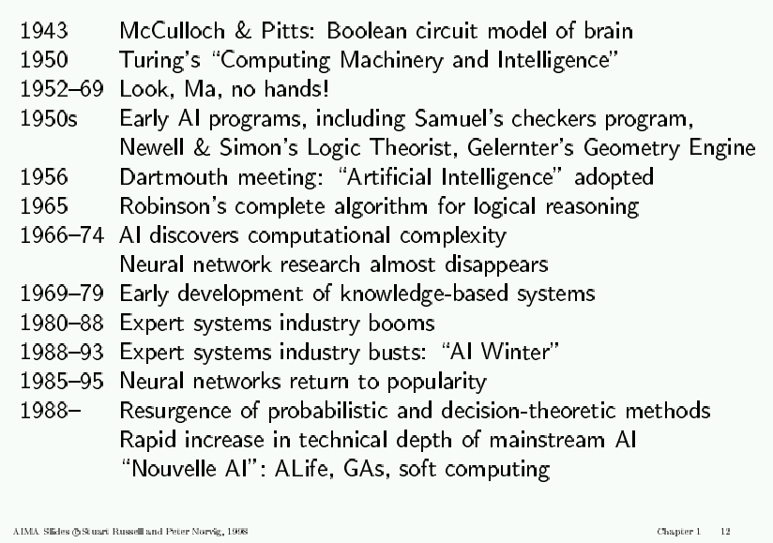
AI History

Slide 21
AI State of the art
Have the following been achieved by AI?
  World-class chess playing
  Playing table tennis
  Cross-country driving
  Solving mathematical problems
  Discover and prove mathematical theories
  Engage in a meaningful conversation
  Understand spoken language
  Observe and understand human emotions
  Express emotions
  …
Deep Blue defeated the reigning world chess champion Garry Kasparov in 1997
Proved a mathematical conjecture (Robbins conjecture) unsolved for decades
No hands across America (driving autonomously 98% of the time from Pittsburgh to San Diego)
During the 1991 Gulf War, US forces deployed an AI logistics planning and scheduling program that involved up to 50,000 vehicles, cargo, and people
NASA's on-board autonomous planning program controlled the scheduling of operations for a spacecraft
Proverb solves crossword puzzles better than most humans

Slide 22
Course Overview
General Introduction
01-Introduction. [AIMA Ch 1] Course Schedule. Homeworks, exams and grading. Course material, TAs. Why study AI? What is AI? The Turing test. Rationality. Branches of AI. Research disciplines conn-ected to and at the foundation of AI. Brief history of AI. Challenges for the future. Overview of class syllabus.
02-Intelligent Agents. [AIMA Ch 2] What is
an intelligent agent? Examples. Doing the right
thing (rational action). Performance measure.
Autonomy. Environment and agent design.
Structure of agents. Agent types. Reflex agents.
Reactive agents. Reflex agents with state.
Goal-based agents. Utility-based agents. Mobile
agents. Information agents.
Agent
sensors
effectors

Slide 23
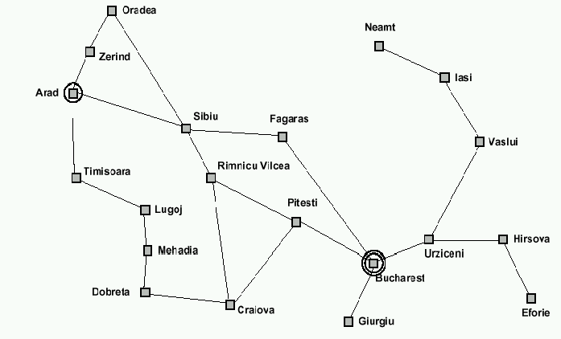
Course Overview(Cont.)
How can we solve complex problems?
03-Problem solving and search. [AIMA Ch 3] Example: measuring problem. Types of problems. More example problems. Basic idea behind search algorithms. Complexity. Combinatorial explosion and NP completeness. Polynomial hierarchy.
04-Uninformed search. [AIMA Ch 3] Depth-first. Breadth-first. Uniform-cost. Depth-limited. Iterative deepening. Examples. Properties.
05/06-Informed search. [AIMA Ch 4] Best-first. A* search. Heuristics. Hill climbing. Problem of local extrema. Simulated annealing.
9 l
3 l
5 l
Using these 3 buckets,
measure 7 liters of water.
Traveling salesperson problem

Slide 24
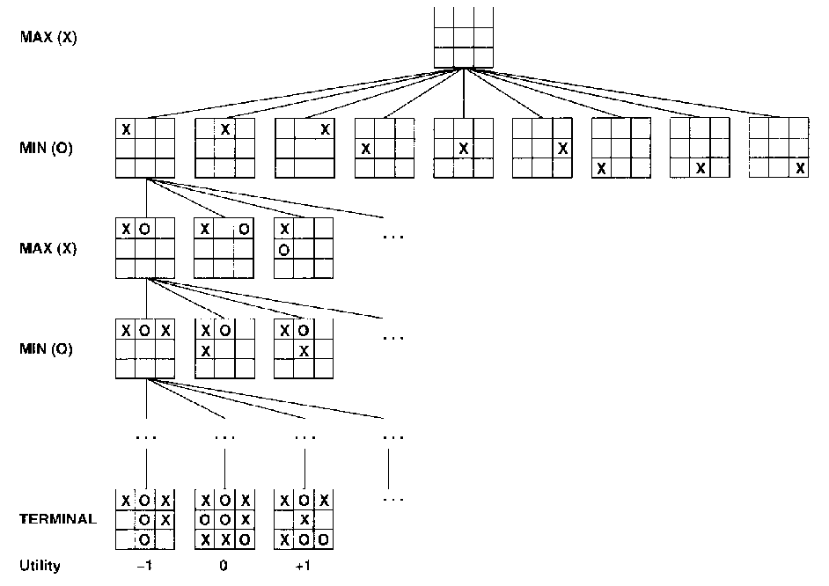
Course Overview(Cont.)
Practical applications of search.
07/08-Game playing. [AIMA Ch 5] The minimax algorithm. Resource limitations. Aplha-beta pruning. Elements of
chance and non-
deterministic games.
tic-tac-toe

Slide 25
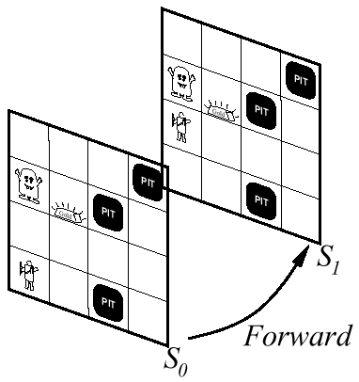
Course Overview(Cont.)
Building knowledge-based agents: 1st Order Logic
09-Logical Agents. [AIMA Ch 7] Syntax. Semantics. Atomic sentences. Complex sentences. Quantifiers. Examples. FOL knowledge base. Situation calculus.
10-First-order logic.
[AIMA Ch 7] Describing actions.
Planning. Action sequences.

Slide 26
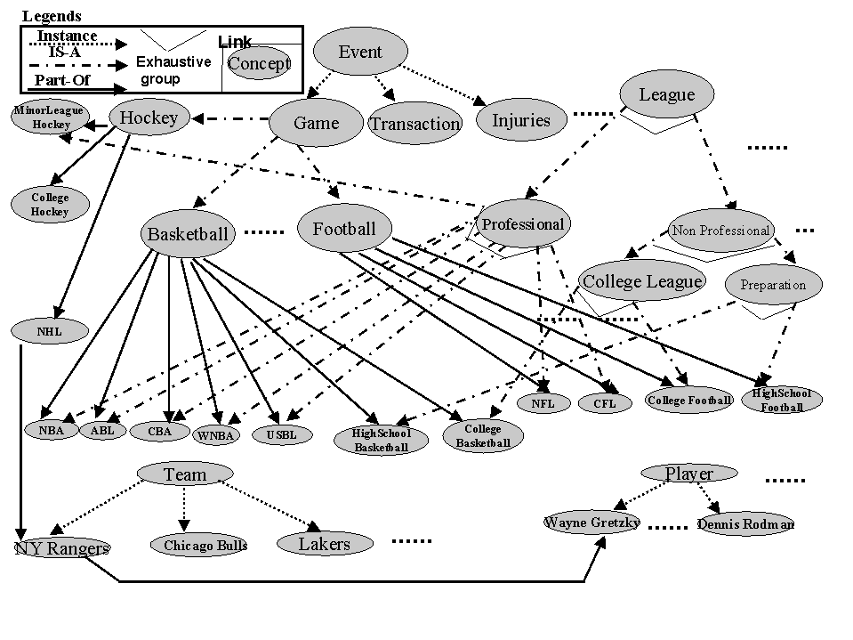
Course Overview(Cont.)
Representing and Organizing Knowledge
11-Building a knowledge base. [AIMA Ch 8] Knowledge bases. Vocabulary and rules. Ontologies. Organizing knowledge.
An ontology
for the sports
domain
Kahn & Mcleod, 2000

Slide 27
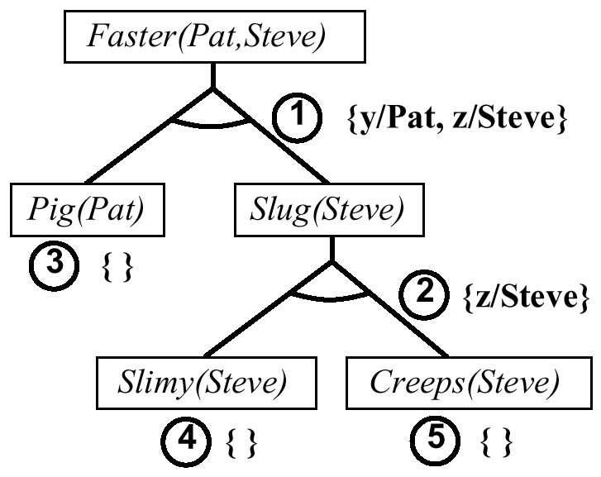
Course Overview(Cont.)
Reasoning Logically
12-Inference in first-order logic. [AIMA Ch 9] Proofs. Unification. Generalized modus ponens. Forward and backward chaining.
Example of
backward chaining

Slide 28
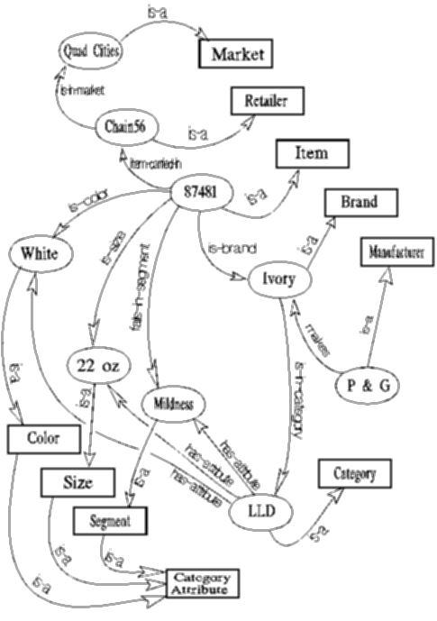
Course Overview(Cont.)
Examples of Logical Reasoning Systems
13-Logical reasoning systems.
[AIMA Ch 10] Indexing, retrieval
and unification. The Prolog language.
Theorem provers. Frame systems
and semantic networks.
Semantic network
used in an insight
generator (Duke
university)

Slide 29
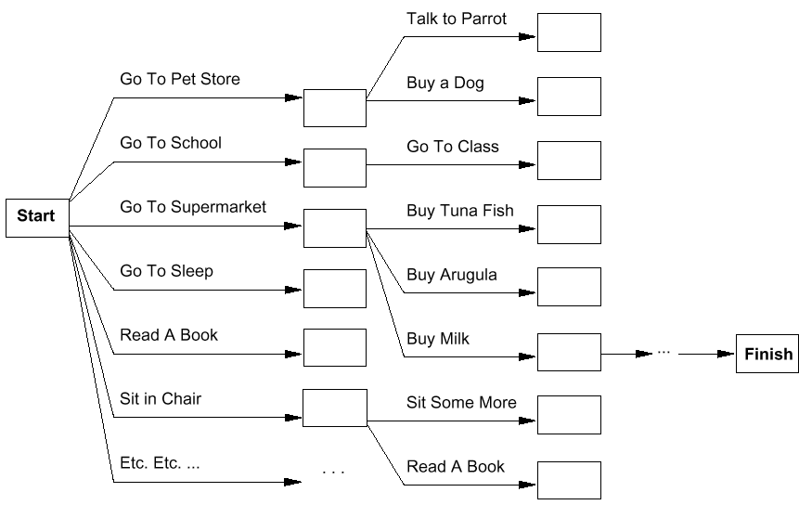
Course Overview(Cont.)
Systems that can Plan Future Behavior
14/15-Planning. [AIMA Ch 11] Definition and goals. Basic representations for planning. Situation space and plan space. Examples.

Slide 30
Course Overview(Cont.)
Logical Reasoning in the Presence of Uncertainty
16/17-Uncertainty. [AIMA Ch 13/14] Introduction to Uncertainty and Probabilistic Reasoning
Center of gravity
Center of largest area

Slide 31
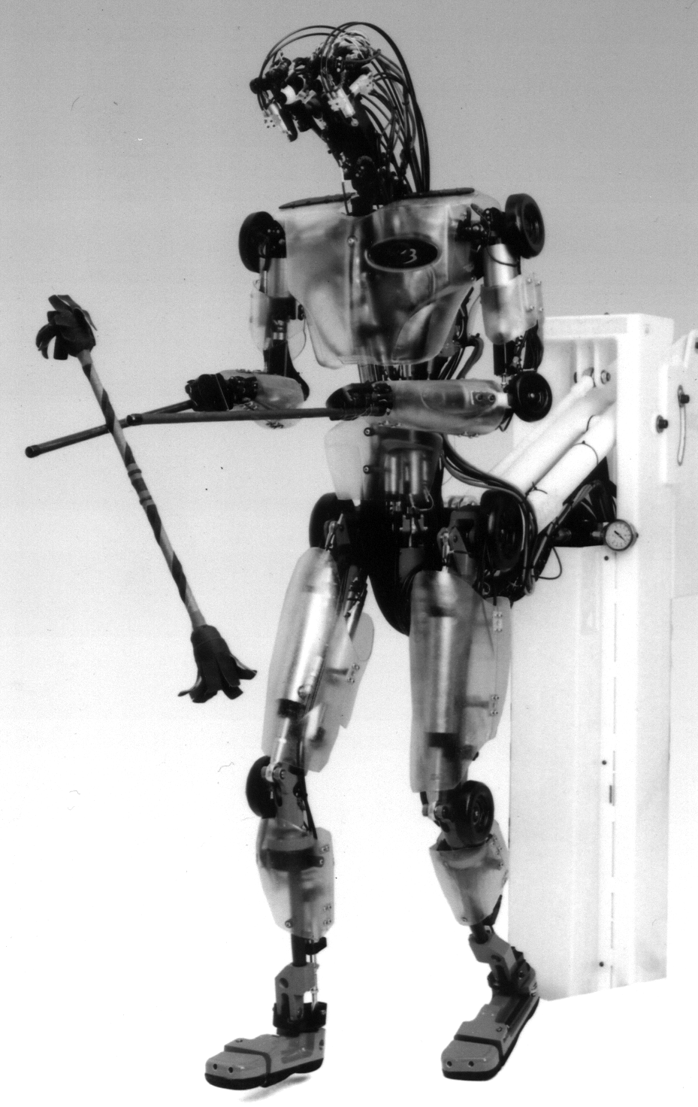
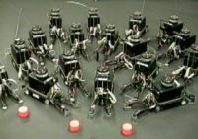
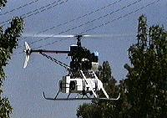
Course Overview(Cont.)
What challenges remain?
18-Overview and summary. [all of the above] What have we learned. Where do we go from here?

Slide 32
HOMEWORK
Learning Python programming language.
Collecting the related conferences and journals on AI, every student at least gather 3 kind of Confs. or Journals, and list their scope.
Selecting 3 from 13 exercises of chapter 1.

