Slide 1
Artificial intelligence
Autumn 2008
Instructor: Wang Xiaolong
Harbin Institute of Technology, Shenzhen Graduate School
Intelligent Computation Research Center
(HITSGS ICRC)

Slide 2
III. Solving Problems by Searching
Autumn 2008
Instructor: Wang Xiaolong
Harbin Institute of Technology, Shenzhen Graduate School
Intelligent Computation Research Center
Reference: [Stuart Russell, Berkeley ]

Slide 3
Outline
Problem-solving agents
Problem types
Problem formulation
Example problems
Basic search algorithms

Slide 4
Example: Measuring problem!
9 l
5 l
3 l
Problem: Using these three buckets,
measure 7 liters of water.

Slide 5
Example: Measuring problem!
(one possible) Solution:
a b c
0 0 0 start
3 0 0
0 0 3
3 0 3
0 0 6
3 0 6
0 3 6
3 3 6
1 5 6
0 5 7 goal
9 l
5 l
3 l
a
b
c

Slide 6
Example: Measuring problem!
(one possible) Solution:
a b c
0 0 0 start
3 0 0
0 0 3
3 0 3
0 0 6
3 0 6
0 3 6
3 3 6
1 5 6
0 5 7 goal
9 l
5 l
3 l
a
b
c

Slide 7
Example: Measuring problem!
(one possible) Solution:
a b c
0 0 0 start
3 0 0
0 0 3
3 0 3
0 0 6
3 0 6
0 3 6
3 3 6
1 5 6
0 5 7 goal
9 l
5 l
3 l
a
b
c

Slide 8
Example: Measuring problem!
(one possible) Solution:
a b c
0 0 0 start
3 0 0
0 0 3
3 0 3
0 0 6
3 0 6
0 3 6
3 3 6
1 5 6
0 5 7 goal
9 l
5 l
3 l
a
b
c

Slide 9
Example: Measuring problem!
(one possible) Solution:
a b c
0 0 0 start
3 0 0
0 0 3
3 0 3
0 0 6
3 0 6
0 3 6
3 3 6
1 5 6
0 5 7 goal
9 l
5 l
3 l
a
b
c

Slide 10
Example: Measuring problem!
(one possible) Solution:
a b c
0 0 0 start
3 0 0
0 0 3
3 0 3
0 0 6
3 0 6
0 3 6
3 3 6
1 5 6
0 5 7 goal
9 l
5 l
3 l
a
b
c

Slide 11
Example: Measuring problem!
(one possible) Solution:
a b c
0 0 0 start
3 0 0
0 0 3
3 0 3
0 0 6
3 0 6
0 3 6
3 3 6
1 5 6
0 5 7 goal
9 l
5 l
3 l
a
b
c

Slide 12
Example: Measuring problem!
(one possible) Solution:
a b c
0 0 0 start
3 0 0
0 0 3
3 0 3
0 0 6
3 0 6
0 3 6
3 3 6
1 5 6
0 5 7 goal
9 l
5 l
3 l
a
b
c

Slide 13
Example: Measuring problem!
(one possible) Solution:
a b c
0 0 0 start
3 0 0
0 0 3
3 0 3
0 0 6
3 0 6
0 3 6
3 3 6
1 5 6
0 5 7 goal
9 l
5 l
3 l
a
b
c

Slide 14
Example: Measuring problem!
(one possible) Solution:
a b c
0 0 0 start
3 0 0
0 0 3
3 0 3
0 0 6
3 0 6
0 3 6
3 3 6
1 5 6
0 5 7 goal
9 l
5 l
3 l
a
b
c

Slide 15
Example: Measuring problem!
Another Solution:
a b c
0 0 0 start
0 5 0
0 0 3
3 0 3
0 0 6
3 0 6
0 3 6
3 3 6
1 5 6
0 5 7 goal
9 l
5 l
3 l
a
b
c

Slide 16
Example: Measuring problem!
Another Solution:
a b c
0 0 0 start
0 5 0
3 2 0
0 0 3
3 0 3
0 0 6
3 0 6
0 3 6
3 3 6
1 5 6
0 5 7 goal
9 l
5 l
3 l
a
b
c

Slide 17
Example: Measuring problem!
Another Solution:
a b c
0 0 0 start
0 5 0
3 2 0
3 0 2
3 0 3
0 0 6
3 0 6
0 3 6
3 3 6
1 5 6
0 5 7 goal
9 l
5 l
3 l
a
b
c

Slide 18
Example: Measuring problem!
Another Solution:
a b c
0 0 0 start
0 5 0
3 2 0
3 0 2
3 5 2
0 0 6
3 0 6
0 3 6
3 3 6
1 5 6
0 5 7 goal
9 l
5 l
3 l
a
b
c

Slide 19
Example: Measuring problem!
Another Solution:
a b c
0 0 0 start
0 5 0
3 2 0
3 0 2
3 5 2
3 0 7 goal
3 0 6
0 3 6
3 3 6
1 5 6
0 5 7 goal
9 l
5 l
3 l
a
b
c

Slide 20
Which solution do we prefer?
Solution 1:
a b c
0 0 0 start
3 0 0
0 0 3
3 0 3
0 0 6
3 0 6
0 3 6
3 3 6
1 5 6
0 5 7 goal
Solution 2:
a b c
0 0 0 start
0 5 0
3 2 0
3 0 2
3 5 2
3 0 7 goal

Slide 21
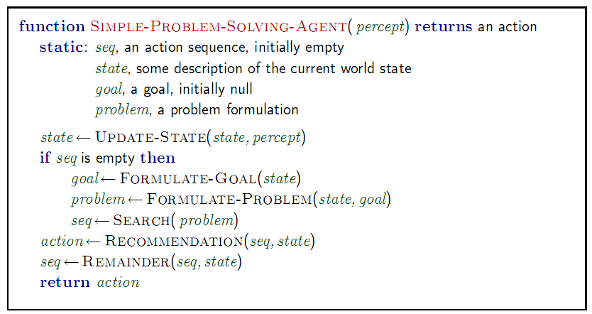
Problem-solving agents
One kind of goal-based agent.
Restricted form of general agent:
Note: this is offline problem solving; solution executed "eyes closed."
Online problem solving involves acting without complete knowledge.

Slide 22
Example: Buckets
Measure 7 liters of water using a 3-liter, a 5-liter, and a 9-liter buckets.
Formulate goal: Have 7 liters of water in 9-liter bucket
Formulate problem:
  states: amount of water in the buckets
  actions: Fill bucket from source, empty bucket
Find solution: sequence of actions that bring you
from current state to the goal state

Slide 23
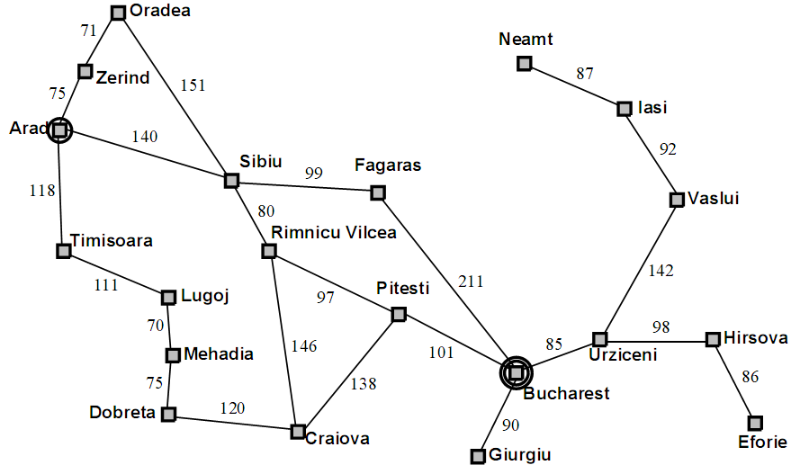
Example: Romania

Slide 24
Example: Romania
On holiday in Romania; currently in Arad.
Flight leaves tomorrow from Bucharest
Formulate goal: be in Bucharest
Formulate problem:
  states: various cities
  actions: drive between cities
Find solution: sequence of cities, e.g., Arad, Sibiu, Fagaras, Bucharest

Slide 25
Single-state problem formulation
A problem is defined by four items:
initial state e.g., "at Arad"
actions or successor function S(x) = set of action–state pairs
  e.g., S(Arad) = {<Arad → Zerind, Zerind>, … }
goal test, can be
  explicit, e.g., x = "at Bucharest"
  implicit, e.g., Checkmate(x)
path cost (additive)
  e.g., sum of distances, number of actions executed, etc.
  c(x,a,y) is the step cost, assumed to be ≥ 0
A solution is a sequence of actions leading from the initial state to a goal state

Slide 26
Selecting a state space
Real world is absurdly complex
  → state space must be abstracted for problem solving
(Abstract) state = set of real states
(Abstract) action = complex combination of real actions
  e.g., "Arad → Zerind" represents a complex set of possible routes, detours, rest stops, etc.
For guaranteed realizability, any real state "in Arad“ must get to some real state "in Zerind"
(Abstract) solution =
  set of real paths that are solutions in the real world
Each abstract action should be "easier" than the original problem

Slide 27
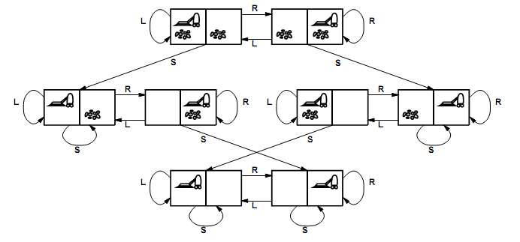
Vacuum world state space graph
states?
actions?
goal test?
path cost?

Slide 28
Vacuum world state space graph
states? integer dirt and robot location
actions? Left, Right, Suck
goal test? no dirt at all locations
path cost? 1 per action

Slide 29

Example: The 8-puzzle
states?
actions?
goal test?
path cost?

Slide 30
Example: The 8-puzzle
states locations of tiles
actions move blank left, right, up, down
goal test = goal state (given)
path cost 1 per move
[Note: optimal solution of n-Puzzle family is NP-hard]

Slide 31

Example: robotic assembly
states: real-valued coordinates of robot joint angles parts of the object to be assembled
actions: continuous motions of robot joints
goal test: complete assembly
path cost: time to execute

Slide 32
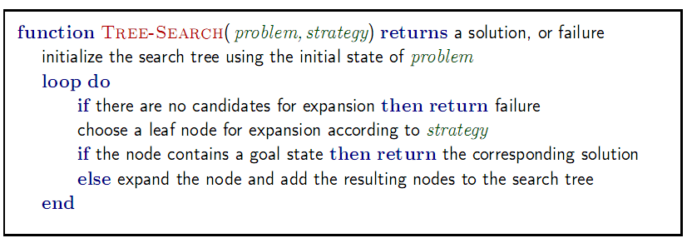
Tree search algorithms
Basic idea:
  offline, simulated exploration of state space by generating successors of already-explored states (a.k.a.~expanding states)

Slide 33

Tree search example

Slide 34

Tree search example

Slide 35

Tree search example

Slide 36
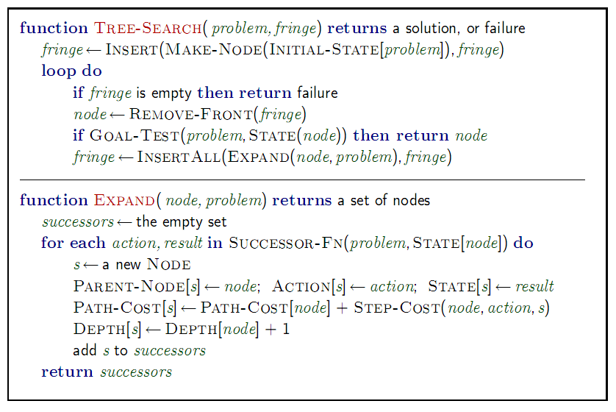
Implementation: general tree search

Slide 37

Implementation: states vs. nodes
A state is a (representation of) a physical configuration
A node is a data structure constituting part of a search tree includes state, parent node, action, path cost g(x), depth
The Expand function creates new nodes, filling in the various fields and using the SuccessorFn of the problem to create the corresponding states.

Slide 38
Search strategies
A search strategy is defined by picking the order of node expansion
Strategies are evaluated along the following dimensions:
  completeness: does it always find a solution if one exists?
  time complexity: number of nodes generated
  space complexity: maximum number of nodes in memory
  optimality: does it always find a least-cost solution?
Time and space complexity are measured in terms of
  b: maximum branching factor of the search tree
  d: depth of the least-cost solution
  m: maximum depth of the state space (may be ∞)

Slide 39
Uninformed search strategies
Uninformed search strategies use only the information available in the problem definition
Breadth-first search
Uniform-cost search
Depth-first search
Depth-limited search
Iterative deepening search

Slide 40
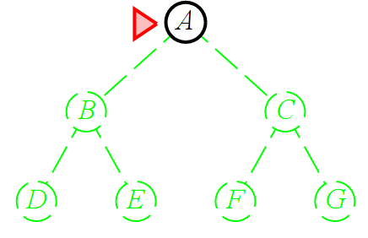
Breadth-first search
Expand shallowest unexpanded node
Implementation:
  fringe is a FIFO queue, i.e., new successors go at end

Slide 41
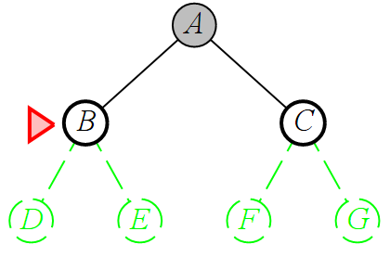
Breadth-first search
Expand shallowest unexpanded node
Implementation:
  fringe is a FIFO queue, i.e., new successors go at end

Slide 42
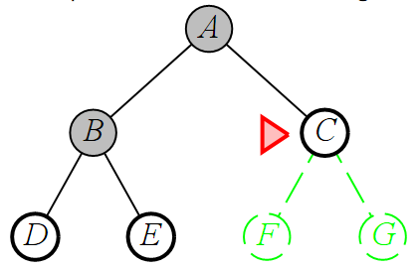
Breadth-first search
Expand shallowest unexpanded node
Implementation:
  fringe is a FIFO queue, i.e., new successors go at end

Slide 43
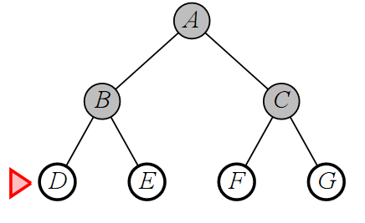
Breadth-first search
Expand shallowest unexpanded node
Implementation:
  fringe is a FIFO queue, i.e., new successors go at end

Slide 44
Properties of breadth-first search
Complete? Yes (if b is finite)
Time? 1+b+b²+b³+… +b^{d} + b(b^{d}-1) = O(b^{d+1})
Space? O(b^{d+1}) (keeps every node in memory)
Optimal? Yes (if cost = 1 per step)
Space is the bigger problem (more than time); can easily generate nodes at 100MB/sec, so 24hrs = 8640GB.

Slide 45
Uniform-cost search
Expand least-cost unexpanded node
Implementation:
  fringe = queue ordered by path cost
Equivalent to breadth-first if step costs all equal
Complete? Yes, if step cost ≥ ε
Time? # of nodes with g ≤ cost of optimal solution, O(b^{ceiling(C*/ ε)}) where C* is the cost of the optimal solution
Space? # of nodes with g ≤ cost of optimal solution, O(b^{ceiling(C*/ ε)})
Optimal? Yes – nodes expanded in increasing order of g(n)

Slide 46
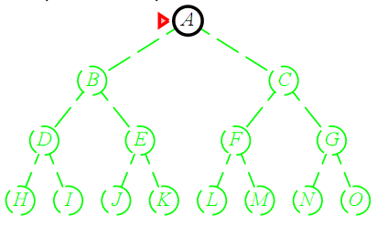
Depth-first search
Expand deepest unexpanded node
Implementation:
  fringe = LIFO queue, i.e., put successors at front

Slide 47
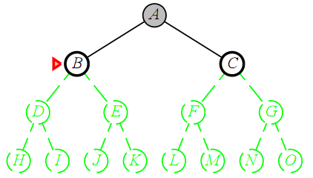
Depth-first search
Expand deepest unexpanded node
Implementation:
  fringe = LIFO queue, i.e., put successors at front

Slide 48
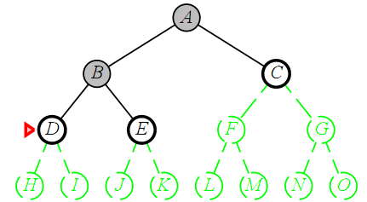
Depth-first search
Expand deepest unexpanded node
Implementation:
  fringe = LIFO queue, i.e., put successors at front

Slide 49
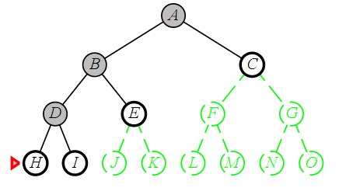
Depth-first search
Expand deepest unexpanded node
Implementation:
  fringe = LIFO queue, i.e., put successors at front

Slide 50
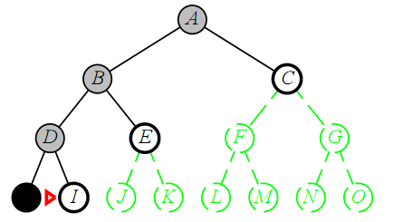
Depth-first search
Expand deepest unexpanded node
Implementation:
  fringe = LIFO queue, i.e., put successors at front

Slide 51
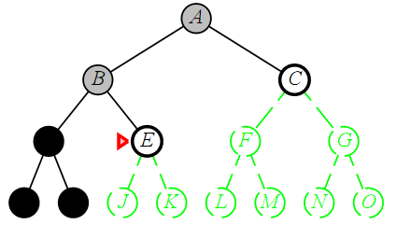
Depth-first search
Expand deepest unexpanded node
Implementation:
  fringe = LIFO queue, i.e., put successors at front

Slide 52
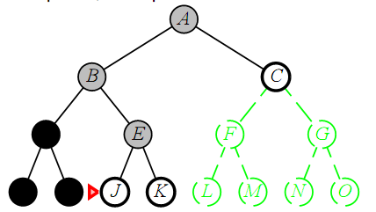
Depth-first search
Expand deepest unexpanded node
Implementation:
  fringe = LIFO queue, i.e., put successors at front

Slide 53
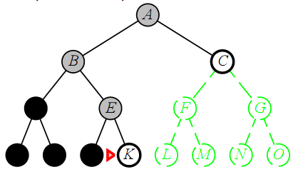
Depth-first search
Expand deepest unexpanded node
Implementation:
  fringe = LIFO queue, i.e., put successors at front

Slide 54
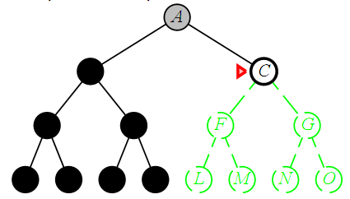
Depth-first search
Expand deepest unexpanded node
Implementation:
  fringe = LIFO queue, i.e., put successors at front

Slide 55
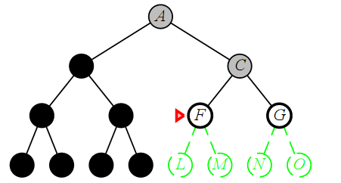
Depth-first search
Expand deepest unexpanded node
Implementation:
  fringe = LIFO queue, i.e., put successors at front

Slide 56
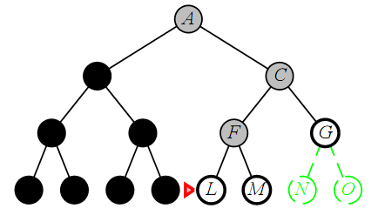
Depth-first search
Expand deepest unexpanded node
Implementation:
  fringe = LIFO queue, i.e., put successors at front

Slide 57
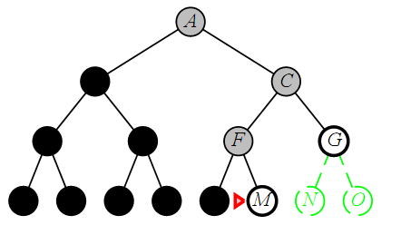
Depth-first search
Expand deepest unexpanded node
Implementation:
  fringe = LIFO queue, i.e., put successors at front

Slide 58
Properties of depth-first search
Complete? No: fails in infinite-depth spaces, spaces with loops
  Modify to avoid repeated states along path
    → complete in finite spaces
Time? O(b^{m}): terrible if m is much larger than d
  but if solutions are dense, may be much faster than breadth-first
Space? O(bm), i.e., linear space!
Optimal? No

Slide 59
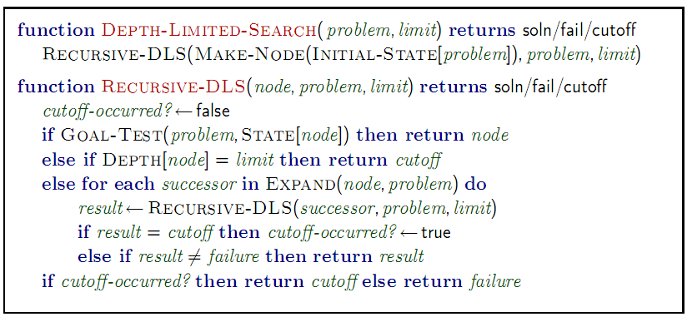
Depth-limited search
= depth-first search with depth limit l,
i.e., nodes at depth l have no successors
Recursive implementation:

Slide 60
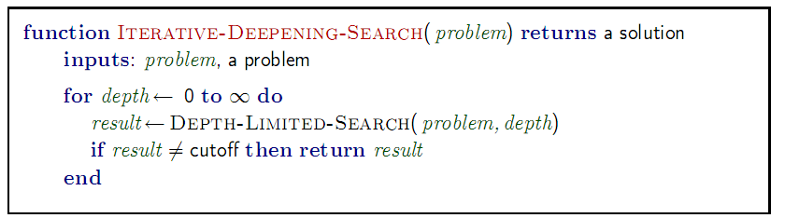
Iterative deepening search

Slide 61

Iterative deepening search l =0

Slide 62

Iterative deepening search l =1

Slide 63

Iterative deepening search l =2

Slide 64

Iterative deepening search l =3

Slide 65
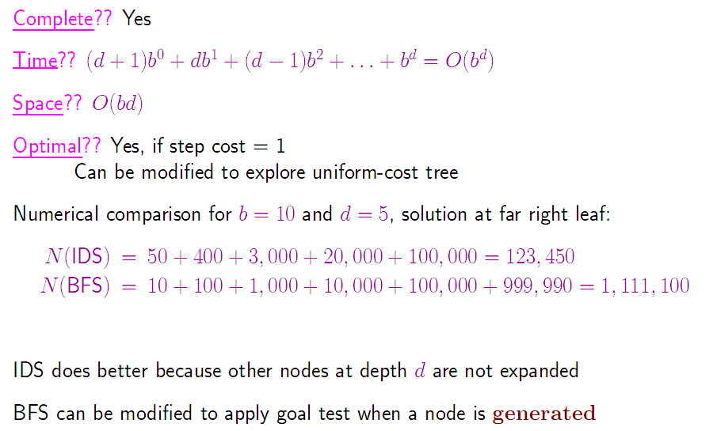
Properties of iterative deepening search

Slide 66
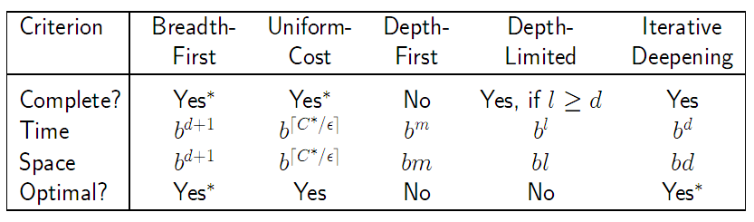
Summary of algorithms

Slide 67
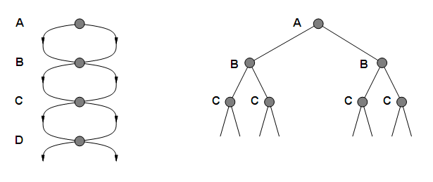
Repeated states
Failure to detect repeated states can turn a linear problem into an exponential one!

Slide 68
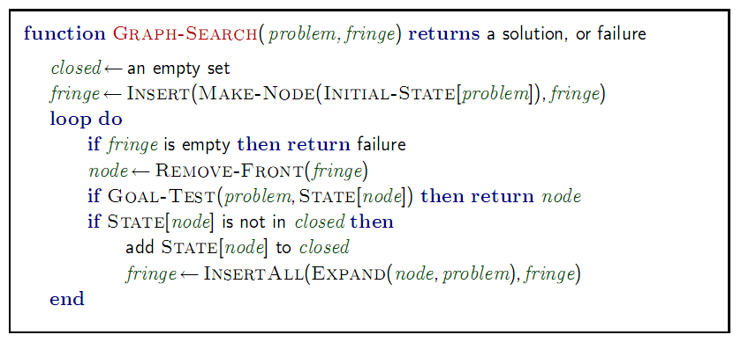
Graph search

Slide 69
Problem types
Deterministic, fully observable → single-state problem
  Agent knows exactly which state it will be in; solution is a sequence
  E.g., playing chess. Any action will result in an exact state
Non-observable → sensorless problem (conformant problem)
  Agent may have no idea where it is; solution is a sequence
  E.g., walking in a dark room
    If you are at the door, going straight will lead you to the kitchen
    If you are at the kitchen, turning left leads you to the bedroom
Nondeterministic and/or partially observable → contingency problem
  percepts provide new information about current state
  often interleave search, execution
  E.g., a new skater in an arena
    Many skaters around
Unknown state space → exploration problem
Notes:
Conformant planning is a variation of classical AI planning where the initial state is partially known and actions can have nondeterministic effects.

Slide 70
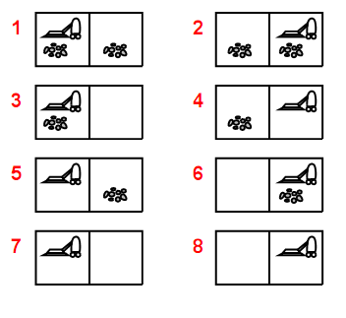
Example: vacuum world
Single-state, start in #5.
Solution?

Slide 71
Example: vacuum world
Single-state, start in #5.
Solution? [Right, Suck]
Sensorless, start in
{1,2,3,4,5,6,7,8} e.g.,
Right goes to {2,4,6,8}
Solution?

Slide 72
Example: vacuum world
Sensorless, start in
{1,2,3,4,5,6,7,8} e.g.,
Right goes to {2,4,6,8}
Solution?
[Right,Suck,Left,Suck]
Contingency
  Nondeterministic: Suck may
  dirty a clean carpet
  Partially observable: location,
  dirt at current location.
  Percept: [L, Clean], i.e., start
  in #5 or #7
  Solution?

Slide 73
Example: vacuum world
Sensorless, start in
{1,2,3,4,5,6,7,8} e.g.,
Right goes to {2,4,6,8}
Solution?
[Right,Suck,Left,Suck]
Contingency
  Nondeterministic: Suck may
  dirty a clean carpet
  Partially observable: location,
  dirt at current location.
  Percept: [L, Clean], i.e., start in #5 or #7
  Solution? [Right, if dirt then Suck]

Slide 74
Summary
Problem formulation usually requires abstracting away real-world details to define a state space that can feasibly be explored
Variety of uninformed search strategies
Iterative deepening search uses only linear space and not much more time than other uninformed algorithms
Graph search can be exponentially more efficient than tree search

Slide 75
Homework
Exercises of Chapter 3
  3.4
  3.8
  3.12

