Slide 1
Artificial intelligence
Autumn 2008
Instructor: Wang Xiaolong
Harbin Institute of Technology, Shenzhen Graduate School
Intelligent Computation Research Center
(HITSGS ICRC)

Slide 2
IV. Informed search algorithms
Autumn 2008
Instructor: Wang Xiaolong
Harbin Institute of Technology, Shenzhen Graduate School
Intelligent Computation Research Center
(HITSGS ICRC)

Slide 3
Outline
Best-first search
Greedy best-first search
A* search
Heuristics
Local search algorithms
Hill-climbing search
Simulated annealing search
Local beam search
Genetic algorithms

Slide 4
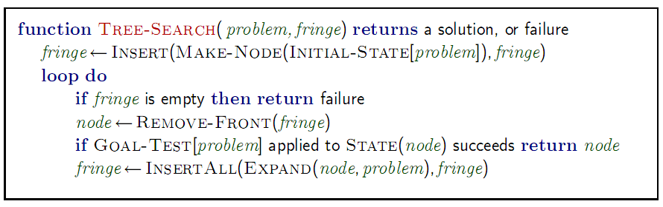
Review: Tree Search
A strategy is defined by picking the order of node expansion

Slide 5
Best-first search
Idea: use an evaluation function f(n) for each node
  estimate of "desirability"
  Expand most desirable unexpanded node
Implementation:
Order the nodes in fringe in decreasing order of desirability
Special cases:
  greedy best-first search
  A* search

Slide 6
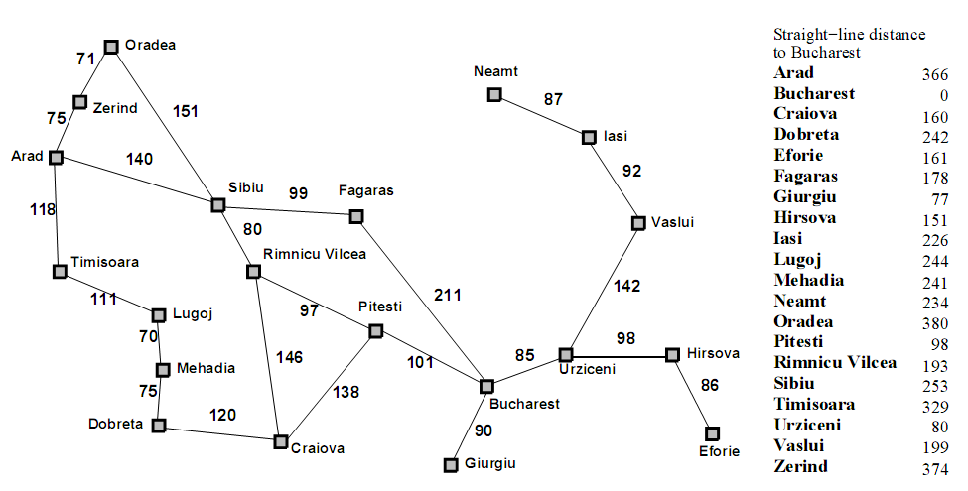
Romania with step costs in km

Slide 7
Greedy best-first search
Evaluation function f(n) = h(n) (heuristic)
= estimate of cost from n to goal
e.g., h_{SLD} (n) = straight-line distance from n to Bucharest
Greedy best-first search expands the node that appears to be closest to goal

Slide 8

Greedy best-first search example
Wednesday, October 20, 2008
Wednesday, October 20, 2008

Slide 9

Greedy best-first search example

Slide 10

Greedy best-first search example

Slide 11

Greedy best-first search example

Slide 12
Properties of greedy best-first search
Complete? No – can get stuck in loops, e.g., Iasi → Neamt → Iasi → Neamt →
Complete in finite space with repeated-state checking
Time? O(b^{m}), but a good heuristic can give dramatic improvement
Space? O(b^{m}) -- keeps all nodes in memory
Optimal? No

Slide 13
A* search
Idea: avoid expanding paths that are already expensive
Evaluation function f(n) = g(n) + h(n)
g(n) = cost so far to reach n
h(n) = estimated cost from n to goal
f(n) = estimated total cost of path through n to goal

Slide 14

A* search example

Slide 15

A* search example

Slide 16

A* search example

Slide 17

A* search example

Slide 18

A* search example

Slide 19

A* search example

Slide 20
Admissible heuristics
A heuristic h(n) is admissible if for every node n,
h(n) ≤ h*(n), where h*(n) is the true cost to reach the goal state from n.
An admissible heuristic never overestimates the cost to reach the goal, i.e., it is optimistic
Example: h_{SLD}(n) (never overestimates the actual road distance)
Theorem: If h(n) is admissible, A* using TREE-SEARCH is optimal

Slide 21
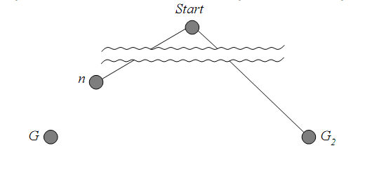
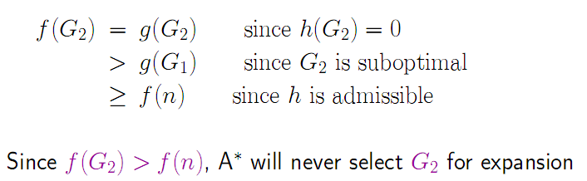
Optimality of A* (proof)
Suppose some suboptimal goal G₂ has been generated and is in the fringe. Let n be an unexpanded node in the fringe such that n is on a shortest path to an optimal goal G₁.

Slide 22

Consistent heuristics
A heuristic is consistent if for every node n, every successor n' of n generated by any action a,
h(n) ≤ c(n,a,n') + h(n')
If h is consistent, we have
f(n') = g(n') + h(n')
= g(n) + c(n,a,n') + h(n')
≥ g(n) + h(n)
= f(n)
i.e., f(n) is non-decreasing along any path.
Theorem: If h(n) is consistent, A* using GRAPH-SEARCH is optimal

Slide 23
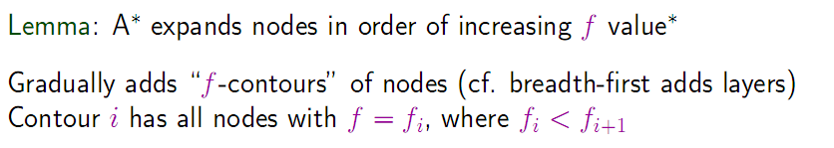

Optimality of A*

Slide 24
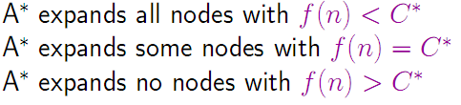
Properties of A*
Complete?
  Yes (unless there are infinitely many nodes with f ≤ f(G) )
Time?
  Exponential
Space?
  Keeps all nodes in memory
Optimal?
  Yes
  —cannot expand fi+1 until fi is finished
  in [relative error in h × length of soln.]

Slide 25

Admissible heuristics
E.g., for the 8-puzzle:
h₁(n) = number of misplaced tiles
h₂(n) = total Manhattan distance
(i.e., no. of squares from desired location of each tile)
h₁(S) = ?
h₂(S) = ?

Slide 26
Admissible heuristics
E.g., for the 8-puzzle:
h₁(n) = number of misplaced tiles
h₂(n) = total Manhattan distance
(i.e., no. of squares from desired location of each tile)
h₁(S) = ? 8
h₂(S) = ? 3+1+2+2+2+3+3+2 = 18

Slide 27
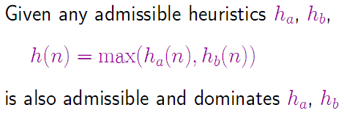
Dominance
If h₂(n) ≥ h₁(n) for all n (both admissible)
then h₂ dominates h₁
h₂ is better for search
Typical search costs (average number of nodes expanded):
d=12 IDS = 3,644,035 nodes
A*(h₁) = 227 nodes
A*(h₂) = 73 nodes
d=24 IDS = too many nodes
A*(h₁) = 39,135 nodes
A*(h₂) = 1,641 nodes

Slide 28
Relaxed problems
A problem with fewer restrictions on the actions is called a relaxed problem
The cost of an optimal solution to a relaxed problem is an admissible heuristic for the original problem
If the rules of the 8-puzzle are relaxed so that a tile can move anywhere, then h₁(n) gives the shortest solution
If the rules are relaxed so that a tile can move to any adjacent square, then h₂(n) gives the shortest solution
Key point: the optimal solution cost of a relaxed problem is no greater than the optimal solution cost of the real problem

Slide 29
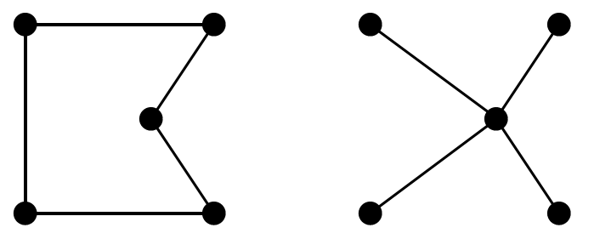
Relaxed problems (Contd.)
Well-known example: traveling salesperson problem (TSP)
Find the shortest tour visiting all cities exactly once
Minimum spanning tree can be computed in O(n²) and is a lower bound on the shortest (open) tour

Slide 30
Summary
Heuristic functions estimate costs of shortest paths
Good heuristics can dramatically reduce search cost
Greedy best-first search expands lowest h
  incomplete and not always optimal
A* search expands lowest g + h
  incomplete and optimal
  also optimally efficient (up to tie-breaks, for forward search)
Admissible heuristics can be derived from exact solution of relaxed problems

Slide 31
Local search algorithms
In many optimization problems, the path to the goal is irrelevant; the goal state itself is the solution
State space = set of "complete" configurations
Find configuration satisfying constraints, e.g., n-queens
In such cases, we can use local search algorithms
keep a single "current" state, try to improve it
Constant space, suitable for online as well as offline search

Slide 32
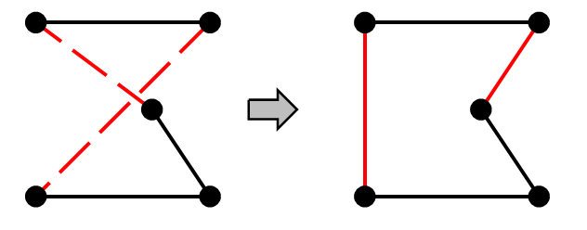
Example: Travelling Salesperson Problem
Start with any complete tour, perform pairwise exchanges
Variants of this approach get within 1% of optimal very quickly with thousands of cities

Slide 33
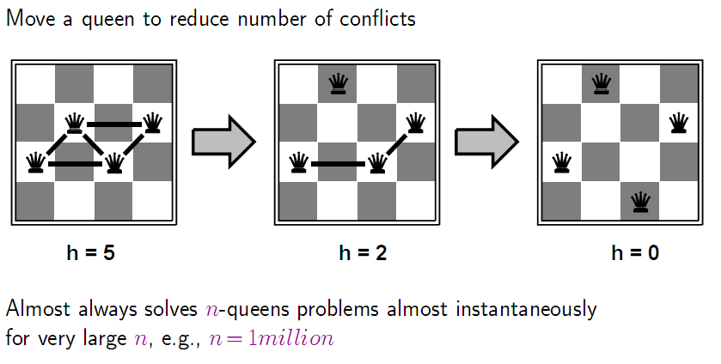
Example: n-queens
Put n queens on an n × n board with no two queens on the same row, column, or diagonal

Slide 34
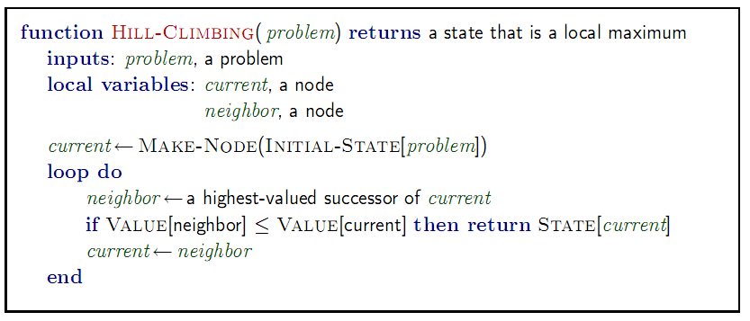
Hill-climbing search
"Like climbing Everest in thick fog with amnesia"

Slide 35
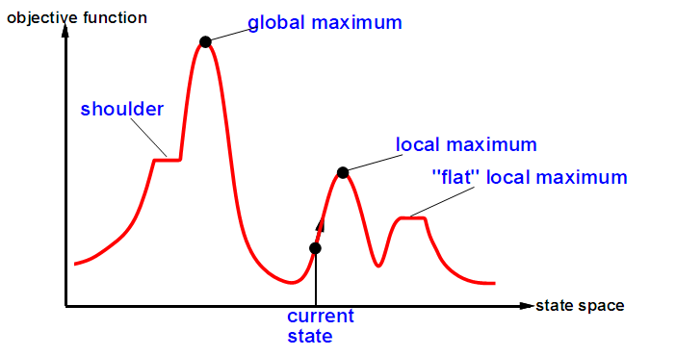
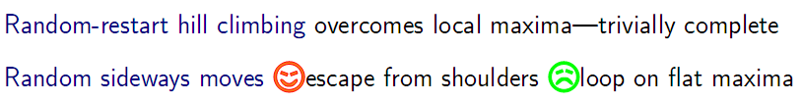
Hill-climbing search
Problem: depending on initial state, can get stuck in local maxima
Useful to consider state space landscape
Notes:
state space landscape:状态空间图。

Slide 36

Hill-climbing search: 8-queens problem
h = number of pairs of queens that are attacking each other, either directly or indirectly
h = 17 for the above state

Slide 37

Hill-climbing search: 8-queens problem
A local minimum with h = 1

Slide 38
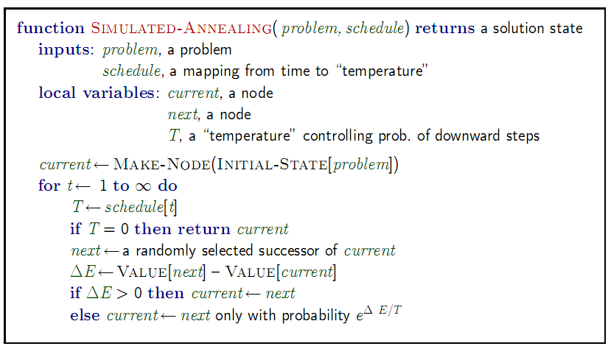
Simulated annealing search
Idea: escape local maxima by allowing some "bad" moves but gradually decrease their frequency

Slide 39
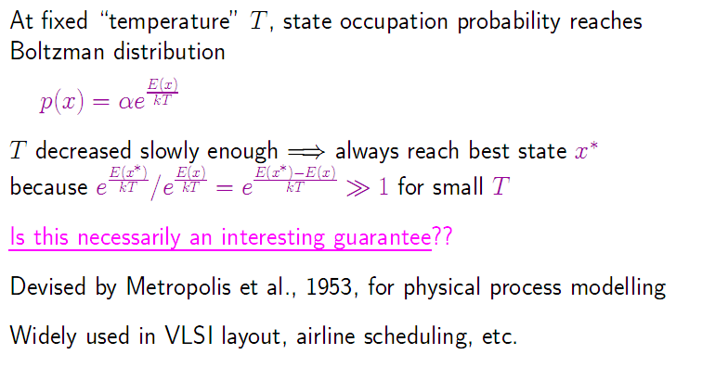
Properties of simulated annealing search

Slide 40
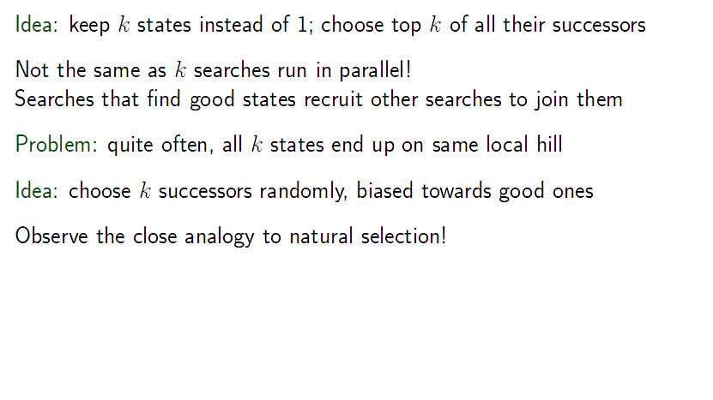
Local beam search

Slide 41
Genetic algorithms
A successor state is generated by combining two parent states
Start with k randomly generated states (population)
A state is represented as a string over a finite alphabet (often a string of 0s and 1s)
Evaluation function (fitness function). Higher values for better states.
Produce the next generation of states by selection, crossover, and mutation

Slide 42
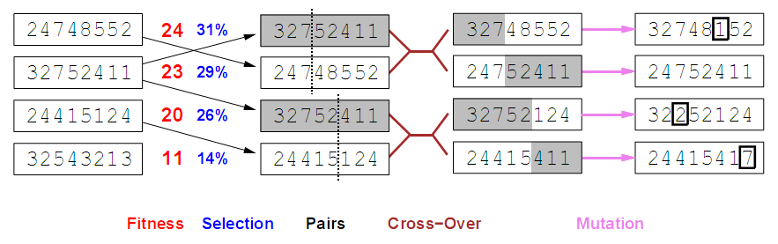
Genetic algorithms
Fitness function: number of non-attacking pairs of queens (min = 0, max = 8 × 7/2 = 28)
24/(24+23+20+11) = 31%
23/(24+23+20+11) = 29% etc

Slide 43
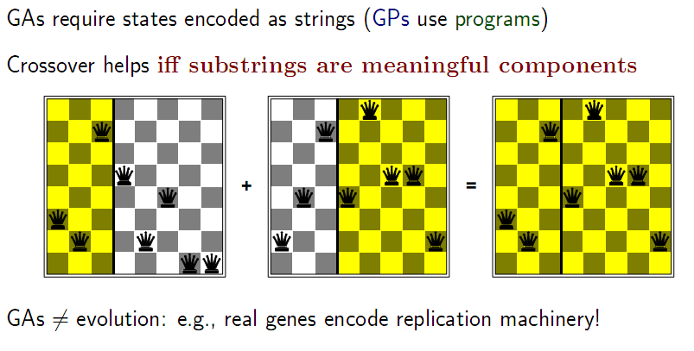
Genetic algorithms (Contd.)

Slide 44
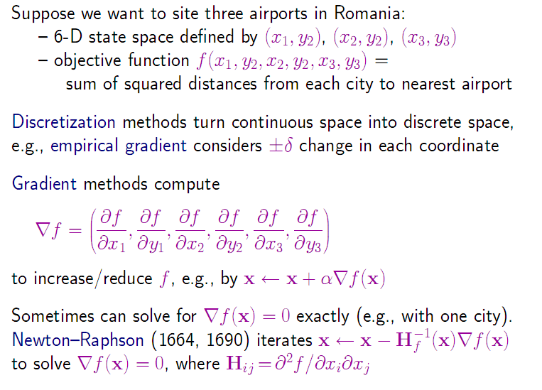
Continuous state spaces

