Slide 1
Artificial intelligence
Autumn 2008
Instructor: Wang Xiaolong
Harbin Institute of Technology, Shenzhen Graduate School
Intelligent Computation Research Center
(HITSGS ICRC)

Slide 2
V. Constraint Satisfaction Problems
Autumn 2008
Instructor: Wang Xiaolong
Harbin Institute of Technology, Shenzhen Graduate School
Intelligent Computation Research Center
(HITSGS ICRC)

Slide 3
Outline
Constraint Satisfaction Problems (CSP)
Backtracking search for CSPs
Problem structure and problem decomposition
Local search for CSPs

Slide 4
Constraint satisfaction problems (CSPs)
Standard search problem:
  state is a "black box“ – any data structure that supports successor function, heuristic function, and goal test
CSP:
  state is defined by variables X_{i} with values from domain D_{i}
  goal test is a set of constraints specifying allowable combinations of values for subsets of variables
Simple example of a formal representation language
Allows useful general-purpose algorithms with more power than standard search algorithms

Slide 5
A Logic Puzzle
Consider the following logic puzzle: In five houses, each with a different color, live 5 persons of different nationalities, each of whom prefer a different brand of cigarette, a different drink, and a different pet.
  The Englishman lives in the red house.
  The Portuguese owns the dog.
  The Norwegian lives in the first house on the left.
  Marlboro are smoked in the yellow house.
  The man who smokes Chesterfields lives in the house next to the man with the fox.
  The Norwegian lives next to the blue house.
  The Barclay smoker owns a rabbit.
  The Lucky Strike smoker drinks orange juice.
  The Russian drinks tea.
  The Chinese smokes Parisienne.
  Marlboro are smoked in the house next to the house where the horse is kept.
  Coffee is drunk in the green house.
  The Green house is immediately to the right (your right) of the white house.
  Milk is drunk immediately to the right (your right) of the yellow house.
Question: Who has a fish, where does the zebra live, and in which house do they drink water?

Slide 6

Example: Map-Coloring
Variables WA, NT, Q, NSW, V, SA, T
Domains D_{i} = {red,green,blue}
Constraints: adjacent regions must have different colors
e.g., WA ≠ NT(if the language allows this), or
(WA,NT) ∈ {(red,green),(red,blue),(green,red), (green,blue),(blue,red),(blue,green)}

Slide 7

Example: Map-Coloring
Solutions are complete and consistent assignments, e.g.,
WA = red, NT = green,Q = red,NSW = green,V = red,SA = blue,T = green

Slide 8

Constraint graph
Binary CSP: each constraint relates two variables
Constraint graph: nodes are variables, arcs are constraints
General-purpose CSP algorithms use the graph structure to speed up search. E.g., Tasmania is an independent subproblem!

Slide 9
Varieties of CSPs
Discrete variables
  finite domains:
    n variables, domain size d → O(d^{n}) complete assignments
    e.g., Boolean CSPs, incl. Boolean satisfiability (NP-complete)
  infinite domains:
    integers, strings, etc.
    e.g., job scheduling, variables are start/end days for each job
    need a constraint language, e.g., StartJob1 + 5 ≤ StartJob3
    linear constraints solvable, nonlinear undecidable
Continuous variables
  e.g., start/end times for Hubble Space Telescope observations
  linear constraints solvable in polynomial time by linear programming methods

Slide 10
Varieties of constraints
Unary constraints involve a single variable,
  e.g., SA ≠ green
Binary constraints involve pairs of variables,
  e.g., SA ≠ WA
Higher-order constraints involve 3 or more variables,
  e.g., cryptarithmetic column constraints
Preferences (soft constraints), e.g., red is better than green often representable by a cost for each variable assignment
    → constrained optimization problems

Slide 11
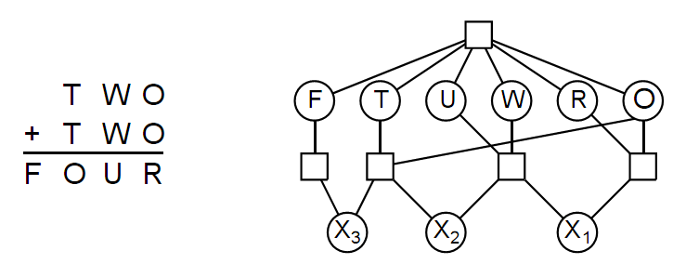
Example: Cryptarithmetic
Variables: F T U W R O X₁ X₂ X₃
Domains: {0,1,2,3,4,5,6,7,8,9 }
Constraints:
  alldiff (F,T,U,W,R,O)
  O + O = R + 10 · X₁
  X₁ + W + W = U + 10 · X₂
  X₂ + T + T = O + 10 · X₃
  X₃ = F, T ≠ 0, F ≠ 0

Slide 12
Real-world CSPs
Assignment problems
  e.g., who teaches what class
Timetabling problems
  e.g., which class is offered when and where?
Hardware configuration
Spreadsheets
Transportation scheduling
Factory scheduling
Notice that many real-world problems involve real-valued variables

Slide 13


Standard search formulation (incremental)
Let's start with the straightforward approach, then fix it
States are defined by the values assigned so far
Initial state: the empty assignment { }
Successor function: assign a value to an unassigned variable that does not conflict with current assignment
  → fail if no legal assignments
Goal test: the current assignment is complete
This is the same for all CSPs!
Every solution appears at depth n with n variables
→ use depth-first search
Path is irrelevant, so can also use complete-state formulation
b = (n - l )d at depth l, hence n!d^{n} leaves!!!!

Slide 14
Backtracking search
Variable assignments are commutative}, i.e.,
[ WA = red then NT = green ] same as [ NT = green then WA = red ]
Only need to consider assignments to a single variable at each node
  → b = d and there are d^{n} leaves
Depth-first search for CSPs with single-variable assignments is called backtracking search
Backtracking search is the basic uninformed algorithm for CSPs
Can solve n-queens for n ≈ 25

Slide 15
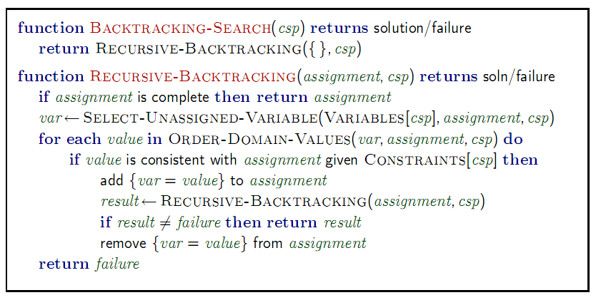
Backtracking search

Slide 16

Backtracking example

Slide 17

Backtracking example

Slide 18

Backtracking example

Slide 19

Backtracking example

Slide 20
Improving backtracking efficiency
General-purpose methods can give huge gains in speed:
  Which variable should be assigned next?
  In what order should its values be tried?
  Can we detect inevitable failure early?
  Can we take advantage of problem structure?

Slide 21

Most constrained variable
Most constrained variable:
choose the variable with the fewest legal values
a.k.a. minimum remaining values (MRV) heuristic

Slide 22

Most constraining variable
Tie-breaker among most constrained variables
Most constraining variable:
  choose the variable with the most constraints on remaining variables

Slide 23
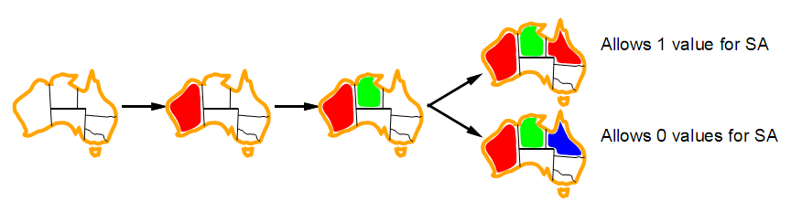
Least constraining value
Given a variable, choose the least constraining value:
  the one that rules out the fewest values in the remaining variables
Combining these heuristics makes 1000 queens feasible

Slide 24
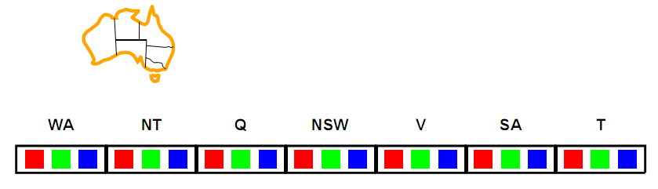
Forward checking
Idea:
  Keep track of remaining legal values for unassigned variables
  Terminate search when any variable has no legal values

Slide 25
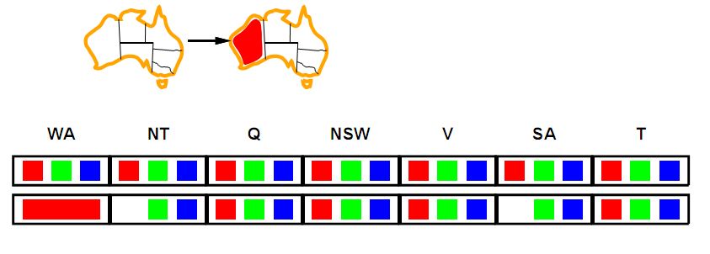
Forward checking
Idea:
  Keep track of remaining legal values for unassigned variables
  Terminate search when any variable has no legal values

Slide 26
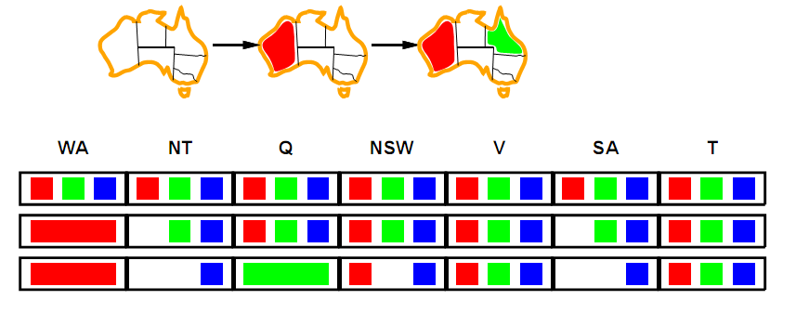
Forward checking
Idea:
  Keep track of remaining legal values for unassigned variables
  Terminate search when any variable has no legal values

Slide 27
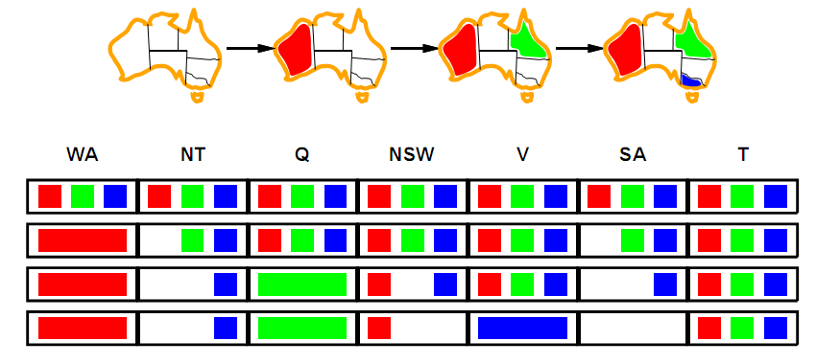
Forward checking
Idea:
  Keep track of remaining legal values for unassigned variables
  Terminate search when any variable has no legal values

Slide 28
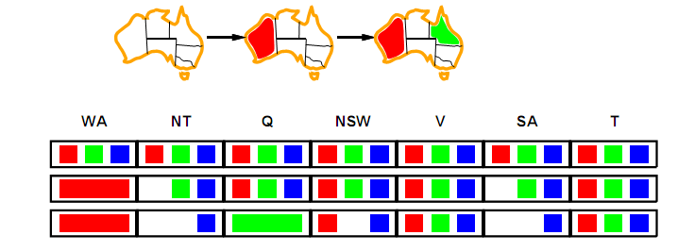
Constraint propagation
Forward checking propagates information from assigned to unassigned variables, but doesn't provide early detection for all failures:
NT and SA cannot both be blue!
Constraint propagation repeatedly enforces constraints locally

Slide 29
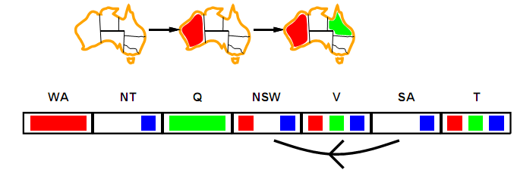
Arc consistency
Simplest form of propagation makes each arc consistent
X →Y is consistent iff
  for every value x of X there is some allowed y

Slide 30
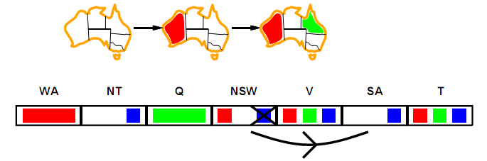
Arc consistency
Simplest form of propagation makes each arc consistent
X →Y is consistent iff
  for every value x of X there is some allowed y

Slide 31
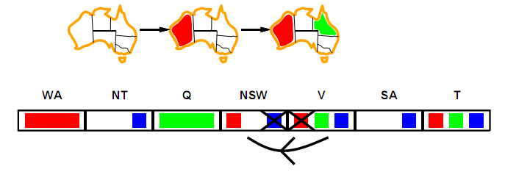
Arc consistency
Simplest form of propagation makes each arc consistent
X →Y is consistent iff
  for every value x of X there is some allowed y
If X loses a value, neighbors of X need to be rechecked

Slide 32
Arc consistency
Simplest form of propagation makes each arc consistent
X →Y is consistent iff
  for every value x of X there is some allowed y
If X loses a value, neighbors of X need to be rechecked
Arc consistency detects failure earlier than forward checking
Can be run as a preprocessor or after each assignment

Slide 33
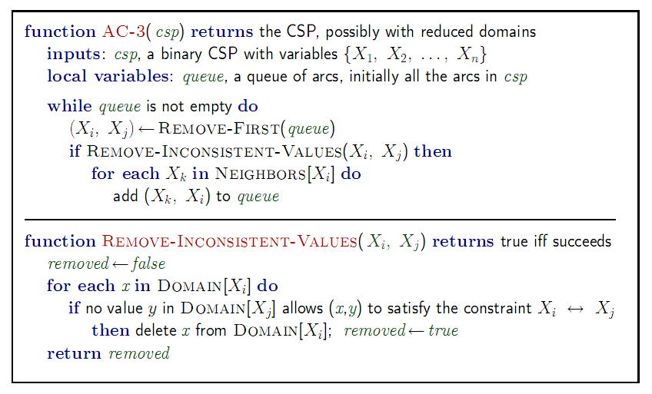
Arc consistency algorithm AC-3
Time complexity: O(n²d³), can be reduced to O(n²d²) (but detecting all is NP-hard)

Slide 34
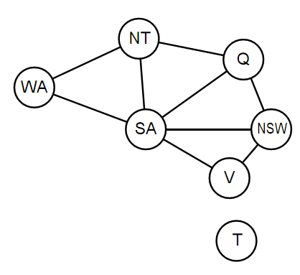
Problem Structure
Tasmania and mainland are independent subproblems
Identifiable as connected components of constraint graph

Slide 35

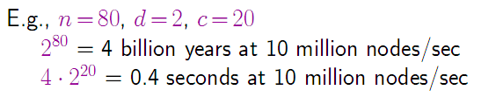
Problem Structure (Contd.)
Suppose each subproblem has c variables out of n total
Worst-case solution cost is , linear in n

Slide 36
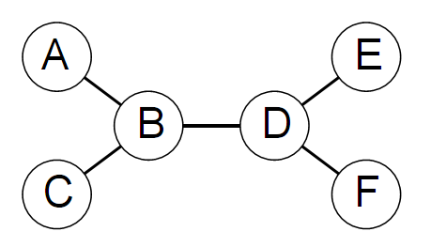
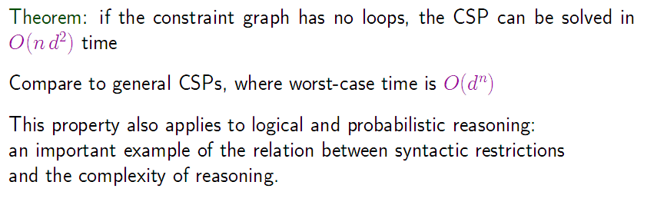
Tree-structured CSPs

Slide 37
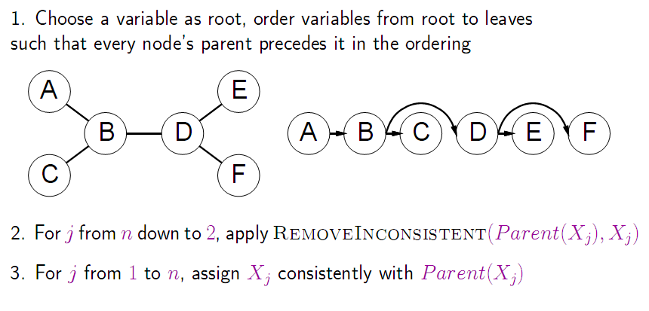
Algorithm for tree-structured CSPs

Slide 38
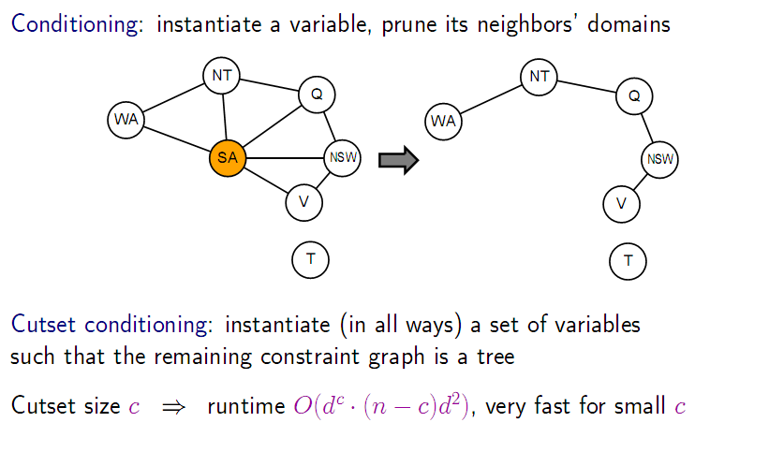
Nearly tree-structured CSPs

Slide 39
Local search for CSPs
Hill-climbing, simulated annealing typically work with "complete" states, i.e., all variables assigned
To apply to CSPs:
  allow states with unsatisfied constraints
  operators reassign variable values
Variable selection: randomly select any conflicted variable
Value selection by min-conflicts heuristic:
  choose value that violates the fewest constraints
  i.e., hill-climb with h(n) = total number of violated constraints

Slide 40
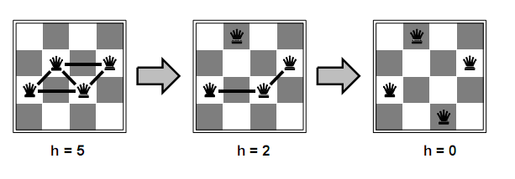
Example: 4-Queens
States: 4 queens in 4 columns (4⁴ = 256 states)
Actions: move queen in column
Goal test: no attacks
Evaluation: h(n) = number of attacks
Given random initial state, can solve n-queens in almost constant time for arbitrary n with high probability (e.g., n = 10,000,000)

Slide 41
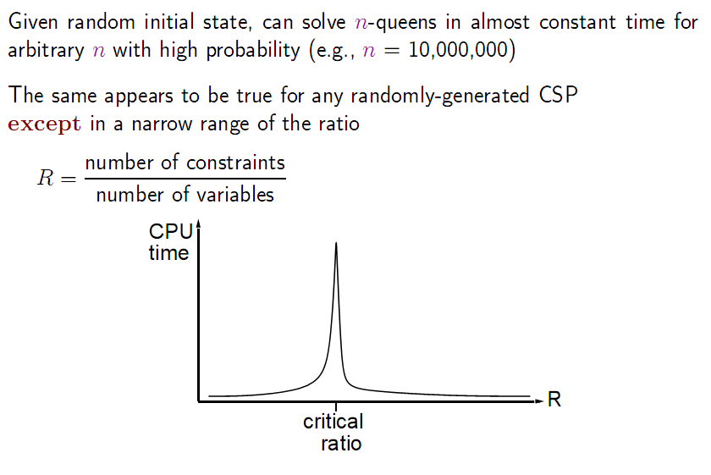
Performance of min-conflicts

Slide 42
Summary
CSPs are a special kind of problem:
  states defined by values of a fixed set of variables
  goal test defined by constraints on variable values
Backtracking = depth-first search with one variable assigned per node
Variable ordering and value selection heuristics help significantly
Forward checking prevents assignments that guarantee later failure
Constraint propagation (e.g., arc consistency) does additional work to constrain values and detect inconsistencies
The CSP representation allows analysis of problem structure
Tree-structured CSPs can be solved in linear time
Iterative min-conflicts is usually effective in practice

Slide 43
Homework
5-4(*)
5-7(*)
5-10
5.6

