Slide 1
Artificial intelligence
Autumn 2008
Instructor: Wang Xiaolong
Harbin Institute of Technology, Shenzhen Graduate School
Intelligent Computation Research Center
(HITSGS ICRC)

Slide 2
VI. Adversary Search
Autumn 2008
Instructor: Wang Xiaolong
Harbin Institute of Technology, Shenzhen Graduate School
Intelligent Computation Research Center
(HITSGS ICRC)

Slide 3
Outline
What is game? Why we study it?
Games as search problems---search techniques
Advanced search techniques（More）
Deep Blue---A typical case
Introductions to some games
Game : the state of art
New problems arise，new techniques developed
SiGuo (Junqi) --- our considerations

Slide 4
What & Why
Games are a form of multi-agent environment
  What do other agents do and how do they affect our success?
  Cooperative vs. competitive
  Competitive multi-agent environments give rise to adversarial search a.k.a. games
Why study games?
  Fun; historically entertaining
  Interesting subject of study because they are hard
  Easy to represent and agents restricted to small number of actions

Slide 5
Relation of Games to Search
Search – no adversary
  Solution is (heuristic) method for finding goal
  Heuristics and CSP techniques can find optimal solution
  Evaluation function: estimate of cost from start to goal through given node
  Examples: path planning, scheduling activities
Games – adversary
  Solution is strategy (strategy specifies move for every possible opponent reply).
  Time limits force an approximate solution
  Evaluation function: evaluate “goodness” of
  game position
  Examples: chess, checkers, Othello, backgammon

Slide 6
Meaning of Games
The ‘Game’ in common use
The ‘Game’ in Game Theory
The ‘Game’ with the same meaning of Gamble
So if one claims he has the view that “Life is game”, he could be：
  A hedonist
  A sage
  A opportunist
Notes:
我们会注意到1.博弈中的Game来源于

Slide 7
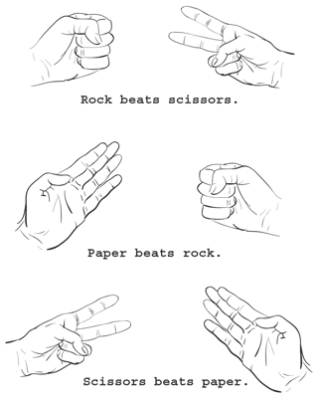
General Games
Games go with us since we are very young. Besides the joy it brings us, it trains us too.
Many games have their sense in everyday life.
Some are designed for gamble.

Slide 8
‘Game’ in Game Theory
Initially, von Neumann and Morganstern
  Zero-sum games
    von Neumann, J. & Morganstern, O. (1944). The Theory of Games and Economic Behaviour. Princeton: Princeton University Press.
John Nash
  Nonzero-sum
    Nash, J. (1950). Equilibrium points in N-person games. Proceedings of the National Academy of Sciences 36: 48 - 49.
Harsanyi, Selten
  Incomplete information
    J. Harsanyi [1967-8], "Games with Incomplete Information Played by Bayesian Players," Management Science, 14, 159-82,320-34, 486-502
Game theory is the general theory of strategic behavior.
  Generally depicted in mathematical form.
  Game Theory is a theory of decision-making
  Plays an important role in modern economics. Game theory spread from math and economics to sociology, political science, and business

Slide 9
Game Normal form
Normal form of game
  Players I = {i = 1,2,3...,n}
  Strategy S = {S1, S2, S3, ..., Sn}
  Payoff U = {U1, U2, U3, ..., Un}
  G = {I,S,U}
    Ui : S→R

Slide 10
Game Tree (Extensive Form)
A game tree has a set of nodes and a set of edges
There is a special node x₀ called the root of the tree which is the beginning of the game
Any node other than the root has a unique predecessor.
Any node that has no successor is called a terminal node which is a possible end of the game
Any node other than a terminal node represents some player.
A path from the root to a terminal node represents a complete sequence of moves which determines the payoff at the terminal node
a path from x₀ to x₄
x₀
a node
x₁
x₂
x₃
x₄
x₅
x₆
x₇
x₈
an edge connecting nodes x₁ and x₅

Slide 11
Types of Game
single-player | multi-player(two-player)
zero-sum | non-zero-sum
deterministic | non-deterministic
perfect information | imperfect information
Notes:
博弈还分为静态的和动态的两种，但是我们玩的棋牌类游戏大多是动态的。

Slide 12
Types of game
 | Deterministic | Chance
Perfect information | Chess, checkers, go, othello | Backgammon, monopoly
Imperfect information | Stratego JunQi | Bridge, poker, scrabble, nuclear war

Slide 13
Game-Playing and AI
Game-playing is a good problem for AI research:
  all the information is available (easy and clear game rules)
    i.e., human and computer have equal information
  game-playing is non-trivial
    need to display “human-like” intelligence
    some games (such as chess) are very complex
    requires decision-making within a time-limit
      more realistic than other search problems
  games are played in a controlled environment
    can do experiments, repeat games, etc: good for evaluating research systems
  can compare humans and computers directly
    can evaluate percentage of wins/losses to quantify performance

Slide 14
Games and Computers
some games are amenable to computer treatment
  mostly mental activities
  well-formulated rules and operators
  accessible state
others are not
  emphasis on physical activities
  rules and operators open to interpretation
    need for referees, mitigation procedures
  state not (easily or fully) accessible
Notes:
结合Turing 测试， physical的可能对计算机来说不是那么“合适” ， 博弈测试比Turing测试更加适合计算机。
当然这要求博弈的因素 要包含更广泛的推理

Slide 15
3 meanings of the word “Game”
Game theory : man and their contributions
Two forms of game
Types of game
What kind of game is more fit for computer to deal with

Slide 16
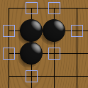
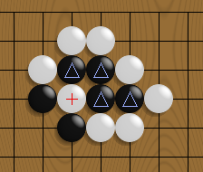
Games as search problem
Search techniques

Slide 17
Problem Formulation
Initial state
  Initial board position, player to move
Successor function
  Returns list of (move, state) pairs, one per legal move
Terminal test
  Determines when the game is over
Utility function
  Numeric value for terminal states
  E.g. Chess +1, -1, 0
  E.g. Backgammon +192 to -192

Slide 18
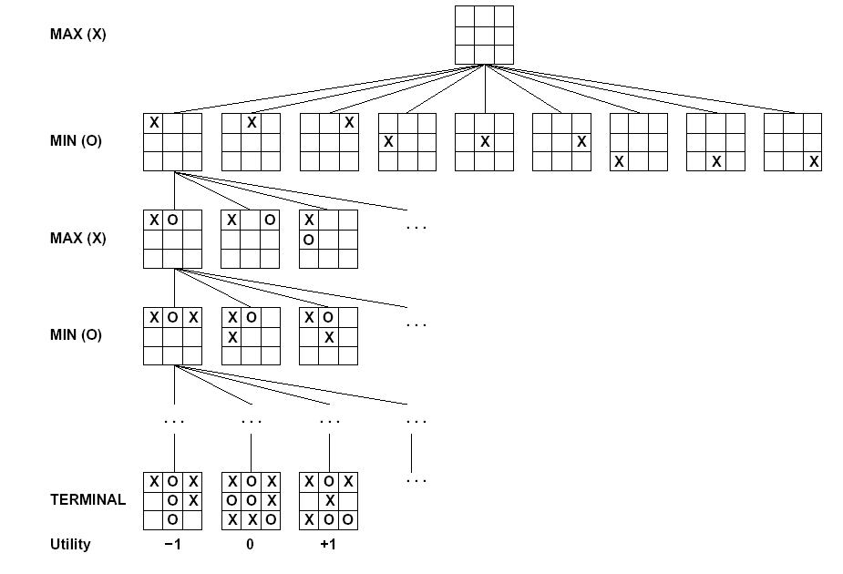
Partial Game Tree for Tic-Tac-Toe

Slide 19
Single-Person Game
conventional search problem
  identify a sequence of moves that leads to a winning state
  examples: Solitaire, dragons and dungeons
  little attention in AI
  Not adversary search

Slide 20
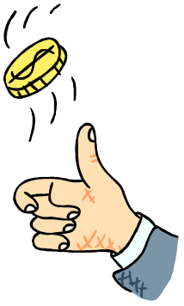
Contingency Problem
uncertainty due to the moves and motivations of the opponent
  tries to make the game as difficult as possible for you
  different from contingency due to neutral factors
    chance
    outside influence

Slide 21
General Search Algorithm
Initialize the search tree using the initial state of problem
Loop:
  If there are no candidates for expansion, return failure
  Choose a leaf node for expansion according to strategy
  If the node contains a goal state, return the corresponding solution
  Else expand the node and add the resulting nodes to the search tree

Slide 22
Search Strategies
Brute-force, uninformed, or blind search
  Depth-First search
  Breadth-First search
Heuristic, informed, or directed search
  Best-First Search Algorithm
  Greedy Search
  Uniform Cost Search
  A* Search
Optimal search
Complete search
Complexity
  Time
  Space

Slide 23
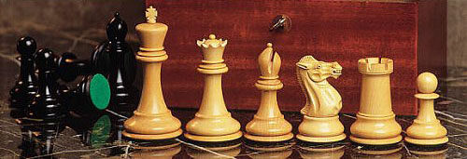
Two-Person Game
(Adversarial search)
In games with two players
  often called MIN and MAX
  usually MAX moves first, then they take turns
MAX must find a strategy to find a winning state
  no matter what MIN does
MIN does the same
  or at least tries to prevent MAX from winning

Slide 24
Most popular games
We’ll initially consider special kinds of games
  Deterministic
  Two-player
  Zero-sum
  Perfect information
Some kinds of games
  Chess, checkers, tic-tac-toe, etc.

Slide 25
Minimax Strategy
Optimal strategy for MAX
  generate the whole game tree
  calculate the value of each terminal state
    based on the utility function
  calculate the utilities of the higher-level nodes
    starting from the leaf nodes up to the root
  MAX selects the value with the highest node
  MAX assumes that MIN in its move will select
  the node that minimizes the value

Slide 26
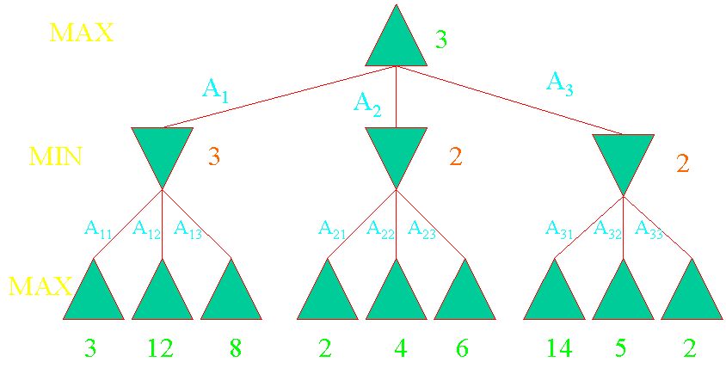
Strategy: The Minimax Algorithm
Figure 5.2 from Artificial Intelligence: A Modern Approach, Russell, Stuart and Peter Norvig, Page 125

Slide 27
What if MIN does not play optimally?
Definition of optimal play for MAX assumes MIN plays optimally: maximizes worst-case outcome for MAX.
But if MIN does not play optimally, MAX can do even better.

Slide 28
Minimax Algorithm
function MINIMAX-DECISION(state) returns an action
inputs: state, current state in game
v←MAX-VALUE(state)
return the action in SUCCESSORS(state) with value v
function MAX-VALUE(state) returns a utility value
if TERMINAL-TEST(state) then return UTILITY(state)
v ← ∞
for a,s in SUCCESSORS(state) do
v ← MAX(v,MIN-VALUE(s))
return v
function MIN-VALUE(state) returns a utility value
if TERMINAL-TEST(state) then return UTILITY(state)
v ← ∞
for a,s in SUCCESSORS(state) do
v ← MIN(v,MAX-VALUE(s))
return v

Slide 29
Properties of Minimax
Criterion | Minimax
Complete?
Optimal?
Time
Space
yes, ☺
in theory…
yes, ☺
O(b^{m}), ☹
O(bm), ☺

Slide 30
Problem of minimax search
Number of games states is exponential to the number of moves.
  Solution: Do not examine every node
  ==> Alpha-beta pruning
    Remove branches that do not influence final decision

Slide 31
Pruning
Discards parts of the search tree
  guaranteed not to contain good moves
  high likelihood that the solution is not in the branch or subtree
Results in substantial time and space savings
  the leftover part of the task may still be exponential, however

Slide 32
The Alpha-Beta Procedure
Example:
max
min
max
min

Slide 33
The Alpha-Beta Procedure
Example:
max
min
max
β = 4
min
4

Slide 34
The Alpha-Beta Procedure
Example:
max
min
max
β = 4
min
4
5

Slide 35
The Alpha-Beta Procedure
Example:
max
min
α = 3
max
β = 3
min
4
5
3

Slide 36
The Alpha-Beta Procedure
Example:
max
min
α = 3
max
β = 3
β = 1
min
4
5
3
1

Slide 37
The Alpha-Beta Procedure
Example:
max
β = 3
min
α = 3
max
β = 3
β = 1
β = 6
min
4
5
3
1
8
6

Slide 38
The Alpha-Beta Procedure
Example:
max
β = 3
min
α = 3
α = 6
max
β = 3
β = 1
β = 6
min
4
5
3
1
8
6
7

Slide 39
The Alpha-Beta Procedure
Example:
α = 3
max
β = 3
min
α = 3
α = 6
max
β = 3
β = 1
β = 6
min
4
5
3
1
8
6
7

Slide 40
The Alpha-Beta Procedure
Example:
α = 3
max
β = 3
min
α = 3
α = 6
max
β = 3
β = 1
β = 6
β = 2
min
4
5
3
1
8
6
7
2

Slide 41
The Alpha-Beta Procedure
Example:
α = 3
max
β = 3
min
α = 3
α = 6
α = 3
max
β = 3
β = 1
β = 6
β = 2
min
4
5
3
1
8
6
7
2

Slide 42
The Alpha-Beta Procedure
Example:
α = 3
max
β = 3
min
α = 3
α = 6
α = 3
max
β = 3
β = 1
β = 6
β = 2
β = 5
min
4
5
3
1
8
6
7
2
5

Slide 43
The Alpha-Beta Procedure
Example:
α = 3
max
β = 3
min
α = 3
α = 6
α = 3
max
β = 3
β = 1
β = 6
β = 2
β = 4
min
4
5
3
1
8
6
7
2
5
4

Slide 44
The Alpha-Beta Procedure
Example:
α = 3
max
β = 3
β = 4
min
α = 3
α = 6
α = 4
max
β = 3
β = 1
β = 6
β = 2
β = 4
min
4
5
3
1
8
6
7
2
5
4
4

Slide 45
The Alpha-Beta Procedure
Example:
α = 3
max
β = 3
β = 4
min
α = 3
α = 6
α = 4
max
β = 3
β = 1
β = 6
β = 2
β = 4
β = 6
min
4
5
3
1
8
6
7
2
5
4
4
6

Slide 46
The Alpha-Beta Procedure
Example:
α = 3
max
β = 3
β = 4
min
α = 3
α = 6
α = 4
max
β = 3
β = 1
β = 6
β = 2
β = 4
β = 6
min
4
5
3
1
8
6
7
2
5
4
4
6
7

Slide 47
The Alpha-Beta Procedure
Example:
α = 4
max
β = 3
β = 4
min
α = 3
α = 6
α = 4
α = 6
max
β = 3
β = 1
β = 6
β = 2
β = 4
β = 6
min
4
5
3
1
8
6
7
2
5
4
4
6
7
7

Slide 48
The Alpha-Beta Procedure
Example:
α = 4
max
Done!
β = 3
β = 4
min
α = 3
α = 6
α = 4
α = 6
max
β = 3
β = 1
β = 6
β = 2
β = 4
β = 6
min
4
5
3
1
8
6
7
2
5
4
4
6
7
7

Slide 49
Alpha-Beta Algorithm
function ALPHA-BETA-SEARCH(state) returns an action
inputs: state, current state in game
v←MAX-VALUE(state, - ∞ , +∞)
return the action in SUCCESSORS(state) with value v
function MAX-VALUE(state,α , β) returns a utility value
if TERMINAL-TEST(state) then return UTILITY(state)
v ← - ∞
for a,s in SUCCESSORS(state) do
v ← MAX(v,MIN-VALUE(s, α , β))
if v ≥ β then return v
α ← MAX(α ,v)
return v

Slide 50
Alpha-Beta Algorithm
function MIN-VALUE(state, α , β) returns a utility value
if TERMINAL-TEST(state) then return UTILITY(state)
v ← + ∞
for a,s in SUCCESSORS(state) do
v ← MIN(v,MAX-VALUE(s, α , β))
if v ≤ α then return v
β ← MIN(β ,v)
return v

Slide 51
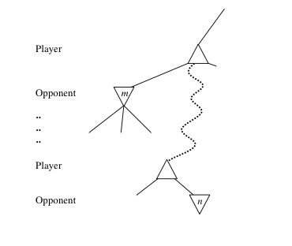
General alpha-beta pruning
Consider a node n somewhere in the tree
If player has a better choice at
  Parent node of n
  Or any choice point further up
n will never be reached in actual play.
Hence when enough is known about n, it can be pruned.

Slide 52
Comments: Alpha-Beta Pruning
Pruning does not affect final results
Entire subtrees can be pruned.
Good move ordering improves effectiveness of pruning
With “perfect ordering,” time complexity is O(b^{m/2})
  Branching factor of sqrt(b) !!
  Alpha-beta pruning can look twice as far as minimax in the same amount of time

Slide 53
Imperfect Real-time Decisions
In general the search tree is too big to make it possible to reach the terminal states!
Examples:
Checkers: ~10⁴⁰ nodes
Chess: ~10¹²⁰ nodes
SHANNON (1950):
  Cut off search earlier (replace TERMINAL-TEST by CUTOFF-TEST)
  Apply heuristic evaluation function EVAL (replacing utility function of alpha-beta)

Slide 54
Cutting off search
Change:
  if TERMINAL-TEST(state) then return UTILITY(state)
into
  if CUTOFF-TEST(state,depth) then return EVAL(state)
Introduces a fixed-depth limit depth
  Is selected so that the amount of time will not exceed what the rules of the game allow.
When cuttoff occurs, the evaluation is performed.

Slide 55
Utility function
A utility function is some numeric representation of a games outcome.
It is only applied to leaves of a tree (terminal states).
Some games we can look at this very simply. (+1 for win, 0 for draw, -1 for loss)
    Backgammon for instance could have payoffs (outcomes) in the range of -192 to 192.
It is the property of the game itself. Some are zero-sum, some are nonzero-sum.

Slide 56
Evaluation function
Evaluation function or static evaluator is used to evaluate the “goodness” of a game position.
  Contrast with heuristic search where the evaluation function was a non-negative estimate of the cost from the start node to a goal and passing through the given node
The zero-sum assumption allows us to use a single evaluation function to describe the goodness of a board with respect to both players.
  f(n) >> 0: position n good for me and bad for you
  f(n) << 0: position n bad for me and good for you
  f(n) near 0: position n is a neutral position
  f(n) = +infinity: win for me
  f(n) = -infinity: win for you

Slide 57
Evaluation Functions
Restrictions are placed on Evaluation functions:
  It must agree with the utility function on terminal states (states which are end-points in the game).
  It must adhere to certain time constraints with limited complexity. This provides a trade-off between accuracy and time-cost.
  The evaluation function should accurately reflect winning chances.
  Essentially, the evaluation function should reflect the chance that a position chosen at random will result in a terminal state from past experience.

Slide 58
Evaluation Functions
The Material advantage evaluation function assumes that values on certain game components can be judged independently from other game pieces.
This function is called a weighted linear function and can be expressed as:
  w₁ * f₁ + w₂ * f₂ + … + w_{n} * f_{n}
  wi are the weights, and f’s are the features of the particular position.

Slide 59
Problem Formulation
    Initial state , Successor function , Terminal test , Utility function
Minimax Algorithm
The Alpha-Beta Algorithm
Evaluation function

Slide 60
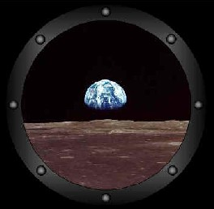
Advanced Search techniques
Variants of Alpha-Beta Search
  Aspiration Search
  NegaScout/ PVS
  MTD(f)
  History(Killer) Heuristic
Transposition (Hash) Table
Iterative Deepening
Quiescence Search
Horizon Problem
Book Moves
Null Move
Singular extensions
Forward pruning

Slide 61
Variants of Alpha-Beta Search
  Although the basic alpha-beta search discussed already is simple and works well, there have been several attempts to search game trees even more efficiently. The basic idea behind most of these is that, if we consider the scores in the range from alpha to beta as being "interesting" and all other scores to be "uninteresting", then alpha-beta gets its efficiency by cutting off the search quickly at nodes with uninteresting scores. If we narrow the gap between alpha and beta, fewer scores will be interesting and more cutoffs will happen.
  NegaScout/ PVS
  MTD(f)
  Aspiration Search
  ......

Slide 62
alpha-beta review
// basic alpha-beta search
int alphabeta(int depth, int alpha, int beta)
{
move bestmove;
if(game over or depth <= 0)
  return winning score or eval();
for (each possible move m) {
make move m;
score = -alphabeta(depth - 1, -beta, -alpha)
if (score >= alpha) { alpha = score; bestmove = m; }
unmake move m;
if (alpha >= beta) break;
}
return alpha;
}

Slide 63
Aspiration Searching
Instead of searching with the full
  (-infinity..+infinity)
  alpha-beta window, we "guess" what the score will be and then apply a small "aspiration window" on either side of the score
Question: Where might we get a reasonable guess?
  Maybe a lower search can give us
We gain by searching with a small window (+/- Window )
We lose if the window needs to be widened
  So, we have a trade off between these two possibilities

Slide 64
Aspiration Searching Algorithm
// aspiration search
int alpha = previous - WINDOW;
int beta = previous + WINDOW;
for (;;) {
score = alphabeta(depth, alpha, beta)
if (score <= alpha) alpha = -WIN;
else if (score >= beta) beta = WIN;
else break;
}

Slide 65
NegaScout/ PVS-
Principal Variation Search
  The idea is that alpha-beta search works best if the first recursive search is likely to be the one with the best score. Techniques such as sorting the move list or using a best move stored in the hash table make it especially likely that the first move is best. If it is, we can search the other moves more quickly by using the assumption that they are not likely to be as good.
  So PVS performs that first search with a normal window, but on subsequent searches uses a zero-width window to test each successive move against the first move. Only if the zero-width search fails does it do a normal search.

Slide 66
NegaScout Algorithm
  C Code
  int NegaScout ( position p; int alpha, beta );
  { /* compute minimax value of position p */
  int a, b, t, i;
  determine successors p_1,...,p_w of p;
  if ( w == 0 )
  return ( Evaluate(p) ); /* leaf node */
  a = alpha;
  b = beta;
  for ( i = 1; i <= w; i++ ) {
  t = -NegaScout ( p_i, -b, -a );
  if (t > a) && (t < beta) && (i > 1) && (d < maxdepth-1)
  a = -NegaScout ( p_i, -beta, -t ); /* re-search */
  a = max( a, t );
  if ( a >= beta )
  return ( a ); /* cut-off */
  b = a + 1; /* set new null window */
  }
  return ( a );
  }

Slide 67
NegaScout/ PVS
  Like AlphaBeta, NegaScout is a directional search algorithm for computing the minimax value of a node.
  NegaScout dominates AlphaBeta: It never examines a node that can be pruned by AlphaBeta.
  Neither does NegaScout dominate SSS* nor vice versa: There exist trees in which NegaScout searches strictly fewer nodes than SSS* and vice versa. On averagely ordered trees, however, the best-first procedure SSS* usually searches less nodes than NegaScout.
  The same applies to DUAL*.
  Formal proofs can be found in: A. Reinefeld. Spielbaum-Suchverfahren. Informatik-Fachbericht 200, Springer-Verlag, Berlin (1989), ISBN 3-540-50742-6

Slide 68
MTD(f)
MTD(f) – Memory Enhanced Test Driver
  Very sophisticated, can be thought of as a “binary search” into the decision tree space by continuously probing state-space with alpha-beta window equal to 1 and adjusting additional parameters accordingly
  DP algorithm by design, requires a hash table
  Works best with good first guess f and well ordered moves

Slide 69
MTD(f) Algorithm
  int alpha = -WIN;
  int beta = +WIN;
  while (beta > alpha+1) {
  int test = (alpha+beta)/2;
  if (alphabeta(depth, test, test+1) <= test) beta = test;
  else alpha = test+1;
  }

Slide 70
SSS*/Dual
Best First Search
Algorithm is complexed in implementation

Slide 71
History Heuristic
Based on the question,
    "In the whole search we've conducted so far, how often have moves with the same to-square and from-square as this move caused a beta-cutoff?“
It turns out that by recording how often moves from any square to any other square have caused beta-cutoffs, we can improve our move-ordering
Reference:
  The History Heuristic and the Performance of Alpha-Beta Enhancements, Jonathan Schaeffer, IEEE Transactions on Pattern Analysis and Machine Intelligence, vol. 11, no. 11, pp. 1203-1212, 1989

Slide 72
Implementing History
We declare an array:
  int history[SQUARES][SQUARES];
Before embarking on a search, we zero this array:
  memset(history, 0, sizeof(history));
  In other words, as far as we know, all moves are equally likely to cause a cutoff
During the search, whenever we get a beta-cutoff, we increment the appropriate entry in the history table:
  history[mv.from][mv.to] += draft;
draft is defined as the difference between ply and depth
  the greater the draft, the more nodes we saved

Slide 73
Problems with History
History is simple to implement, but it can cause problems to existing move-ordering schemes
Specifically, the history values can get very large in deep searches
They quickly come to dominate the values we award for moving forward and capturing
We can't add the history scores to the other scores unless we scale our existing scores
History Heuristic do not rely on the knowledge of specific game

Slide 74
Problems with History
Depending on how we scale the history scores, we might use them to:
  differentiate between two moves to the same rank
  replace the rank scores altogether;
To do either of these we'd have to scale the capture scores so that the score for a capture is greater than any history score
The only way to solve these potential problems is with experimentation

Slide 75
Killer Heuristic
Like a more specific kind of history
  At each ply in the search, if we get a cutoff, we record the move which causes it
  The next time we're searching at this ply, before searching any other moves, we try this killer move to see if it causes a cutoff again
  Normally, we don't accept captures as killers (but you should test this)
Killers are normally better than history
Some implementations use two killers

Slide 76
Transposition(Hash) Table
An advanced technique
Depends on the fact that there may be several ways to reach the same position (of the game)
    a2-a3 h6-h5 b2-b3 e6-e5
    b2-b3 e6-e5 a2-a3 h6-h5
    a2-a3 e6-e5 b2-b3 h6-h5
These variations all lead to the same position

Slide 77
Transposition Tables
X X X X X X X X
X X X X . X X .
. . . . X . . X
. . . . . . . .
. . . . . . . .
O O . . . . . .
. . O O O O O O
O O O O O O O O
O to move
This is the position after the variations shown on the previous slide
It represents a three-ply search from the starting position
Suppose, however, that the position is reached as part of a nine-ply search
  We still have six plies to search
  But we’re going to do that three times
    Actually more than three

Slide 78
Transposition Tables
X X X X X X X X
X X X X . X X .
. . . . X . . X
. . . . . . . .
. . . . . . . .
O O . . . . . .
. . O O O O O O
O O O O O O O O
O to move
Transposition Tables are used to “remember” the results of previous searches
But…
  How many positions are possible in a game?
  We can’t possibly store all of them, can we?
So we use “Hash functions”
  Zobrist
We store information about a subset of positions, favouring stuff about deeper searches

Slide 79
Transposition Tables
Information we store:
  Best move
  Score
  How deep the search was under the node
    The deeper the search, the more useful the information
At the top of the node, we ask,
  Have we searched this node before?
  Was that search deeper than we are searching now?
  What was the score?
  What was the best move?
Fills up => replacement strategies
  Keep positions with greater searched tree depth under them
  Keep positions with more searched nodes under them

Slide 80
Iterative Deepening
  Iterative deepening is an interesting combination of breadth-first and depth-first strategies
  Rather than analyzing a position at an arbitrary Minimax depth of n, analyze iteratively and incrementally at depth 1, 2, 3, …, n
  Then try best move at previous iteration first in next iteration
  Is guaranteed to find the shortest path to a solution without searching unnecessarily deep.
  The idea is to successively apply depth-first searches with increasing depth bounds (maximum search depth).
  Counter-intuitive, but very good in practice!

Slide 81
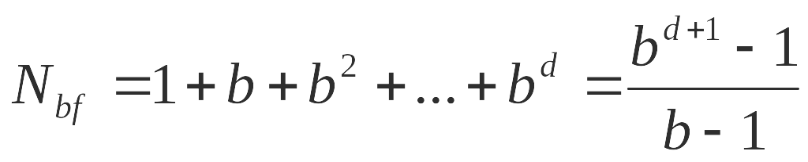
Iterative Deepening
  But it seems that the time complexity of iterative deepening is much higher than that of breadth-first search!
  Well, if we have a branching factor b and the shallowest goal at depth d, then the worst-case number of nodes to be expanded by breadth-first is:

Slide 82
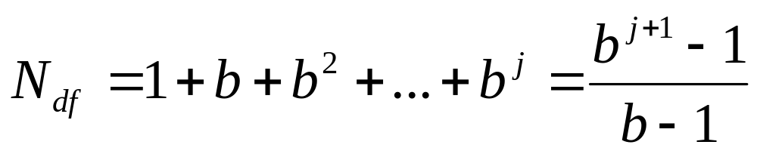
Iterative Deepening
  In order to determine the number of nodes expanded by iterative deepening, we have to look at depth-first search.
  What is the worst-case number of nodes expanded by depth-first search for a branching factor b and a maximum search level j ?

Slide 83
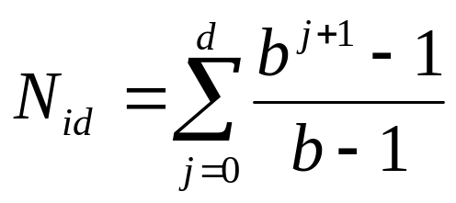
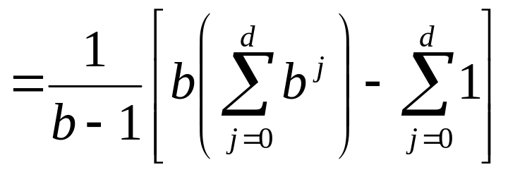
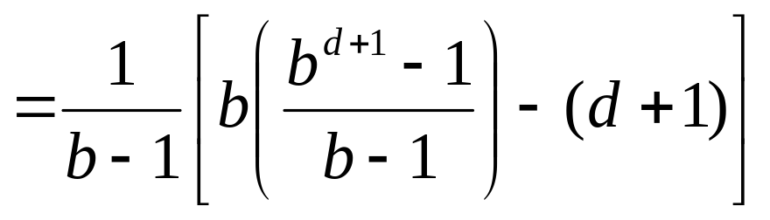
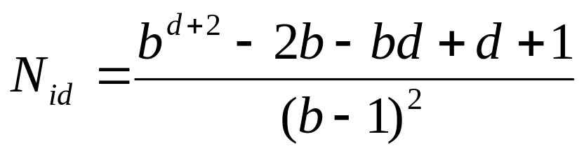
Iterative Deepening
Therefore, the worst-case number of nodes expanded by iterative deepening from depth 0 to depth d is:

Slide 84
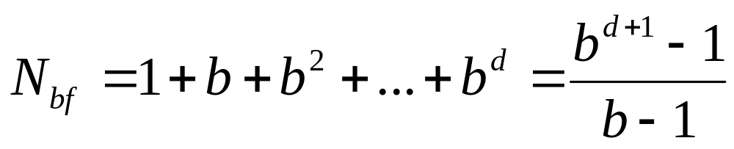
Iterative Deepening
  Let us now compare the numbers for breadth-first search and iterative deepening:
  For large d, you see that N_{id}/N_{bf} approaches b/(b – 1), which in turn approaches 1 for large b.
  So for big trees (large b and d), iterative deepening does not expand many more nodes than does depth-first search (about 11% for b = 10 and large d).

Slide 85
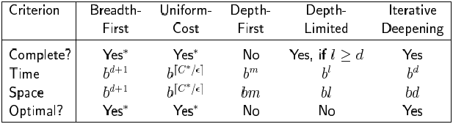
Summary of algorithms

Slide 86
Quiescence
Suppose evaluation function captures only # of each color
  Appears red has advantage
  Ignores fact that black can double jump to win
Only apply eval func in quiescent positions
  A quiescence search normally involves looking for positions where no captures are possible
  If we evaluate in such positions, we are relatively safe from these kinds of errors
  extend the search depth of mini-max with some nodes at the depth limit
  Consider whether a node is likely to exhibit large changes from it’s state
    Pursue that node a little deeper
  E.g. Only apply if black has no jumps

Slide 87
Horizon Problem
Moves may have disastrous consequences in the future, but the consequences are not visible
  the corresponding change in the evaluation function will only become evident at deeper levels
  they are beyond the horizon

Slide 88
Book Moves
Build a database of opening moves, end games, and studied configurations
If the current state is in the database, use database:
  to determine the next move
  to evaluate the board
Otherwise, do alpha-beta search
Only have meaning to the game which its complexity decreases linearly with the step’s increasing. A tip to help search, can not solve the problem

Slide 89
Null-Move Forward Pruning
Null-Move Forward Pruning
  During certain positions in the decision tree let the current player “pass” the move to the other player, perform Minimax algorithm at a reduced look-ahead, then if score returned is still greater than the upper bound it is assumed that if the current player had actually moved then the resulting Minima score would still be greater than the upper bound, so take the beta cutoff immediately
  Results in excellent reduction of nodes expanded in the decision tree

Slide 90
Null Move
Suppose it is my turn and I have a position that is so good that I can let you go instead of me (ie I make a null move) and still have a superior position
Such a position is so obviously so wonderful that we don’t need to search it in detail

Slide 91
Null Move
Before recursively calling AlphaBeta()
  Check if evaluation is positive; if so:
    Make a null move
    Search the position to depth-2 instead of depth
    UnMake the null move
  If the score from the null search is good, just return that
Rules:
  Never make consecutive null moves
  Don’t do it if ply==0

Slide 92
Null Move
Null move is an example of forward pruning
  We prune without full knowledge of the position
  Because we do the null search to (depth-2)
A huge win in chess
  Can gain you two whole plies of depth

Slide 93
Singular extension
Singular extension: If a move is obviously better than the others in a node at horizon h, then expand this node along this move
Singular extension
  Domain independent
  A node is searched deeper if its value is much better than its siblings’
  Even 30-40 ply
  A variant is used by Deep Blue

Slide 94
Forward pruning
Forward pruning
  Prune away branches without any computation
  E.g. symmetric moves

Slide 95
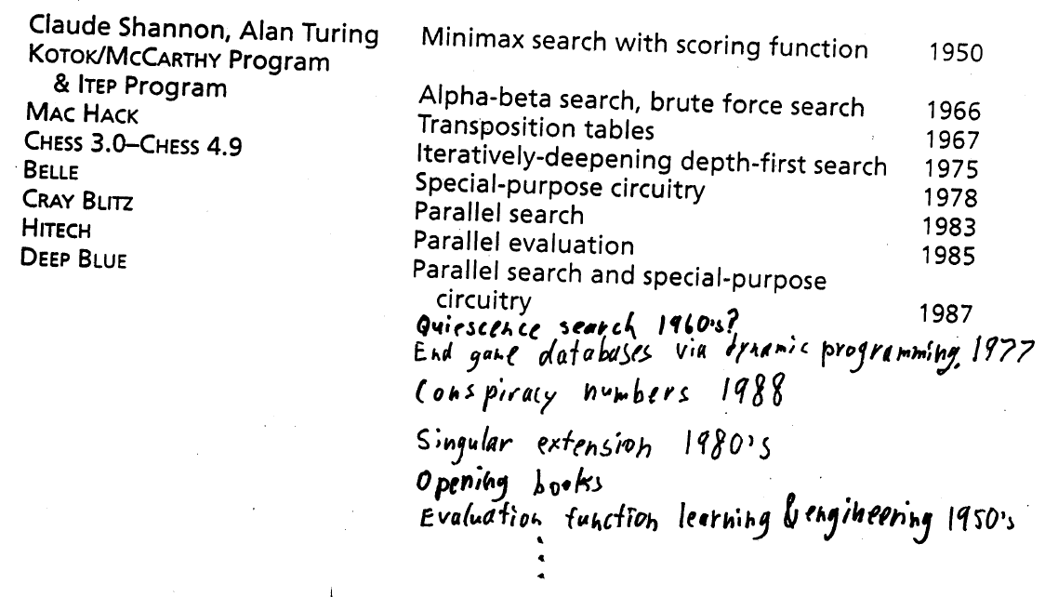
Rich history of cumulative ideas

Slide 96
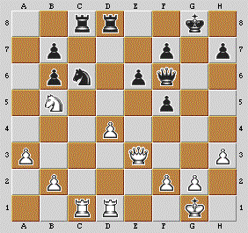
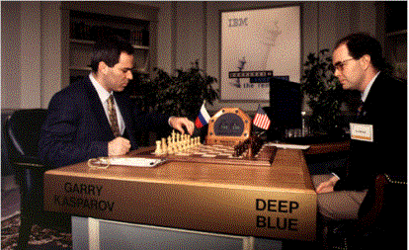
Deep Blues

Slide 97
Brief History
1970s
  Chess 4.5 program; emphasis on hardware speed
1980s
  Belle
    Bell labs; special purpose hardware chess machine
1988-91
  Deep Thought I/II (Hsu)
1996, 1997
  Deep Blue (Hsu/IBM)
  Matches against Garry Kasparov, the World Chess Grandmaster
    Deep Blue wins on 11 May 1997
    Series of 6 games, draw on 3 games; other 3, Deep Blue wins 2:1

Slide 98
The Chess Problem (Hsu, 1999)
To win against the world chess champion under regulation time control
  >= 3 minutes per move
In 1977 a computer first defeated a Grandmaster
  “blitz” game
  Five minutes for the entire game
  “Even world-class Grandmasters have trouble avoiding simple mistakes in fast games” (p. 71, Hsu, 1999)

Slide 99
Deep Blue Hardware
IBM RS/6000 SP supercomputer
  About 510 processors
  Collection of 30 RS/6000 processors
    Connected by a high-speed switching network
  Additional special purpose hardware
    480 chess chips
      40-50 ns cycle time; about 10 cycles per chess position
      Each chess chip can search about 2 million chess positions per second
    Each RS/6000 processor controlled about 16 chess chips

Slide 100
Overall Approach to Problem
“integrate the maximally possible amount of software-modifiable chess knowledge onto … chess chips” (p. 71)
Individually adjustable weights associated with positional features
  In 1997 match with Kasparov, changed weights for positional features between games
  Weight adjustment between games appears to not have been an autonomous feature of program

Slide 101
Move selection strategy: Search tree parallelization
Example: Depth 12 search tree
4 plies: one CPU
Next 4 plies: 30 CPU’s
Next 4 plies: chess chips
30 CPU’s handle less than 1% of the board positions searched
  But, this is about 2/3 of the search depth
Chess chips handle 90% of the board positions

Slide 102
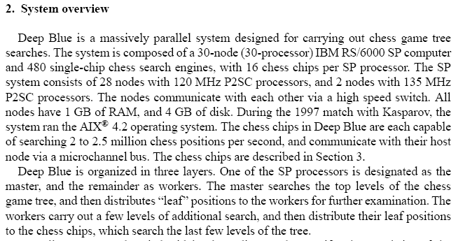

Slide 103
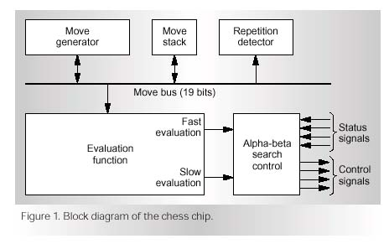
Chess Chip

Slide 104
Chess Chip: Move Generator
(p. 76-78, Hsu, 1999)
8x8 array of combinational logic
  A “silicon chessboard”
Components of each cell in the array
  Find-victim transmitter
  Receiver
  Distributed arbiter
  Piece register: type & color of piece
Move generation
  Find-victim cycle executes: pieces “radiate” attack signals
  Signals reach receivers
  Vote to find highest valued victim

Slide 105
Evaluation function...
Deep Blue used ~6,000 different features in its evaluation function (in hardware)
A different weighting of these features is downloaded to the chips after every real world move (based on current situation on the board)
  Contributed to strong positional play
Acquiring the weights for Deep Blue
  Weight learning based on a database of 900 grand master games (~120 features)
    Alter weight of one feature => 5-6 ply search => if matches better with grand master play, then alter that parameter in the same direction further
    Least-squares with no search
  Other learning is possible, e.g. Tesauro’s Backgammon
    Solves credit assignment problem
    Was confined to linear combination of features
  Manually: Grand master Joel Benjamin played take-back chess. At possible errors, the evaluation was broken down, visualized, and weighting possibly changed
Deep Blue is brute force
Smart search and knowledge
engineered evaluation

Slide 106
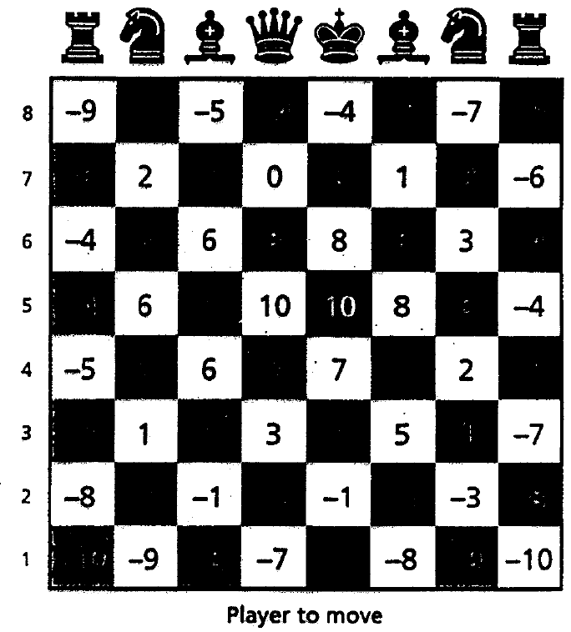
Evaluation function
Difference (between player and opponent) of
  Material
  Mobility
  King position
  Bishop pair
  Rook pair
  Open rook files
  Control of center (piecewise)
  Others
Values of knight’s position in Deep Blue

Slide 107
Deep Blue’s search
~200 million moves / second = 3.6 * 10^10 moves in 3 minutes
  3 min corresponds to
  ~7 plies of uniform depth minimax search
10-14 plies of uniform depth alpha-beta search
1 sec corresponds to 380 years of human thinking time
Software searches first
  Selective and singular extensions
Specialized hardware searches last 5 ply

Slide 108
Kasparov lost to Deep Blue in 1997
Win-loss-draw-draw-draw-loss
  (In even-numbered games, Deep Blue played white)

Slide 109
The game of Chess
First chess AI at 1958 – novice level
Machine strength increasing linearly
1997 – defeat of former world champion, Garry Kasparov, by IBM’s deep blue
Last years – performance still increasing
  Mainly Hardware
  Also Software
… The End ?

Slide 110
The game of Chess
…NO!
Deep(er) blue uses extreme brute-force, traversing several millions of boards ps
Very little generalization
Virtually no human resemblance
Deemed theoretically uninteresting
  Chomsky: As interesting as a weight lifting competition between machine and man
Low A to I ratio; Low return

Slide 111
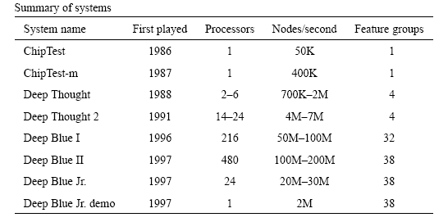
IBM Chess Machines

Slide 112
World Champion Programs of Chess
  KAISSA 1974 Stockholm
  CHESS 1977 Toronto
  BELLE 1980 Linz
  CRAY BLITZ 1983 New York
  CRAY BLITZ 1986 Keulen
  DEEP THOUGHT 1989 Edmonton
  REBEL 1992 Madrid
  FRITZ 1995 Hong Kong
  SHREDDER 1999 Paderborn
  JUNIOR 2002 Maastricht
  SHREDDER 2003 Graz
  ? 2004 Ramat-Gan

Slide 113
Chess Rating Scale
3000
Ratings
2800
2600
Garry Kasparov (current World Champion)
Deep Blue
2400
Deep Thought
2200
2000
1800
1600
1400
1200
1966
1971
1976
1981
1986
1991
1997

Slide 114
Perspective on Games: Con and Pro
Chess is the Drosophila of artificial intelligence. However, computer chess has developed much as genetics might have if the geneticists had concentrated their efforts starting in 1910 on breeding racing Drosophila. We would have some science, but mainly we would have very fast fruit flies.
John McCarthy
Saying Deep Blue doesn’t really think about chess is like saying an airplane doesn't really fly because it doesn't flap its wings.
Drew McDermott

Slide 115
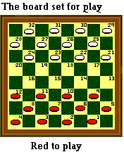
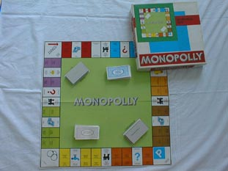
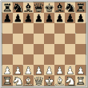
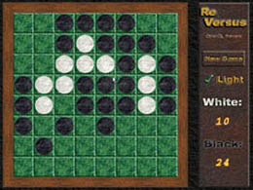
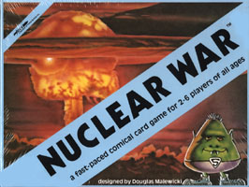
Introduction to games

Slide 116
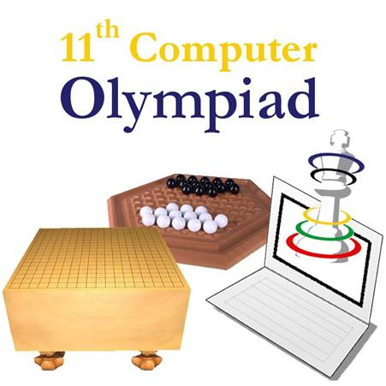
Computer Olympiad
  Initiative of David Levy (1989)
  Goal:
    Finding the best computer program for each game
    Connecting programmers / researchers of different games
  Computers play each other in competition
  Demonstrations:
    Man versus Machine
    Man + Machine versus Man + Machine

Slide 117
Computer Olympiad
  Last time in Turin 2006(11th)
    http://www.cs.unimaas.nl/Olympiad2006/
  Also 14th World Championship Computer Chess and World Championship Backgammon
  80 particpants in several categories
  Competitions in olympiad’s history:
  Abalone, Awari, Amazons, Backgammon, Bao, Bridge, Checkers, Chess, Chinese Chess, Dots and Boxes, Draughts, Gipf, Go-Moku, 19x19 Go, 9x9 Go, Hex, Lines of Action, Poker, Renju, Roshambo, Scrabble, and Shogi

Slide 118
Games in CO’06
Game Olympiad
  Abalone
  Amazons
  Arimaa
  Backgammon
  Bao
  Bridge
  Chinese Chess
  8x8 Checkers
  Clobber
  Connect6
  Diplomacy
  Dominoes
  Dots and Boxes
  10x10 DraughtsComputational Pool
  Gipf
  19x19 Go
  9x9 Go
  Hex
  Kriegspiel
  Lines of Action
  6x7 OCTI
  9x9 OCTI
  Othello
  Poker
  Renju
  Scrabble
  Shogi
http://www.cs.unimaas.nl/Olympiad2006/

Slide 119
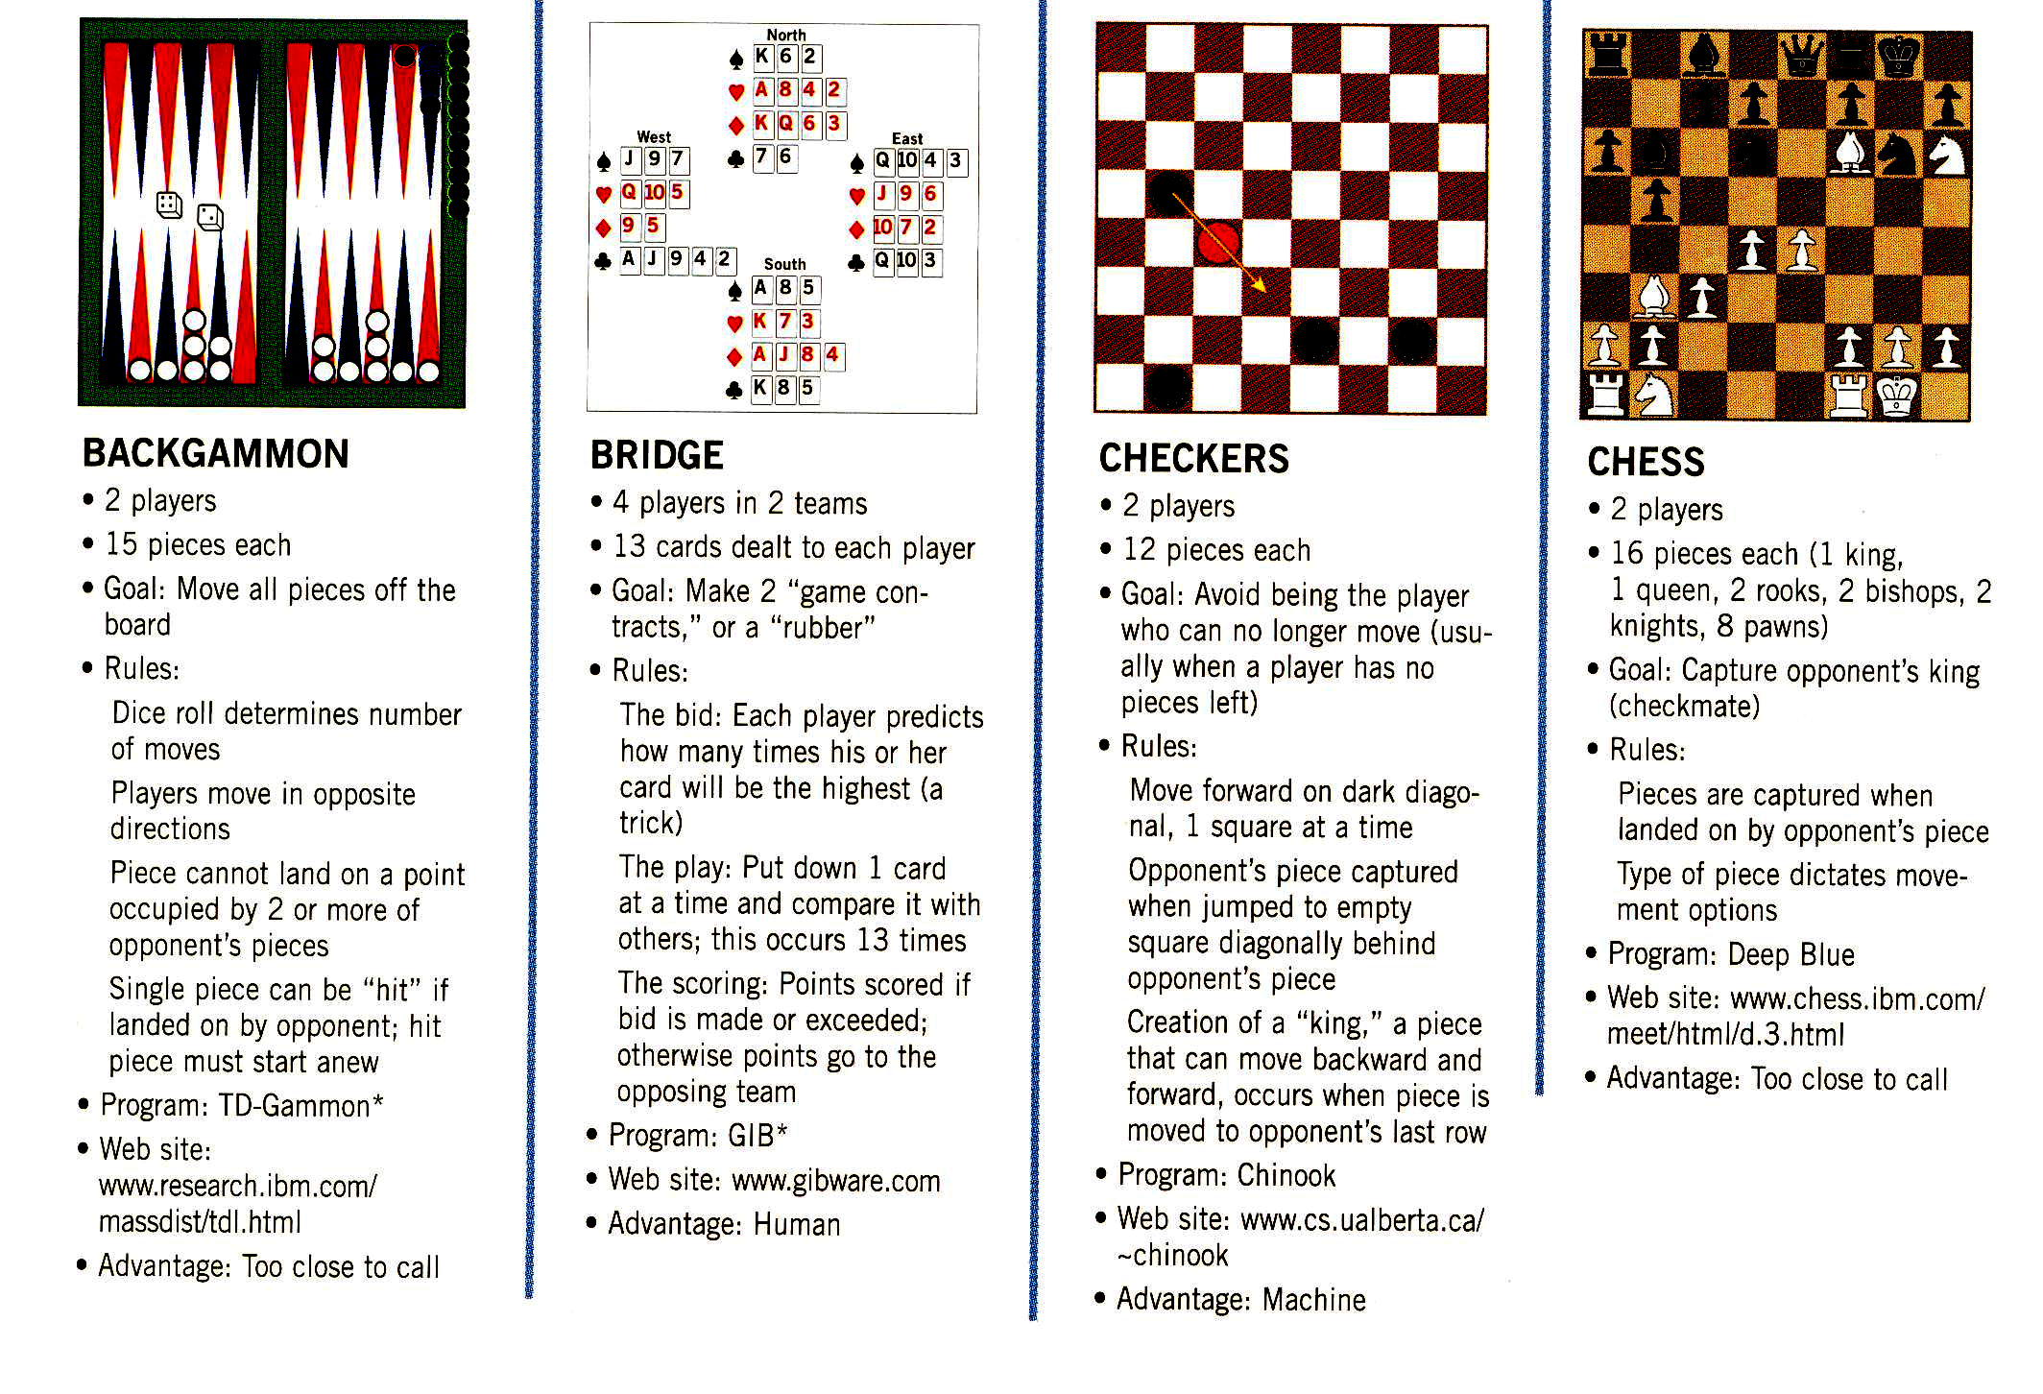
Introduction to games

Slide 120
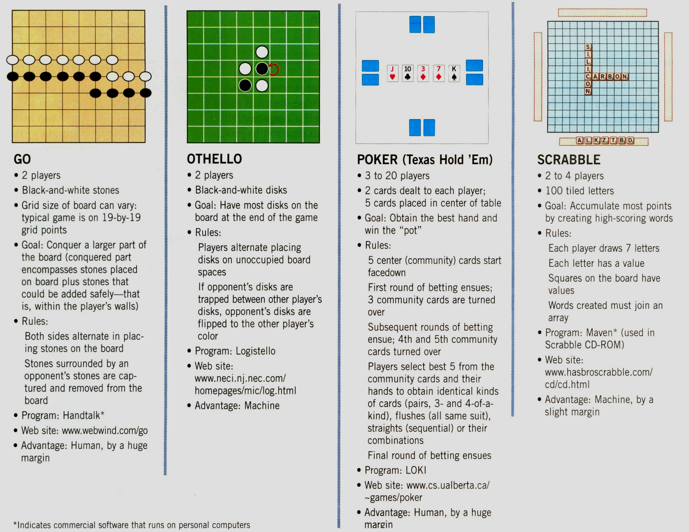
Introduction to games

Slide 121
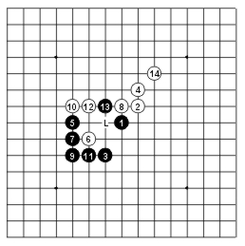
Renju
These games are for two people; one plays black stones or crosses (X), second plays white stones or nougths (O). Game always starts with a cross. The size of board is 15x15 or 19x19. The basic "completely free" rules of all five-in-a-row games:
  Rule 1. Play alternates between one player who starts the game (called Black because he is playing with black stones in the intersections of a board and another player (usually called White because he is playing with white stones).
  Rule 2. The first player to get an unbroken line of five stones (marks) whether vertically, horizontally, or diagonally, wins the game.
Besides the two basic rules the following rules are used in Renju
  Rule 3. Black is prohibited from making a double-three, a double-four and an overline. If Black makes one of these patterns either accidentally or by being forced to, he loses the game.
  Rule 4. White is not subject to any restrictions and may make double-threes, double-fours, and overlines,, an overline having the same value for him as a five.
  Observe that the double-three is counted as a forbidden double-three only if it is in principal not possible to stop for the opponent who has nothing to attack with and who is only playing defensive. For example if there is only space for 5 stones in a line it is not necessary to stop a three on this line.
  The move on spot marked as black point is allowed for Black. The opponent is able to stop the other three and black cannot win with the three limited within 5 intersections.
  Rule 5. If neither player has succeeded in making a row of five stones when the board has been played out, the game is called a draw. It is also possible to agree on draw.
  Opening rules : 6-13
  Renju International Federation (RIF).
  http://www.renju.net/

Slide 122
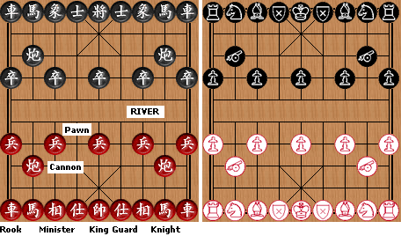
Chinese Chess
  2 Rooks (R) (or chariots)
  2 Knights (N) (or horses)
  2 Elephants(M) (or bishops or ministers)
  2 Mandarins (G) (or advisors or assistants or guards)
  1 King (K) (or generals)
  2 Cannons (C)
  5 Pawns (P) (or soldiers)
  Red moves first.
  The game is won by checkmating or stalemating the opponent King.
  Perpetual check is forbidden. You cannot check your opponent more than three times in a row with the same piece and same board positions.
  You cannot force an enemy piece to move to and from the same two points, indefinitely, in order to avoid capture. If you move a Rook to e5, threatening a Cannon on e6, and your opponent's only viable move is Cannon to f6, then you cannot force that Cannon to and from e6 and f6 by moving your Rook to and from e5 and f5, indefinitely. The purpose of this rule (and the above rule) is to avoid perpetual-check draws. Some of these situations are complicated, but the person who is forcing the perpetual move must usually break it off.
  The game is a draw when neither side can force a checkmate or a stalemate.
  http://www.chessvariants.com/xiangqi.html

Slide 123
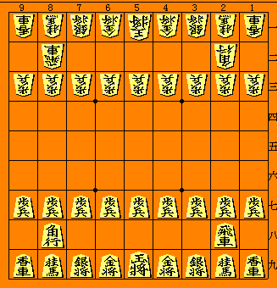
Shogi（Japanese Chess）
Rules:
A Pawn is tossed to decide which player moves first.
The object of the game is to checkmate the enemy King.
Perpetual check is forbidden. The player initiating the check must break it off.
Promotions are granted as follows...
  A starting piece moving to a square in the promotion zone (the last 3 ranks) earns a promotion. A promotion is indicated by flipping the piece over to display the symbol on its bottom side.
  An earned promotion (see above) may be deferred to a later move, as long as this move begins inside the promotion zone (the last 3 ranks). Where the move ends is of no relevance.
  Pieces arriving at a rank whereon they can move no further must promote. [e.g., a Pawn or Lance arriving on the 9th rank; a Knight arriving on the 8th or 9th rank.]
  Promoted pieces lose their promotion upon capture.
  Pieces 'dropped' into the promotion zone (the last 3 ranks) may not promote until making at least one move. (See below).
Captive drops are performed as follows...
  A captured piece may be dropped onto the board (placed on a vacant square) to subsequently be used as one's own. This is done in lieu of a regular move.
  A Pawn may not be dropped onto a file containing a non-promoted Pawn.
  No piece may be dropped to a square from which it is impossible to move. [e.g., a Pawn or Lance to the 9th rank; a Knight to the 8th or 9th rank.]
  A checkmate may not be performed by the drop of a Pawn. A King may be checked by dropping a Pawn, but only if the drop does not result in an immediate checkmate.
  http://www.shogi.net/rjhare/
  http://www.ricoh.co.jp/SHOGI/rules/erules.html

Slide 124
Shogi Piece Moves
King
  one step in any direction per move
Gold General
  one step per move any way except diagnoally backward
  (as a king but not diagonally backward)
Silver General
  one step per move forwards or diagonally
  (as a king but not sideways or vertically backward)
Knight
  one step to left or right, and two steps forward
  (the only piece which may jump over other pieces)
Rook
  moves vertically or horizontally any distance
Bishop
  moves diagonally any distance
Lance
  moves forward any distance
Pawn
  one step forward

Slide 125
Promoted Piece
Apart from the King and the Gold General all pieces can promote.
Promoted Silver
  all move as a Gold.
Promoted Knight
  all move as a Gold.
Promoted Lance
  all move as a Gold.
Promoted Pawn
  all move as a Gold.
Promoted Rook
  in addition to the moves of the unpromoted Rook can move one step in the diagonal directions. It either moves like a Rook or like a King.
Promoted Bishop
  in addition to the moves of the unpromoted Bishop can move one step horizontally or vertically. It either moves like a Bishop or like a King.

Slide 126
Chess variants
The world's first chess variant Chaturanga arose in India in approximately the seventh century AD. From there it migrated both westward and northward, mutating along the way. The western branch became Shatranj in Arabia and Orthodox Chess in Europe. The northern branch became Xiangqi in China and Changgi in Korea. Sometime in the 10th to 12th centuries, 'chess' crossed the channel to Japan where it spawned a number of interesting variants. One of these was called 'Small Shogi'. Eventually, Small Shogi (though it went through many forms) won out over the larger variants and is now referred to simply as 'Shogi'. It is certain that Shogi in its present form was played in Japan as early as the 16th century.

Slide 127
Kriegspiel
General procedure
  (1) White sends to the referee one or more moves in order of preference. Enough moves should be sent so that at least one is almost certain to be legal. The referee finds the first legal move on the list, and informs White which move was made, whether a check and/or a capture occurred, and whether Black now has any pawn captures available. The referee informs Black that White has moved, how many illegal moves were tried, whether a capture occurred, whether Black is in check, and whether Black has any available pawn captures. (Details on announcements are below). If all of the moves White sends are illegal, the referee should inform White of this and ask for additional moves.
  (2) Black sends the referee a series of moves in the same manner. The referee selects the first legal move and informs Black which one was made. He informs White that Black has moved and how many illegal tries were made. Both players are informed of checks, captures, and available pawn captures for the player to move.
  (3) The same sequence of play is followed until the game ends by checkmate, stalemate, insufficient material, threefold repetition of moves, etc. The referee informs both players when a checkmate occurs or the game is drawn. Stalemate is a draw.
  (4) In order to speed up play (particularly in the opening and endgame), a player may send a series of moves intended to be played over several moves "if quiet". The referee plays these moves in order on consecutive turns (just as if they had been sent one by one), until a check, capture, or available pawn capture for either side occurs, of until one of the moves is illegal. The referee makes announcements to both players in the usual manner.
  (5) In order to save postage, the referee need only contact a player each time the player is to move, giving the result of the previous move by each player.

Slide 128
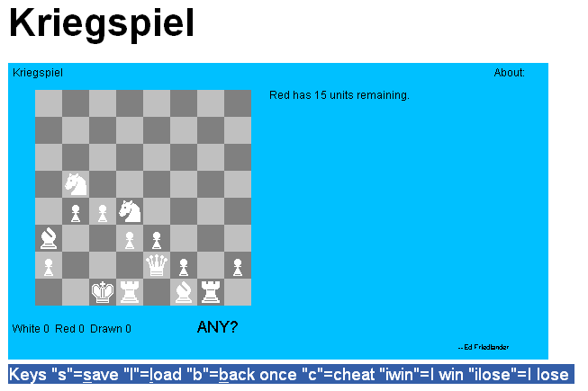
Kriegspiel
http://www.pathguy.com/chess/Kriegspi.htm

Slide 129
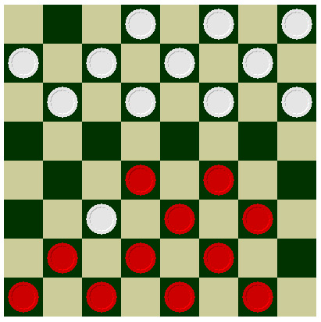
State of the Art Game Programs - Checkers
  First programmed on computer in 1952, advanced player level.
  As of 1992, Chinook, is on par with best in the world.
  Uses alpha-beta search, and a database of perfect solutions for all six pieces.

Slide 130
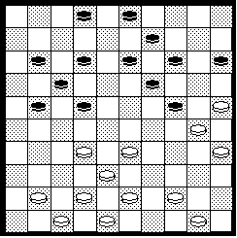
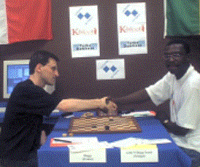
International Draughts(10*10)
Buggy best draughts program
Human better than computer, but the margin is small
Challenge: More knowledge in program

Slide 131
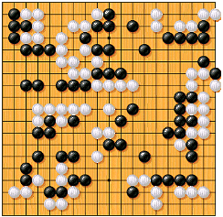
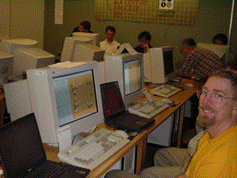
Go
Computer Go programs are weak
Problem: recognition of patterns
Top Go programs: Go4++, Many Faces of Go, GnuGo, and Handtalk

Slide 132
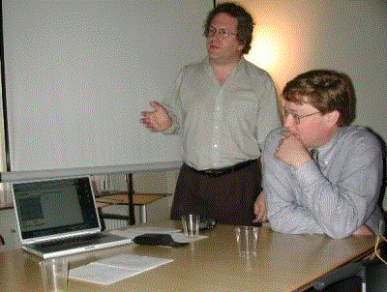
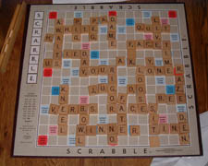
Scrabble
Maven beats every human opponent
Author Brian Sheppard
Maven can play scrabble in any language

Slide 133
State of the Art Game Programs - Chess
  1950s - First computer chess games.
  1970s - complicated tricks for branch elimination and move-generation -- OK, amateur level.
  Basic alpha-beta pruning and infallible endgame routines generally most successful.
  First major performance improvement -- better hardware -- Belle.
  Belle (1982), master level player, calculate several million moves per turn.
  Today, Deep Blue a top chess player of the world.

Slide 134
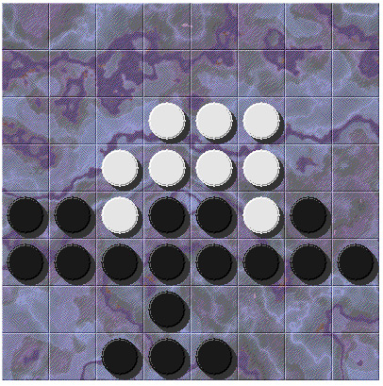
State of the Art Game Programs - Reversi
  Each turn between 5 and 15 legal moves.
  Relatively small search space.
  Better than human players.

Slide 135
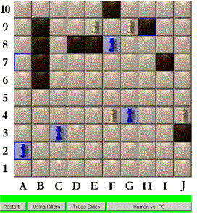
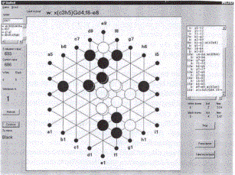
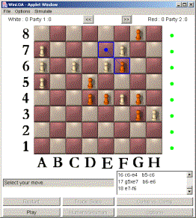
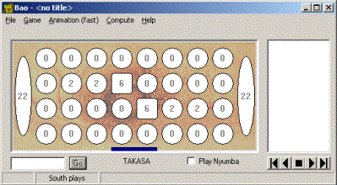
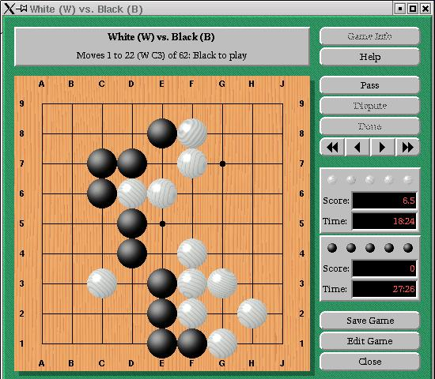
UM Programs on the Computer Olympiads
Gipfted - Gipf
MIA - LOA
Anky - Amazons
Bao 1.0
Magog - Go

Slide 136
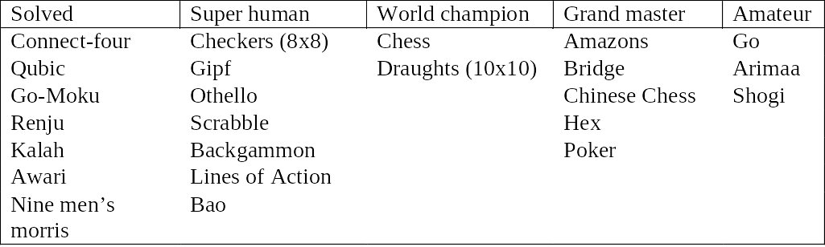
Games solved

Slide 137
New problems arise
Games with huge game trees : Go, etc.
Multi-player Games : (with or without Alliance) Bridge, Poker, SiGuo, etc.
Games with Chance : Backgammon, Poker, etc.
Games with imperfect/incomplete information : Kriegspiel, Bridge, SiGuo, etc.

Slide 138
Game Tree Size
Sizes of game trees:
  Nim-5: 28 nodes
  Tic-Tac-Toe: ≈ 10⁵ nodes
  Checkers: ≈ 10³¹ nodes
  Chess: ≈ 10¹²³ nodes
  Go: ≈ 10³⁶⁰ nodes
Game tree size is a big problem.
  Branch factor : b
  Length of paths lead to a leaf node : d
    b^d

Slide 139


Slide 140
To deal with big game tree
More efficient pruning algorithms
More accurate evaluation functions (better heuristic)
Learning to make good evaluations

Slide 141
Multi-player games
Many games have more than two players
Even if each player is on his own, what is the best to do?
Cooperate or not?
Multiple playes game usually has bigger search tree.
Equilibrium is not unique.
Examples:
  Chinese Checkers with 6 players.
  Othello extended by having different colored pieces for each player.
  E.g. triple-chess,
  Colonists of Catan, Risk, etc.

Slide 142
Multiple players example
A
(2,2,6)
B
(2,2,6)
(1,5,2)
C
(2,2,6)
(6,1,2)
(1,5,2)
(5,4,5)
A
(2,2,6)
(4,2,3)
(6,1,2)
(7,4,1)
(5,1,1)
(1,5,2)
(7,7,1)
(5,4,5)

Slide 143
Multi-player games
Strategy 1:
  No cooperation: all players maximize payoff
  Max-n algorithm by Luckhart&Irani (1986)
  Pruning is possible if bounded sums
Strategy 2:
  Opponents cooperate against you
  Paranoid assumption by Sturtevant&Korf (2000)
  Use standard Alphabeta
Strategy 3
  Form (temporarily) coalitions
  Negotiation is needed to form safe coalition
  Otherwise, speculate on coalitions
  Difficult theory, only available for small games

Slide 144
Maxn (max^{n}) Algorithm
Assumption:
the players alternate moves
each player tries to maximize his/her return
and indifferent to returns of others.

Slide 145
Maxn Algorithm
At frontier nodes, evaluation function returns an n-tuple of values:
(player1, P2, P3, …. Player n)
For example:
  Othello - return number of pieces for each player.

Slide 146
Maxn Algorithm
evaluation function in each interior node where player i is to move
=
the entire n-tuple of the child for which the i^{th} component is maximum.

Slide 147
Maxn Algorithm - Example
(7,3,6)
1
(1,7,2)
(7,3,6)
2
2
(6,5,4)
(1,7,2)
(7,3,6)
(3,1,8)
3
3
3
3
(2,8,1)
(1,7,2)
(5,6,3)
(6,5,4)
(8,5,4)
(7,3,6)
(4,2,7)
(3,1,8)

Slide 148

Maxn Algorithm
Formal notations:
  M(x) - static heuristic value of node x
  M(x,p) - backed-up maxn value of node x by player p.
  M_{i}(x,p) - component of M(x,p) corresponds to the return for player i.
  M(x_{i},p’) = maxM_{p}(x_{i},p’) over children of node x,
  p’ is player that follows player p
  tie breaking in favor of leftmost node.
Recursive definition of the maxn node:

Slide 149
Maxn Algorithm
Minimax can be viewed as a special case of maxn, when
  n = 2,
  evaluation function: (x, -x).
Luckhardt & Irani observed:
  at nodes where player i is to move, only the i^{th} component of the children need be evaluated.
  It may be no less expensive to compute all components.
Without assumptions on values of components, pruning of branches is impossible (with more than 2 players).

Slide 150
Paranoid Algorithm
Here we see the other players as one big opponent.
There is my own player. The Max player.
There are all the others. The Min players.
The paranoid algortihm evalutes the tree as follows.
When it is my turn to play – take the maximum of my utility.
When it is not my turn (it is one of them) I take the minimum of my utility.

Slide 151
Paranoid Algorithm
With max^n we assumed that each of the other palyers chooses to take its maximum value.
With paranoid algorithm we assume that each of the other players chooses to take my minimum.
Paranoid algorithm is actually MIN^(n-1) MAX.
Paranoid better generalizes minimax because it also gives an insurance of the value of the root node. (see chapter 8)

Slide 152
Paranoid Vs. Maxn
Paranoid runs faster as we can see it as a regular minimax algorithm with only two players. The max player (myself) and the min player (them, n-1 players).
In the min phase of minimax, we can span n-1 levels at once without the need to evaluate internal nodes.
The two algorithms are not necessarily comparable since they require different assumptions of the intentions of the players.
Maxn assume that every player wants its own highest score.
Paranoid assumes that the other players want to kill me.

Slide 153
Can we prune max^{n} trees
In minimax we bound the game tree value
In max^{n} we bound based on sum of values
  All scores sum to 10
  If Player 1 gets 7 points…
  Player 2-3 will get ≤ 3 points
Tree pruning is possible when :
  there is an upper bound on the sum of all components of a tuple
  a lower bound on the values of each component.
For example:
  Othello - no player can have less than zero, and total number of pieces on the board is equal for all nodes at same level.

Slide 154
Immediate Pruning
  Player I is to move, and in one child the i^{th} component equals the upper bound of sum on all components.
  Obvious that any other child can be pruned.
  This is equivalent to situations in the two-player case when a child of a Max node has value of ∞, or a child of a Min node has value of -∞, indication a won position for the corresponding player.

Slide 155
Shallow Max^{n} Pruning
(3 Players)
(7, 3, 0)
(≥7, ≤3, ≤3)
1
(7, 3, 0)
2
(0, 10, 0)
2
(≤6, ≥4, ≤6)
2
3
3
3
3
(7, 3, 0)
(3, 2, 5)
(0, 10, 0)
(1, 4, 5)

Slide 156
Shallow algorithm
Shallow(Node, Player, Bound)
IF Node is terminal, RETURN static value
Best = Shallow(first Child, next Player, Sum)
FOR each remaining Child
IF Best[Player] >= Bound, RETURN Best
Current = Shallow(Child, next Player,
Sum - Best[Player] )
IF Current[Player] > Best[Player],
Best = Current
RETURN Best

Slide 157
Shallow Max^{n} Pruning
Complete?
  Yes
Optimal?
  Yes*
Time Complexity?
  Best-case**: b^{d/2}
  Average-case: b^{d}
Space Complexity?
  b•d

Slide 158
Optimality of shallow pruning
Theorem:
  Every directional algorithm that computes the maxn value of a game tree with more than 2 players must evaluate every terminal node evaluated by shallow pruning under the same order.
Steps of proof:
  The formal proof is by induction on the height of the tree and generalizes the result to an arbitrary number of players greater than 2.

Slide 159
Failure of deep pruning
In a 2-player game, alpha-beta allows deep pruning - pruning a node based on bounds inherited from its great-grandparents, or other distant ancestor.
Deep pruning does not generalize to more than 2 players!

Slide 160
Max^{n} Pruning
Why is max^{n} weak in practice?
  Only compares 2 scores out of n players
  Relies on game evaluation properties, not ordering
Last-Branch Pruning
Speculative Pruning

Slide 161
Last-Branch/Speculative Pruning
(3 Players)
(3, 3, 4)
1
(3, 3, 4)
2
2
2
(1, 4, 5)
3
3
(2, 4, 4)
1

Slide 162
Last Branch/Spec. Pruning
Best case: O(b^{d·(n-1)/n})
  As b gets large
  Dependent only on node ordering in tree
  http://www.cs.ucla.edu/~nathanst/ for more info

Slide 163
Chance
Dices, Cards, Scrabble, etc
  Chance in games started as a “divine” mechanism:
    Relation between divination and games, e.g. Tarot
    Many “road of life” games (Ganzebord, Snakes and ladders, Parchisi, Seth)
    Chess started as a racing game with dice
Chance is introduced in the game tree by chance-nodes (a third player)
Equilibria are not pure anymore (the best way to move might be a mixture of two moves)

Slide 164
Chance
Strategy 1: Use *-minimax by Ballard 1983
  At min nodes minimize, at max nodes maximize, at chance nodes determine the expected payoff
  Might not produce optimal strategy
  Works with dice, not with card decks or scrabble
Strategy 2: use Monte-Carlo Simulation
  Generate a random configuration of cards
  Compute an optimal strategy (Alphabeta)
  Repeat many times
  Determine move with best average pay-off
Used in Scrabble, Bridge, Poker, etc

Slide 165

Games of Chance
Backgammon is a two player game with uncertainty.
Players roll dice to determine what moves to make.
White has just rolled 5 and 6 and had four legal moves:
  5-10, 5-11
  5-11, 19-24
  5-10, 10-16
  5-11, 11-16
Such games are good for exploring decision making in adversarial problems involving skill and luck.

Slide 166

Game Trees with Chance Nodes
Chance nodes (shown as circles) represent the dice rolls.
Each chance node has 21 distinct children with a probability associated with each.
We can use minimax to compute the values for the MAX and MIN nodes.
Use expected values for chance nodes.
For chance nodes over a max node, as in C, we compute:
epectimax(C) = Sum_{i}(P(d_{i}) * maxvalue(i))
For chance nodes over a min node compute:
epectimin(C) = Sum_{i}(P(d_{i}) * minvalue(i))
Min
Rolls
Max
Rolls

Slide 167
Hidden Information
Can be caused by chance – see previous
Moves of opponent can be hidden
  E.g. Kriegspiel
  Solution: Meta-moves, Meta-positions
  (Sakuta & Iida)
Types of piece can be hidden
  E.g. Siguo
  No new uncertainty adding to the game during the 2nd stage.
  Game becomes more and more clear.

Slide 168
Imperfect Information
either hidden information, chance or…
Simultaneous moves
  e.g. Roshambo
  Start of Dakon
Solution? Treat like chance?

Slide 169
Incomplete information
You do not know all the rules of the game
You do not know the pay-offs of the opponent
  Negotiation – information exchange
  Speculation

Slide 170

Imperfect information game
Information set:
Information set pruning:
Extension form of
imperfect information game tree

Slide 171


Imperfect Information using MC
Most card games have imperfect information
We can use monte-carlo simulation
  Create many consistent samples of possible opponent hands
  Solve using perfect-information methods
  Combine results together to make next move

Slide 172
Infinite games
Are all non-finite games:
Infinite move space
Infinite game space
Infinite game length
Changing game rules…. Real word!!

Slide 173

What are we focusing on?

Slide 174
Type of problem
4-player
  (while the team-mates can see the others’ piece, it can be taken as the 2-player game)
Zero-Sum
Deterministic
Imperfect Information (Incomplete information)

Slide 175
Other characteristic of the game
If each player knows all the information, the game becomes easy to be unmeaning
  Reason:
    Although the branch factor is big, but some movements will have the same effect on final consequences (so we needn’t search them as different nodes)
    Although the area of board are broad, the rencounter concentrate on the railway lines
    Easy to defend, because chessman’s power differ, the situation that can beat all happens in few time.
    Some lost is inevitable, for the position at initial time.--- Unbalance
  In a word: very different from the chess, which was discussed broadly and had significant fruit.

Slide 176
Other characteristic of the game
To behave the cooperations between two players in a team.
  Evaluations should be redesigned to show the view of the overall situations.
  The decision making and planning will take a circle movements as a unit to deal with. (Mixing Strategies, models will be a little different)
To deal with the imperfect information, we must find a way which compromise between information acquirement and the risk taken. (a study on Game Theory and Decision Making)

Slide 177
Other characteristic of the game
To master the game, the key is how to guess, how to plan, and how to find the opponents stratagem.
Some factors consist in luck and different players’ style

Slide 178
Some Ideas
May the following theories or tools can help us in machine gaming:
  Pattern matching
  Rule based expert system
  Probabilistic Reasoning
    Bayes Rule, Bayesian network
    Markov assumption, Markov chain, Hidden Markov Model
  Learning from Observations
    The Decision Making Problem (Decision Tree)

Slide 179
Some Ideas
  Neural Networks – To recognize feature, to build good evaluator (some efforts in GO)
  Reinforcement Learning (RL)
    Q-learning
  Temporal-difference learning (TD)
  Case based study
  Some other optimization algorithms – SA, GA,TB
  Multi-agent games (Risk, diplomacy, etc.)

Slide 180
Other Ideas
Goal-oriented rather than combinatorial searching.
Area of research -- still no great approaches that can combine the two.
A mix of the two strategies may be ideal.

Slide 181
A paper to the Game ML lover
Machine Learning in Games: A Survey (2001)
    Johannes F¨urnkranz

Slide 182
Samuel’s concluding(1960)
  “Programming computers to play games is but one stage in the development of an understanding of the methods which must be employed for the machine simulation of intellectual behavior. As we progress in this understanding it seems reasonable to assume that these newer techniques will be applied to real-life situations with increasing frequency, and the effort devoted to games . . . will decrease. Perhaps we have not yet reached this turning point, and we may still have much to learn from the study of games.”

Slide 183
Homework
EX6.3

Slide 184
Thank you!

